Slide 1


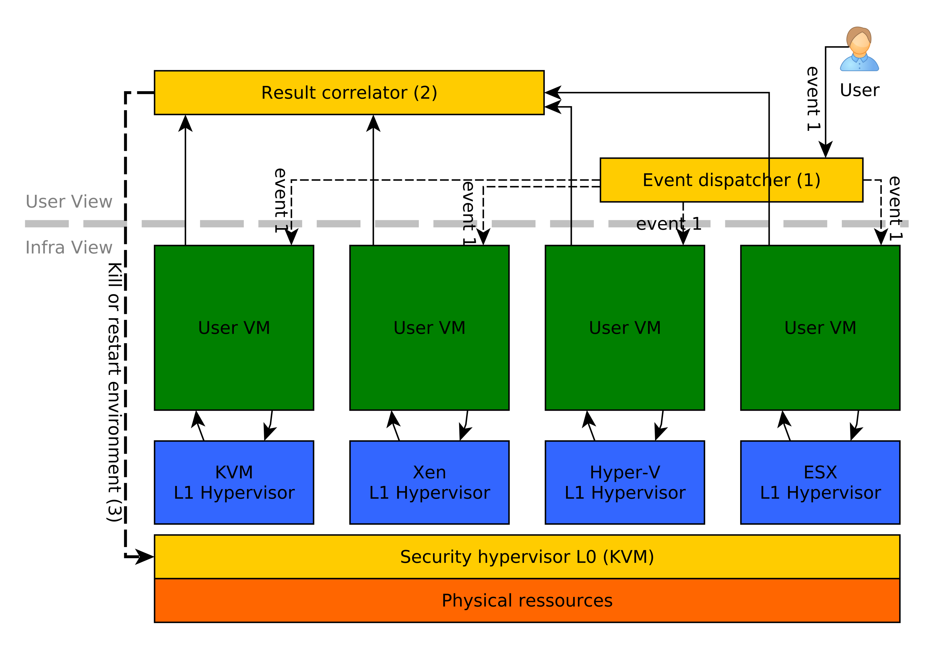

RetroVisor: Nested Virtualization
for Multi-IaaS VM Availability
Aurélien Wailly¹, Marc Lacoste¹, Hervé Debar²
¹Orange Labs, ²Télécom SudParis
ARCHITECTURE
CONTEXT
Problem
Multi-IaaS platforms offer low protection against the failure of an hypervisor
Is it possible to replicate execution of a single VM on different hypervisors ?
Security architecture to seamlessly
run a virtual machine on multiple hypervisors simultaneously.
Solution: RetroVisor
High-availability
Strong execution guarantees
Benefits
IMPLEMENTING THE DISPATCHER
EVALUATION (higher is better)
Option 1: User-based synchronization
User handles multiple connections to the hypervisor.
Sends mouse moves / keystrokes to each hypervisor.
VNC clients are available in Python.
Increased size of client display program.
User has to perform entire security administration.
Approach | Easiness | Fault tolerance | Genericity | Security
User | High | High | High | Low
Router | High | Medium | Medium | High
Hypervisor | Low | Low | Low | High
+
-
-
Strong guarantees of VM execution.
High availability.
Leverage nested virtualization.
Detect failures and recover to a safe state.
Option 2: Router-based synchronization
Packets received on router VNC port are replicated.
Transparent security management.
Network protocols and management components need
to be modified (porting RFB or using UDP tunnel).
Summary
+
-
NEXT STEPS
Option 3: L0 Hypervisor-based synchronization
Facade to L1 hypervisors to notify user events to VMs.
User uses normalized interfaces, increasing security.
Error-prone: each bug in L0 hypervisor severely threatens infrastructure security.
More investigation of reaction mechanisms.
Advanced threat detection through the VESPA
framework [ICAC12].
+
REFERENCES
-
[CCS12] S. BUTT et al. Self-Service Cloud Computing. CCS 2012.
[VESPA] A. WAILLY, M. LACOSTE, and H. DEBAR. VESPA:
Multi-Layered Self-Protection forCloud Resources. ICAC’12.
[RFB] T. RICHARDSON and J. LEVINE. The Remote Framebuffer
Protocol. IETF RFC 6143, 2011.
[OSDI10] M. BEN-YEHUDA et al. The Turtles project: Design and
Implementation of Nested Virtualization. OSDI’10.
[XenB12] D. WILLIAMS et al.. The Xen-Blanket: Virtualize Once,
Run Everywhere. EUROSYS’12.
We selected the user-based approach as a first implementation of RetroVisor

