Slide 1
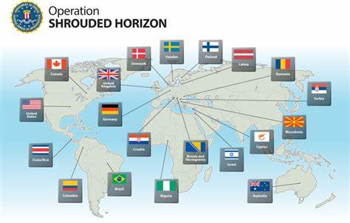
Operation Shrouded Horizon: The Takedown of Darkode
A Case Study in Advanced Cybercrime Investigation
Presented by: Awais Ahmed
AA
Notes:
1

Slide 2
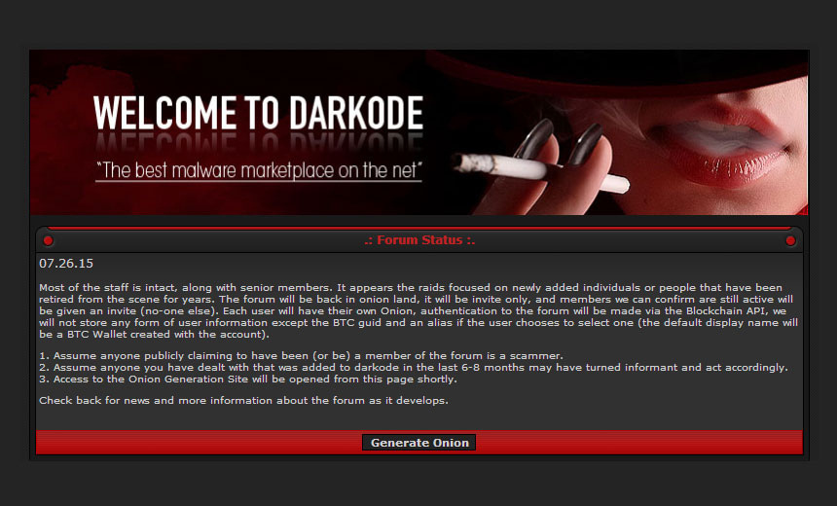
Understanding Darkode
Elite Marketplace
Trade Items
User Base
Invite-only, stringent vetting process
  Malware kits
High-value users from 20+ countries
  Botnets
  Exploits
  Stolen data
Notes:
2

Slide 4
Launching the Investigation
Early Monitoring
Infiltration Attempts
Key Focus
Technical Measures
Started 2010 by FBI Pittsburgh & Europol
Undercover agents engaged the forum
Trace malware linked to major U.S. cyberattacks
Offshore servers, encrypted messaging, proxies
Notes:
3

Slide 5
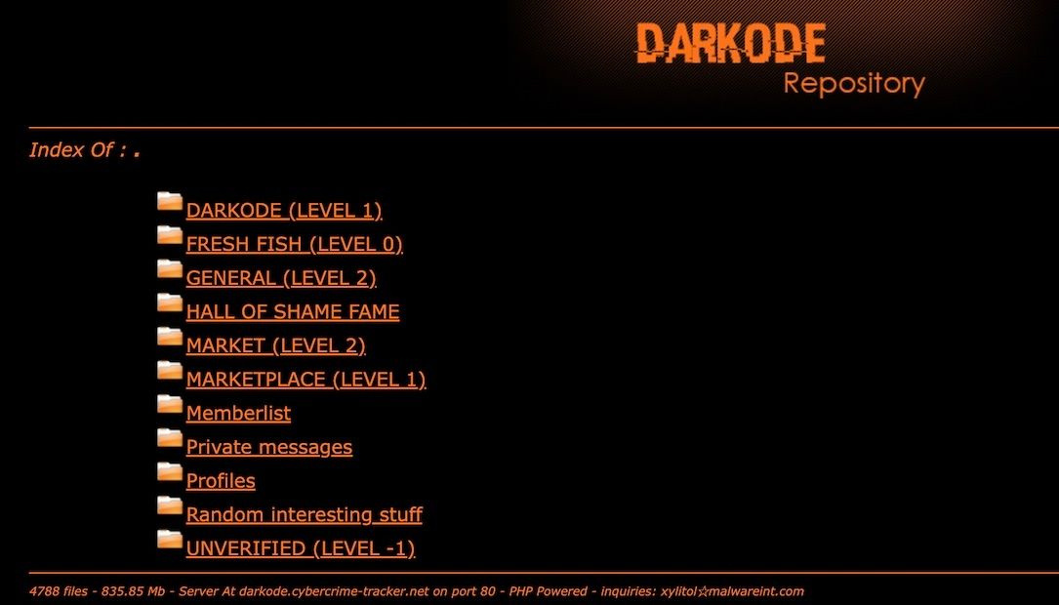
Technical Breakthrough #1: Log Trail Discovery
2012 Milestone
Forum Link
Verification
Custom keylogger infection traced in U.S. hospitals
Logs matched malware sold by “Mlj” on Darkode
Undercover account purchased tools, confirmed fingerprints
Notes:
4

Slide 6



Technical Breakthrough #2: Undercover Penetration
Agent Strategy
Built credible hacker personas
Access Gained
Endorsements secured via code samples
Data Collected
  Server addresses
  Moderator usernames
  Zero-day discussion timestamps
  Botnet rental chats by region
Notes:
5

Slide 7
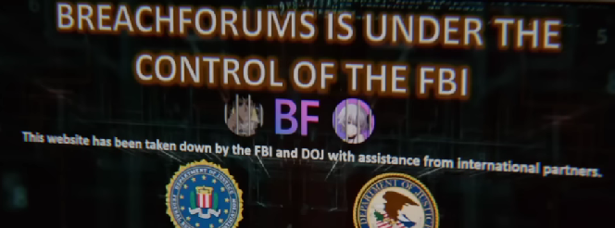
Seizures & Coordination
Targets Seized
Log Correlation
  VPS in Romania, Sweden, Germany
Linked forum to offshore VPS providers
  28 personal devices confiscated
1
2
3
4
Multinational Raids
Forum Shutdown
2015 coordinated action across 20 countries
Replaced by FBI seizure banner
Notes:
6

Slide 8



Arrests & Forensic Analysis
2
Recovered Evidence
  Obfuscated malware source code
  Encrypted customer logs
Suspects
  Chats and transaction records
1
28 arrested, 70+ identified
Popular Toolkits
3
NJRAT, Dendroid, Zeus variants
Notes:
7

Slide 9

Legal Outcomes & Lessons Learned
Forum Dismantled
Convictions
Permanent shutdown, no re-emergence
Across U.S., Europe, South America
Key Lessons
  Long-term infiltration succeeds
  Logs can expose malware sources
  Cross-border cooperation vital
Notes:
8

