Slide 1


The Silk Road Case: Unveiling Cyber Fraud
Explore the Silk Road case, a landmark in cybercrime history. This presentation highlights the convergence of technology, crime, and law enforcement in the digital age.
Presented by: Awais Ahmed
AA
Notes:
1

Slide 2
Emergence of Darknet Market
Visionary Beginnings
Strategic Launch
Illicit Focus
envisioned a platform promoting anonymity.
Launched in February 2011, integrated Tor and Bitcoin.
The early growth focused on illicit goods and services.
He wanted decentralized commerce free from regulation.
The initial server was located in Iceland, leveraging privacy laws.
This attracted a user base seeking unregulated transactions.
Notes:
2

Slide 3
Rise to Fame & Scale
Community Buzz
Transaction Volume
Risks & Frauds
Notes:
2

Slide 4


U.S. Agencies Take Notice
Financial Analysis
Multiagency Effort
IRS detects unusual Bitcoin movements tied to suspicious activity.
Homeland Security, the FBI, DEA, IRS-CI, and even the Secret Service
Tor Origin Concern
Tor’s roots in U.S. Navy tech raise additional security interest.

Slide 5
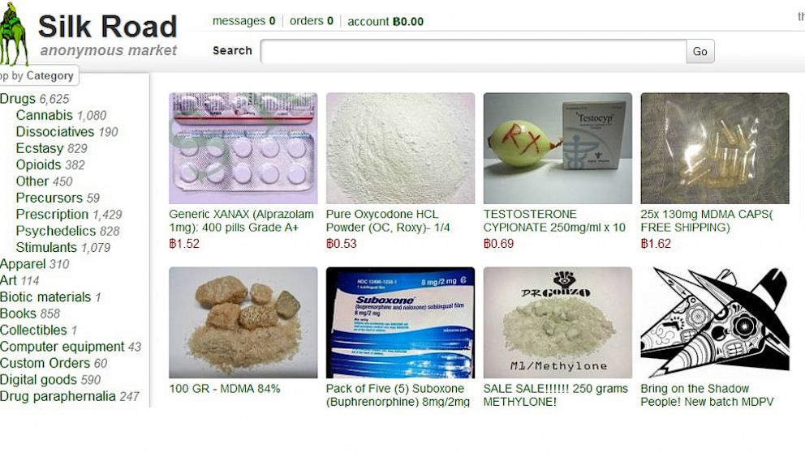
Notes:
3

Slide 6

Operation Marco Polo
Collaboration
Undercover
Multi-agency collaboration: FBI, DEA, IRS, international partners.
Undercover operations: Agents posed as buyers and sellers.
Server Seizure
User Accounts
Seizure of Silk Road server in Iceland: Key evidence and data.
1.5 million user accounts uncovered during the investigation.
Notes:
4

Slide 7





Unmasking Dread Pirate Roberts
Online Alias
Digital Forensics
Laptop Seizure
Ross Ulbricht's alias: Dread Pirate Roberts (DPR).
Linking Ulbricht to the Silk Road server.
Seizure of Ulbricht's laptop in a San Francisco library: Real-time evidence.
Bitcoin Wallet
Ulbricht's Bitcoin wallet contained millions in Bitcoin.
Notes:
5

Slide 8




The Verdict and Sentencing
Conviction
Guilty verdict after a month-long trial.
Life Sentence
Life sentence without parole: Harshest possible punishment.
Asset Forfeiture
Forfeiture of assets: Over $18 million in Bitcoin and other property.
Notes:
7

Slide 9


Slide 10


Lessons Learned and Future Challenges
3
2
Ongoing need for collaboration between law enforcement and tech.
Ethical considerations in the digital age.
1
Evolving landscape of online fraud.
Notes:
10

