Slide 1

Digital Forensics: History File Artifacts in Windows
Presented By:
Abubakr Latif - 003
Awais Ahmed – 008
Ahmar Hassan – 010
Ahmad Javaid – 015
Muhammad Ali – 019
Sultan ul Arfeen - 031

Slide 2
Objective
What Are History Files?
Importance of History Files in Forensics
Where History Files Are Stored
How to Recover History Files
Challenges in Working with History Files

Slide 3
What are history file Artifacts?

Slide 4
History Files
Definition
History files are records automatically generated by software or the operating system that log a user's actions or system events over time.
Key Characteristics
Store chronological information about activities.
Help track what was done on a device and when.
Often created without user input or awareness.

Slide 5
History Files in Web Browsers
Definition
In the context of web browsers, history files are records automatically created and stored by the browser that log websites a user visits, including the date and time of each visit.
What Browser History Files Store
URLs of visited websites.
Page titles.
Timestamps (date and time of each visit).
Number of visits to each site.
Download history.
Search queries (from address bar or search engines).
Form data and autofill entries (optional).

Slide 6
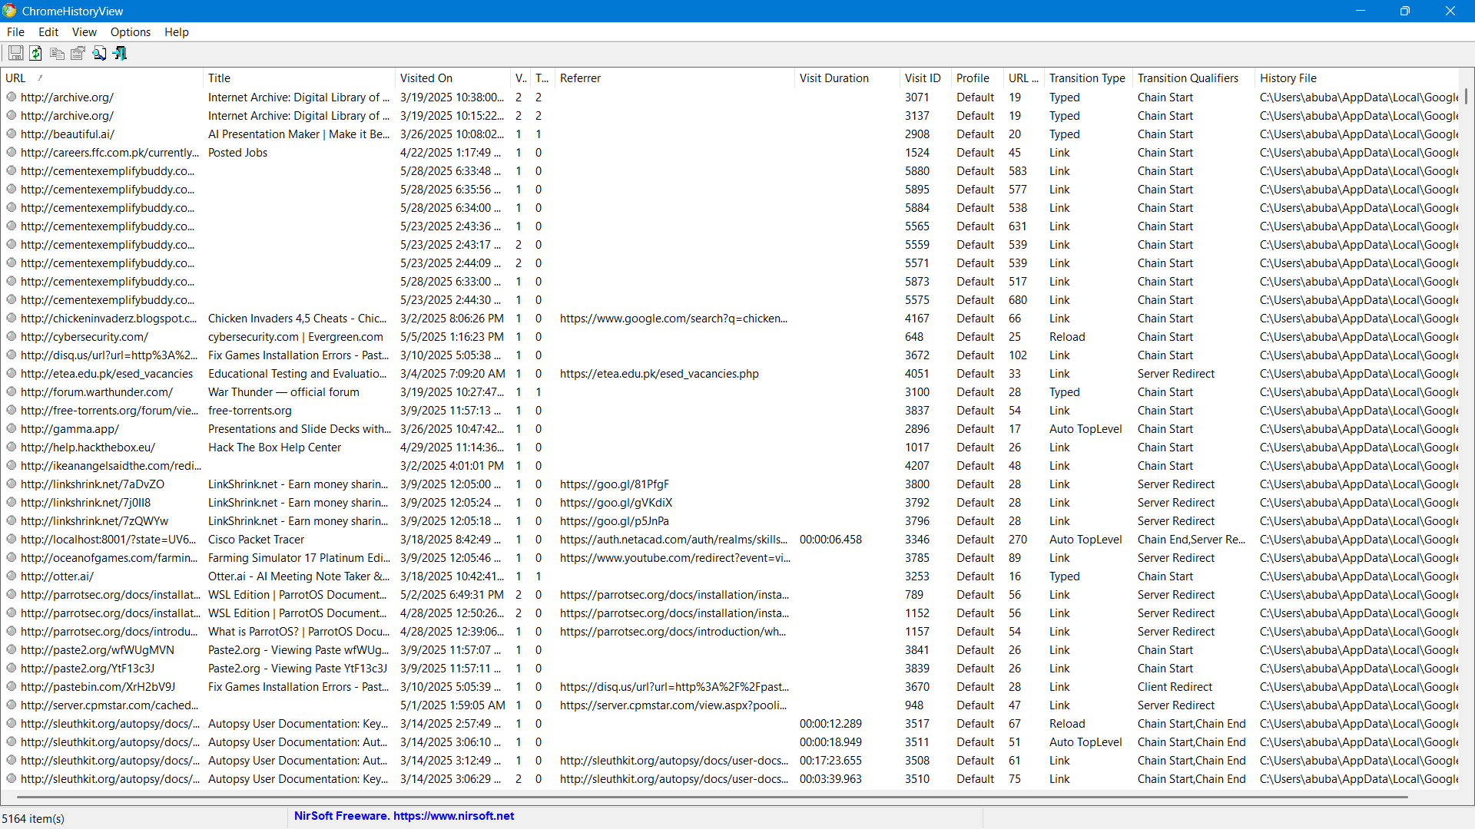
A view of chrome-history-viewer

Slide 7
Importance of History Files in Forensics

Slide 8
Why Browser History Matters in Forensics
Artifacts Establishes user intent and behavior through browsing patterns
Reveals access to illicit or suspicious content
Supports profiling in suspect attribution
Highlights use of anonymizers, forums, or communication platforms
Plays key role in insider threat and HR investigations

Slide 9
Timeline Reconstruction & Correlation
Precise timestamps of site visits help build detailed activity timelines
Enables correlation with file downloads, USB events, login times, etc.
Fills gaps in evidence when other logs are missing or incomplete
Essential for determining sequence of actions in incidents

Slide 10
Strength as Corroborative & Persistent Evidence
Confirms and supports evidence from other sources (e.g., emails, registry)
Useful even after deletion—remnants remain in cache, prefetch, or restore points
Attempted deletion can indicate intent to hide evidence
Can survive browser clearing via forensic techniques (SQLite recovery, carving)

Slide 11
Where History files Are Stored

Slide 12
Google chrome history file path
Windows Version | History File Path
Windows 7 | C:\Users\<Username>\AppData\Local\Google\Chrome\User Data\Default\History
Windows 10 | C:\Users\<Username>\AppData\Local\Google\Chrome\User Data\Default\History
Windows 11 | C:\Users\<Username>\AppData\Local\Google\Chrome\User Data\Default\History
Access Rights: Only that user can access their own history Admin users can access other users’ history using tools or permissions Form: SQLite database
Data Inside: URLs visited Page titles Visit times & date Visit count Download history (in another file)

Slide 13
Microsoft edge History file path
Windows Version | History File Path
Windows 7 | ❌ Not supported (Edge Chromium not available)
Windows 10 | C:\Users\<Username>\AppData\Local\Microsoft\Edge\User Data\Default\History
Windows 11 | C:\Users\<Username>\AppData\Local\Microsoft\Edge\User Data\Default\History
Access Rights: Same as Chrome: own user or admin-level access Hidden folder (AppData) Form: SQLite database Data Inside: Same as Chrome (Edge is also Chromium-based)

Slide 14
Mozilla Firefox history file path
Windows Version | History File Path
Windows 7 | C:\Users\<Username>\AppData\Roaming\Mozilla\Firefox\Profiles\<Profile>\places.sqlite
Windows 10 | C:\Users\<Username>\AppData\Roaming\Mozilla\Firefox\Profiles\<Profile>\places.sqlite
Windows 11 | C:\Users\<Username>\AppData\Roaming\Mozilla\Firefox\Profiles\<Profile>\places.sqlite
Access Rights: Same: Only accessible by that user or admin Roaming folder is part of user profile — hidden by default Form: SQLite database Data Inside: Browsing history (URLs, titles, time) Bookmarks Visit count Download records (in older versions) Favicon icons (in favicons. SQLite)

Slide 15
Internet Explorer history file path
Windows Version | History File Path
Windows 7 | C:\Users\<Username>\AppData\Local\Microsoft\Windows\History
Windows 10 | C:\Users\<Username>\AppData\Local\Microsoft\Windows\WebCache\WebCacheV01.dat
Windows 11 | C:\Users\<Username>\AppData\Local\Microsoft\Windows\WebCache\WebCacheV01.dat
Access Rights: Same: Only accessible by that user or an administrator AppData\Local folder is hidden by default Requires elevated permission/tools to view or extract .dat content Data Inside (in WebCacheV01.dat): Visited URLs Cached web content Cookies Form data Typed URLs Local Storage

Slide 16
How to recover history files

Slide 17
Manually
1. Enable Hidden Files
Open File Explorer → View tab → Check "Show hidden files“
2. Navigate to History File Paths
Chrome: C:\Users\<Username>\AppData\Local\Google\Chrome\User Data\Default\History
Firefox: C:\Users\<Username>\AppData\Roaming\Mozilla\Firefox\Profiles\<Profile>\places.sqlite
Edge: C:\Users\<Username>\AppData\Local\Microsoft\Edge\User Data\Default\History
Internet Explorer: C:\Users\<Username>\AppData\Local\Microsoft\Windows\WebCache\WebCacheV01.dat
3. Copy Files to safe location
4. Use SQLite Tools (for viewing only)
5. Limitations
Deleted entries might not be visible
Cannot decode ESE files like IE’s.dat

Slide 18
Recovering through autopsy
1. Autopsy (Open Source Tool)
Create a New Case → Add data source
Select “Web history” in ingest modules
Show deleted and existing URL’s, visits, and searches

Slide 19
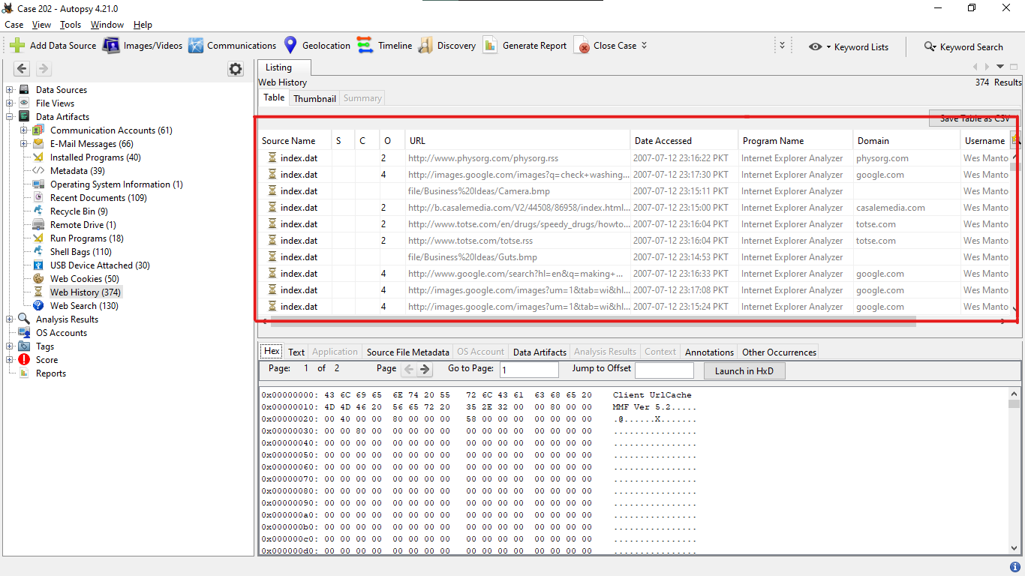

Slide 20
Some challenges
Automatic deletion mechanisms in privacy-focused browsers (e.g., Brave, Tor) purge history files after sessions
Shift-based work environments leverage portable browsers on USB drives, leaving minimal traces on host machines.
Anti-forensic tools overwrite free disk space to prevent file carving recovery of deleted SQLite entries.

Slide 21
Conclusion: Key Takeaways on Browser History Artifacts
Browser history artifacts provide persistent evidence crucial in digital forensic investigations.
Timestamps and URLs enable precise timeline reconstruction and user activity correlation.
History remnants often survive standard deletion; recovery is possible via Autopsy.
They support suspect profiling, reveal intent, and confirm access to suspicious or illegal content.
Anti-forensic tools and privacy-focused browsers pose recovery challenges — awareness of these is essential.
Despite limitations, browser artifacts remain high-value sources in incident response and legal proceedings.

