Slide 1


New Technology File System (NTFS): A Deep Dive
Exploring NTFS, the modern Windows file system. Learn its architecture, advantages, and forensic importance.
Presented by:
Abubaker (003)
Awais (008)
Ahmar (010)
AA
Notes:
1

Slide 2

Introduction
Origins
Evolution
Developed by Microsoft in 1993 for Windows NT 3.1 release.
Successor to FAT, standard Windows file system since 1993.
Design Focus
Built for security, reliability, and advanced file system features.
Notes:
2

Slide 3
Advantages Over FAT
Greater Capacity
Security
Reliability
Additional Features
Supports files and partitions up to 256 TB.
Access Control Lists enable detailed permissions.
Journaling helps recover from sudden crashes.
Supports file compression, encryption, quotas, and Unicode filenames.
Notes:
3

Slide 4
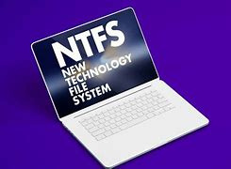
Key Features
Master File Table (MFT)
Stores metadata for every file and directory.
Journaling
Logs file system changes for robust crash recovery.
Security Descriptors
Manage access to files and directories securely.
Volume Shadow Copy
Creates snapshots to facilitate backups and recovery.
Notes:
4

Slide 5
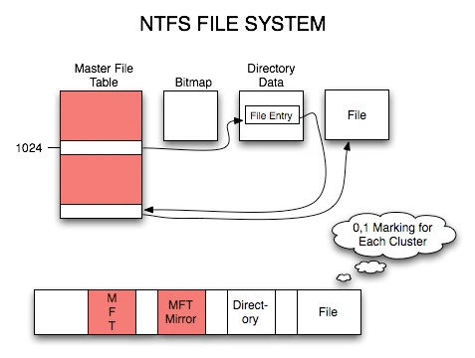
NTFS Data Structures
1
MFT Entries
Contain metadata, attributes, and data location info.
3
Attribute Types
Include standard info, filename, data, and security details.
2
Data Runs
Specify physical locations of file data on disk.
4
Indexing
Speeds up file and directory lookups efficiently.
Notes:
5

Slide 6
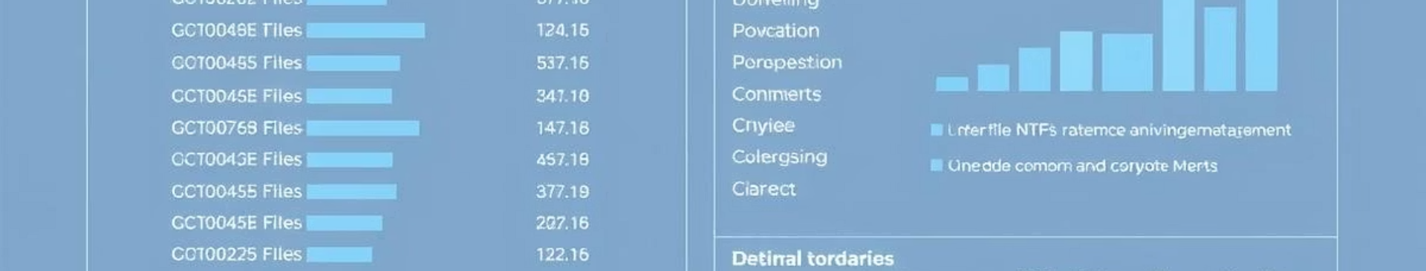
NTFS Metadata Files
$MFT
Central database of file metadata
$LogFile
Transaction log for journaling
$Volume
Holds volume-level metadata
$AttrDef
Defines attribute types
$Bitmap
Tracks volume allocation
Notes:
6

Slide 7
Role of NTFS in Digital Forensics
Metadata Richness
File Slack Space
Journaling Logs
Volume Shadow Copies
Timestamps and file attributes aid investigations.
Potential hiding place for deleted or hidden data.
Track file system changes and user activity.
Access previous versions for evidence recovery.
Notes:
7

Slide 8





Recent Developments and Forensics Tools
NTFS Today
Still dominant on Windows OS drives, despite new file systems.
Forensic Tools
Tools like Autopsy, EnCase, and FTK Imager handle NTFS analysis.
Challenges
Encrypted files and anti-forensic methods complicate investigations.
New File Systems
ReFS offers resilience but NTFS remains widely used.
Notes:
8

