Slide 1
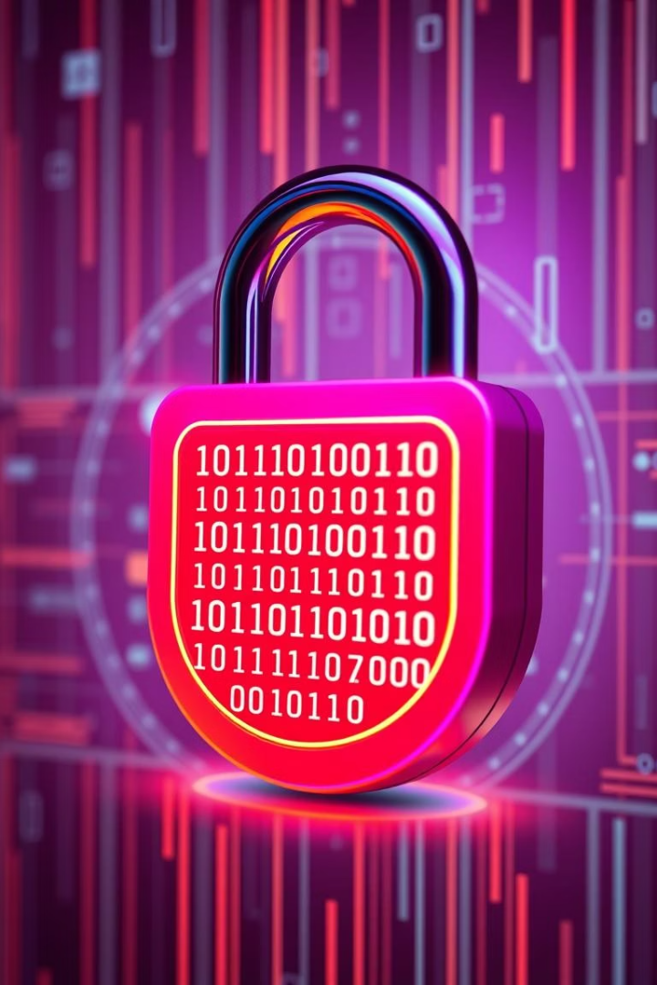
Understanding Anti-Forensics in Cybersecurity
Techniques, Tools, and Real-World Applications
AA
by Awais Ahmed

Slide 2
Introduction to Anti-Forensics
Definition
Purpose
Common Users
Methods to obstruct digital forensic investigations.
Erase evidence
Cybercriminals
Alter digital trails
Malware developers
Hindering evidence collection.
Delay forensic analysis
Advanced Persistent Threats (APTs)

Slide 3





Goals and Importance of Anti-Forensics
Avoid Detection
Delay Response
Undermine Reliability
Evade Legal Steps
Slow down incident containment efforts.
Stay hidden during and after an attack.
Corrupt or confuse forensic findings.
Prevent attribution and prosecution.
For cybersecurity professionals, understanding these goals helps to develop proactive defenses and enhance incident response capabilities.

Slide 4
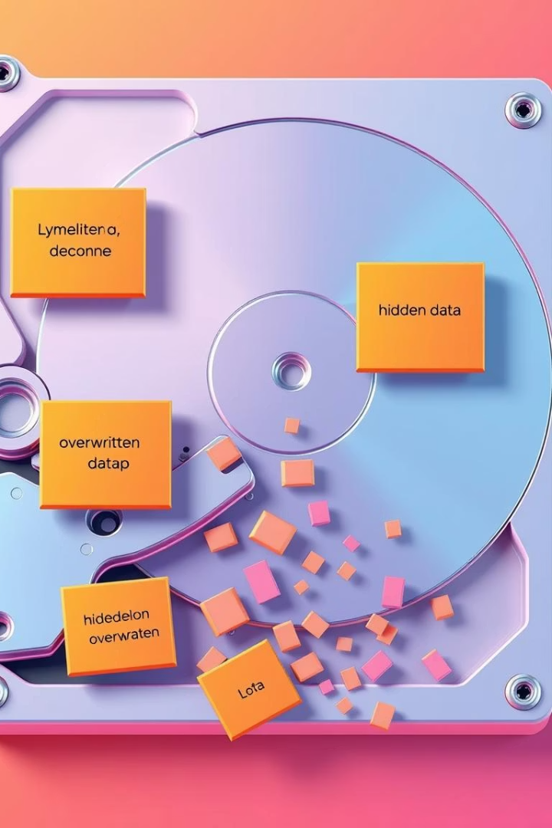



Categories & Techniques (Beginner Level)
Anti-forensics techniques often start with fundamental methods to obscure data.
Data Hiding
Steganography (images/audio)
Alternate Data Streams (ADS)
Data Destruction
File wiping tools (CCleaner, SDelete)
Secure deletion (multiple overwrites)
Metadata Manipulation
Change file dates
Edit EXIF data in images

Slide 5
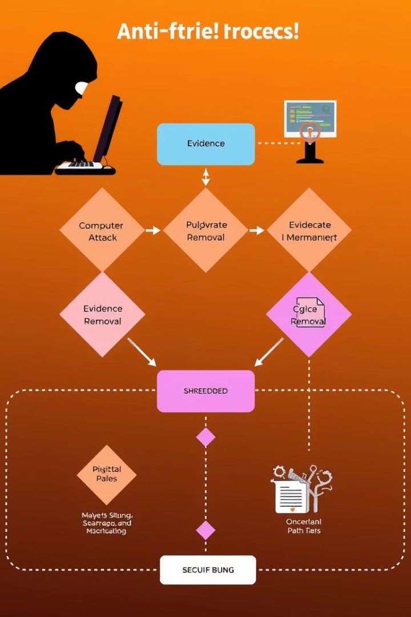



Advanced Techniques & Real-world Applications
Timestamp Tampering
Tools: Timestomp, Touch.
Modify MACE times.
Encryption Misuse
Encrypt volumes (VeraCrypt).
Prevent data access.
Anti-Reverse Engineering
Obfuscate code, pack binaries.
Debugger detection (Themida, UPX).

Slide 6
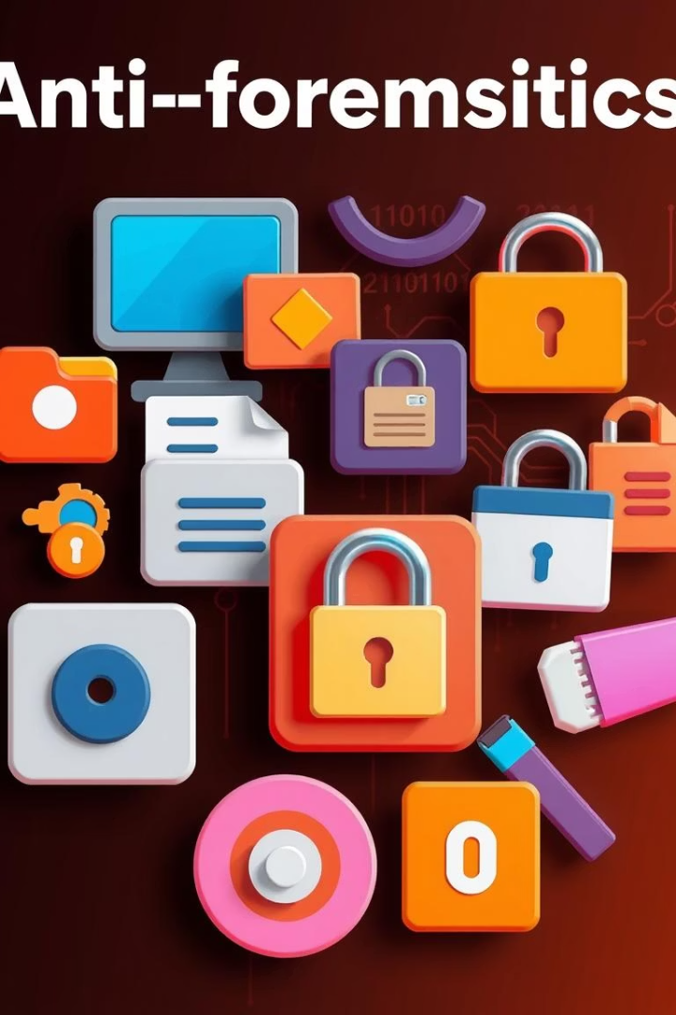
Tools Commonly Used in Anti-Forensics
Category
Tool
Purpose
Data Hiding
Slacker
Hide files in slack space
Timestamp Tampering
Timestomp
Modify NTFS file times
Data Deletion
SDelete
Secure file deletion
Metadata Editing
ExifTool
Edit image metadata
Volume Encryption
VeraCrypt
Encrypt drives/files
Binary Obfuscation
UPX
Compress and obfuscate binaries

Slide 7





Detection Challenges for Forensic Investigators
Obfuscated Timestamps
Hidden Partitions
Erased Logs
Encrypted or concealed storage areas.
Corrupted or missing system records.
Disguised file names.
Inconsistent Evidence
Blended Signatures
Fragmented or contradictory data trails.
Malicious tools mimic legitimate utilities.

Slide 8
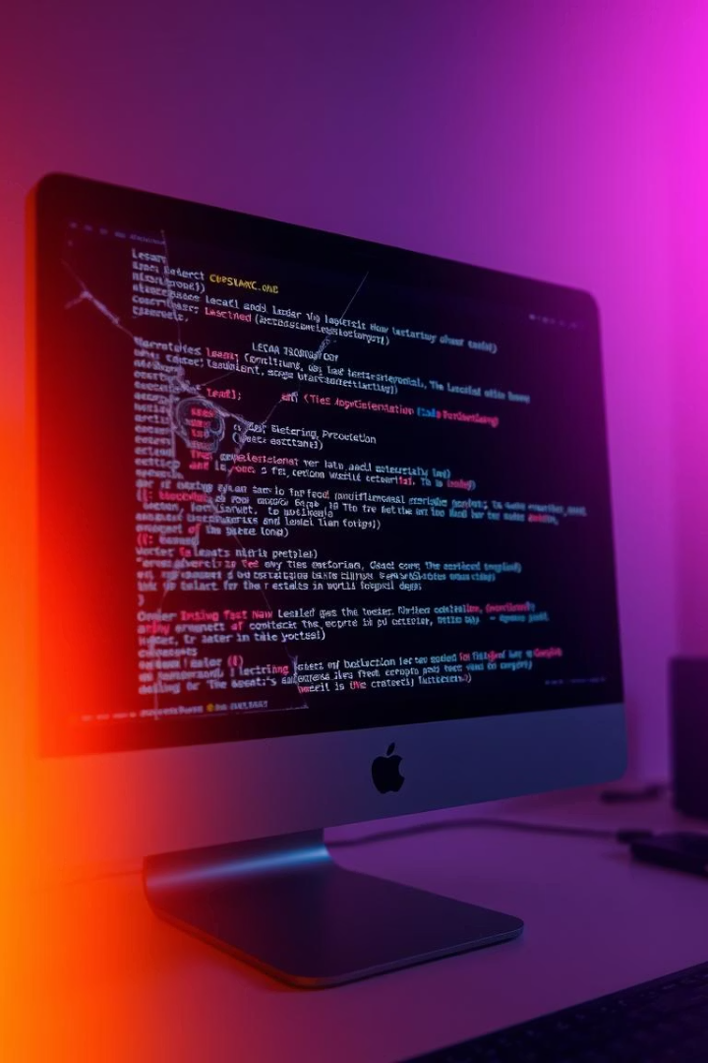
Case Study – Hacking Team Breach (2015)
Incident Details
Hacking Team's tools leaked online.
Exposed stealth anti-forensic capabilities.
Relevance to Cybersecurity
Demonstrated advanced attacker tools.
Increased awareness of offensive tactics.
Key Takeaway
State-level tools integrate anti-forensics.
Constant vigilance is critical.

Slide 9




Conclusion & Takeaways
Diverse Techniques
Enhanced Defense
Methods range from simple to complex.
Understanding AF builds better forensic tools.
Purposeful Evasion
Stay Updated
Anti-Forensics aims to hide digital activities.
Evolving tools require continuous learning.
2
3
1
4
Always practice ethical usage for research and defense to secure digital environments effectively.

