Slide 1
GUNROOM AND MESS MANAGEMENT SYSTEM
Two user IDs (admin and UTO)
Two user IDs (admin and UTO)
Username
password
Select whether mess or gunroom
SELECT TYPE
LOGIN

Slide 2
WELCOME TO GUNROOM DASHBOARD
GUNROOM 1
GUNROOM 2
GUNROOM 3
Click on desired gunroom to review complaints and rooms
Press logout button to go back to home page
COMPLAINTS
LOGOUT

Slide 3
GUNROOM 1
GUNROOM 1
GUNROOM SUMMARY
GUNROOM 2
Total rooms | 10
Total floors | 3
Occupied | 4
Empty | 5
Officer accommodation total | 40
GUNROOM 3
COMPLAINTS
Floor plan
FLOOR 1
FLOOR 2
FLOOR 3
Select above button to view officers accommodation floor wise
LOGOUT

Slide 4
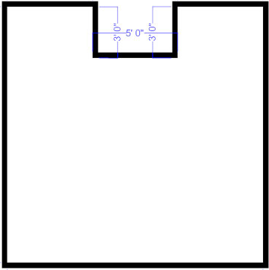


GUNROOM 1 FLOOR 1
FLOOR 1
FLOOR 2
FLOOR 3
S/LT ALI
S/LT AHMED
S/LT USAMA S/LT AHMED
GUNROOM
LOGOUT

Slide 5
COMPLAINT FORM
NAME: P.NO: DATE:
03/25/2022
TO:
LOCATION:
TYPE:
DESCRIPTION :
ATTACH PICTURE
BACK
SUBMIT

