Slide 1
OUR
Data Ecosystem

Slide 2
Agenda
Data Warehouse
OLAP vs OLTP
Data Integration and the Extraction, Transformation, and Load (ETL) Process
BI(Business Intelligence)
Big Data
Data Engineer
Data Science
Advanced Analytics
Cloud Computing

Slide 3
Data Warehouse

Slide 4
What Is a Data Warehouse?
A physical repository where relational data (current and historical) are specially organized to provide enterprise-wide, cleansed data in a standardized format
Data Warehouse
ETL pipeline
outputs
At the top – a centralized database
Generally configured for queries and appends – not transactions
Many indices, materialized views, etc.
Data is loaded and periodically updated via Extract/Transform/Load (ETL) tools
ETL
ETL
ETL
ETL
ETL
RDBMS
RDBMS
1
2
HTML
XML
1
1

Slide 5
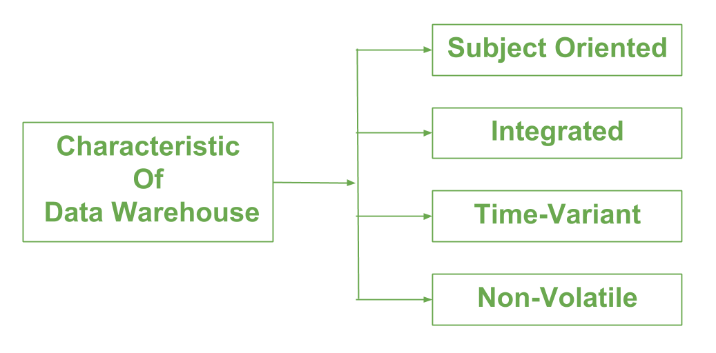
Characteristics of data warehousing
Subject oriented: data are organized by detailed subject containing only information relevant for decision support. It provides a more comprehensive view of the organization
Integrated: data warehouses must place data from different sources into a consistent format
Time variant (time series): it contains historical (daily, weekly and monthly) inc addition to current data (real-time)
Nonvolatile: data can not be changed or updated after it had entered into data warehouse. Obsolete (Old) data are discarded and changes are recorded as new data

Slide 6
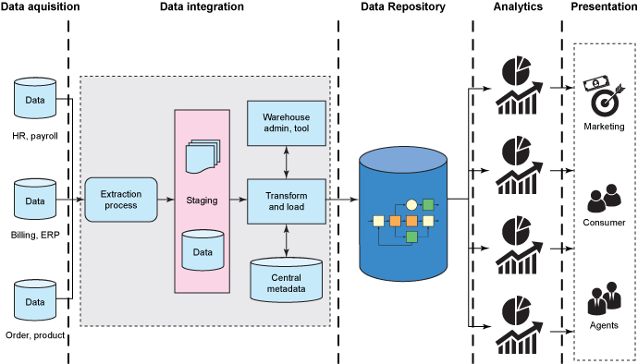
Data warehousing - Architecture

Slide 7
Data warehousing - Components
The major components of a data warehousing process
Data sources: internal, external (data provider), OLAP, ERP, Web data
Data extraction: using custom-written or commercial software called (ETL)
Data loading: loaded into a staging area to be transformed and cleansed, then loaded into the warehouse
Comprehensive database: It is the EDW to support all decision analysis
Metadata: to ease indexing and search
Middleware tools: to enable access to DW. It includes data mining tools, OLAP, reporting tools, and data visualization tools.

Slide 8
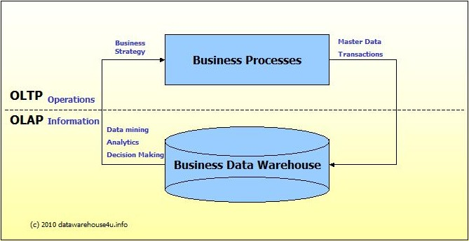
OLTP vs OLAP

Slide 9
OLTP vs OLAP

Slide 10
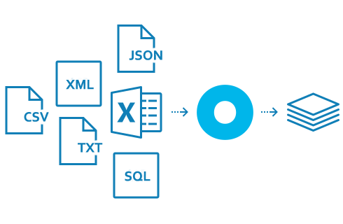
Data Integration and the Extraction, Transformation, and Load (ETL) Process
Data integration
Integration that comprises three major processes that when correctly implemented, data can be accessed and made accessible to an array of ETL and analysis tools and data warehousing environments:
Data access: the ability to access and extract data from any data source
Data federation: the integration of business views across multiple data stores)
Change capture: based on the identification, capture, and delivery of the changes made to enterprise data sources

Slide 11
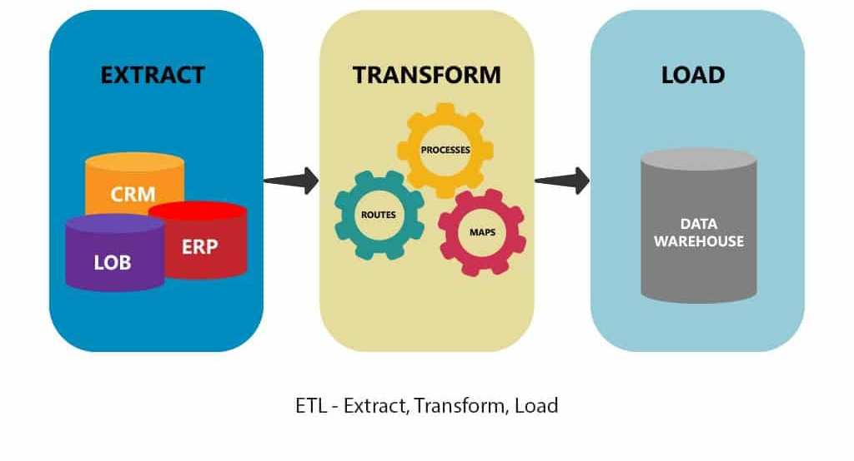
Data Integration and the Extraction, Transformation, and Load (ETL) Process
A data warehousing process that consists of:
Extraction -> reading data from a data sources
Transformation -> converting the extracted data from its previous form into the form in which it needs to be so that it can be placed into a data warehouse or simply another database
Load -> putting the data into the data warehouse

Slide 12
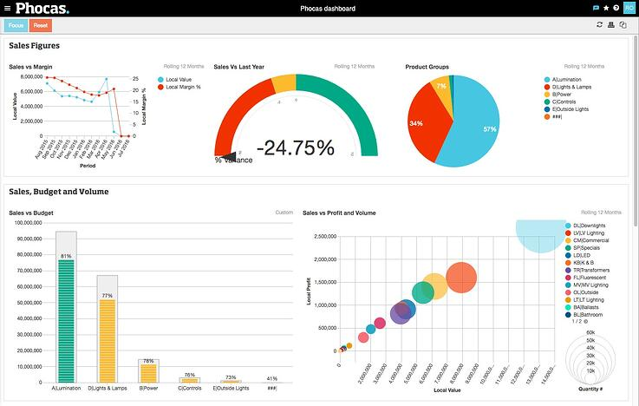
Business Intelligence
The term Business Intelligence (BI) refers to technologies, applications and practices for the collection, integration, analysis, and presentation of business information. The purpose of Business Intelligence is to support better business decision making

Slide 13
BI Questions – 5W’s
What happened?
What were our total sales this month, Time Series?
What’s happening?
Are our sales going up or down, trend analysis
Why?
Why have sales gone down?
What will happen?
Forecasting & What If Analysis
What do I want to happen?
Planning & Targets , Enterprise performance management

Slide 14
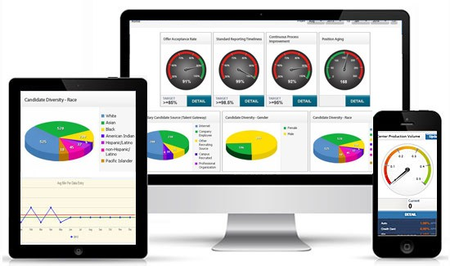
Business Intelligence - Features
Analytical Dashboards
Interactive Dashboards
Real Time Analytics
BI Personalization/Content Management
Self Service BI / Ad-hoc Reporting
Collaboration
Notifications/ Alerts
Mobile / Tablet Access
Publish and share
Location intelligence etc.

Slide 15
Big Data

Slide 16
Big Data Core Concept
Massive volumes of data can be used to address business problems you wouldn’t have been able to tackle before.
Combination of Structured, Semi structured and Unstructured collected by organizations that can be mined for information
Ability to collect different data from various sources, and place those associations in an understandable context
Compute-and-storage architecture that collects and manages large data sets and enables real-time Data Analytics.

Slide 17
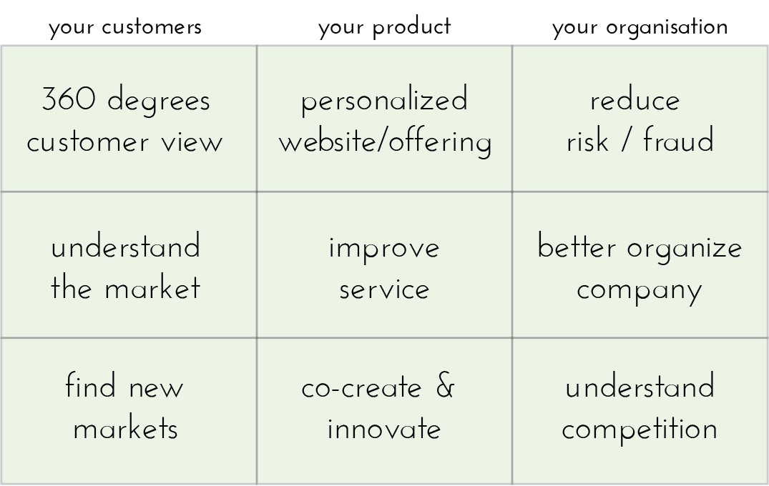
Big Data Use Cases
360° View of the Customer
Fraud Prevention
Security Intelligence
Data Warehouse Offload
Price Optimization
Log Analytics etc.

Slide 18
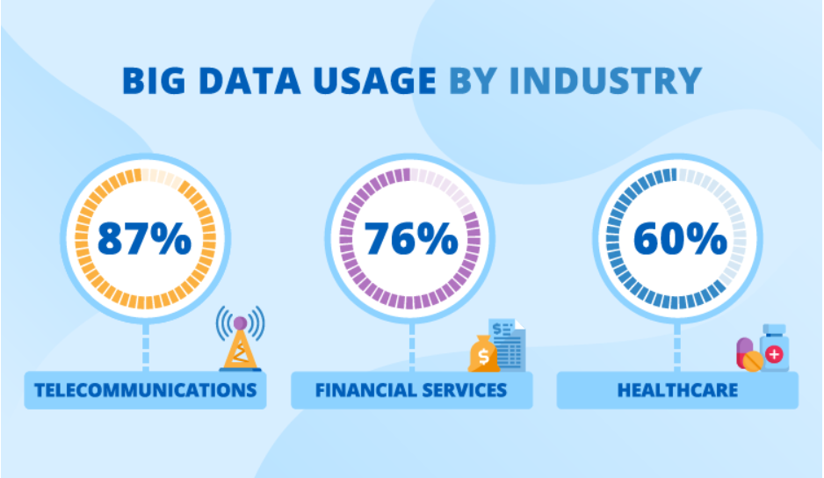

Slide 19
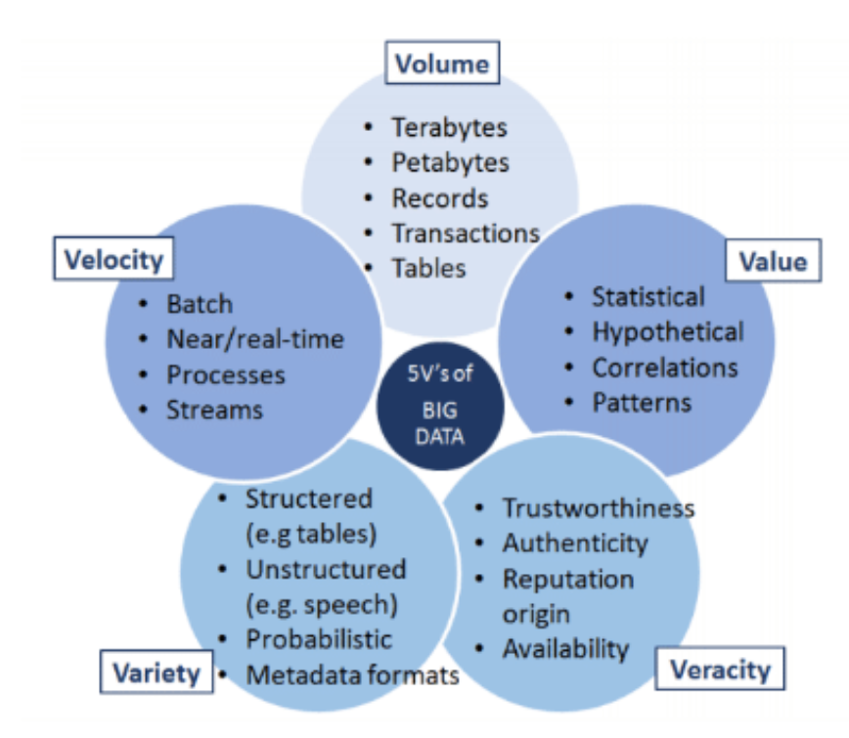
5V’s and More
Volume
How much data we have – what used to be measured in Gigabytes is now measured in Zettabytes (ZB) or even Yottabytes (YB).
Velocity
The speed in which data is accessible.
Variety
So many different types of data from XML to video to SMS.
Veracity
Veracity is all about making sure the data is accurate.
Value
To be sure your organization is getting value from the data.

Slide 20
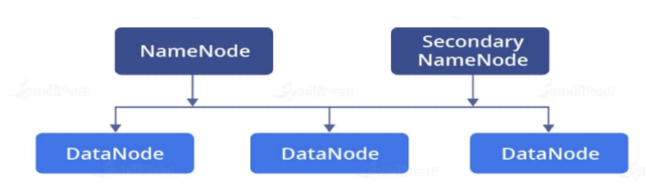
Big Data Storage
HDFS (Hadoop Distributed File System)
HDFS is one of the major components of Apache Hadoop
Single Apache Hadoop cluster to hundreds (and even thousands) of nodes
HDFS has two core components, i.e. NameNode and DataNode.

Slide 21
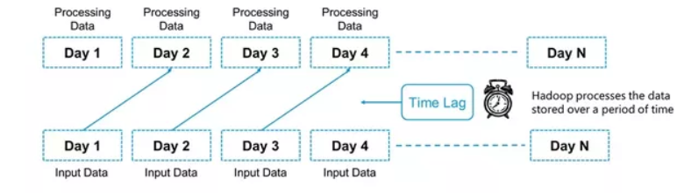
Processing - Batch
The processing happens of blocks of data that have already been stored over a period of time.
Multiple open source stream processing platforms such as Hive, Pig , Apache Kafka etc.

Slide 22
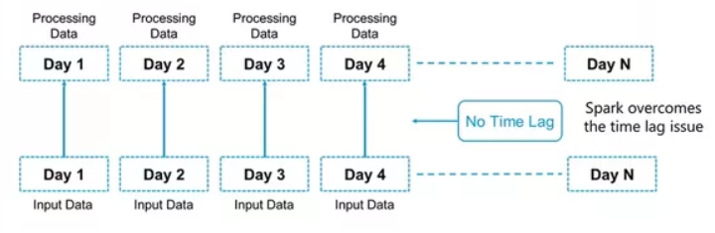
Processing - Stream
Analytics results in real time. Stream processing allows us to process data in real time as they arrive and quickly detect conditions within small time period.
Multiple open source stream processing platforms such as Apache Kafka, Apache Flink, Apache Storm etc.

Slide 23
Big Data Ecosystem
It is a platform or framework which solves big data problems.
It as a suite which encompasses a number of services (ingesting, storing, analyzing and maintaining) inside it.
HDFS -> Hadoop Distributed File System
YARN -> Yet Another Resource Negotiator
MapReduce -> Data processing using programming
Spark -> In-memory Data Processing
PIG, HIVE -> Data Processing Services using Query (SQL-like)
HBase -> NoSQL Database
Mahout, Spark MLlib -> Machine Learning
Apache Drill -> SQL on Hadoop
Zookeeper -> Managing Cluster
Oozie -> Job Scheduling
Kafka, Flume, Sqoop -> Data Ingesting Services
Solr & Lucene-> Searching & Indexing
Ambari -> Provision, Monitor and Maintain cluster

Slide 24
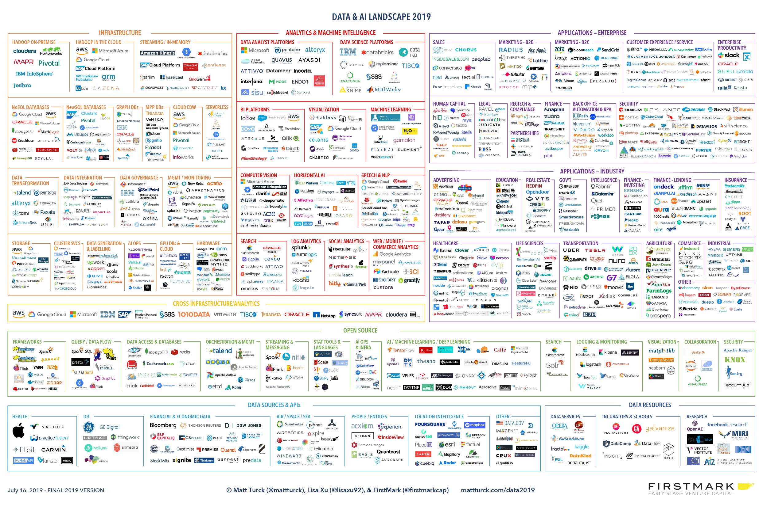

Slide 25
Data Engineering

Slide 26
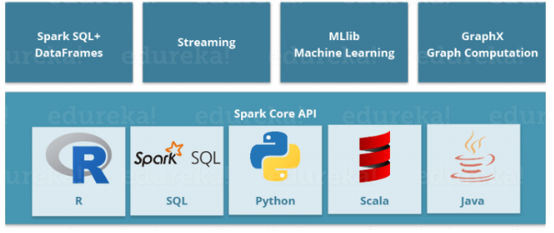
Big Data Processing
APACHE SPARK :
Apache Spark is a framework for real time data analytics in a distributed computing environment.

Slide 27
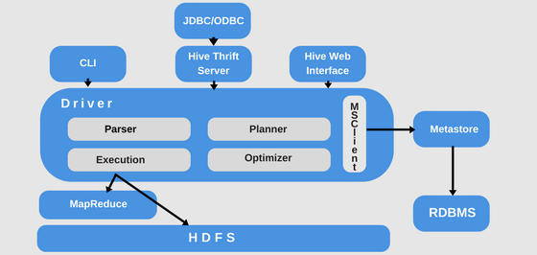
Big Data Processing
APACHE HIVE
HIVE is a data warehousing component which performs reading, writing and managing large data sets in a distributed environment using SQL-like interface.
HIVE + SQL = HQL
The query language of Hive is called Hive Query Language(HQL), which is very similar like SQL.

Slide 28
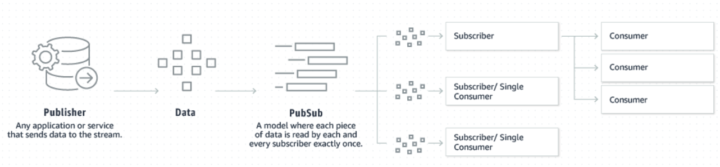
Big Data Processing
APACHE KAFKA
Apache Kafka is a distributed data store optimized for ingesting and processing streaming data in real-time.
Kafka provides three main functions to its users:
Publish and subscribe to streams of records
Effectively store streams of records in the order in which records were generated
Process streams of records in real time

Slide 29
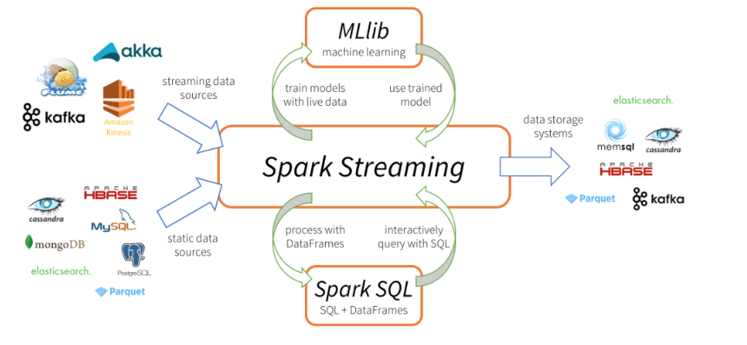
Big Data Processing
SPARK STREAMING
Apache Spark Streaming is a scalable fault-tolerant streaming processing system that natively supports both batch and streaming workloads

Slide 30
Data Sciences
--- Its Slides are not ready yet

Slide 31
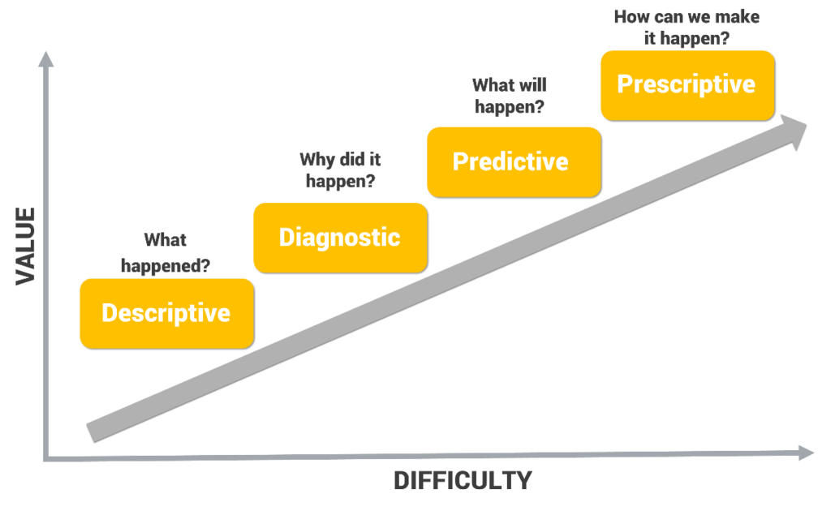
Advanced Analytics
Descriptive Analytics tells you what happened in the past.
Diagnostic Analytics helps you understand why something happened in the past.
Predictive Analytics predicts what is most likely to happen in the future.
Prescriptive Analytics recommends actions you can take to affect those outcomes

Slide 32
Cloud Computing

Slide 33
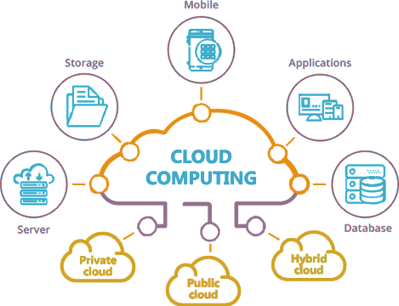
Cloud Computing
Cloud computing is the on-demand delivery of IT resources over the Internet with pay-as-you-go pricing. Instead of buying, owning, and maintaining physical data centers and servers, you can access technology services, such as computing power, storage, and databases, on an as-needed basis from a cloud provider

Slide 34
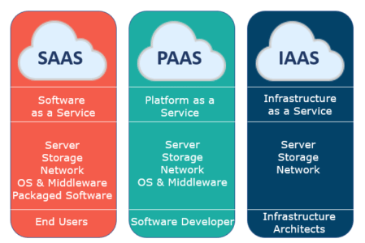
Cloud - Service Models
Infrastructure-as-a-service (IaaS)
Virtual servers, networks, firewalls, etc.
Platform-as-a-service (PaaS)
Deploy application without managing virtual servers
Software-as-a-service (SaaS)
Ready to use software applications

Slide 35
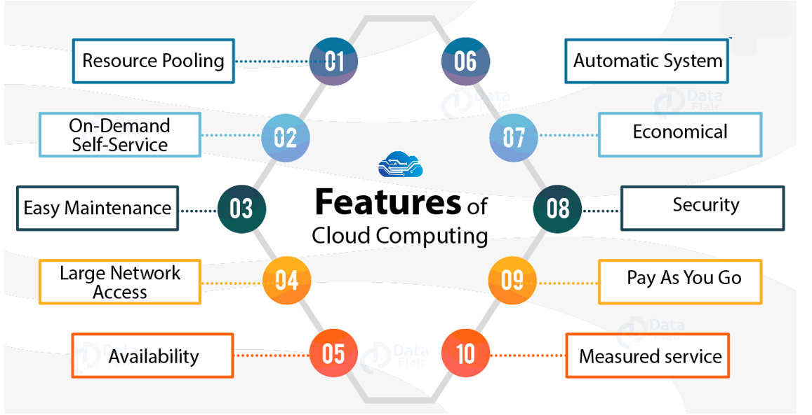
Cloud - Features

Slide 36
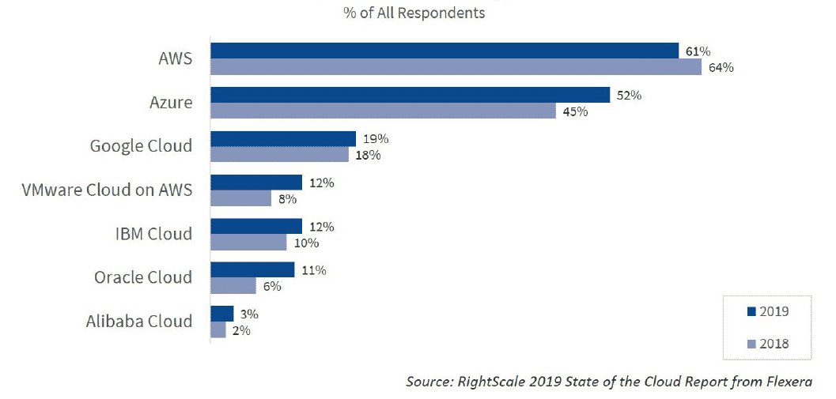
Cloud – Adoption

