Slide 1
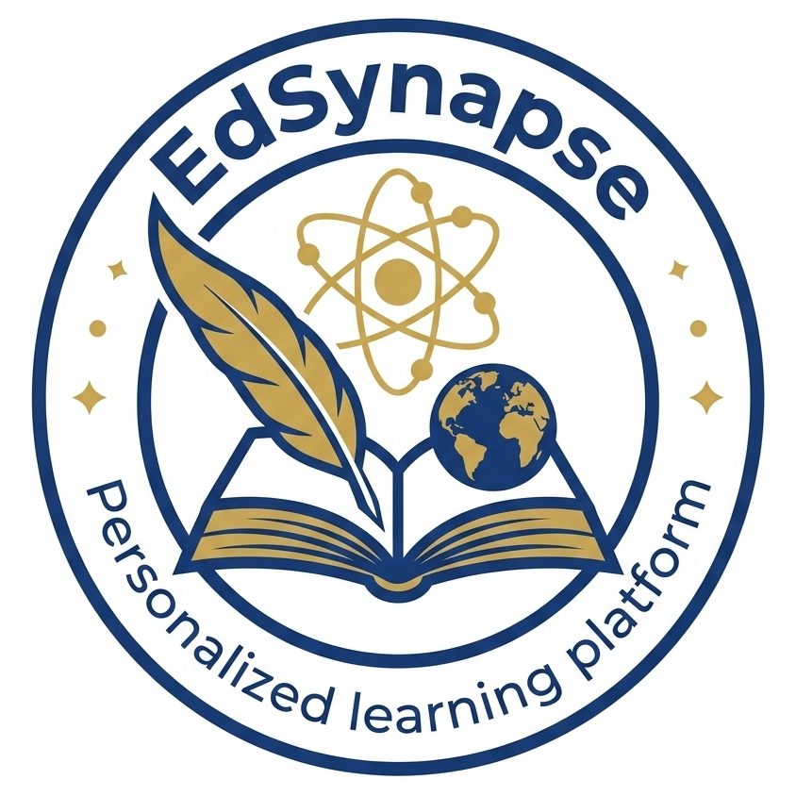
H0 HACKATHON · TRACK 4 — OPEN INNOVATION
EdSynapse
An AI tutor that adapts to how you learn — and grounds every lesson in your own material.
Vercel · Serverless + Edge
Amazon Aurora + pgvector
OpenAI · RAG tutor
Live: https://edsynapse.com
Presented by Awais Aziz
Notes:
0:00-0:15 — Hi, I'm Awais. This is EdSynapse, my Open Innovation submission: a personalized AI tutor that adapts to how each learner learns and grounds every lesson in their own uploaded material. It's live on Vercel, backed by Amazon Aurora with pgvector.

Slide 2
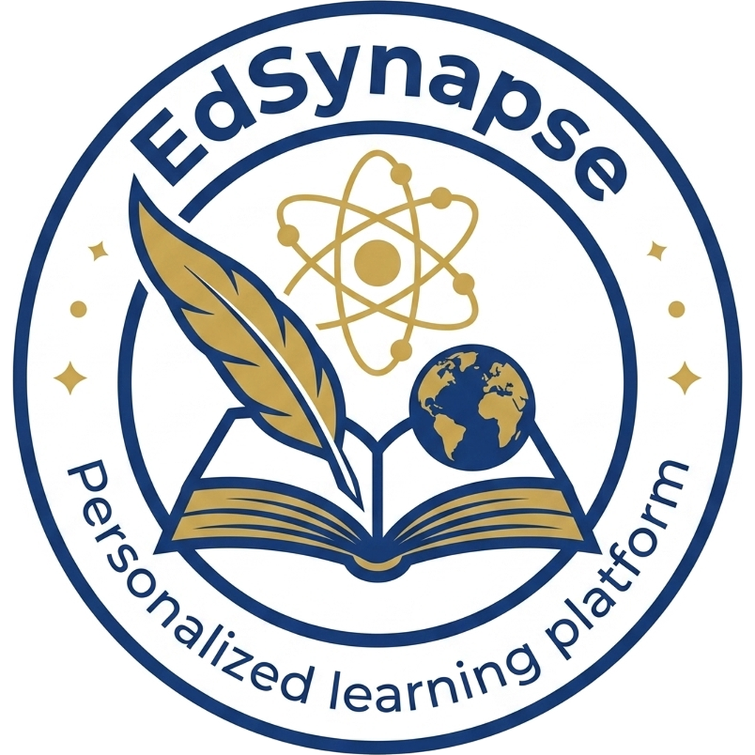
The problem
Learning is one-size-fits-all, and generic AI tutors make it worse.
WHAT
WHO
WHY
Generic, ungrounded tutoring
Students & teachers
Understanding needs grounding
Off-the-shelf AI tutors ignore the learner's actual course material and invent facts. Classrooms move at one pace for everyone.
Students learning from a class or their own uploads — and teachers who need to see where a whole cohort is struggling.
Learning sticks when it's tied to YOUR material, adapts to how you learn, and checks understanding as it goes — not after.
Notes:
0:15-0:45 — The problem: learning is one-size-fits-all, and generic AI tutors make it worse — they hallucinate and ignore your actual material. EdSynapse is for two people: the student learning from a class or their own uploads, and the teacher who needs to see where the whole cohort is stuck. I chose this because understanding only sticks when it's grounded in your own material, adapts to how you learn, and checks understanding as it goes.

Slide 3
LIVE DEMO
See it working
1
Teacher Create a course + join code, upload material — it's chunked & embedded into Aurora/pgvector.
2
Diagnose Student joins by code; an AI diagnostic seeds their strengths & gaps map.
3
Teach + Check The grounded tutor streams answers from the student's own material and checks understanding live.
4
Verify A graded assessment updates the knowledge map — and the teacher's cohort analytics.
Notes:
1:15-2:40 — LIVE DEMO (screen recording). Walk it in this order: (1) As a teacher, create a course, show the join code, upload a PDF — mention it's parsed, chunked, embedded into Aurora/pgvector. (2) As a student, join by code, take the diagnostic, show the strengths & gaps map. (3) Open the AI Tutor — ask something answerable from the uploaded file and point out the source citations appear (grounding). (4) Take the assessment, show it grading and updating the knowledge map, then flip to the teacher analytics. Keep this section the longest.

Slide 4
How it's built — Vercel × AWS Aurora
One request crosses Vercel's edge + serverless compute and lands in Aurora — which serves BOTH relational data and vector search.
CLIENT — BROWSER
VERCEL
AWS
Teacher
Edge Middleware
Aurora PostgreSQL 17 + pgvector 0.8
Cookie-presence route gate · no DB at the edge
Relational app data — users · courses · knowledge map
Vector store — source_chunks, cosine similarity search (RAG)
Student
Next.js App Router (React 19)
Role-protected UI · server components
Serverless Functions /api
Admin
CRUD · RAG ingest · quiz/grade · SSE tutor stream
OIDC identity → short-lived RDS IAM token
Why Aurora + pgvector
OpenAI
Resend
Google Forms
One DB, two jobs — relational data AND the RAG vectors, no second system to sync.
No DB password — Vercel OIDC mints a short-lived AWS IAM token per connection.
chat + embed
auth email
feedback
Notes:
0:45-1:15 — Here's the architecture. A request hits Vercel's edge gate, then a serverless function, which talks to Amazon Aurora. The key choice: Aurora with pgvector does BOTH jobs in one database — it stores the relational app data AND the RAG vectors for grounding, so there's no second vector system to run or sync. And there's no database password anywhere: Vercel's OIDC identity mints a short-lived AWS IAM token for every connection. Below Vercel are the external services — OpenAI for chat and embeddings, Resend for email, and the Google feedback form.

Slide 5
How a tutor turn works — live request flow
Every question is grounded in the learner's own sources and recent conversation before the model ever responds.
Student message
+ topic + preferences
Prompt assembler
/api tutor route
RETRIEVAL AT PROMPT TIME
Content RAG — pgvector
source_chunks · authentic material
Conversation history
tutor_sessions.messages · recent turns
Grounded prompt
sources + history + modality/pace
reads
reads
OpenAI — streaming chat
SSE reply
+ source citations
Append turn
→ tutor_sessions.messages
AWS Aurora
+ pgvector
writes

Slide 6
How a request is authorized — session gate flow
The httpOnly cookie is the only client-side credential — every role and session check happens server-side against Aurora.
Browser — sends httpOnly cookie edsynapse_session
(no role / token in JS storage)
request to /student · /teacher · /admin
Vercel Edge — middleware runs (no DB)
Vercel Serverless — route handler
requireUser(role?)
edsynapse_session
cookie present?
cookie present
Aurora — sessions ⋈ users
token lookup · expiry · status
session valid
& role allowed?
no cookie
302 → /sign-in
yes
no / wrong role
Handler runs
scoped to this user_id
AuthError → 401 / 403

Slide 7
We're in free beta — tell us what to build
Share Feedback
Open the form
Built into the app — “Share Feedback” in the sidebar & landing nav
Role-aware: students and teachers each get their own questions
Anonymous by design — email is optional
Captures what worked, what broke, and what to build next
forms.gle/
sSAexDXNKPuf3hWx9
Notes:
2:40-2:52 — EdSynapse is launching as a free one-month beta, so feedback drives the roadmap. There's a Share Feedback link on every page that opens this Google Form — it's role-aware and anonymous, and it asks what worked, what broke, and what to build next.

Slide 8
Thank you
EdSynapse — personalized, grounded AI tutoring on Vercel + Amazon Aurora.
Live app: https://edsynapse.com
H0 Hackathon · Track 4 — Open Innovation · Awais Aziz
Notes:
2:52-3:00 — That's EdSynapse: personalized, grounded AI tutoring built on Vercel and Amazon Aurora. Thanks for watching — the live app link is on screen.

