Slide 1
Gesture based Smartphone Application for Visually Impaired
Ahmad Ali
FA12-BCS-008
Awais Ahmad
FA12-BCS-025
Supervisor:
Dr. Yasir Faheem

Slide 2
Introduction
Gesture-based Smartphone application is an Android application designed for Visually Impaired people which will be operated using hand gestures and provide them with basic usage of a mobile phone.

Slide 3
Scope statement
The major objective of designing this system is to operate 3 applications (Call, Messaging and Contacts) with selective features which are required by a visually impaired person to facilitate them for using basic functions of a smartphone.
As it is a smartphone application, the system will be an Android application.

Slide 4
Modules
Main modules include:
Call
Messaging
Contacts
Identifying gesture
Action on Gesture
Feedback
Training

Slide 5
Tools and Technologies overview
Android Studio
Java
SensorManager Api
TTS Api

Slide 6
System Architecture
The system architecture followed will be the MVC (Model View Controller). We place Activities in the View part of MVC, as it forms the UIs of Android applications and updates them throughout the lifecycle of the Android application. The Services and Content Provider or data are hidden components and monitoring the behavior of the application, they are placed in Model part of MVC. Widget components at kernel are acting as Controller of MVC and interacts with Models and Views. Therefore, we can separate presentation (View) from the logic of application (Model). Frontend activities rely on the XML and Java files and their interactions in Android app programming. Java files/libraries are falling in Model part of MVC, whereas XML belongs to the View part.

Slide 7
Design Methodology
To design this system, we used Object Oriented Programming in creation of classes and the relation between them.

Slide 8
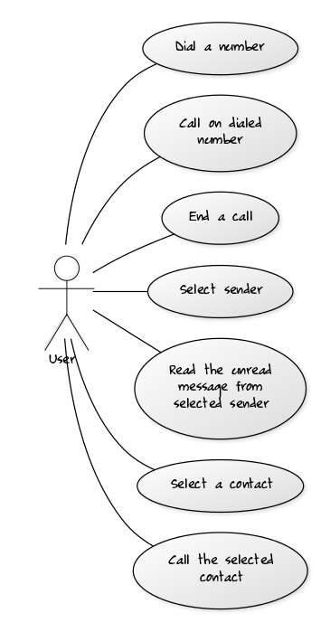
Use Case Diagram

Slide 9
XML Schema
<xs:element name="Contacts">
<xs:complexType>
<xs:sequence>
<xs:element name="name" type="xs:string" />
<xs:element name="id " type="xs:int" />
<xs:element name="number" type="xs:string" />
</xs:sequence>
</xs:complexType>
</xs:element>
<xs:element name="Organiser">
<xs:complexType>
<xs:sequence>
<xs:element name="Date" type="xs:dob" />
<xs:element name="Time" type="xs:HH/MM/SS" />
</xs:sequence>
</xs:complexType>
</xs:element>

Slide 10
Class Diagram

Slide 11
Sequence Diagram

Slide 12
Activity Diagram

Slide 13
Algorithm & Implementation
For limiting the accelerometer values coming from the sensor, to the desired input, the readings are added in three dimensions. Then a modulus is taken to ignore negative values (avoid multiple directions) and these values are used to compare with the defined threshold values.

Slide 14
References
Marco Klingmann, (2009), Accelerometer-Based Gesture Recognition with the iPhone, Goldsmiths University of London.
Creative Commons Attributions, http://developer.android.com/develop/index.html, Index, April 22, 2016.
https://developer.android.com/reference/android/hardware/Sensor.html, Accelerometer, March 07, 2016.
https://developer.android.com/reference/android/speech/tts/TextToSpeech.html, Text-to-Speech, March 14, 2016.

Slide 15
Demo

Slide 16
Question and Answers

