Slide 1
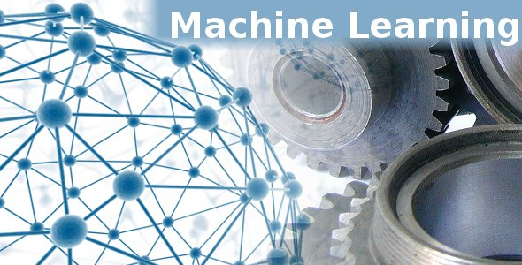

Predictive-Health Risk-Model-Using Lifestyle-Data
Amey Nate 240343025003
Awaiz Bagwan 240343025006
Kshitij Sontakke 240343025023
Muhammad Shaikh 240343025029
Rajat Tikle 240343025057
Guided By:
Ms. Trupti Joshi

Slide 2
1. INTRODUCTION
2. PROBLEM STATEMENT
3. DATASET AND METHODOLOGY
4. DATA PREPROCESSING
5. SYSTEM ARCHITECTURE
6. MODEL ACCURACY
7. CONCLUSION
8. FUTURE SCOPE

Slide 3

Problem Statement
Develop an advanced predictive model to assess the likelihood of individuals developing chronic diseases, such as diabetes, heart disease, and asthma, based on a comprehensive analysis of lifestyle factors (e.g., BMI, sleep patterns, physical activity) and medical history. The model will leverage machine learning techniques to analyze large datasets, enabling personalized health risk assessments.

Slide 4
Significance:
Significance
This predictive tool is designed to empower healthcare providers and individuals with actionable insights, fostering a proactive approach to chronic disease prevention. By identifying at-risk populations early, the model aims to reduce the incidence of chronic diseases, enhance patient outcomes, and contribute to the overall improvement of public health.

Slide 5
Dataset:
About the dataset
According to the CDC, heart disease is a leading cause of death for people of most races in the U.S. (African Americans, American Indians and Alaska Natives, and whites). About half of all Americans (47%) have at least 1 of 3 major risk factors for heart disease: high blood pressure, high cholesterol, and smoking. Other key indicators include diabetes status, obesity (high BMI), not getting enough physical activity, or drinking too much alcohol. This dataset can be used to apply a number of machine learning methods, especially classifier models (logistic regression, SVM, random forest, Gradient boosting).
Around 250,000 rows and 35 predictors
Disease selected for prediction are Heart Attack, Diabetes, Asthma, Arthritis

Slide 6
Data Source
Data is sourced from reputable public repositories, including Kaggle, which provides a diverse range of high-quality datasets on chronic diseases and associated lifestyle factors.
Methodology
Data preprocessing: Comprehensive cleaning and transformation of raw data to ensure accuracy and consistency, including handling missing values and outliers.
Label Encoding: Conversion of categorical variables into numerical format to facilitate machine learning model training.
Implementation Platforms: Leveraged powerful cloud-based and local development environments, including Google Colab and Jupyter Notebook, for efficient data processing and model development.

Slide 7
Pyspark:
Transfer Learning
PYSPARK
Definition
PySpark is the Python interface for Apache Spark, a powerful distributed computing framework that allows for the scalable processing and analysis of massive datasets. PySpark facilitates the seamless integration of Python's rich ecosystem of libraries with Spark's big data capabilities, making it ideal for data engineering, data science, and machine learning tasks.
Use Cases
ETL Processes: Efficiently extract, transform, and load (ETL) large volumes of data from various sources, ensuring data quality and consistency.
Real-Time Data Processing: Handle streaming data for real-time analytics and decision-making, crucial for time-sensitive applications like fraud detection and online recommendations.

Slide 8
MLlib:
Transfer Learning
MLlib
Functionality
MLlib is Apache Spark's scalable machine learning library, providing a suite of high-performance tools for building, evaluating, and deploying machine learning models on large datasets. MLlib leverages Spark's distributed computing power to enable fast and efficient machine learning workflows, making it an essential tool for data scientists working with big data.
Algorithms
Classification: Includes algorithms like Logistic Regression, Decision Trees, Random Forests, and Support Vector Machines for predicting categorical outcomes.
Integration: MLlib seamlessly integrates with PySpark, allowing data scientists to perform complex machine learning tasks directly within the Spark ecosystem, ensuring scalability, efficiency, and ease of use in big data environments.

Slide 9
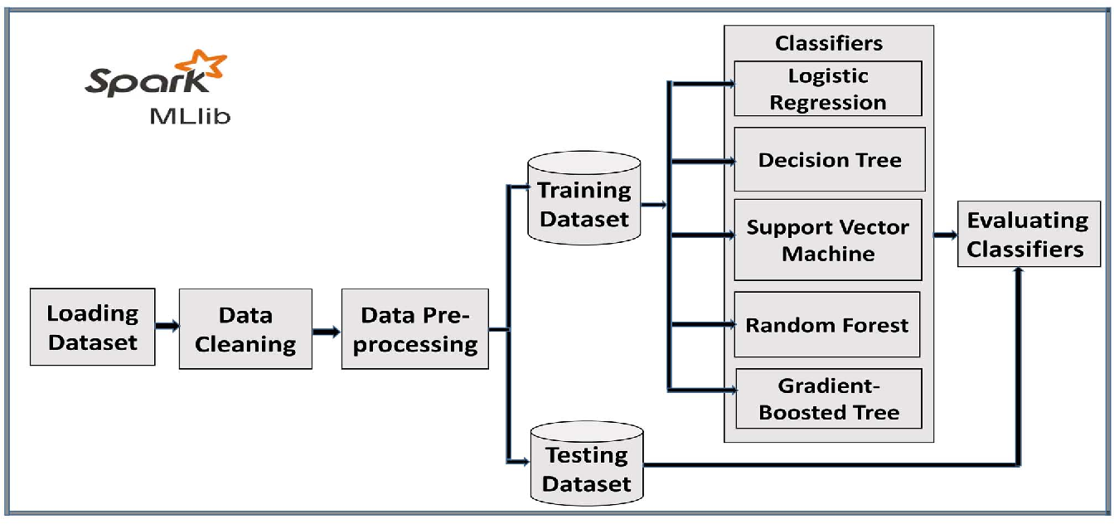
System Architecture

Slide 10
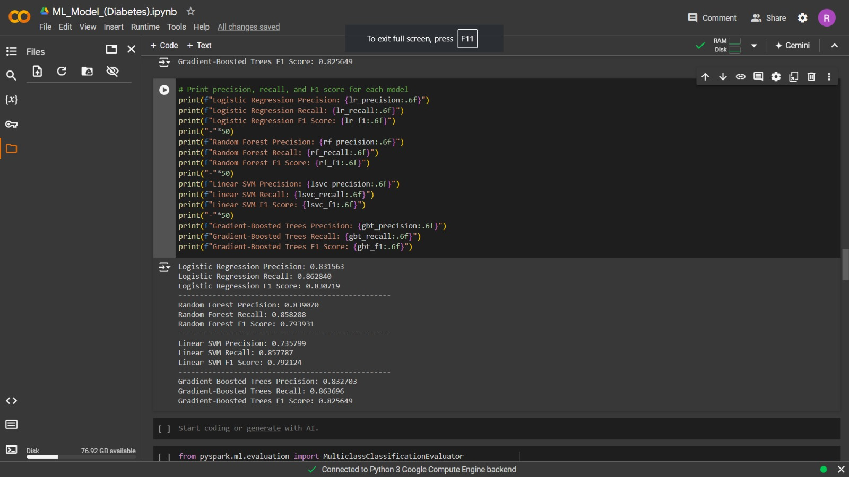
Outputs:

Slide 11
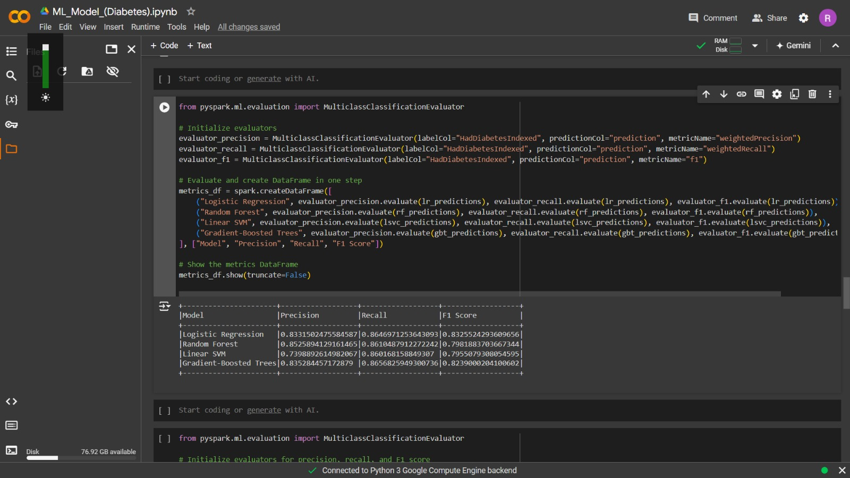
Outputs:

Slide 12
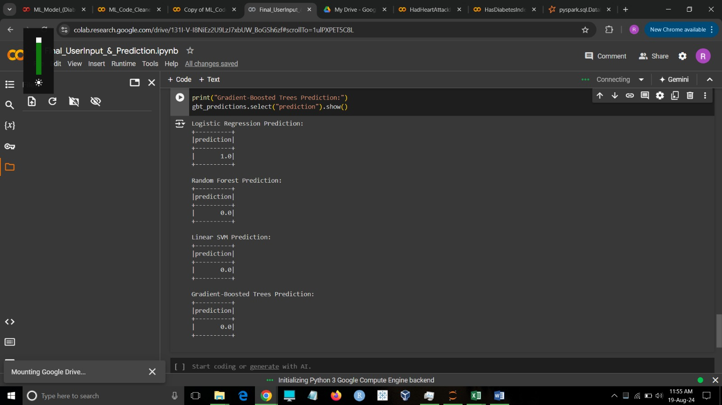
Outputs:

Slide 13
Conclusion:
By leveraging PySpark and its ML library to analyze lifestyle data, we can effectively predict chronic diseases with high accuracy. The combination of robust data processing capabilities and advanced machine learning algorithms enables us to handle large datasets efficiently and extract valuable insights. This approach allows us to identify at-risk individuals based on lifestyle factors, facilitating early intervention and personalized healthcare strategies. Ultimately, using PySpark for predictive modeling enhances our ability to proactively manage and prevent chronic diseases, leading to improved public health outcomes.

Slide 14
Future Scope:
The applications and future scope of this model can be Live monitoring.
The proliferation of wearable technology and IoT devices will allow continuous collection of lifestyle data, such as heart rate, activity levels, and sleep quality. This real-time data can be integrated into predictive models to provide dynamic health risk assessments.

Slide 15


