Slide 1
LOGISTICS & DELIVERY MANAGEMENT SYSTEM
-GROUP 8
• Alan Joy (TVE24CS019)(Roll no:9)
• Deepa Mary Jose (TVE24CS056)(Roll no:25)
• Deva Nanda Sumod (TVE24CS058)(Roll no:27)
• Jairaj R (TVE24CS082)(Roll no:36)
• S V Anupama (TVE24CS135)(Roll no:66)

Slide 2
Introduction
Logistics and Delivery Management System
– a Java Swing & SQLite-based desktop application
Simulates real-world logistics operations through role-based dashboards:
Admin, Customer, Delivery Agent, Warehouse Manager
Key functionalities:
Order placement
Shipment tracking
Vehicle scheduling
Warehouse inventory monitoring
Payment handling
Integrates OOP principles, GUI development, and database management
Demonstrates how logistics operations can be digitized and automated

Slide 3
Problem Statement and Objective
Problem Statement:
Efficient logistics management is critical for e-commerce and retail businesses. Manual tracking of orders, inefficient vehicle allocation, and unorganized warehouse operations often lead to delays, resource wastage, and poor customer satisfaction.
Objective:
To Design and Develop a Logistics and Delivery Management System based on OOP concepts that can handle order placing, shipment scheduling, order tracking, warehouse management, and payments in an integrated manner.

Slide 4
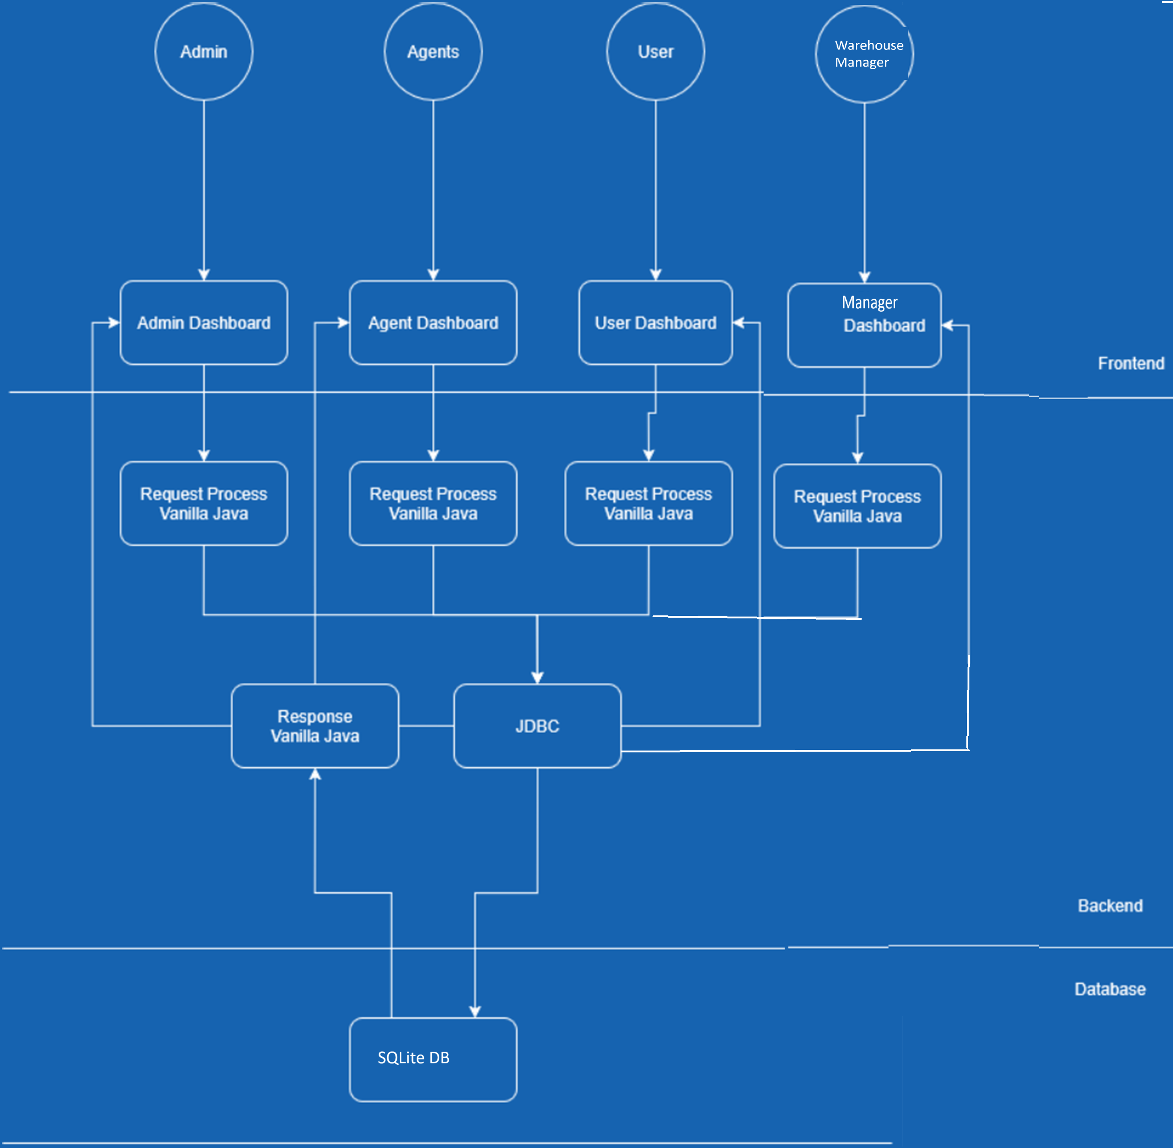
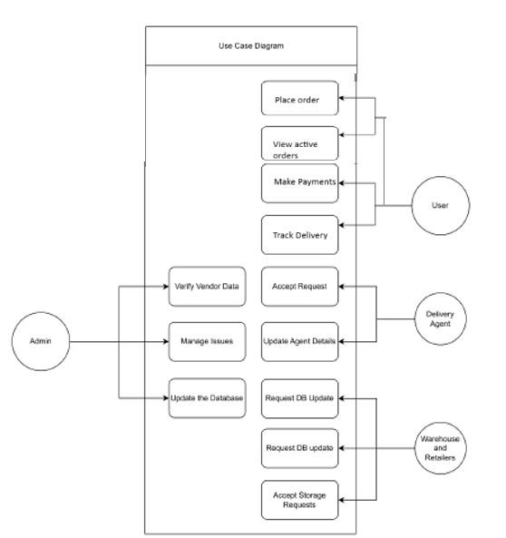
Design Methodology
Architecture Diagram
Use Case Diagram

Slide 5
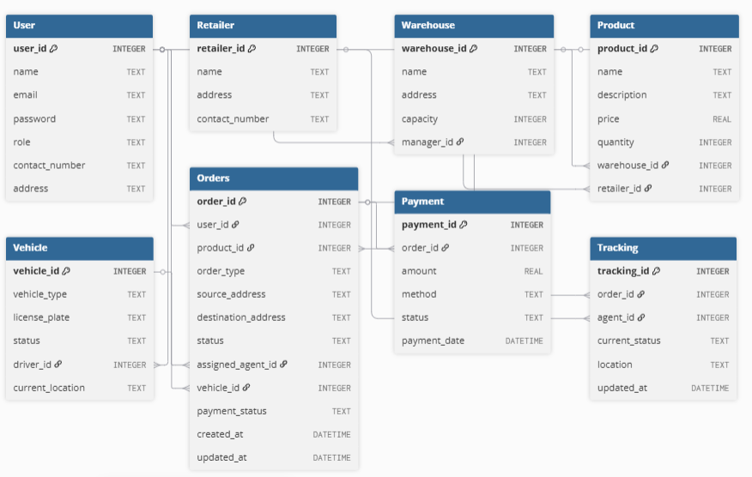
Design Methodology
Class Diagram
DB design

Slide 6
Hardware & Software Requirements
Hardware Requirements
Processor: Dual Core 2.0 GHz or higher
RAM: 2 GB
Hard Disk: 500 MB free space
Display: 1024 × 768 resolution
Input Devices: Keyboard, Mouse
Software Requirements
Operating System: Windows 11
Programming Language: Java (JDK 8 or above)
IDE : Eclipse
Database: SQLite
Libraries / Drivers:
SQLite JDBC Driver
Java Swing (for GUI)

Slide 7
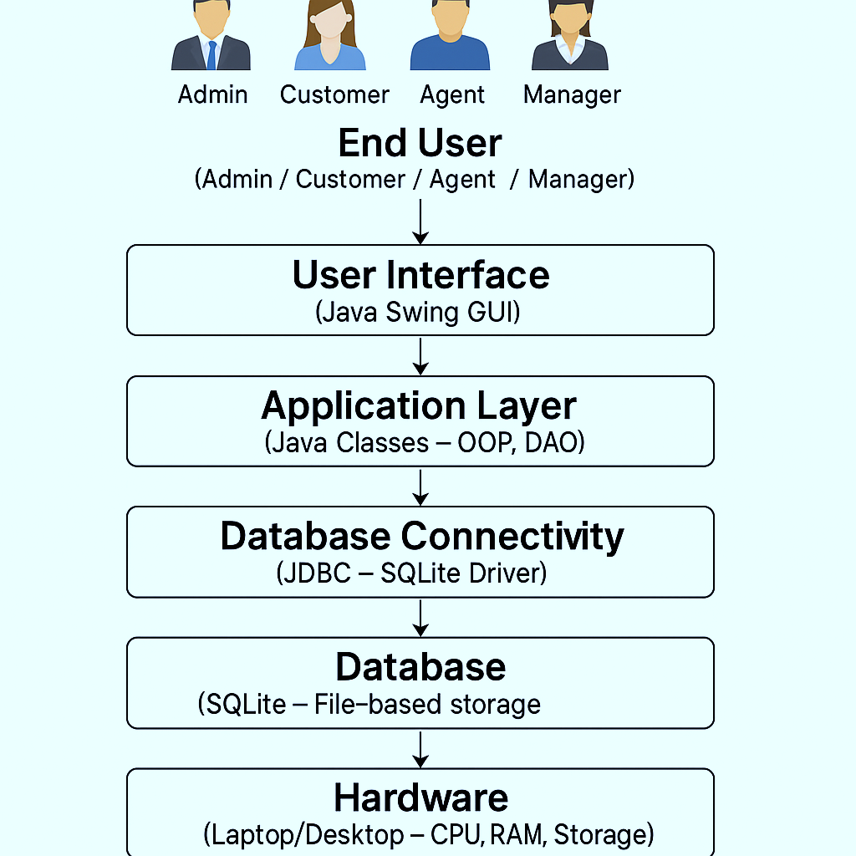
Implementation Environment Setup

Slide 8
Implementation Results
Role based Dashboard screenshots

Slide 9
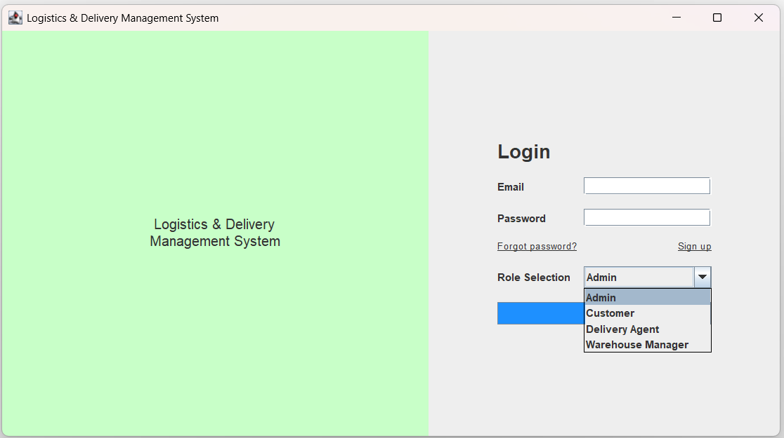
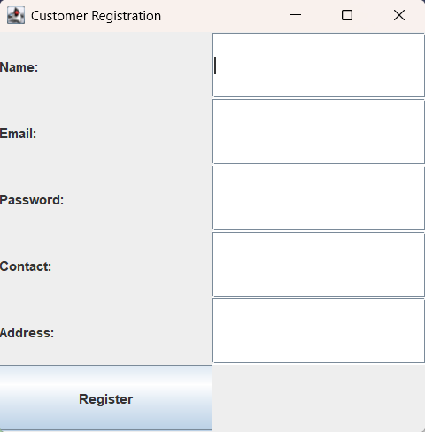
1. Login Page

Slide 10
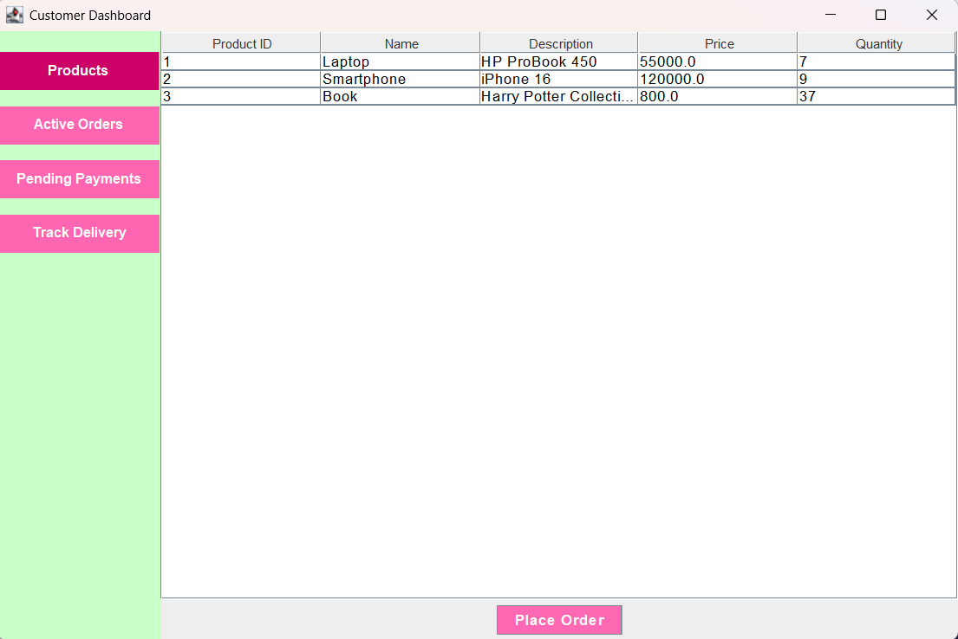
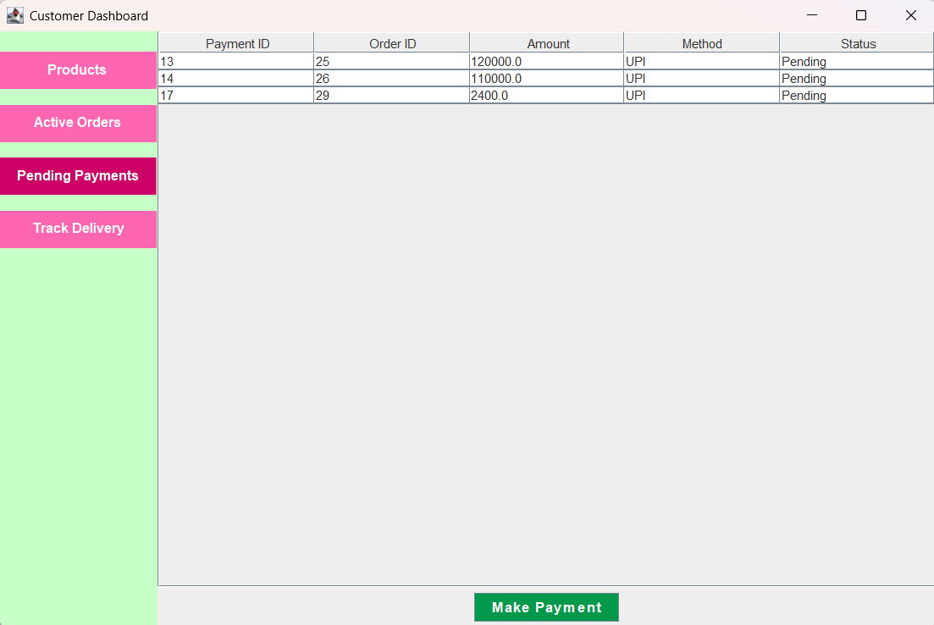
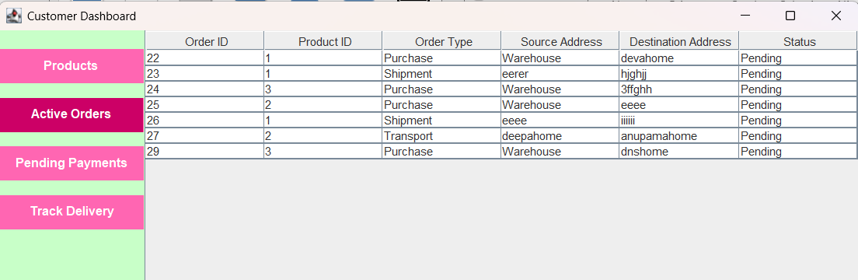
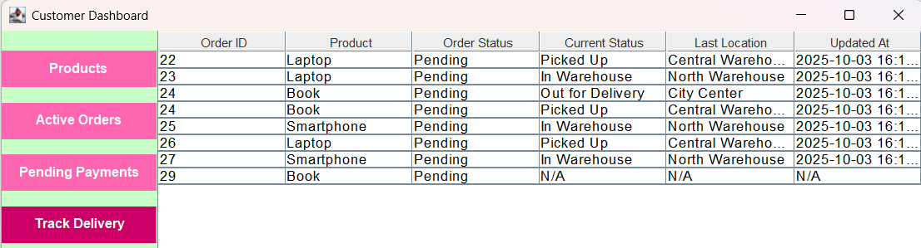
2. Customer(User) Dashboard

Slide 11
3. Admin Dashboard

Slide 12
4. Warehouse Manager Dashboard

Slide 13
5. Delivery Agent Dashboard

Slide 14
Individual Contributions
Role / Module | Team Member | Frontend | Backend | Database
Customer | Deva Nanda | User Dashboard | View products, order placement, active order view, order tracking, Payment processing | Products, Orders, Tracking, Payments
Admin | Alan | Admin Dashboard | User management (CRUD), system monitoring, report generation | Users, Orders, Payments, Vehicles
Delivery Agent | Anupama | Delivery Agent Dashboard | Accept delivery requests, update order status, vehicle assignment, tracking updates | Orders, Vehicles, Tracking
Warehouse Manager | Deepa | Warehouse Manager Dashboard | Inventory management, process orders for dispatch, assign delivery agents | Products, Warehouses, Orders
Register/login & Integration / QA | Jairaj | Register/Login page | User registration, login, integration of modules, validation | All

Slide 15
Conclusion
Successfully integrates OOP, Swing UI, and SQLite for a complete logistics solution.
Simulates real-world operations: orders, payments, shipments, and tracking.
Demonstrates modular, database-driven design with practical applications.
Provides a scalable foundation for industry-level logistics extensions.
“Simplifying logistics, one class at a time.”

