Slide 1
A neuronal model for visually evoked startle responses in schooling fish
Master defense by
Andrej Warkentin
Main supervisor:
Pawel Romanczuk
22.08.2018

Slide 2
Outline
Motivation
Startle Responses
Neuronal model
Collective behavior model
Discussion

Slide 3
Motivation
First top-level goal:
Understand collective behavior from the individual sensory perspective
Second top-level goal:
Understand the neuronal mechanism underlying behavior
Our specific example: spontaneous startling in schooling fish
Notes:
- we had two top-level goals in this project and as it’s often the case in neuroscience it’s about bridging scales
- in our case the scales that we want to bring together are collective behavior at the top level and neuronal processing at the bottom level

Slide 4

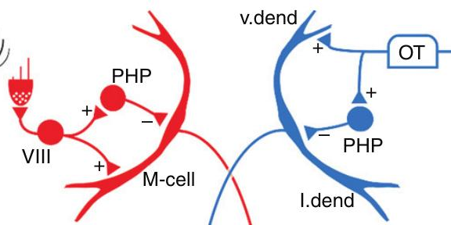
Motivation
v
Two top-level goals
Understand collective behavior from the individual sensory perspective
Second top-level goal:
Understand the neuronal mechanism underlying behavior
Our specific example: spontaneous startling in schooling fish
Notes:
- we had two top-level goals in this project and as it’s often the case in neuroscience it’s about bridging scales
- in our case the scales that we want to bring together are collective behavior at the top level and neuronal processing at the bottom level

Slide 5
Motivation 2
Startle response allow to combine the two goals because:
  Occur in fish schools and can spread within school
  The underlying neuronal circuit is well-studied

Slide 6
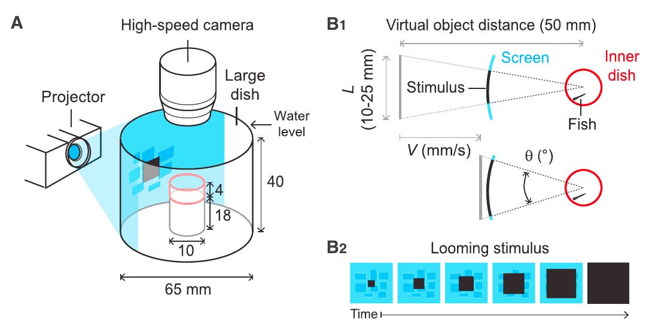
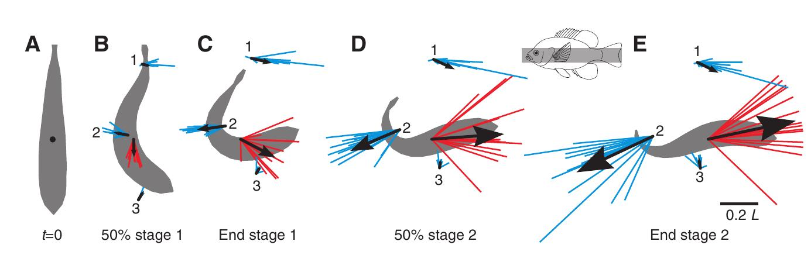
Startle Response

Slide 7
Startle Responses

Slide 8
Startle Responses

