Slide 1


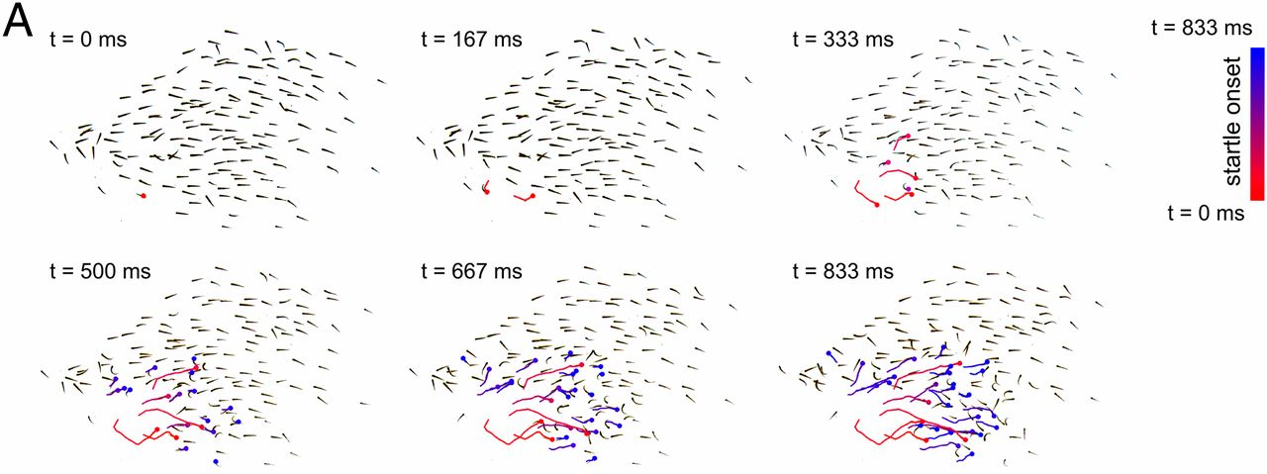
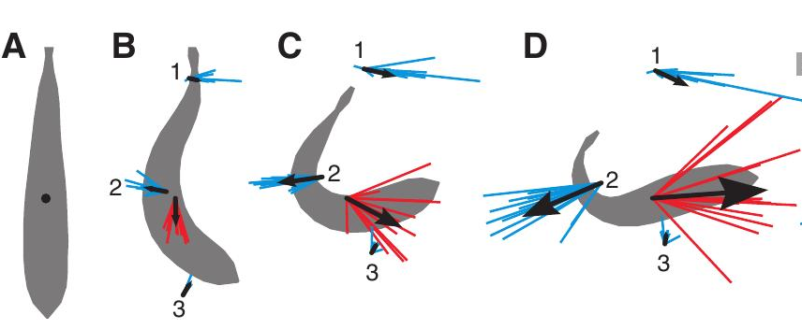
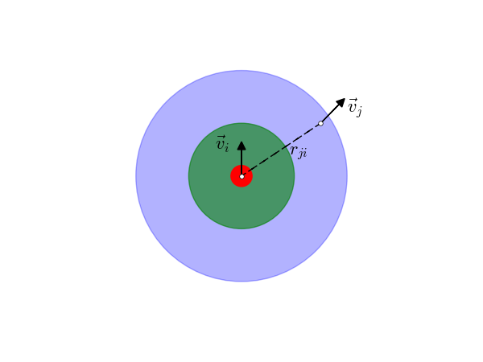
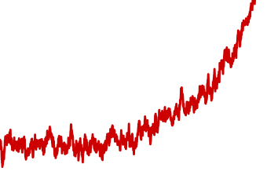
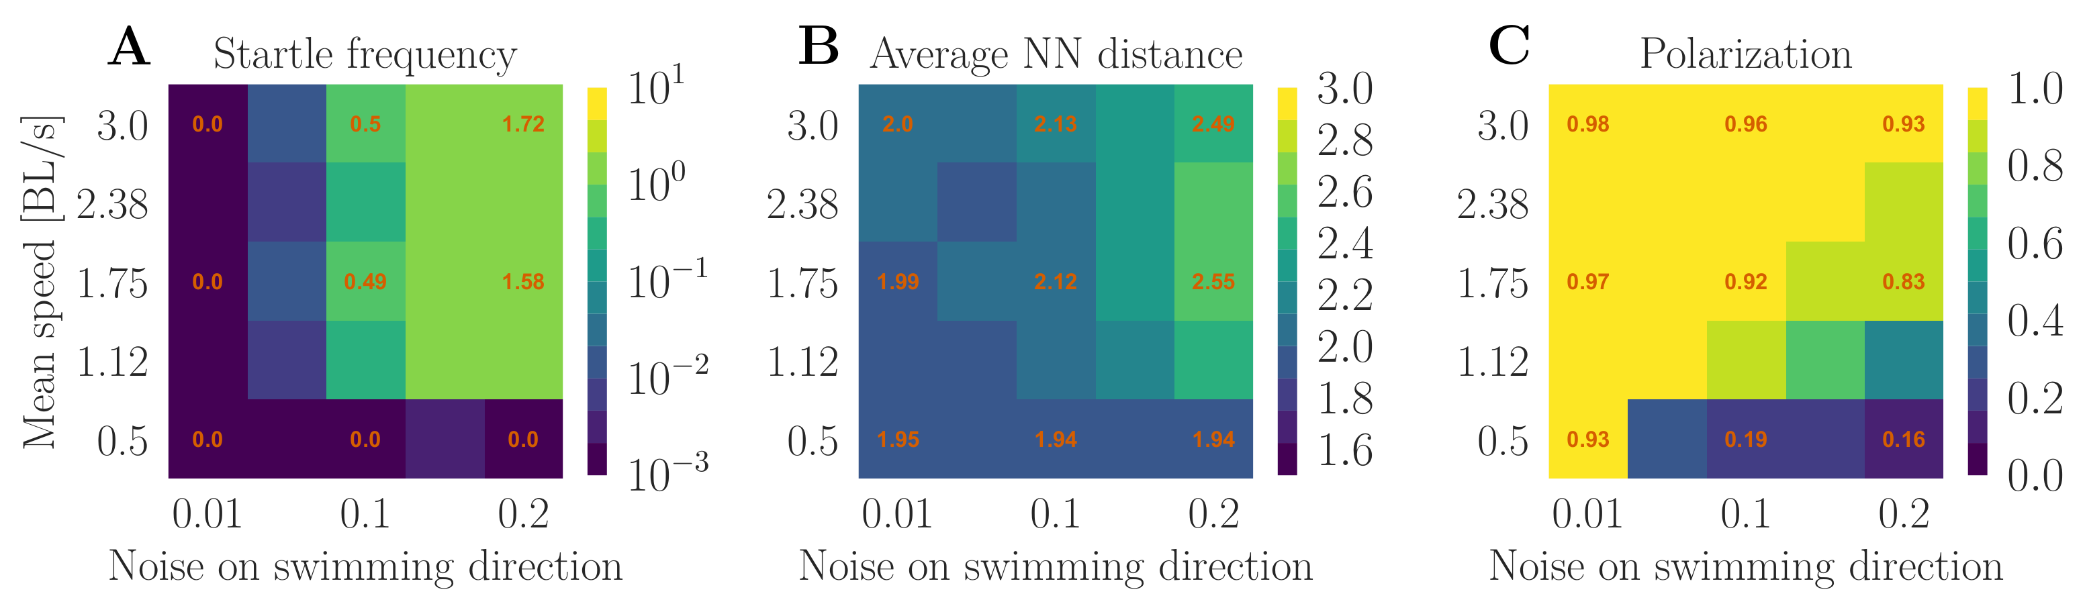
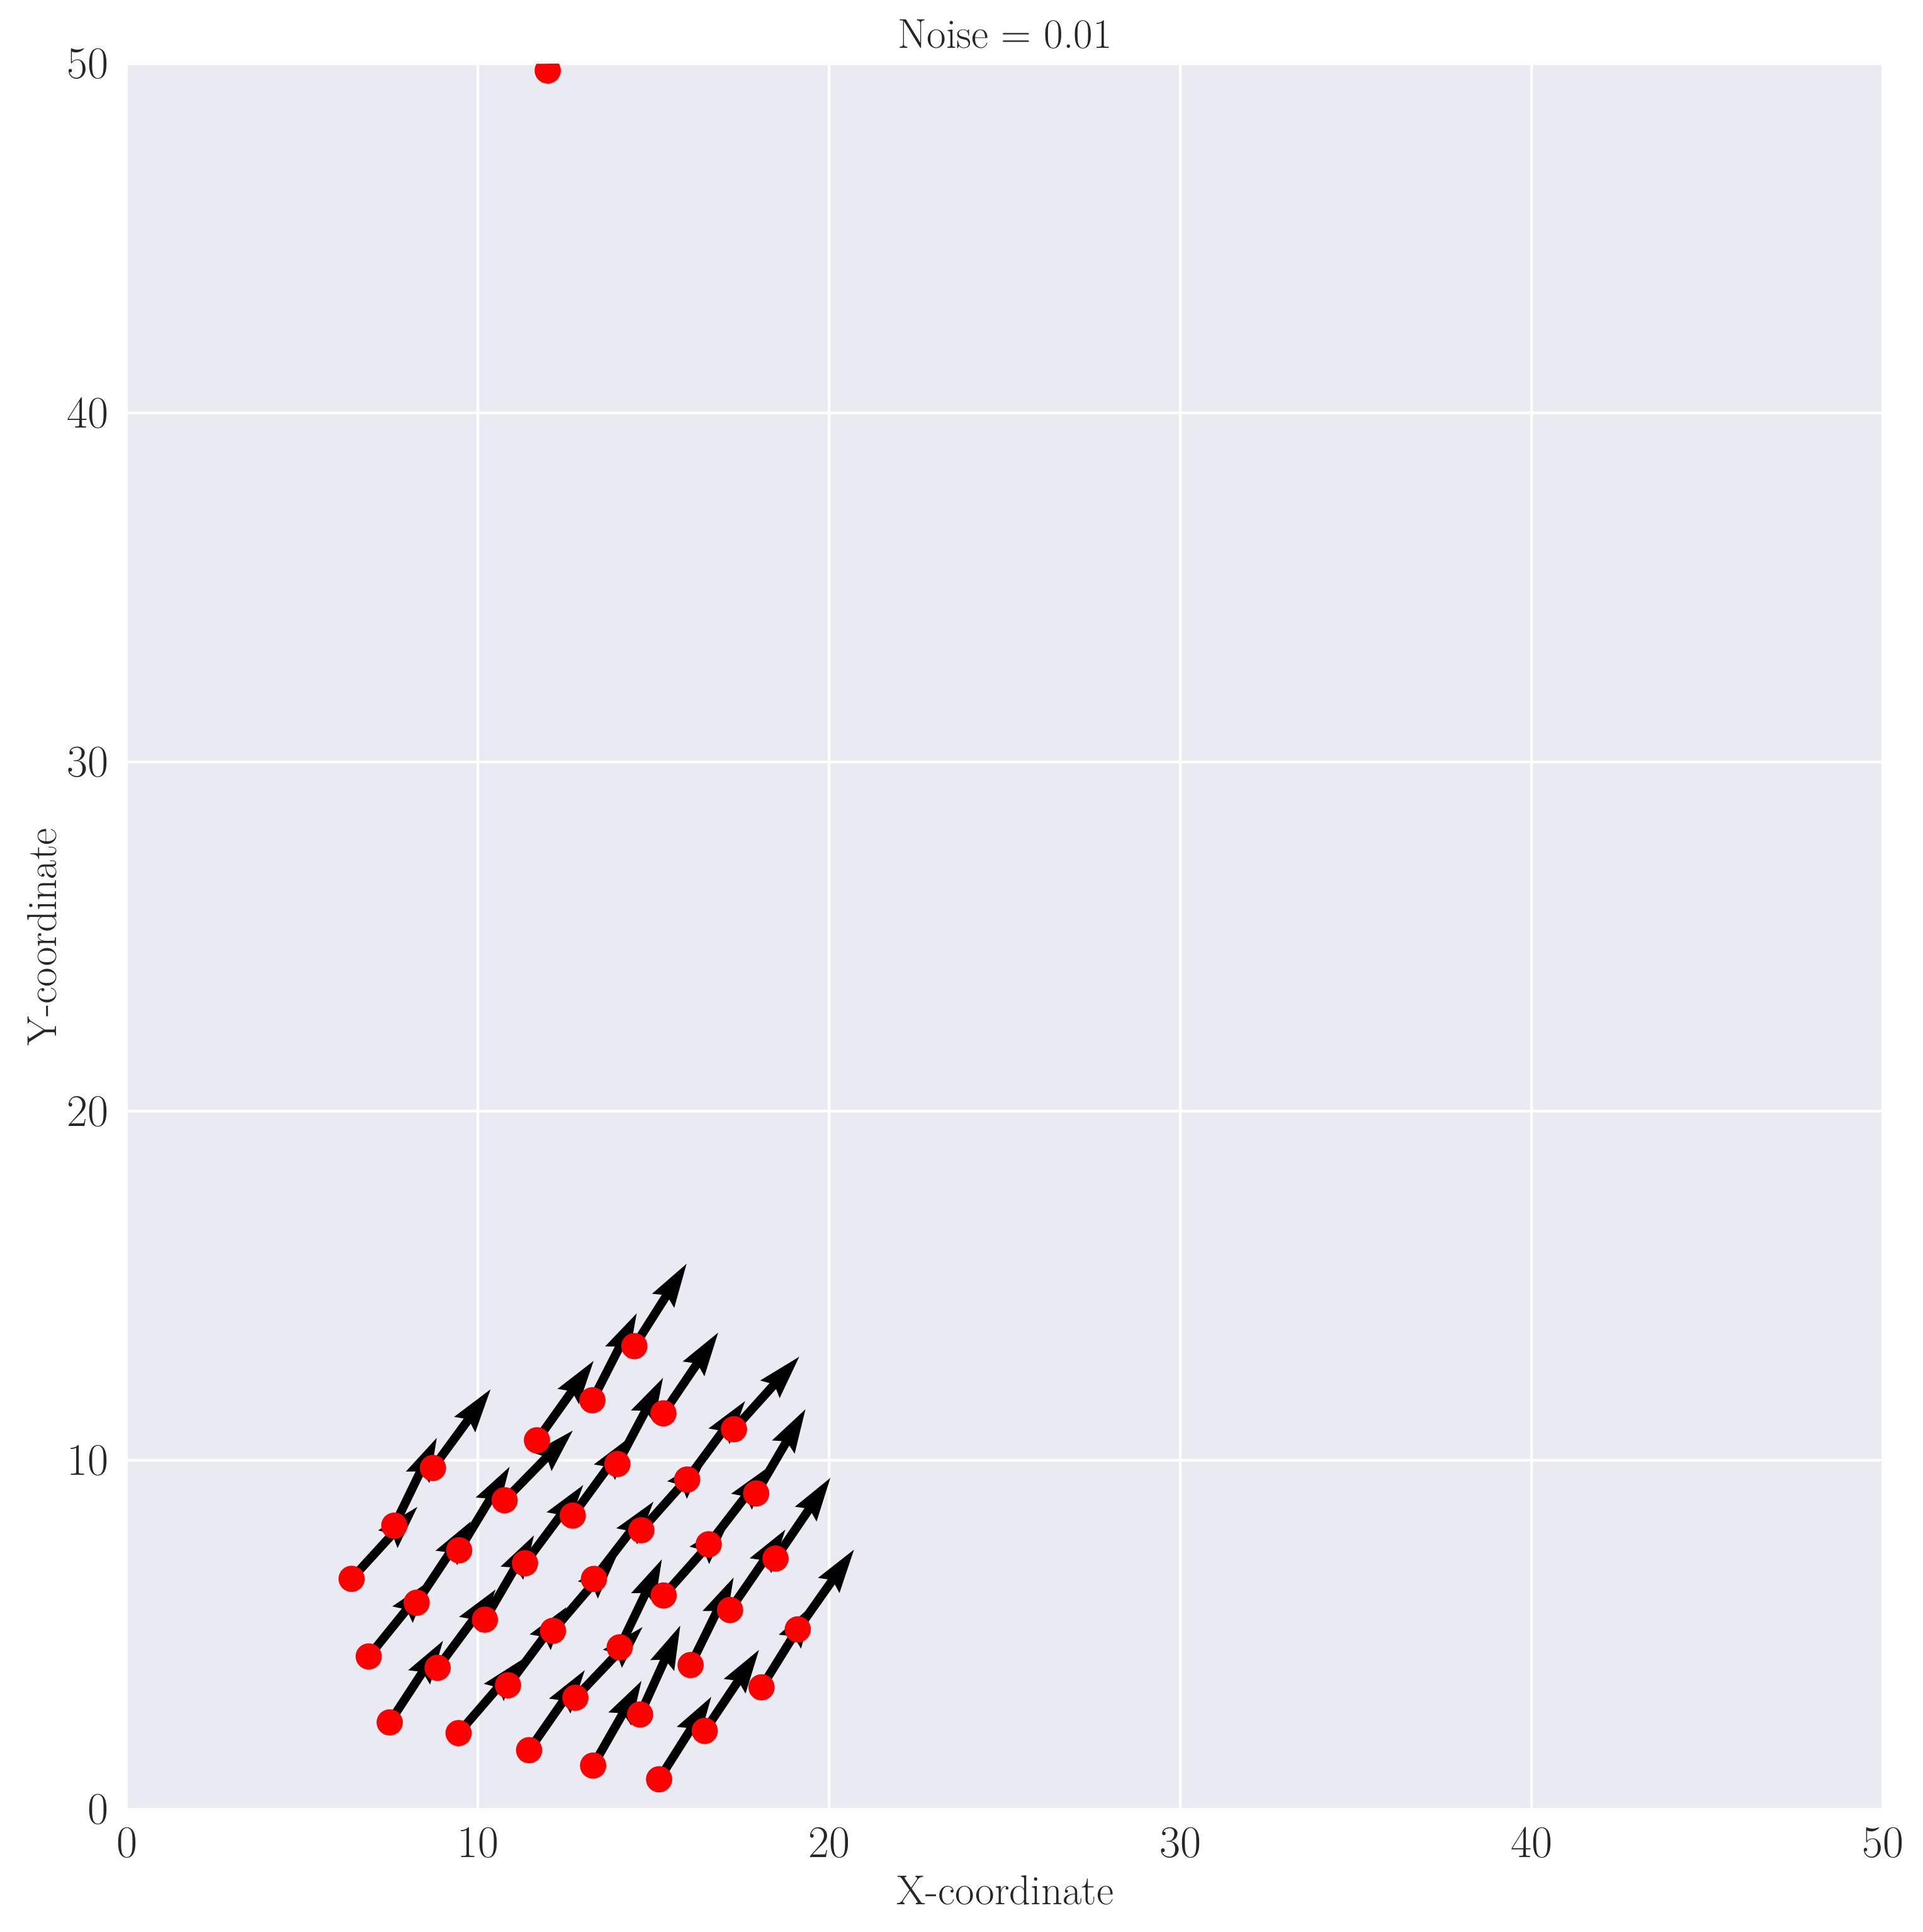
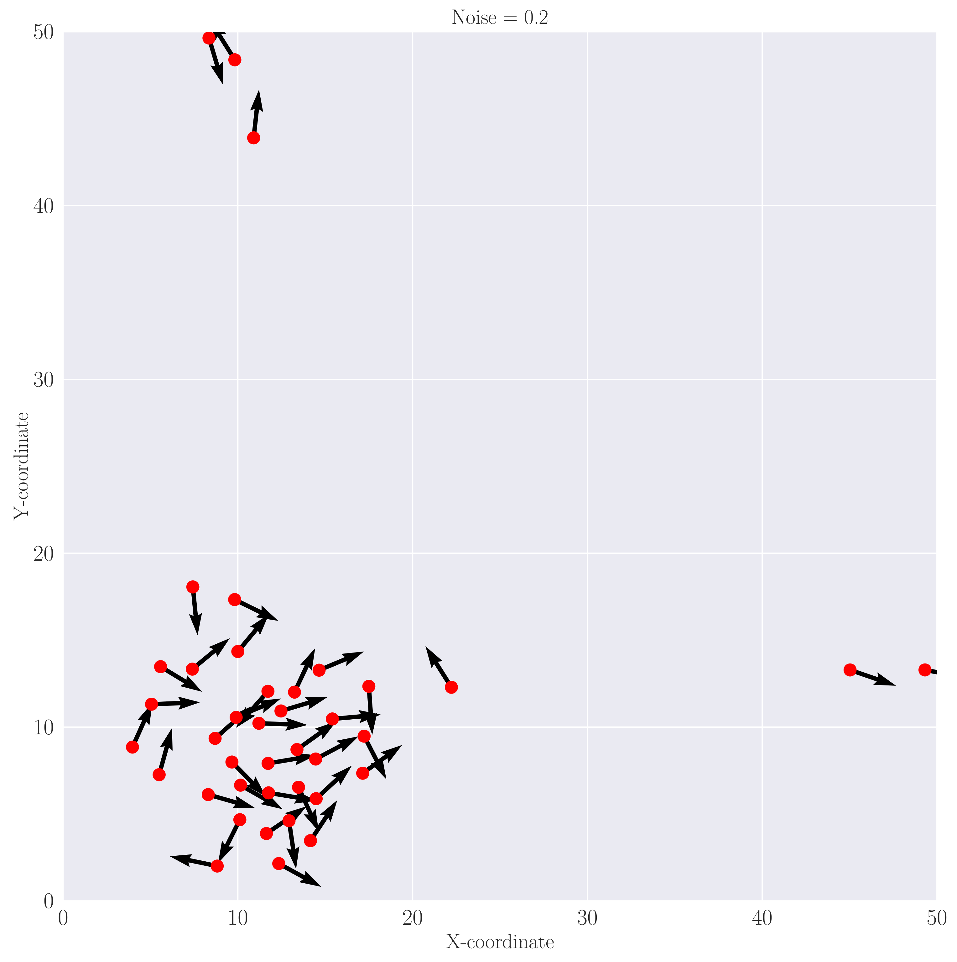
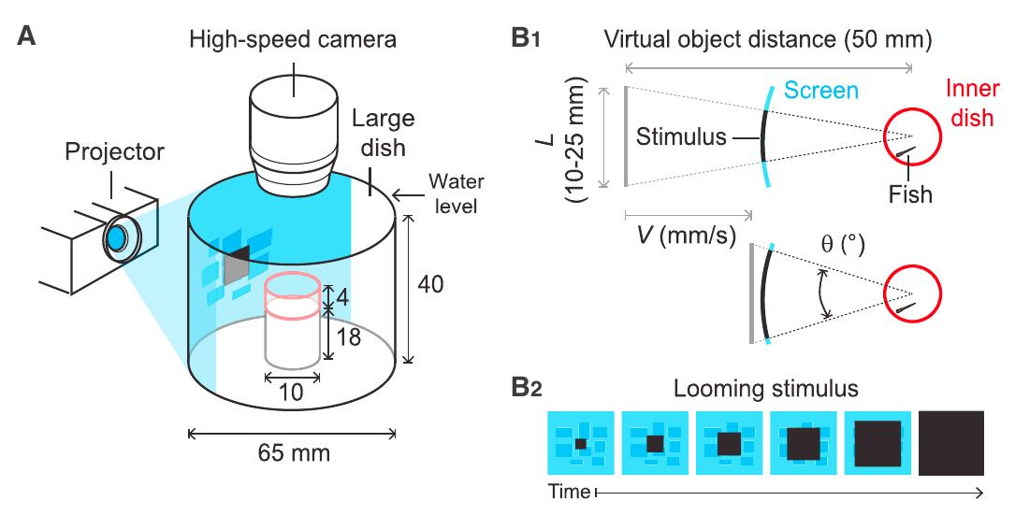
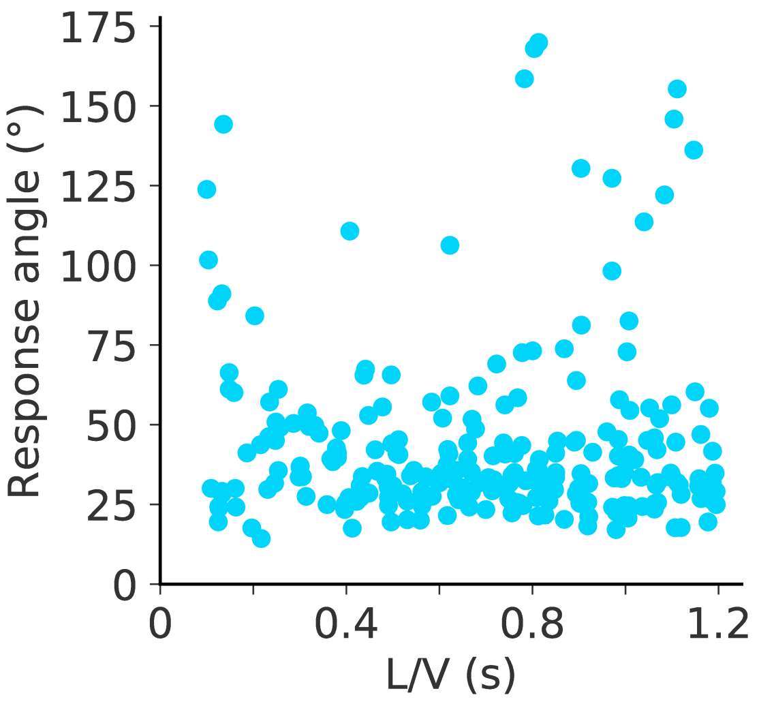
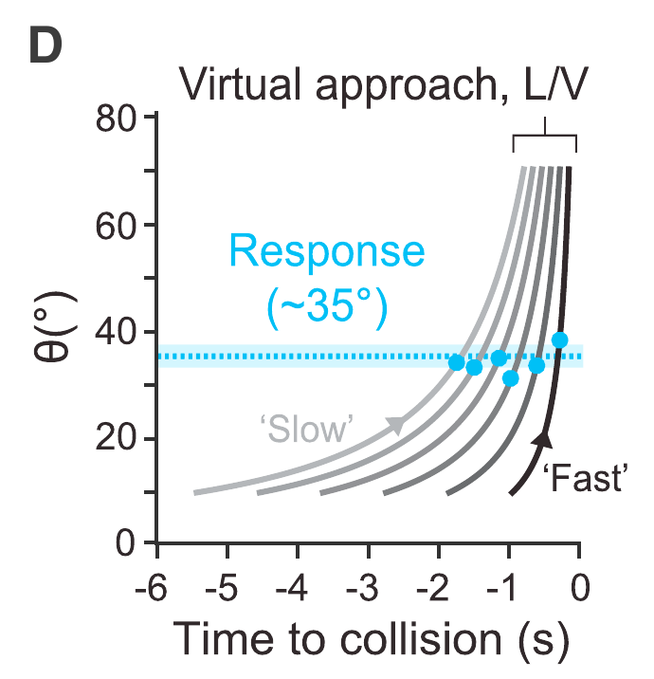
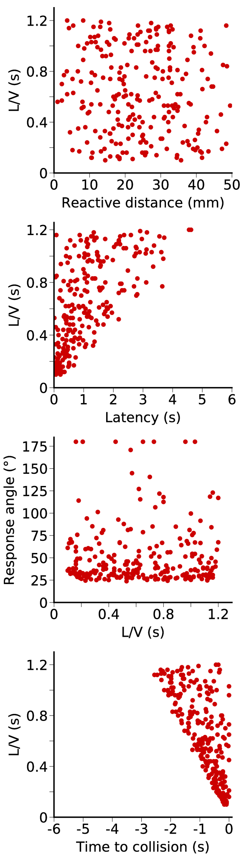
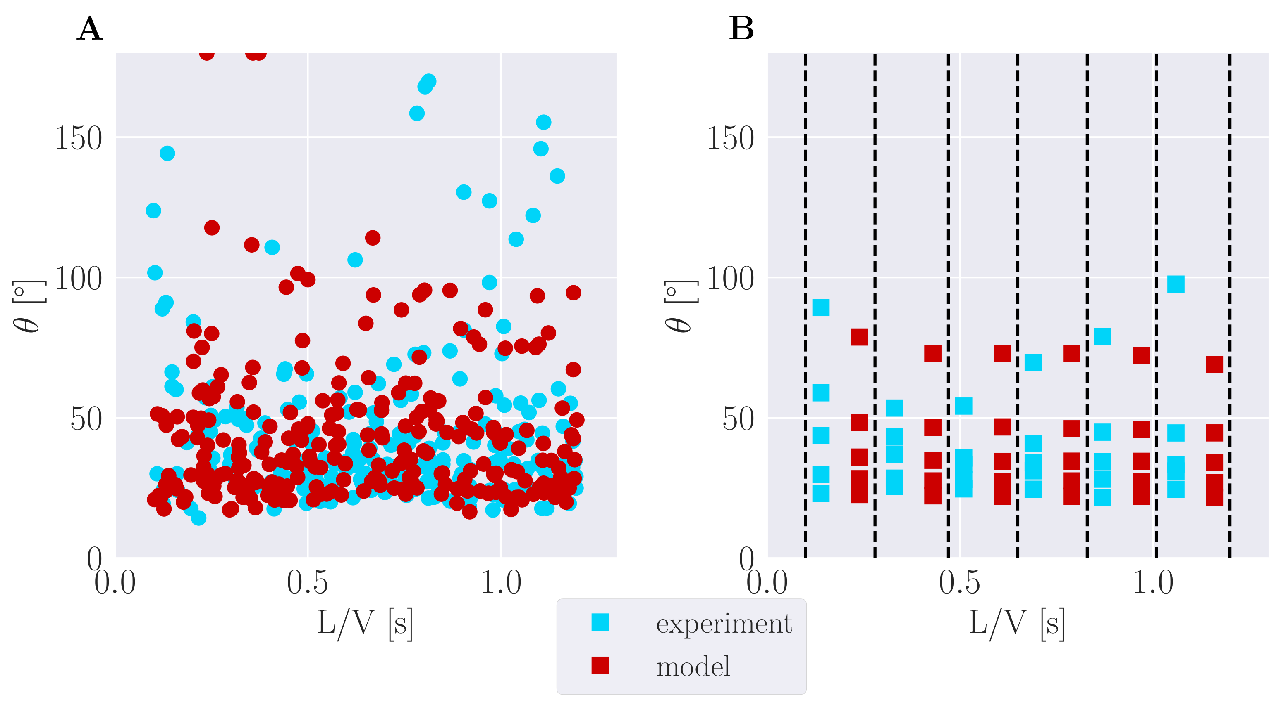
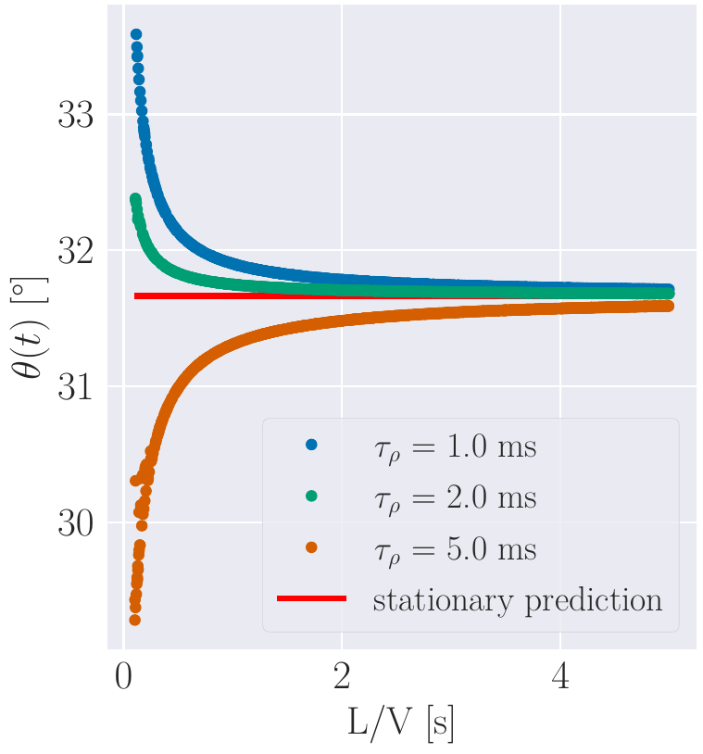
A neuronal model for visually evoked startle responses in schooling fish
Andrej Warkentin, Henning Sprekeler and Pawel Romanczuk
Institute of Theoretical Biology, Department of Biology, Humboldt Universität zu Berlin
Bernstein Center for Computational Neuroscience, Berlin
1 ) Introduction & Neuronal model
The Mauthner-cell (M-cell) circuit has been identified to be responsible for the startle response in fish but we still lack a mechanistic understanding
The startle response is known to spread in fish schools dependent on the network structure (Rosenthal et al. 2015 [1]).
Here we:
  Fitted a neuronal model that reproduces behavior in a visual looming stimulus experiment (Bhattacharyya et al. 2017 [2])
  Combine the neuronal model with a collective behavior model to explore the initiation of startles in a fish school
4) Collective behavior model
Goal: Simulate this
From
Rosenthal et al. 2015 [1]
Looming object
Startling:
Model:
θ₁
θ₂
From Tytell and Lauder 2008 [3]
Inh.
Neuronal model
M-cell
θ(t)
θ₂
Input:
Active brownian motion
+
Social forces
θ₁
Inh.
+
Startle mechanism
M-cell
Inhibitory population:
5) Collective behavior results
Spike threshold
M-cell membrane voltage:
V_{M}(t)
V_{M}(t)
Time
Response time
2) Fitted model reproduces experimental response angles
Using the instantaneous visual angle as input for the neuronal model we can reproduce the response angle distribution from experiments with larval zebrafish (Bhattacharyya et al. 2017 [2]).
Experiment
Model
V_{M}(t)
6) Discussion & Outlook
A simple neuronal model can reproduce response properties of fish in a looming stimulus experiment
We are able to combine the neuronal model with a individual-based collective behavior model in order to analyze startle initiation in fish schools
First results suggest that the polarization of the school determines the startle frequency but further investigation is needed
Outlook Neuronal Model:
How is the visual input related to the visual field of the fish?
What happens if more than one stimulus is present at the same time?
Can we also explain experimental response probabilities?
Outlook Collective Behavior Model:
Are startling frequency and polarization also correlated in a temporal manner?
How is the startling frequency related to the cohesion of the school?
Time
Fitting result
3) Model prediction
If the assumptions of our model are accurate, it predicts that faster stimuli than currently used in experiments would show larger deviations from the mean response angle of slower stimuli. How it deviates depends on the time constant of the inhibitory population activity.
7) References & Links
[1] Rosenthal et al. 2015, PNAS, 112:4690–4695, doi:10.1073/pnas.1420068112
[2] Bhattacharyya et al. 2017, Current Biology, 27 (18):2751 – 2762.e6, doi:10.1016/j.cub.2017.08.012
[3] Tytell and Lauder 2008, J. of Exp. Biology, 211(21):3359–3369, doi:10.1242/jeb.020917.
Github repository: https://github.com/awakenting/master-thesis

