Slide 1

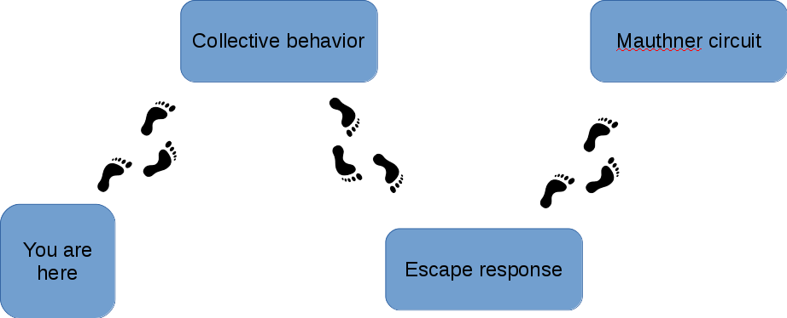
Collective behavior
Mauthner circuit
You are
here
Escape response

