Slide 1

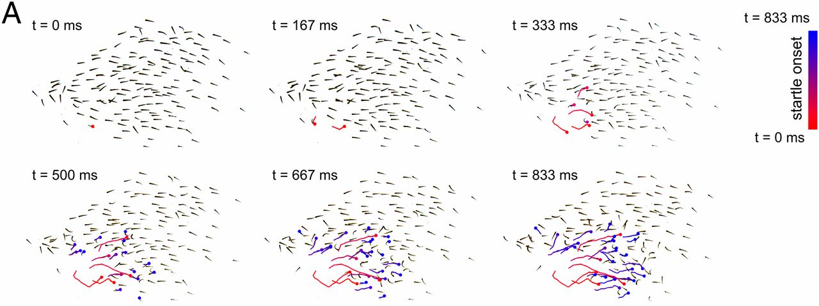
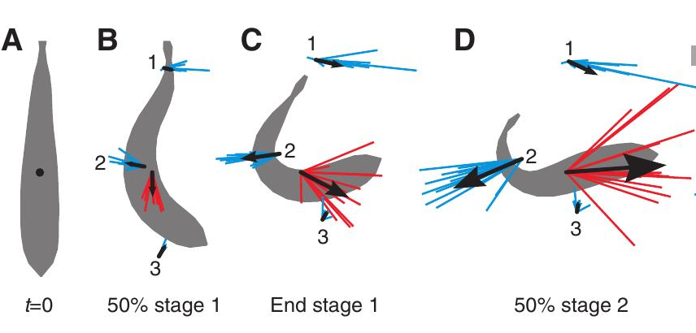
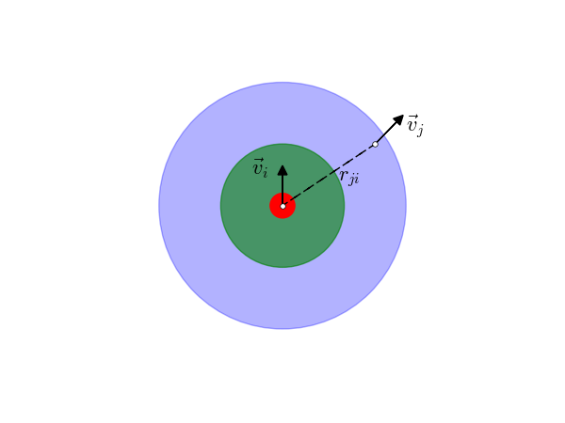
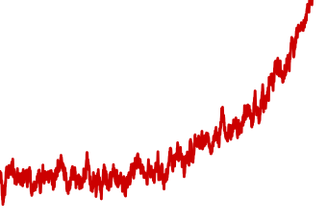
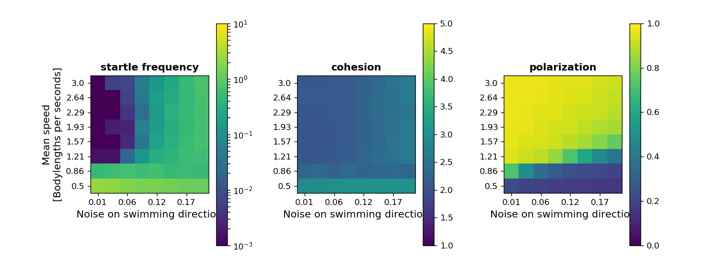
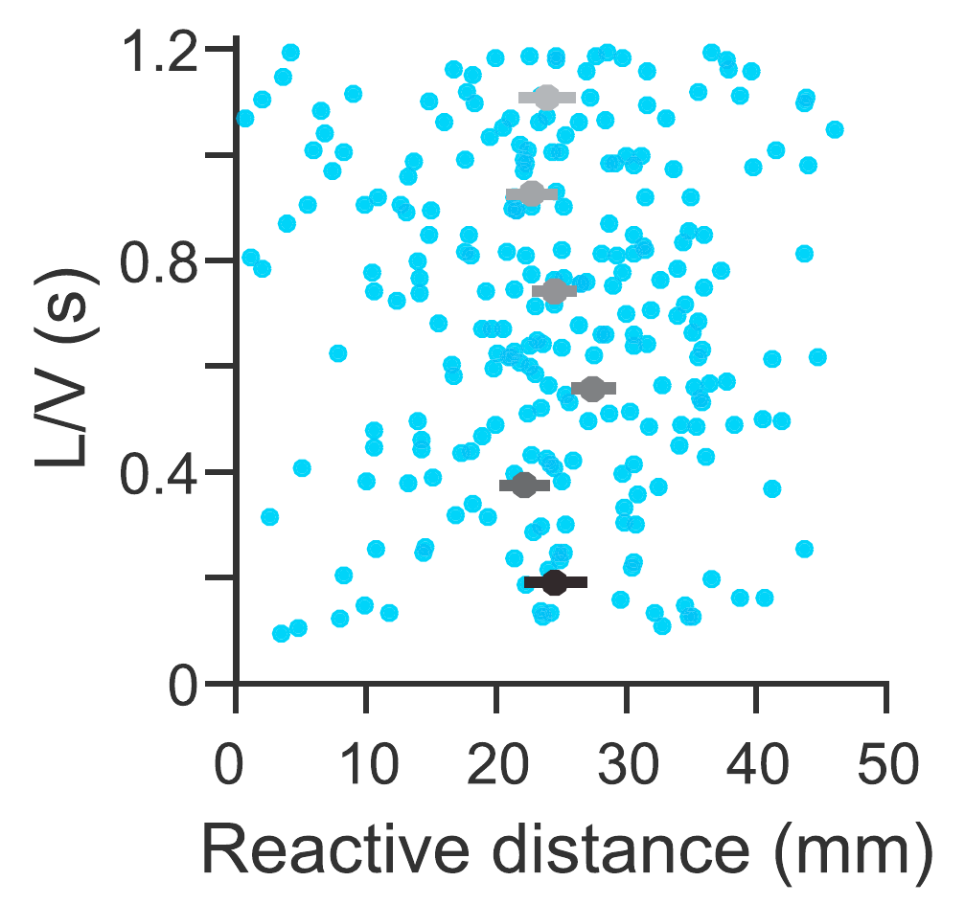
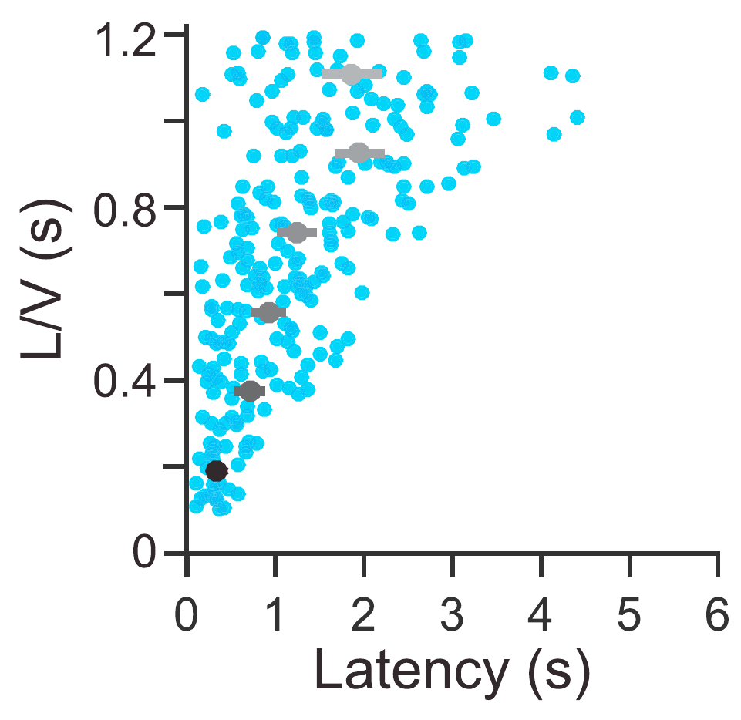
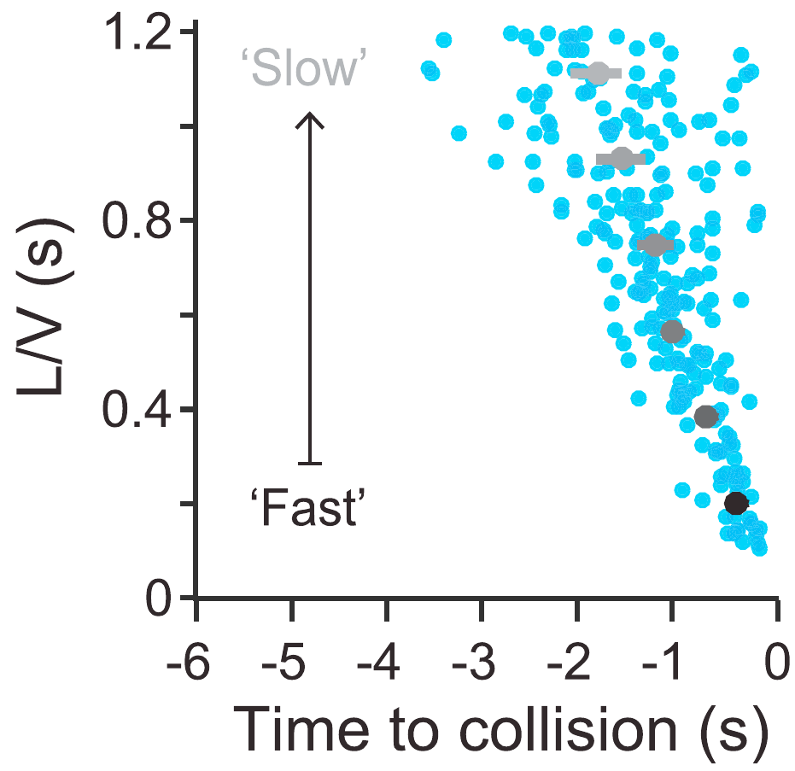
Neuronal model for startling coupled with a collective behavior model
Andrej Warkentin and Pawel Romanczuk
Institute of Theoretical Biology, Department of Biology, Humboldt Universität zu Berlin
Bernstein Center for Computational Neuroscience, Berlin
1 ) Introduction
The Mauthner-cell (M-cell) circuit has been identified to be responsible for the startle response in fish but we still lack a mechanistic understanding
The startle response is known to spread in fish schools dependent on the network structure (Rosenthal et al. 2015 [1]).
Here we:
  Find a neuronal model that reproduces behavior in a visual looming stimulus experiment (Bhattacharyya et al. 2017 [2])
  Combine the neuronal model with a collective behavior model to explore the initiation of startles in a fish school
3) Collective behavior model
Goal: Simulate this
Startle response:
From
Rosenthal et al. 2015 [1]
Looming object
Brownian motion
+
Social forces
+
Startle mechanism
From Tytell and Lauder 2008 [3]
θ₁
θ₂
Neuronal model
Inh.
θ(t)
Input:
M-cell
θ₂
Inh.
θ₁
M-cell
Inhibitory population:
Spike threshold
M-cell membrane voltage:
4) Collective behavior results
V_{M}(t)
Time
Response time
2) Neuronal model reproduces experimental response properties
Using the instantaneous visual angle as input for the neuronal model we can reproduce the patterns of response distance, time and time-to-collision as well as the response angle that were found in an experiment with different approach speeds of a looming stimulus (Bhattacharyya et al. 2017 [2]).
Experiment
Model
5) Dicussion
5) References & Links
[1] Rosenthal et al. 2015, PNAS
[2] Bhattacharyya et al. 2017, Current Biology
[3] Tytell and Lauder 2008, J. of Exp. Biology
Github repository: https://github.com/awakenting/master-thesis

