Slide 1
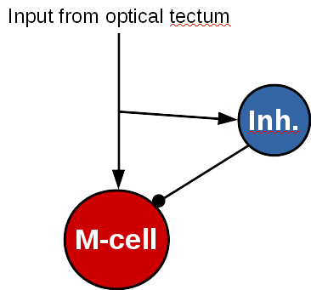
Looming object
θ₁
θ₂
θ(t)
θ₂
θ₁

