Slide 1
Generating Personalized Emails with GPT-2
This project aims to leverage the power of natural language processing and the distilGPT-2 pre-trained model to generate personalized emails based on a target user profile. The goal is to create an effective communication tool that can help establish connections on platforms like LinkedIn.
Group O: Yun Cao, Yue Liu, Muyang Cheng, Nan Chen

Slide 2
Leveraging the Power of AI
Task
Text Generation
Motivation
Establish connections on LinkedIn
Model
postbot/distilgpt2-emailgen-V2
Dataset
LightTai/personalized-email
Libraries
Transformers, datasets, torch, scikit-learn, accelerate

Slide 3

Potential Challenges
1
Small Dataset
2
Training Time
The provided dataset only contains 30 samples, which may not be enough to train the model effectively. Exploring additional datasets may be necessary.
The model training process could be time-consuming, especially with a limited dataset. Efficient training strategies and techniques may be required.
3
Evaluation Criteria
Determining the right criteria to assess the quality and effectiveness of the generated emails is crucial for this project.

Slide 4
Limitations and Biases
Dataset Bias
Ethical Concerns
Model Capabilities
The dataset only contains information about the target user, but a good cold email should involve the sender, receiver, and their relationship. This limited scope may impact the model's ability to generate realistic and engaging emails.
The generated emails could potentially be misused for spam or phishing activities, which raises ethical considerations. Ensuring the responsible use of the model is crucial.
While the distilGPT-2 pre-trained model is powerful, it may not be sufficient for the task at hand. Exploring other language models or fine-tuning techniques could help improve the model's performance.

Slide 5
Goal on Next Week
Finish the 1st edition of model and space development.
Find a proper criteria on analyzing the model.
Analyze results and ensure final outputs.

Slide 6
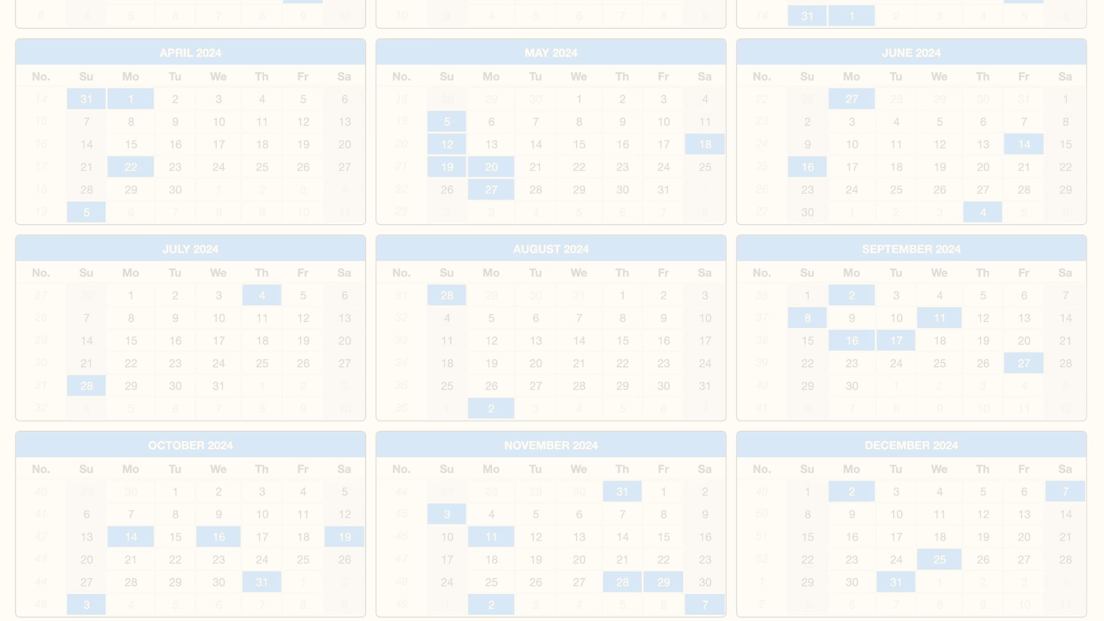
Development Timeline
April 11
1
Complete the model training and test it manually.
2
April 12
Search and discuss the criteria for evaluating the generated emails.
April 13
3
Update the model to the Hub and write the first README.
4
April 15
Develop a Space and share it online.
April 16
5
Discuss recent status, roadblocks, estimate the results in the final week, and update the timeline.

