Slide 1
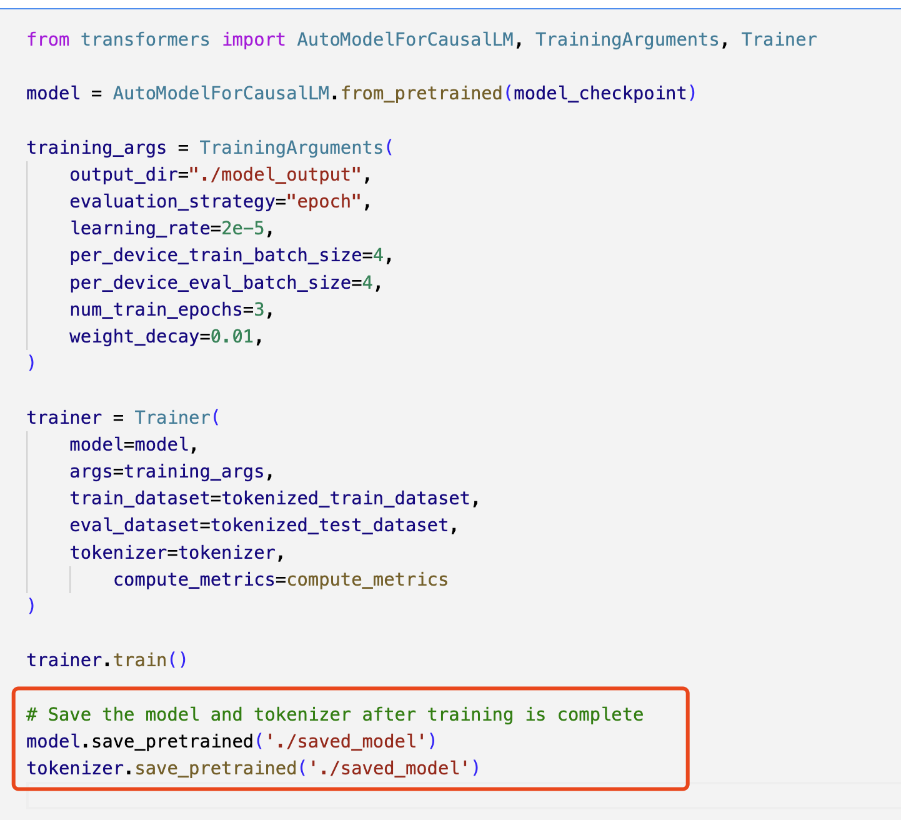

Save and Load Model

Slide 2

Parameters

Slide 3



Comparison of Results

