Slide 1
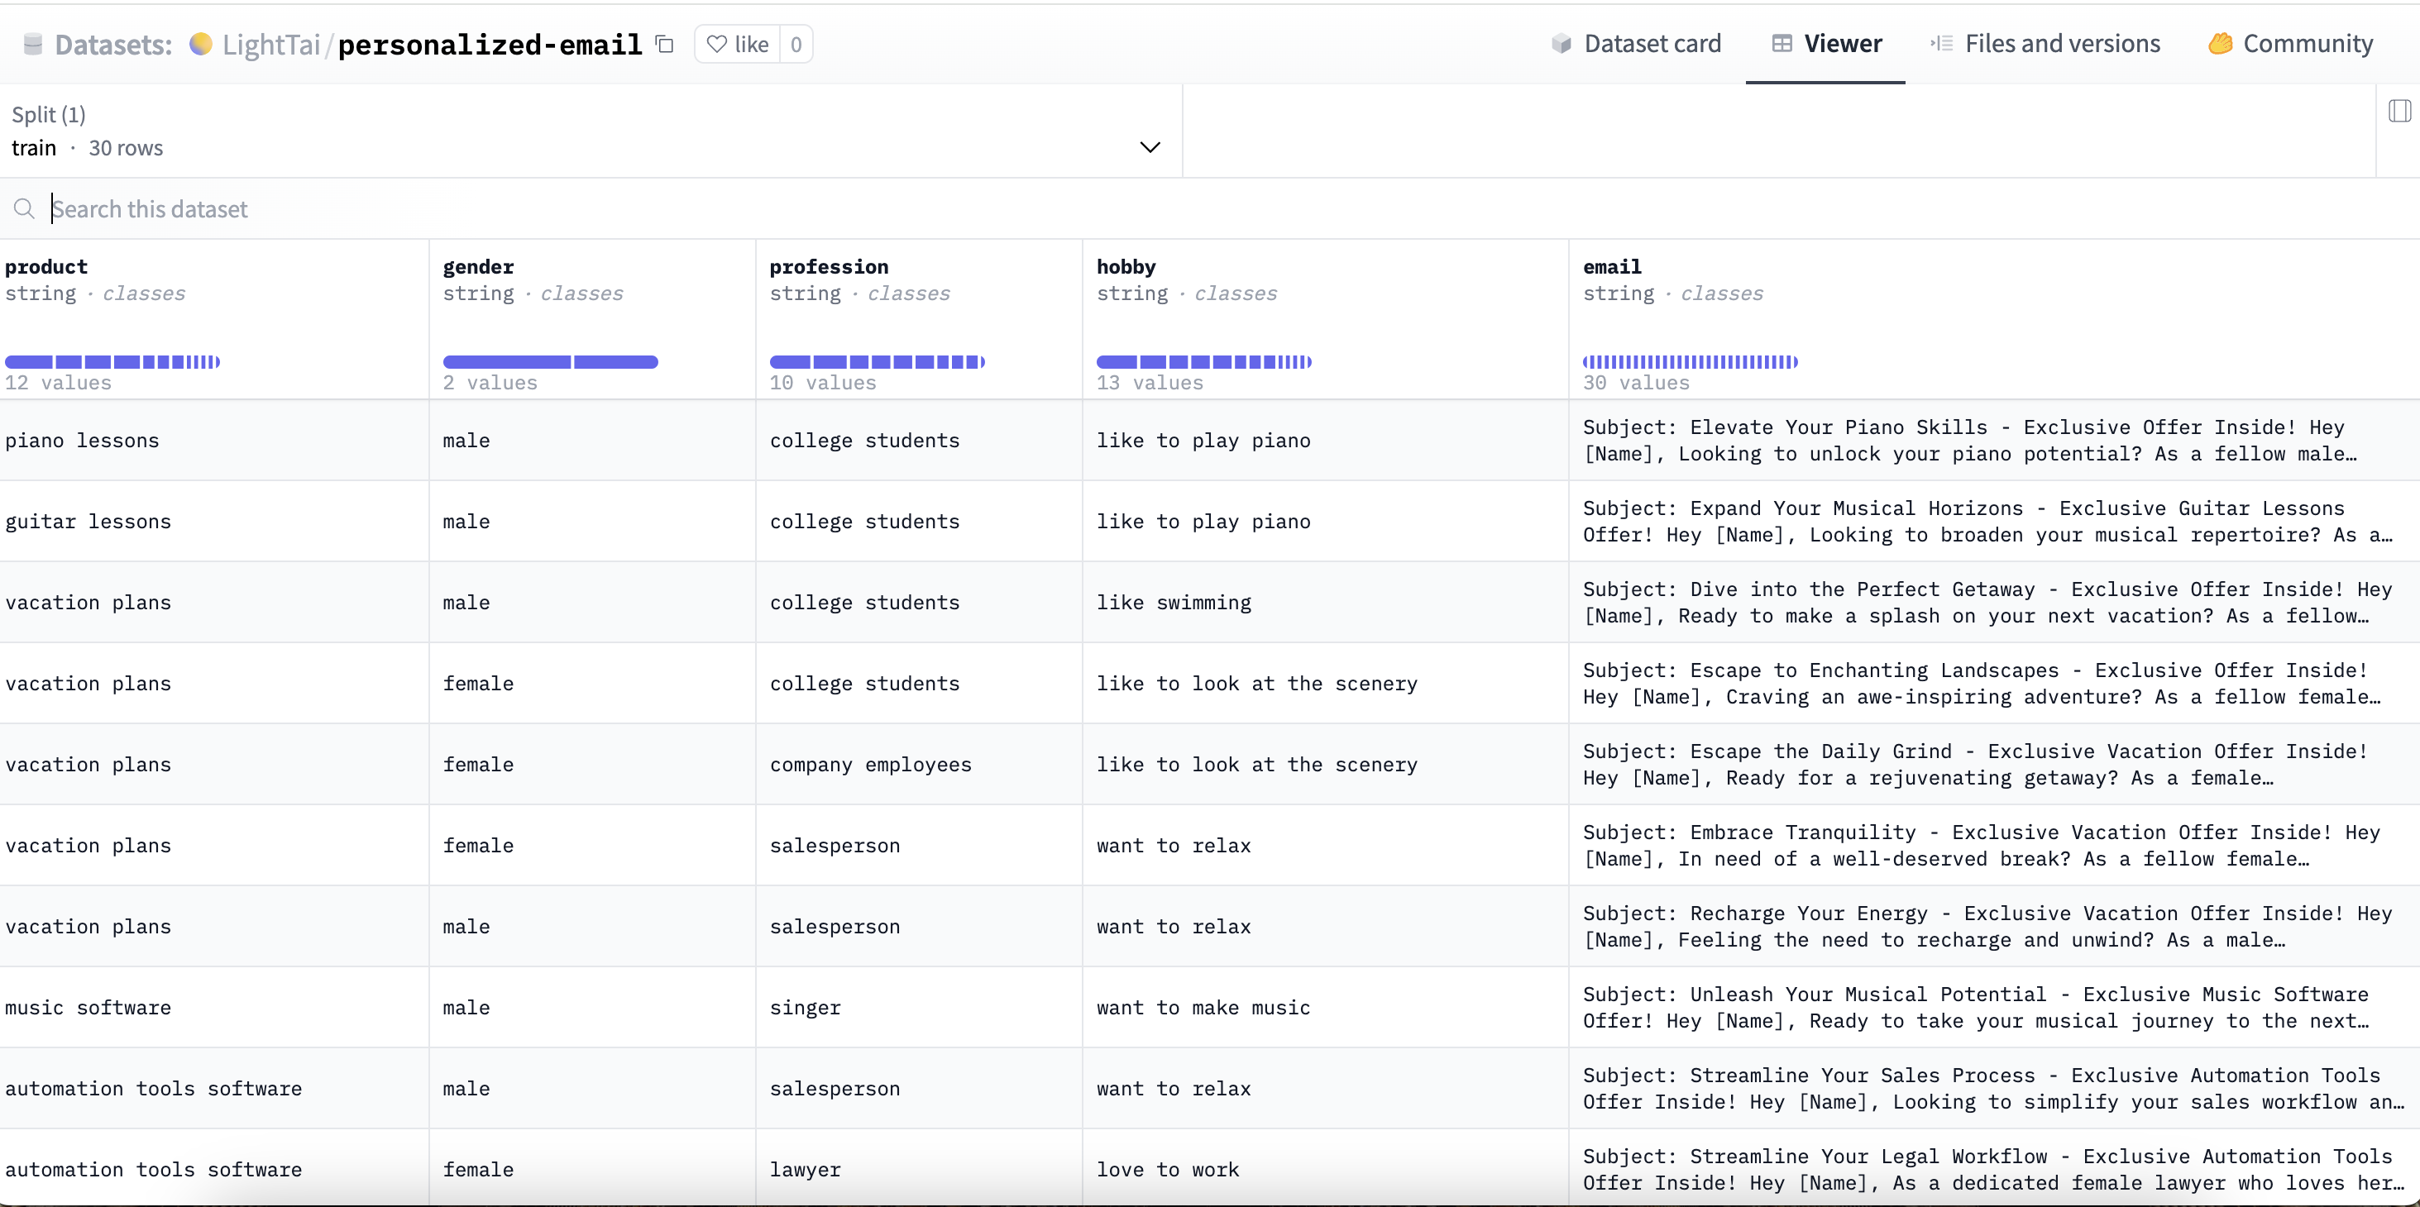
Model
Data Analysis

Slide 2
Model
NLP Methodology and Techniques Employed
Tokenization and Text Processing: Use the AutoTokenizer from the transformers library to tokenize input data, which is crucial for processing text in a format suitable for NLP models.
Dataset Handling: Employs the datasets library to load and manage datasets, converting datasets to Pandas tables for easier handling and then back to the dataset format after preprocessing for training.
Neural Network Modeling: Use AutoModelForCausalLM from the transformers library to load a pretrained causal language model specifically designed for generating sequences of text.
Evaluation Metrics: Implements evaluation metrics using the evaluate library (specifically the rouge metric), which is widely used to assess the quality of text generation against reference texts. This is critical for understanding model performance in generative tasks.

Slide 3
Model
Transfer Dataset to Model Tokenize
Loading Pre-trained Model Tokenizer: An AutoTokenizer is loaded with a specified pre-trained model checkpoint. The tokenizer is a crucial tool that converts text data into a format that can be processed by machine learning models.
Tokenization Function: The tokenize function is defined to tokenize the inputs. It takes examples from the dataset and pulls the product, gender, profession, and hobby columns. These columns are tokenized, meaning they are converted into a sequence of numbers that represent the text in a way the model can understand.
Processing the Dataset: The dataset is split into a training set and a test set with a 50/50 split. The original Data Frame is then converted into a Dataset object, which is a more efficient format for handling datasets in machine learning workflows.
Tokenizing the Dataset: The actual tokenization process happens where the training and test sets are mapped with the tokenize function. This means that all the text data in these datasets is converted into tokens.

Slide 4
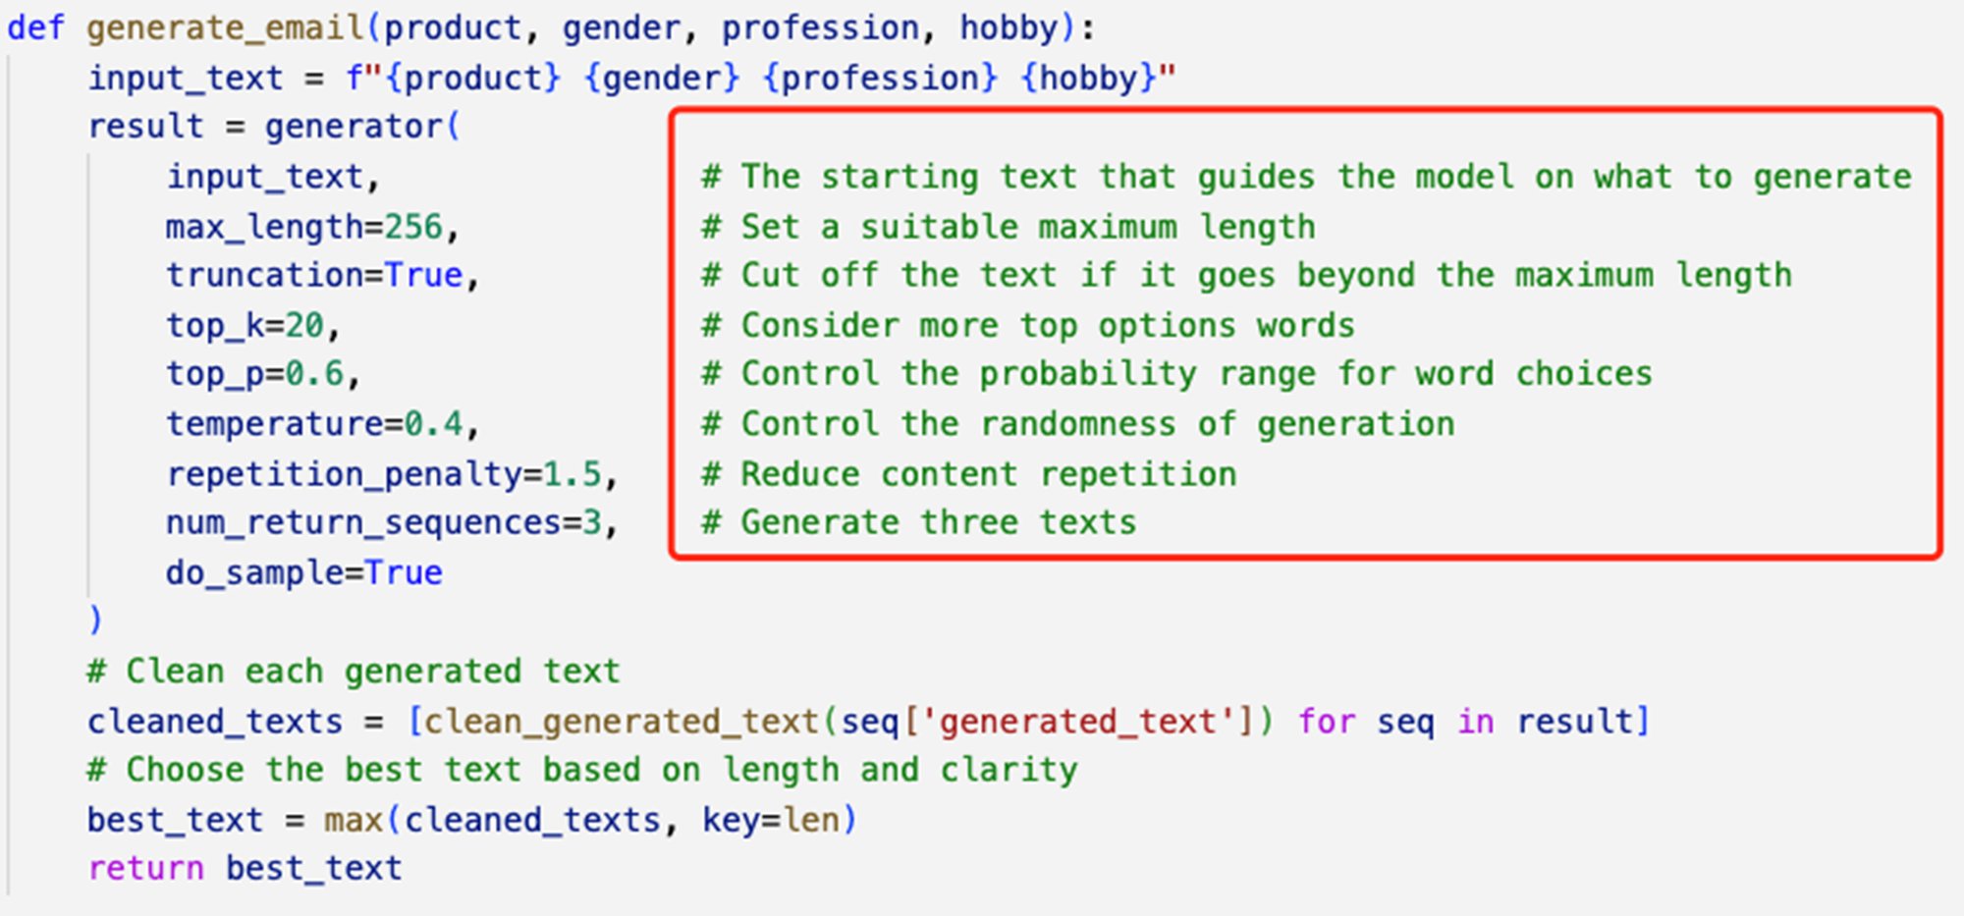
Model
Parameters

