Slide 1
Target Email
Email from the database.
Subject: Elevate Your Piano Skills - Exclusive Offer Inside! Hey [Name], Looking to unlock your piano potential? As a fellow male college student and a passionate piano player, I understand your love for music. That's why I'm thrilled to offer you exclusive piano lessons designed to fit your busy student schedule. Master your favorite melodies, refine techniques, and gain a deeper understanding of music theory-all while enjoying a flexible lesson plan tailored to your goals. Let's embark on this musical journey together! Limited slots available, so act fast! Reply now for more details and an irresistible offer. Keep playing and shining! [Your Name]
Email Generated By GPT 3.5
Translated Twice By DEEPL
Title
X

Slide 2
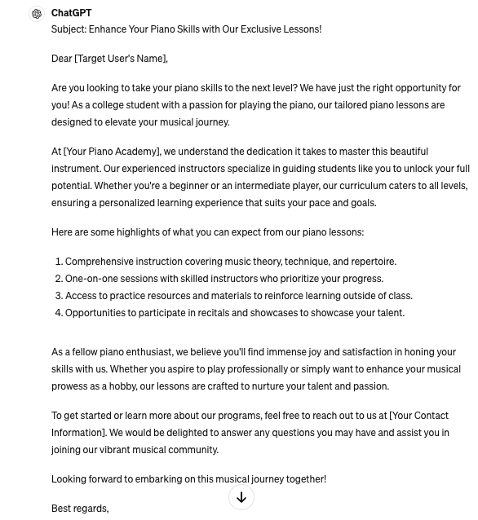
Target Email
Email Generated By GPT 3.5
Translated Twice By DEEPL
Title
X

Slide 3
Target Email
Translated Target Email from English to Chinese, then
translated Chinese result to English
Subject Boost your piano skills - exclusive insider discount! Hey [name], want to unleash your piano potential? As a male college student and a passionate piano player, I understand your love for music. That's why I'm excited to offer you exclusive piano lessons to fit your busy student schedule. Master your favorite melodies, perfect your technique, and gain a deeper understanding of music theory while enjoying a flexible lesson plan tailored to your goals. Let's embark on a musical journey together! Places are limited, so sign up soon! RSVP now for more details and irresistible offers. Keep playing and shine! [your name]
Email Generated By GPT 3.5
Translated Twice By DEEPL
Title
X

Slide 4
Target Email
Only keep the target email title
Email Generated By GPT 3.5
Subject: Elevate Your Piano Skills - Exclusive Offer Inside!
Translated Twice By DEEPL
Title
X

Slide 5
Target Email
Email Generated By GPT 3.5
X
Translated Twice By DEEPL
Title
X

Slide 6
BLEU
Bilingual Evaluation Understudy
Purpose: BLEU is a metric for evaluating a machine-translated text compared to one or more reference translations. It quantifies how close the machine translation is to human translation.
Methodology: BLEU assesses the quality of translation by calculating the precision of matched n-grams (a sequence of 'n' words) between the machine-generated text and the reference texts. It also incorporates a brevity penalty to discourage overly short translations.
Usefulness: Widely used in natural language processing, BLEU provides a quick and effective way to measure the performance of text translation models, helping developers improve and refine translation systems.
Limitations: While BLEU is popular, it has limitations. It primarily focuses on lexical similarity rather than meaning and doesn't account for grammatical structure or semantic coherence.
 | BLEU | BERT | ROUGE
Target | 1.0 | 1.0 | 1.0
GPT3.5 | 0.052389 | 0.843668 | 0.316623
Translated Twice | 0.564568 | 0.96876 | 0.819048
Title | 0.000041 | 0.954038 | 0.140351
X | 0.0 | 0.774057 | 0.0

Slide 7
BERT
Bidirectional Encoder Representations from Transformers
Purpose: BERT is a groundbreaking model in natural language processing that revolutionized how machines understand human language. It uses deep learning to interpret the context of words in a sentence more effectively than previous models.
Methodology: Unlike traditional text analysis models that read text linearly (left-to-right or right-to-left), BERT reads text bidirectionally. This approach allows it to capture the context from both directions, providing a richer understanding of language.
Usefulness: BERT has significantly improved the performance of various NLP tasks such as question answering, sentiment analysis, and language inference. It is also used as a base for further fine-tuning in specific language tasks, enhancing its adaptability and effectiveness.
Limitations: While highly effective, BERT requires substantial computational resources for training and inference, making it challenging to deploy on devices with limited hardware capabilities.
 | BLEU | BERT | ROUGE
Target | 1.0 | 1.0 | 1.0
GPT3.5 | 0.052389 | 0.843668 | 0.316623
Translated Twice | 0.564568 | 0.96876 | 0.819048
Title | 0.000041 | 0.954038 | 0.140351
X | 0.0 | 0.774057 | 0.0

Slide 8
ROUGE
Recall-Oriented Understudy for Gisting Evaluation
Purpose: ROUGE is a set of metrics used to evaluate automatic summarization of texts as well as machine translation. It measures the quality of a summary by comparing it to one or more reference summaries.
Methodology: ROUGE focuses on the overlap of n-grams, word sequences, and word pairings between the system-generated summary and the reference summaries. It uses measures like recall, precision, and F1-score to assess this overlap, emphasizing the importance of content matching.
Usefulness: ROUGE is extensively used in research to validate the effectiveness of summarization algorithms. It helps developers fine-tune their systems, ensuring the summaries capture essential information accurately and concisely.
Limitations: Despite its widespread use, ROUGE has limitations. It primarily assesses content overlap rather than the quality of the language or the coherence and structure of the summary, potentially overlooking the readability or grammatical correctness.
 | BLEU | BERT | ROUGE
Target | 1.0 | 1.0 | 1.0
GPT3.5 | 0.052389 | 0.843668 | 0.316623
Translated Twice | 0.564568 | 0.96876 | 0.819048
Title | 0.000041 | 0.954038 | 0.140351
X | 0.0 | 0.774057 | 0.0

Slide 9
Eval Loss and Rouge Metrics
Final perplexity: 14.17

