Slide 1
Now I will introduce our development in hugging face. In the hugging face, we Create organization for our team, and then we uploaded the model we trained and create an streamlit app in the space to leverage the model, it is an easy interactive user interface , but it takes over three miniutes to finish running the model in the space, so we have some screen shots to demo this.
start the app, it will show an input container, and a "clear" button.
in input container, user input product/gender/profession/hobby, and then click "submit" button,
wait for miniutes,
it will show another output container which shows both the user input and the email generated by the model,
then click "clear" button, it will clear the output container,
user can retry.

Slide 2
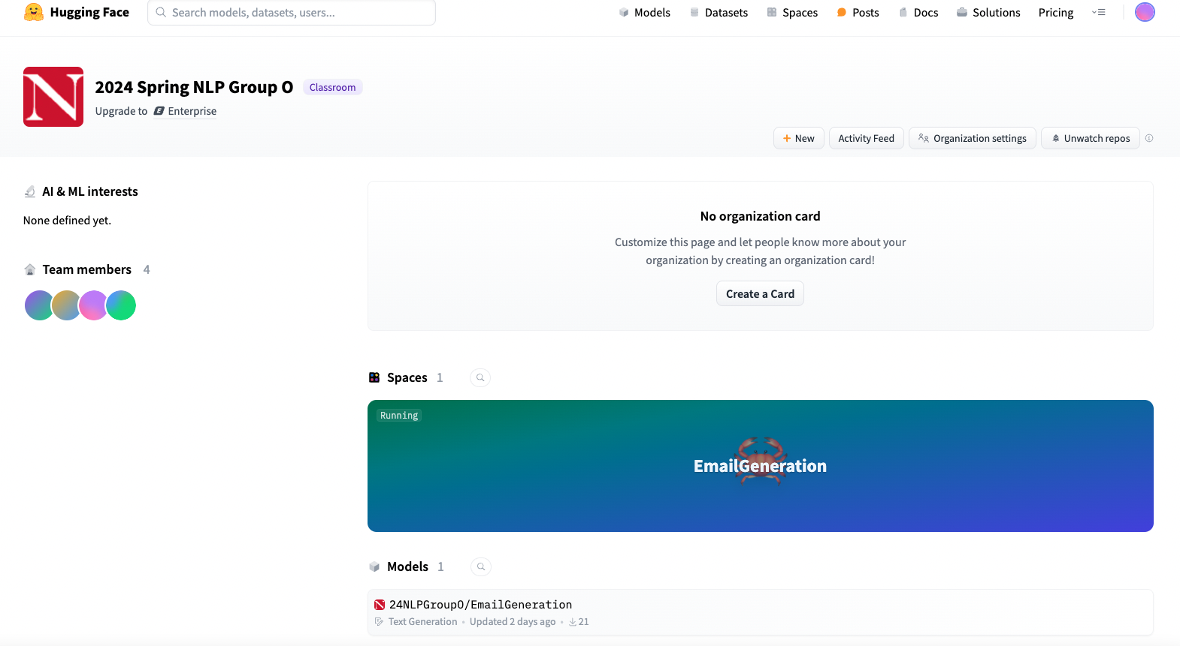

Slide 3
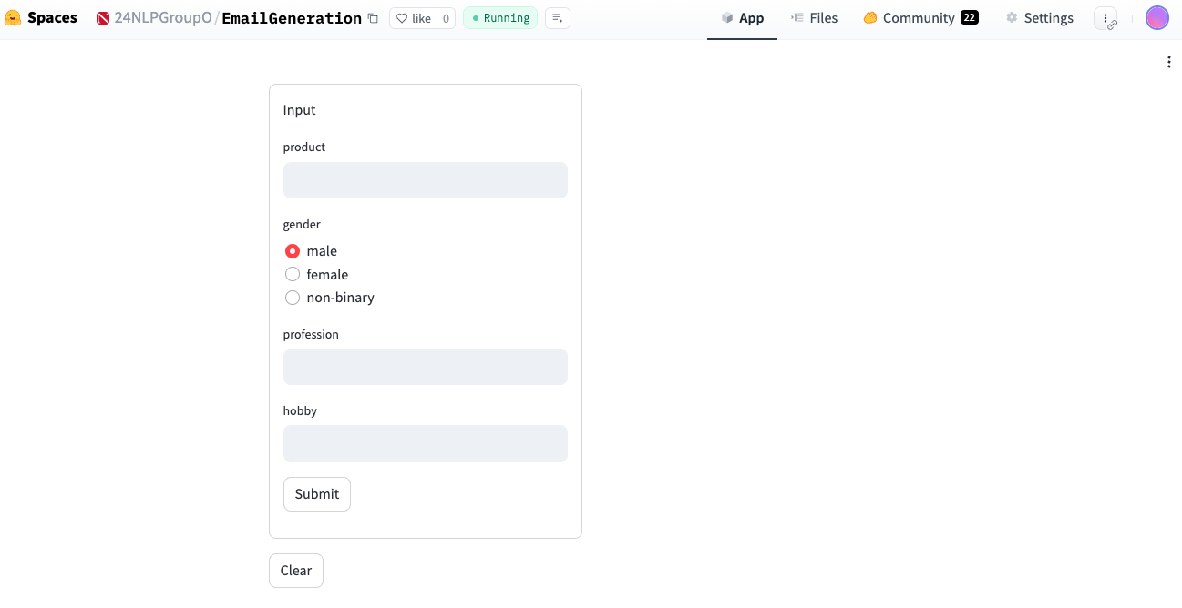
Start the app

Slide 4
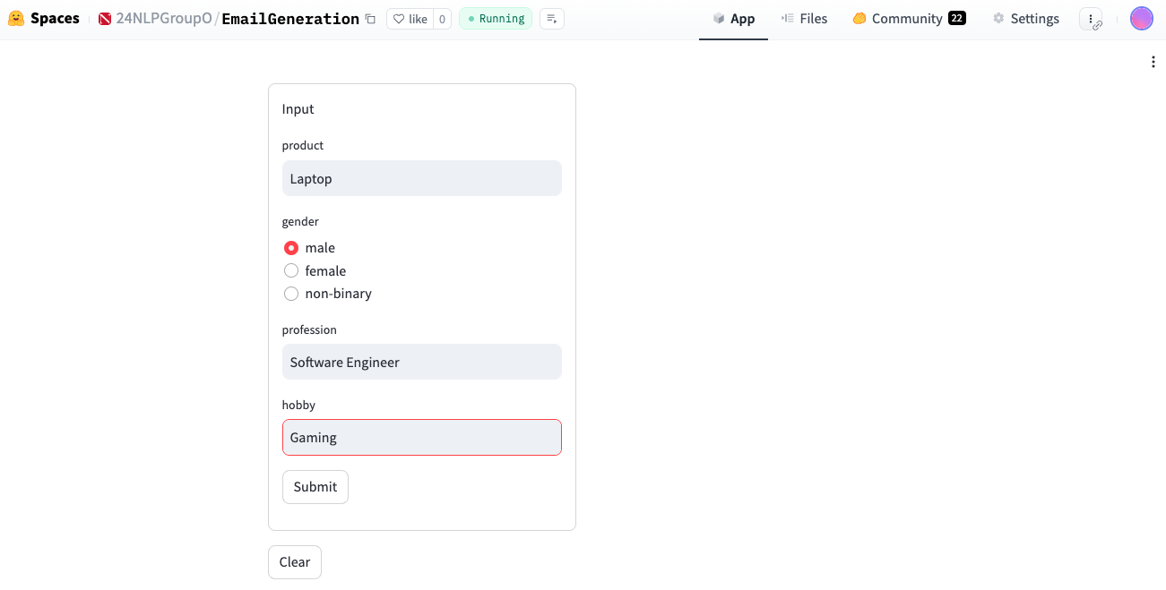
User input

Slide 5
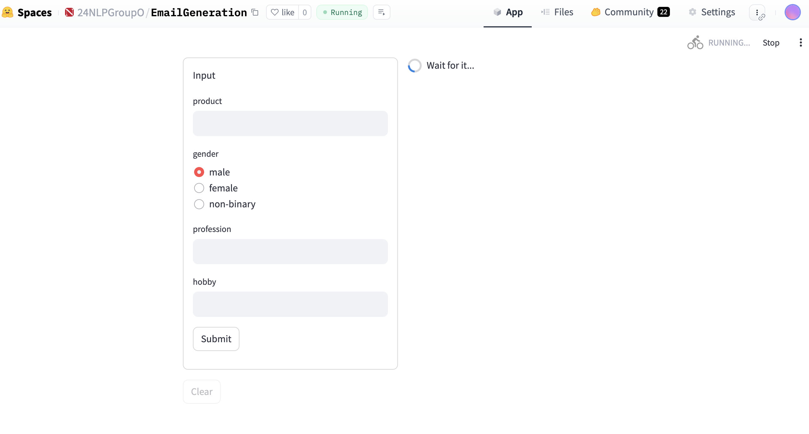
Wait for minutes

Slide 6
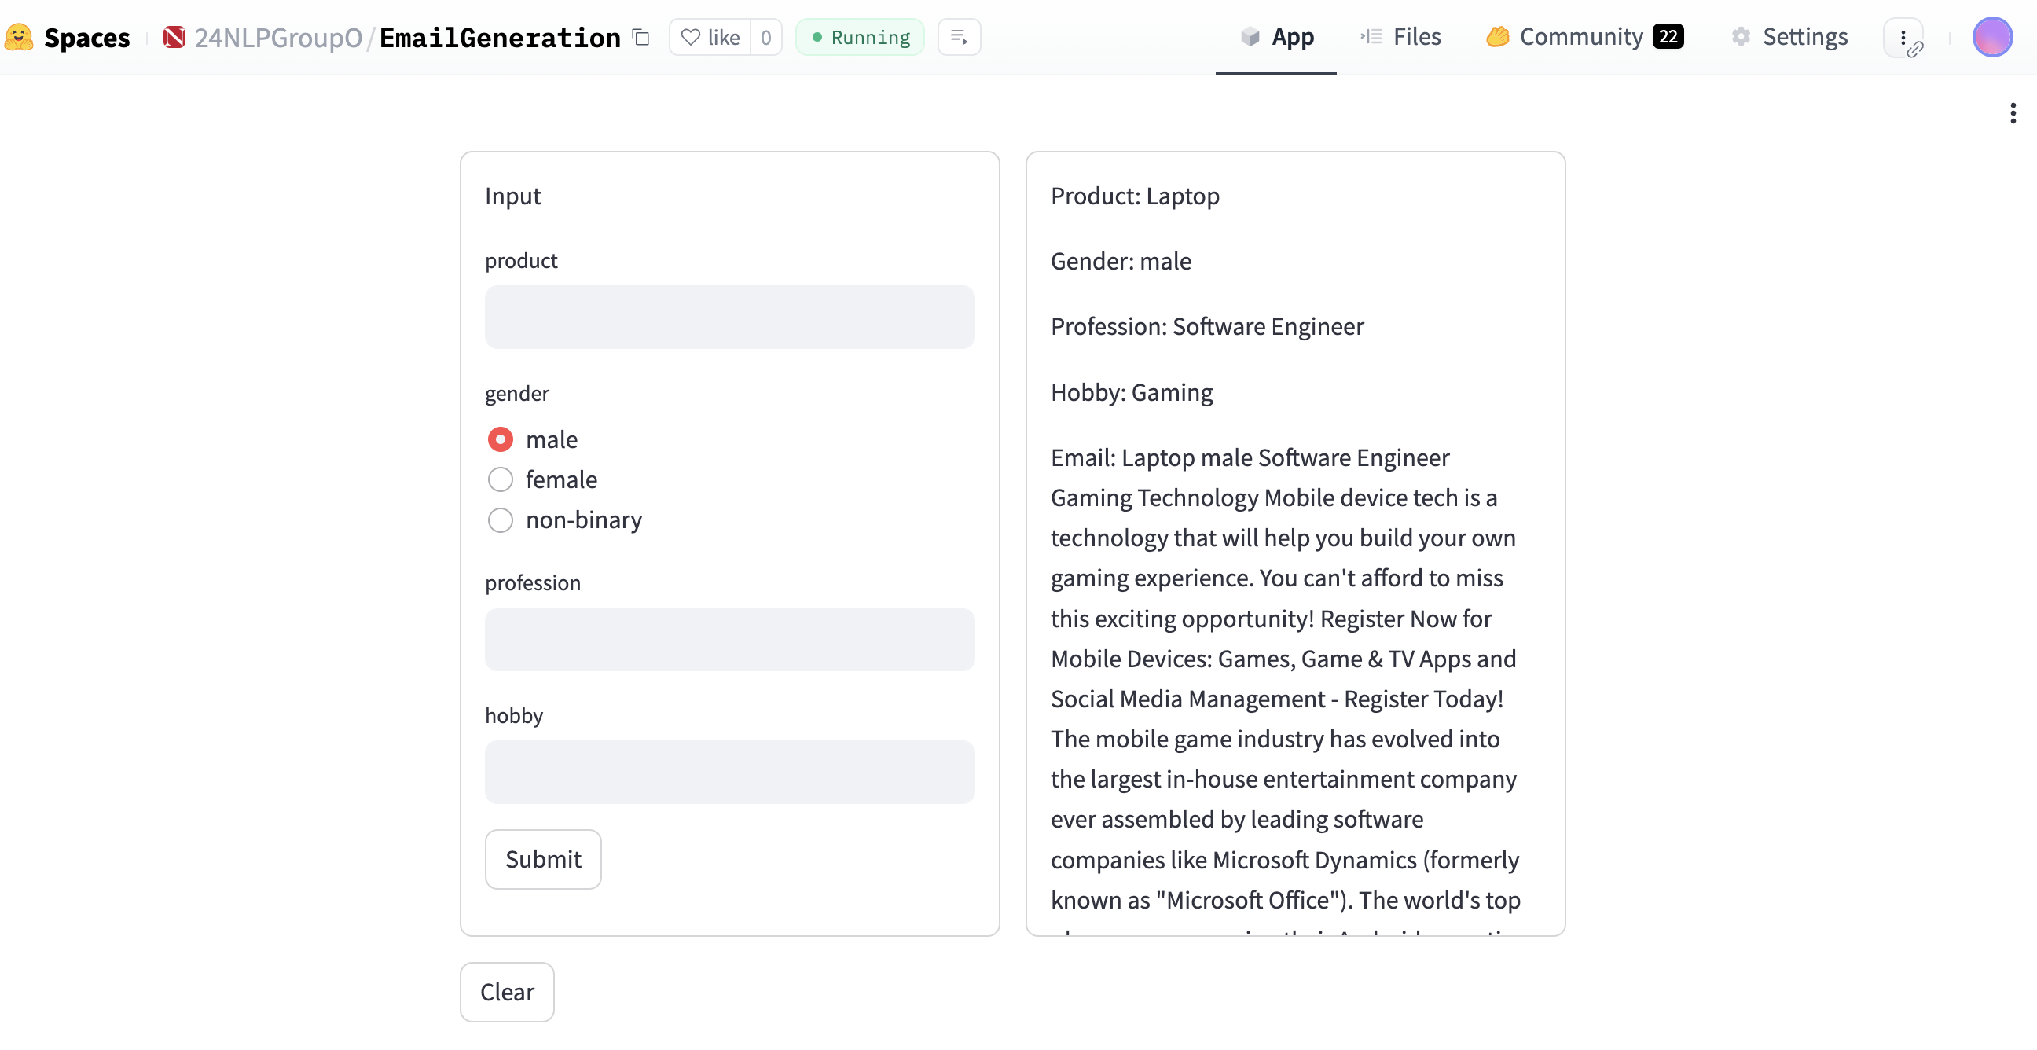
Output

Slide 7
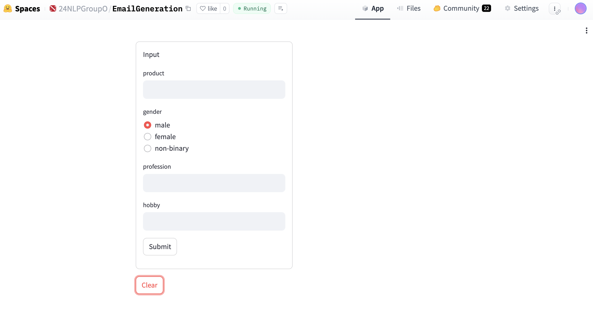
Clear

Slide 8
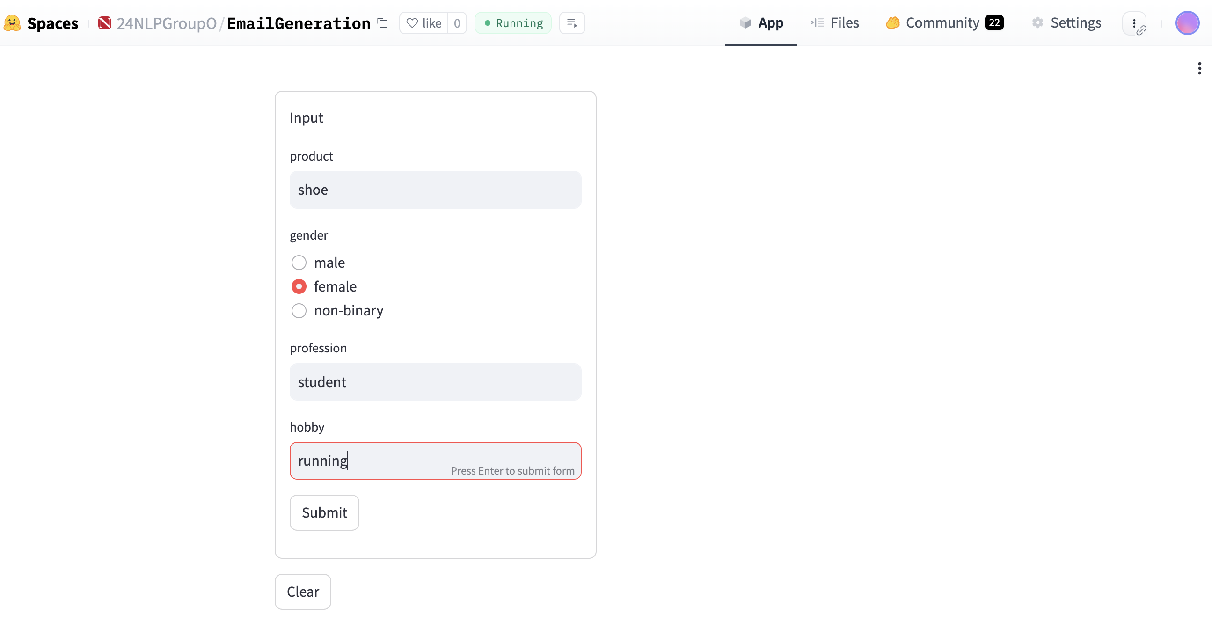
Retry

Slide 9
