Slide 1
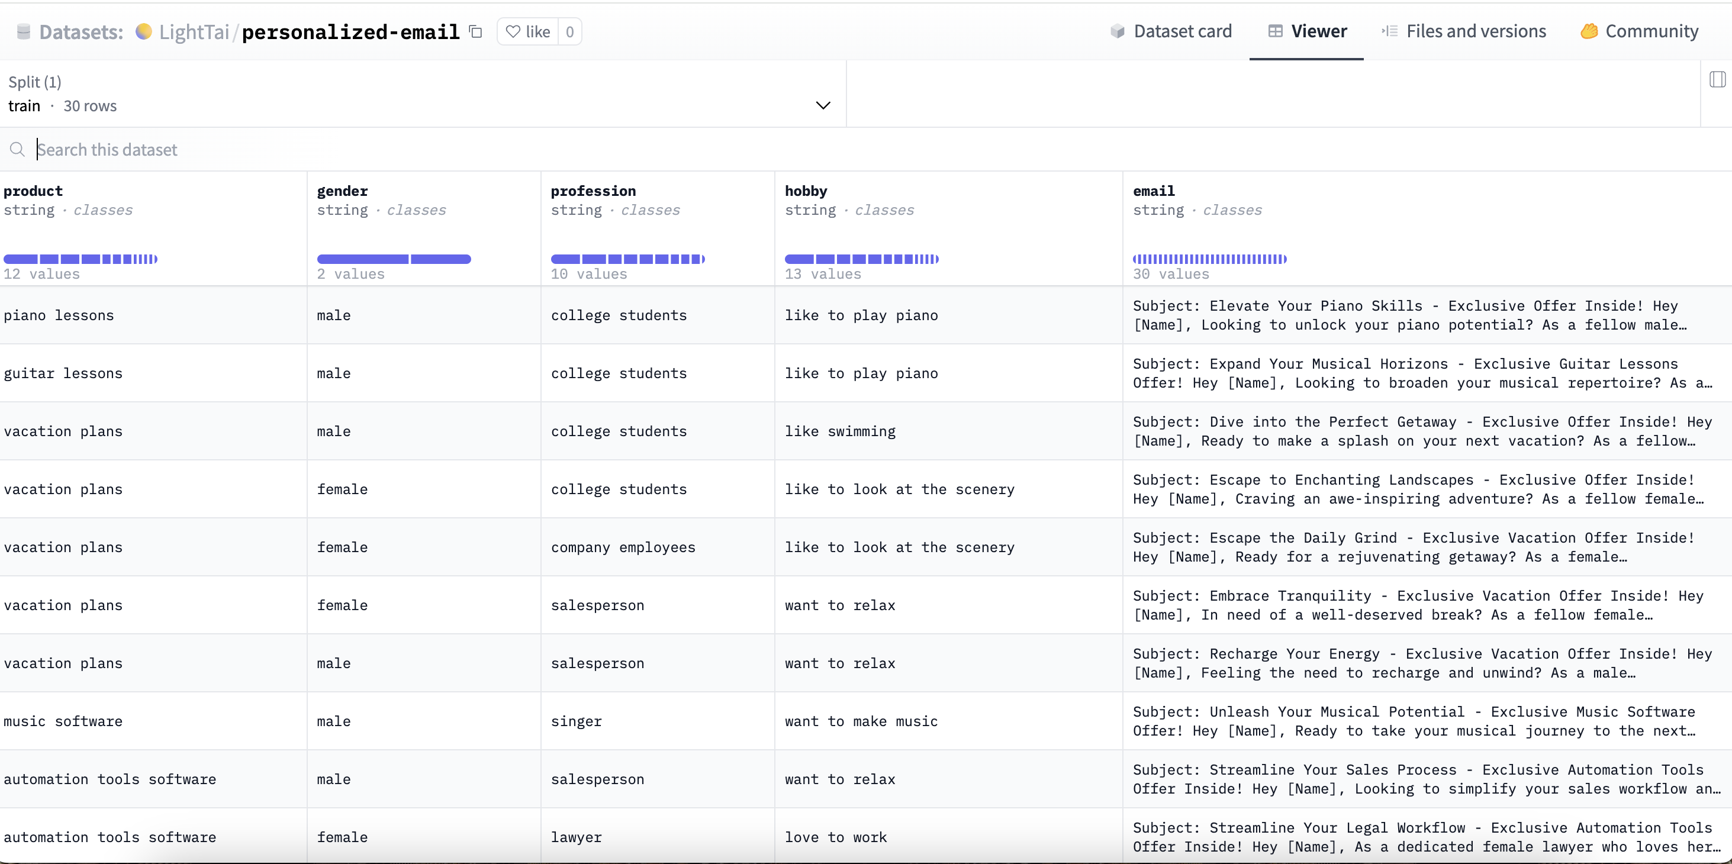
Data Analysis

Slide 2
NLP Methodology and Techniques Employed
Text Classification/Segmentation: To analyze the customer base and categorize it based on different attributes such as gender, profession, and hobbies. This would involve supervised learning algorithms that could classify text into pre-defined classes based on the training data provided in the dataset.
Sentiment Analysis: To understand the sentiment behind the hobbies or professions listed, which might then influence the tone and style of the email content.
Template-Based Text Generation: For generating personalized emails, a template-based approach would be used. Templates would have placeholders for names, professions, products, etc., that would be dynamically filled based on the customer data.
Feature Extraction: Before any text generation, it would be necessary to extract features from the text that are relevant to the product, gender, and hobbies, and use them to tailor the content of the emails.
Data Preprocessing: Cleaning and organizing the data to ensure the NLP models work efficiently. This would include tokenization, stemming, lemmatization, and removal of stop words.

Slide 3
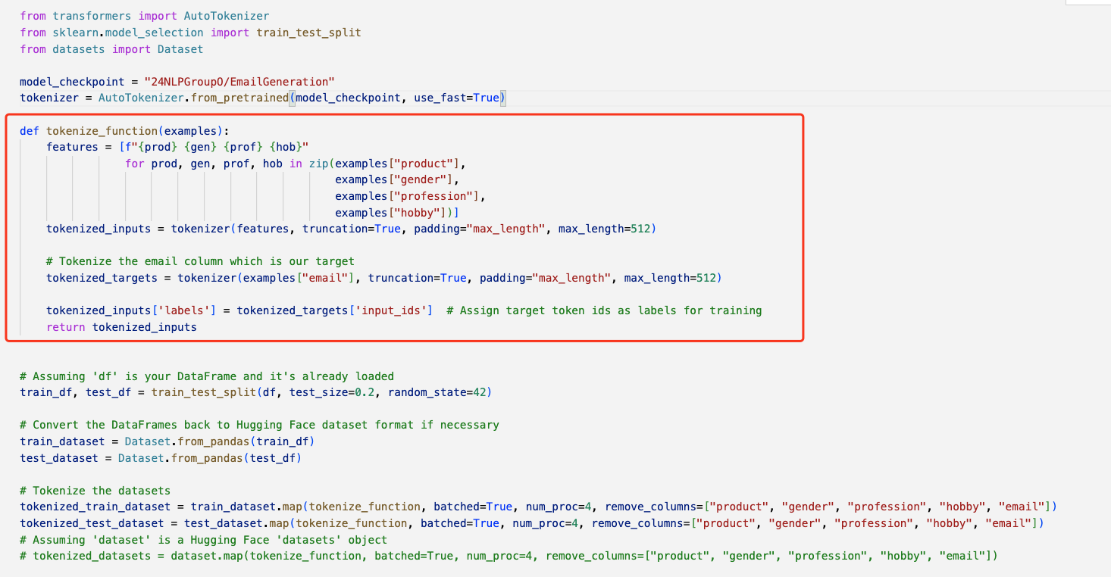
Explain Dataset to Model Tokenize

Slide 4
Explain Dataset to Model Tokenize
Loading Pre-trained Model Tokenizer: An AutoTokenizer is loaded with a specified pre-trained model checkpoint. The tokenizer is a crucial tool that converts text data into a format that can be processed by machine learning models.
Tokenization Function: The function tokenize_function is defined to tokenize the inputs. It takes examples from the dataset and extracts the product, gender, profession, and hobby columns. These columns are tokenized, meaning they are converted into a sequence of numbers that represent the text in a way the model can understand. There's a special focus on the email column since it is the target variable (what the model will learn to generate).
Processing the Dataset: The dataset is split into a training set and a test set with a 50/50 split. The original DataFrame is then converted into a Dataset object, which is a more efficient format for handling datasets in machine learning workflows.
Tokenizing the Dataset: The actual tokenization process happens where the training and test sets are mapped with the tokenize_function. This means that all the text data in these datasets is converted into tokens.

Slide 5
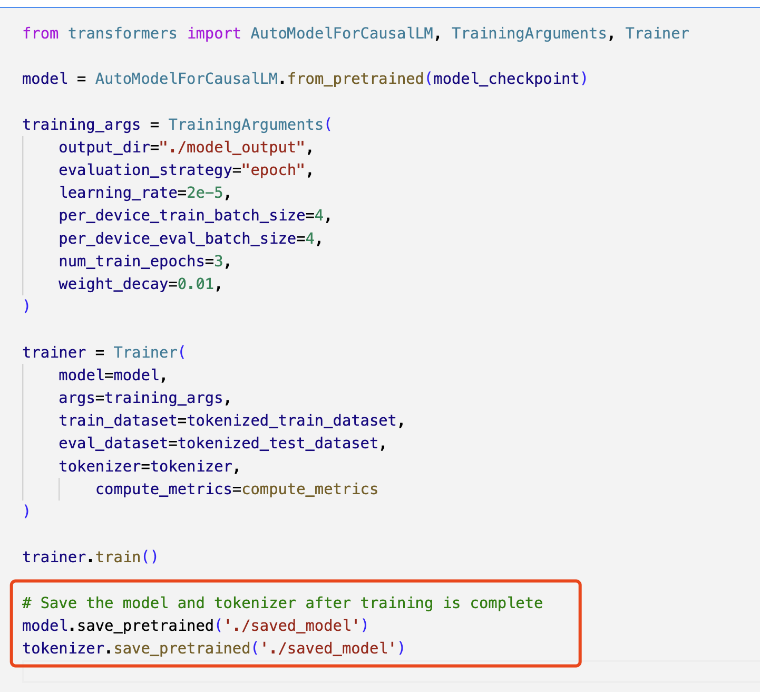

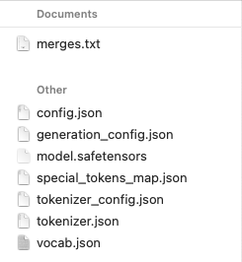
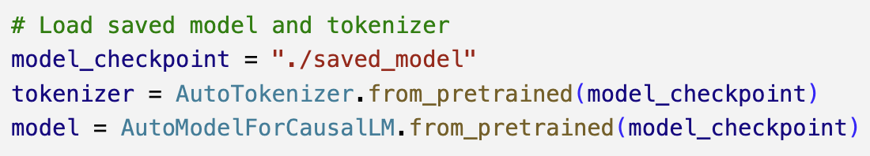
Save and Load Model

Slide 6
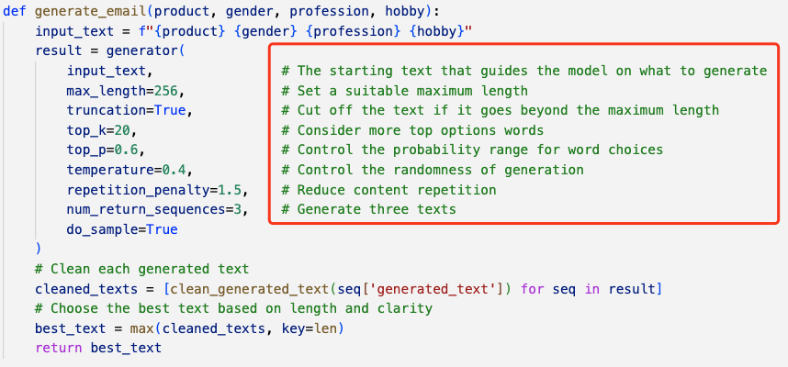
Parameters

Slide 7
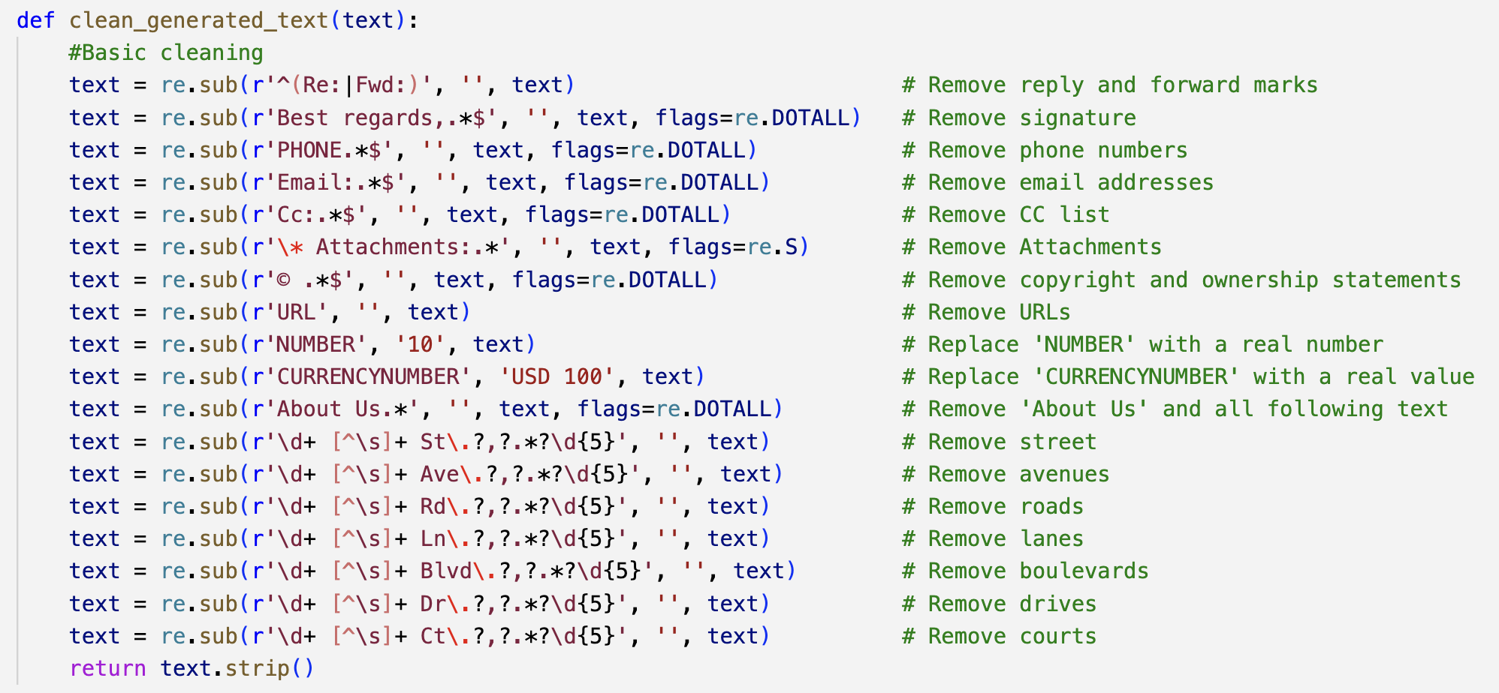
Basic Clean

Slide 8
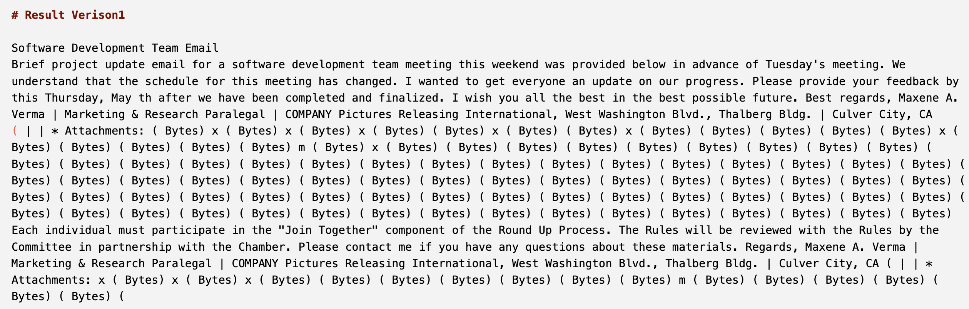
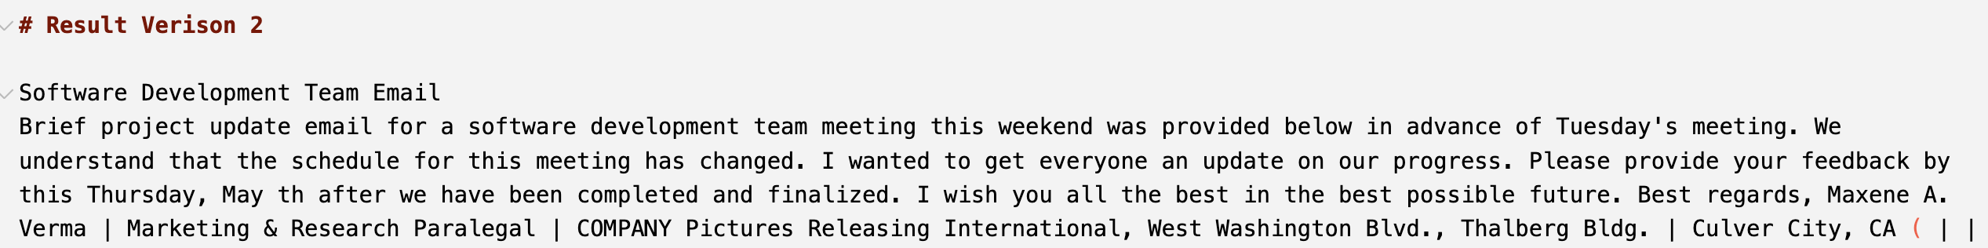
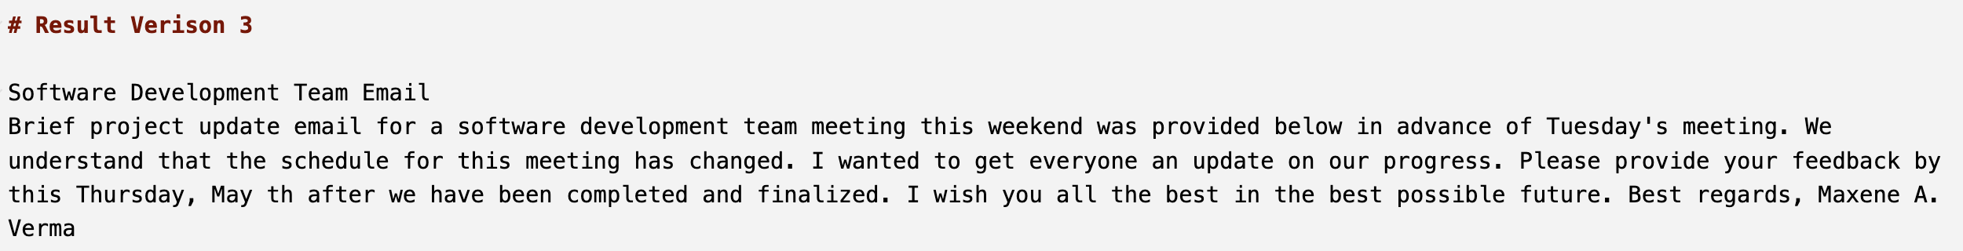
Comparison of Out Put

