Slide 1
Generating Personalized Emails with GPT-2
Group O: Yun Cao, Yue Liu, Muyang Cheng, Nan Chen

Slide 2

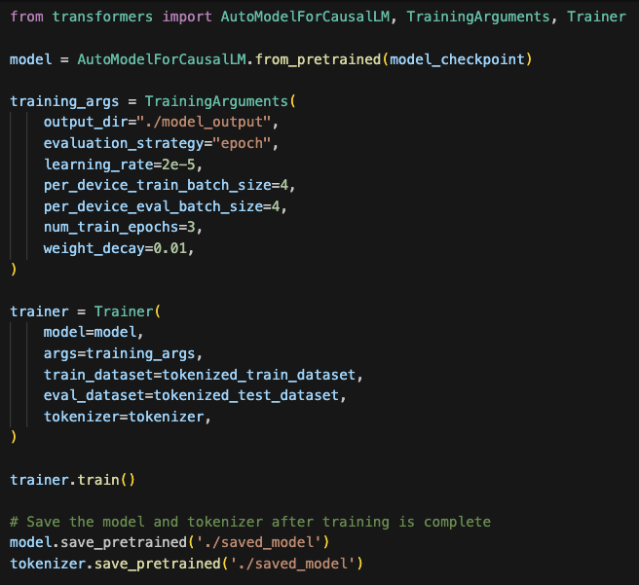
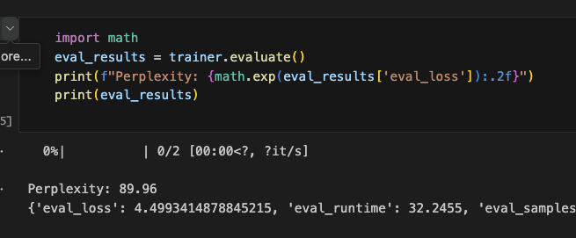
Current Model
What does perplexity mean?
Uncertainty

Slide 3
Current Model
Evaluation on Hugging face.
Current available criteria metric
Next evaluation: BLEU
Bilingual Evaluation Understudy

Slide 4
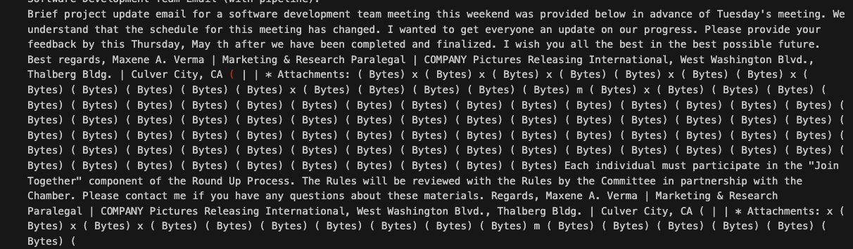
Current Model
Current output

Slide 5
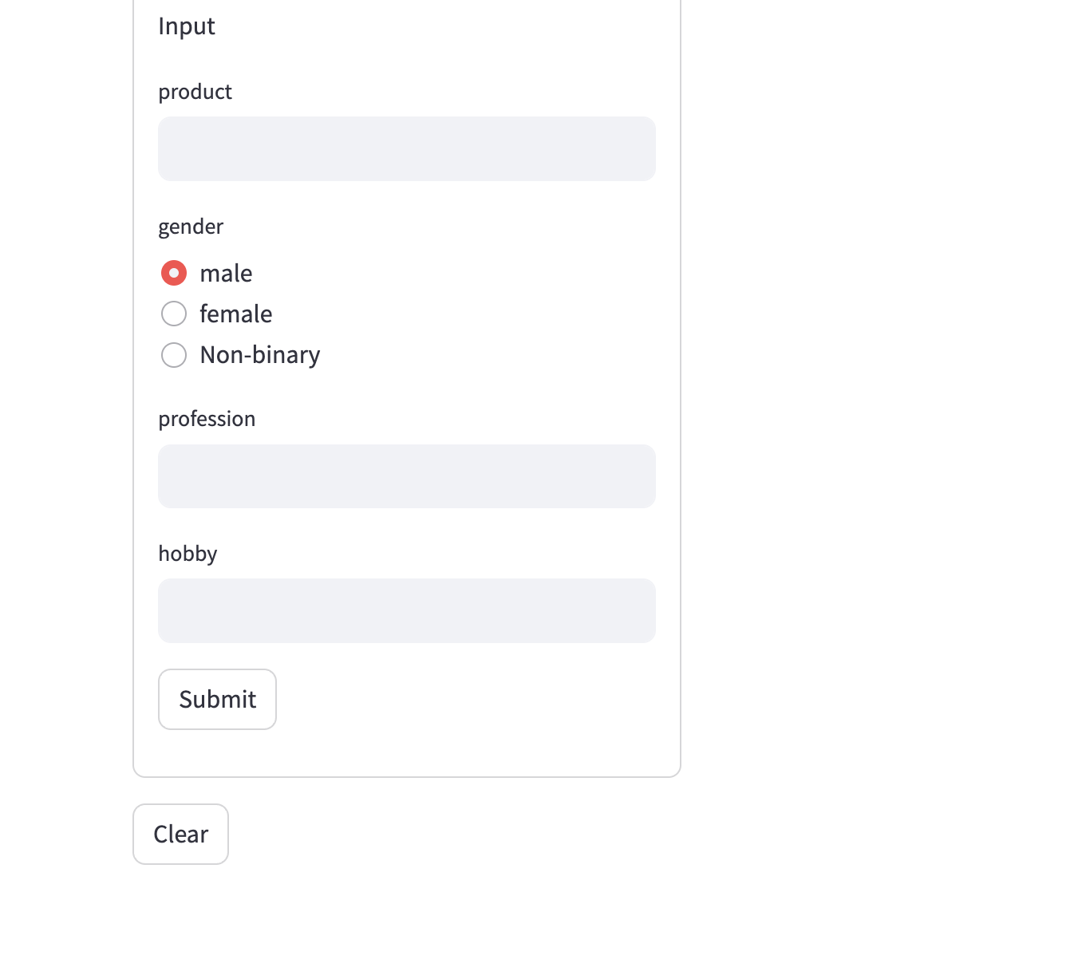
Spaces
Ethical considerations
Definition of Spam and Phishing
Spam Target: Advertisement
Phishing Feature: Fake url.

Slide 6
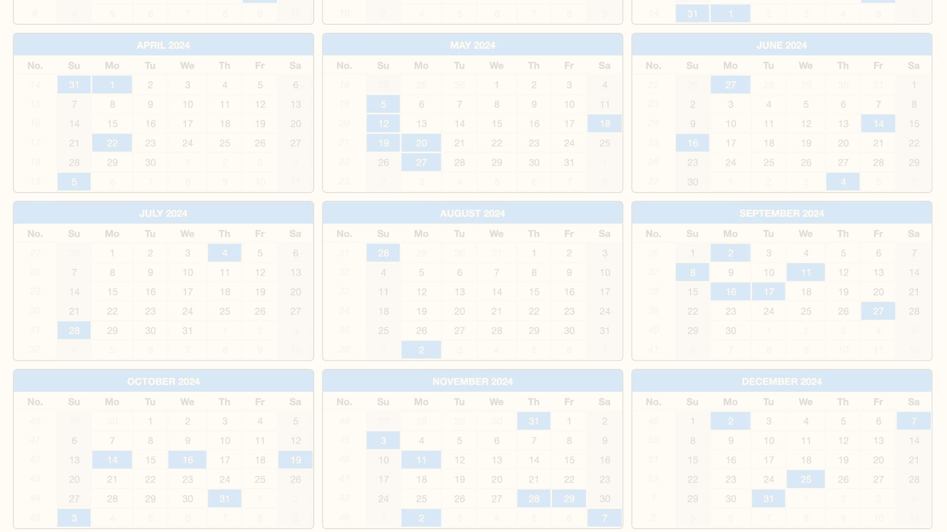
Development Timeline
Thursday
1
Finish BLEU evaluation
2
Friday
Validate model generation results
Saturday
3
Connect Space with the model
4
Rest Time
Prepare Presentations and Reports

