Slide 1

PRESENTATION TEMPLATES
Stories worth telling…
WWW.POWERSLIDES.COM
Notes:
There is a background placeholder in this slide.
To change the images :
Right Click and Select Format Background -> Select FILL -> Picture Or Texture Fill -> Select File...

Slide 2
IMPORT EXPORT
ORDER
SHIP
INTERNATIONAL
TRUCK
Order packed and ready to be delivered.
The orders that will be delivered via sea channels.
The urgent parcels that will be delivered by air.
Heavy and inter-city orders to delivered via road transport.
60%
30%
70%
30%
An quantitative overview of the various orders from around the world that are delivered based on the customers needs via various sea, air, and land channels. The air transportation is default channel for parcels that require urgent delivery.
67%
IMPORT & EXPORT
POWERSLIDES WWW.POWERSLIDES.COM
1

Slide 3
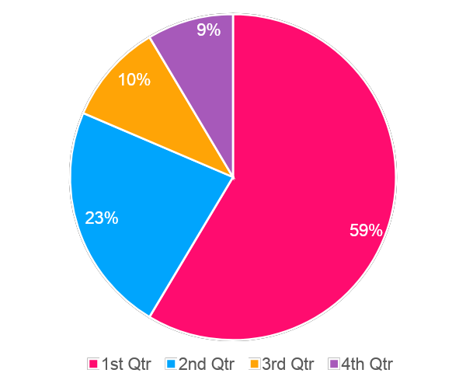
IMPORT EXPORT
IMPORT & EXPORT
ACHIEVEMENTS
Sea Channel
90%
Road transport
70%
Air Cargo
60%
Door-to-Door
40%
2022
HIGHLIGHTS
>15%
First quarter was the successful with around 60% exports of in-house built electronic gadgets.
Second quarter saw a decline in exports owing to the unstable financial situation of the company.
Third and fourth quarter showed nearly the same amount of exports and witnessed a significant decrease in revenues.
>25%
>35%
>45%
POWERSLIDES WWW.POWERSLIDES.COM
2

Slide 4
IMPORT EXPORT
Luggage
Private jet
Cars
Cargo
Air plane
Title Here
Bus
Air plane
Railway
Bus
$37 Billion
$55 Billion
$76 Billion
$23 Billion
$84 Billion
$34 Billion
$23 Billion
$45 Billion
$65 Billion
$44 Billion
56%
56%
56%
56%
56%
56%
56%
56%
56%
56%
$55 Billion
Switzerland
Austria
$55 Billion
$43 Billion
Belgium
France
$55 Billion
$55 Billion
Germany
Iceland
$55 Billion
$42 Billion
Slovenia
Czech Republic
$55 Billion
POWERSLIDES WWW.POWERSLIDES.COM
3

Slide 5
IMPORT EXPORT
Logistics Strategy
Railway Transportation
A exponential increase in exporting the textile products via inter-continental railway networks.
Air Cargo Transportation
A decrease in luggage transportation within the city via personal conveyance.
CARGO LOAD
PER YEARS
>85%
By Air
>85%
By Land
>85%
Cargo
>85%
By Sea
>85%
Railway
>85%
POWERSLIDES WWW.POWERSLIDES.COM
4

Slide 6

THANK YOU
Do you a need bespoke presentation design service? We can custom create your slides from scratch. Contact us today.
WWW.POWERSLIDES.COM
Notes:
There is a background placeholder in this slide.
To change the images :
Right Click and Select Format Background -> Select FILL -> Picture Or Texture Fill -> Select File...

