Slide 1




















DATA MART PLATFORM
MCP Enabled
REGISTRIES (DISCOVERY & GOVERNANCE)
Tooling & Rules Registry
Product Registry
Data Model Registry
Data Contract Registry
SOURCE DATA
LAYER
Registered through
CI/CD
Products registered through
Jobs
Models registered through
UI
Contracts registered through
UI
Metadata through CI/CD
UI LAYER
MCP Enabled
FINE GRAINED
ACCESS CONTROL
ACCESS CONTROLLED
DATA APIs
METASTORE
Protocol for AI access to API’s and tools
READ, WRITE, APPEND, DELETE Access to NPE’s or Users
Row / column policies and Role-based access
MCP Servers
ETL Transformations
REST access
to governed data
Protocol for AI access to API’s and tools
ET Bi-Products
EXTERNAL CONSUMERS
ACCESS CONTROLLED
DATA STREAM
MCP Enabled
SERVING LAYER
Conversational
Interface with data
Batch / Streaming
Ingestion
Kafka topics for
real-time consumers
Quick Retrieval
Query
Vectors
Chatbot
Low-latency lookups
Federated SQL
Similarity search
Conversational
Interface with data
ETL Platform
Enterprise ETL platform and tools
LEGEND
Connections
DATA LAKE
Metadata / Control Flow
Consumers
Vectors
Data Products
Lineage
Track
Validation

Slide 2
DATA MART LAYER
DISCOVERABLE • GOVERNED • CONSUMABLE
Analytics / BI
AI / ML Applications
DATA CATALOG
Product & contract registries · lineage
ETL
PLATFORMS
DATA LAKE
DATA MART
S3 · Iceberg raw &
trusted storage
Writes curated tables
Applications
Data Products in one place
Microservices
Real-time Systems
Operational Systems
TOPIC PUB/SUB
DATA API
Explore & subscribe
to governed topics
Browse & query
governed data APIs
External Partners
Other Integrations

Slide 3
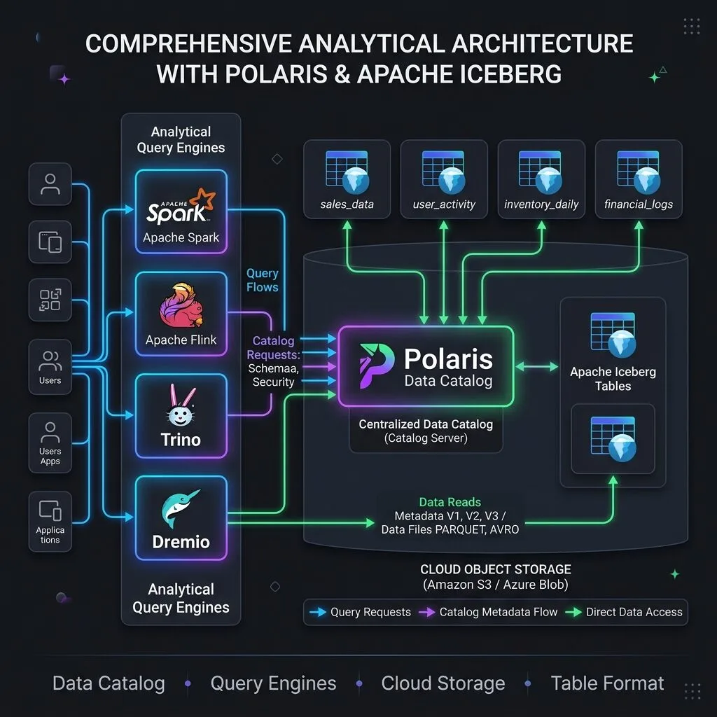
Dremio architecture inspiration

