Slide 1

WHY THE DATA MART?
One place where producers publish business-unit data, and consumers find it, understand it, and use it.
PRODUCERS
DATA MART
CONSUMERS
● Publish their data products emit metadata to the mart
● Apply business units so data is organized and owned
● Register models, products & contracts
Data organized by business unit
● Browse the business units they care about
● Discover and consume the data products inside
● Trust what they get, before they use it
P
REFERENCE
TRC
C
PUBLISH
CONSUME
SLV
PS
STREAMING TOPICS
DATA TRANSPARENCY
Nutrition Facts
QUICK LOOK INTO THE PRODUCT
Like the nutrition label on food, every data product tells consumers exactly what they are consuming.
It surfaces all the metadata we collect, in one view.
Requirements
✓
Consumers with access can query and preview a product right from the mart.
Schema / Data Model
✓
Data contract & SLAs
✓
SELECT *
FROM trc.<data_product>
LIMIT 10;
System-System Lineage
✓
Table and Schema Lineage
✓
Quality & validation
✓
ETL Comments
✓
Governed by fine-grained access control (row / column policies)

Slide 2


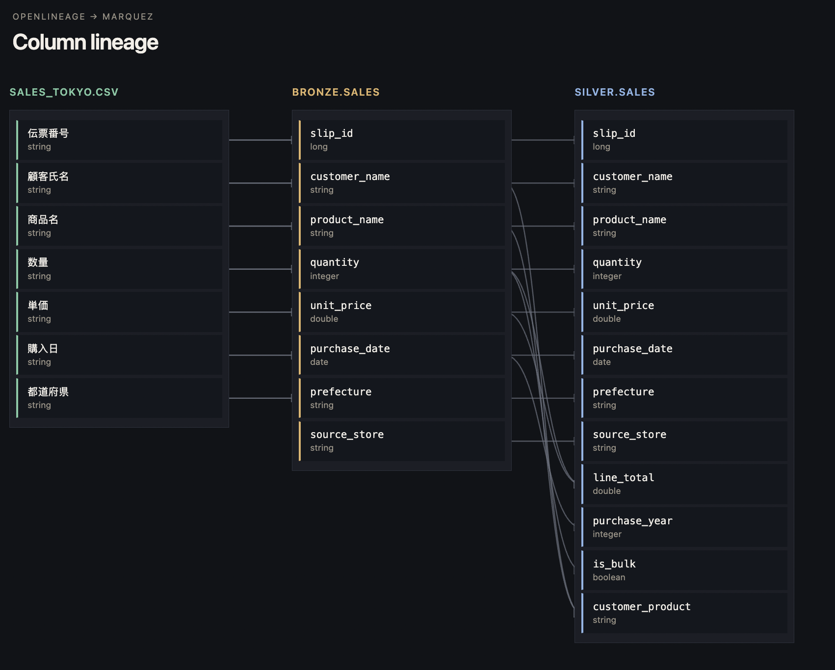
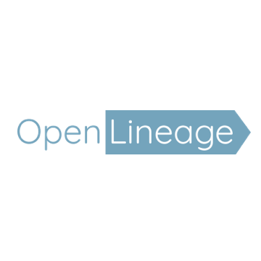
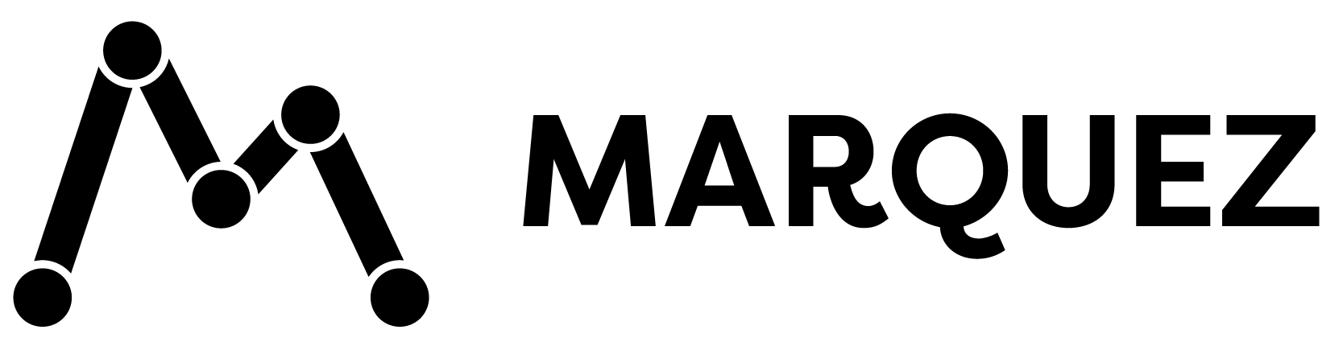
A SHARED PLANE
Some consumers are also producers for other systems. They read from the mart and write lineage back to it.
AS EASY AS CONFIGURING YOUR SPARK SESSION
Both tech easily integrated with snowflake
POLARIS METASTORE
# R read tables from the metastore
spark.sql.catalog.mart.type = rest
spark.sql.catalog.mart.uri = <metastore-url>
# E emit lineage events to Marquez
spark.extraListeners = io.openlineage.spark.agent.OpenLineageSparkListener
spark.openlineage.transport.url = <marquez-url>
Schemas, tables and data models the consumer reads from
READS Tables
R
SHARED CONSUMER
Consumes data products from the mart, then produces data for its own downstream systems.
P
DOWNSTREAM
CONSUMER
E
EMIT Lineage Events
OPENLINEAGE → MARQUEZ
ETL Job Lineage events from the shared consumer extend the graph past the mart into the systems it feeds.
Column lineage emitted by a, viz spun up with no additional tech

Slide 3



















COMPONENT STATUS
DATA MART PLATFORM
Exists today
MCP Enabled
Migrated from another system
REGISTRIES (DISCOVERY & GOVERNANCE)
Needs to be built
Tooling & Rules Registry
Product Registry
Data Model Registry
Data Contract Registry
SOURCE DATA
LAYER
Registered through
CI/CD
Products registered through
Jobs
Models registered through
UI
Contracts registered through
UI
Metadata through CI/CD
UI LAYER
MCP Enabled
FINE GRAINED
ACCESS CONTROL
ACCESS CONTROLLED
DATA APIs
METASTORE
Protocol for AI access to API’s and tools
READ, WRITE, APPEND, DELETE Access to NPE’s or Users
MCP Servers
ETL Transformations
REST access
to governed data
Row / column policies and Role-based access
Protocol for AI access to API’s and tools
Tabular Lineage store
ETL Metadata
EXTERNAL CONSUMERS
ACCESS CONTROLLED
DATA STREAM
MCP Enabled
SERVING LAYER
Conversational
Interface with data
Batch / Streaming
Ingestion
Kafka topics for
real-time consumers
Quick Retrieval
Query
Vectors
Chatbot
Low-latency lookups
Federated SQL
Similarity search
Conversational
Interface with data
ETL Platform
Enterprise ETL platform and tools
LEGEND
Connections
DATA LAKE
Metadata / Control Flow
Consumers
Vectors
Data Products
Validation
Track

