Slide 1
Data Product Technical Catalog
System Design & Product User Experience
August 2026
Governed · Versioned · Discoverable

Slide 2
SECTION 1
Design Principles
DESIGN PATTERNS
One unified, simplified UI/UX over the data lake
Standardize and template easy-to-develop APIs
Standardize and template easy-to-deploy Trino clusters
Minimize overhead through shared infrastructure
Automate metadata collection and publication
Hide system management complexities from users

Slide 3
SECTION 2
Scope
The system serves governed data products in the Data Catalog and provides the governance capabilities required to manage them.
IN SCOPE
OUT OF SCOPE
Product discovery and transparency for cataloged products
Access-controlled metastore (Apache Polaris) for lake reads/writes
Cross-dataset discovery via Discovery Products and global search
Dataset-level content and natural-language search
Registry of data artifacts bound to records at runtime
Lineage and status built on data lake services
Prototype UI — two-step build into the Unified Experience
Under-one-week methodology for governed, documented Data APIs
Deduplication of cost-accumulating shared infrastructure
Containerized governed engines for other ecosystems
Retention cataloging and record purging with lake services
Indexing / query-as-a-service beyond the Enterprise Catalog
User-level workspace discovery or management
Multi–data lake product governance
Rebuilding of Data Lake services
Dataset parent–child governance handling
Data ingest forms
P&L tracking and UI display (inherits from Catalog)
Triage un-processed data
Relationship tracking and UI display (inherits from Catalog)

Slide 4
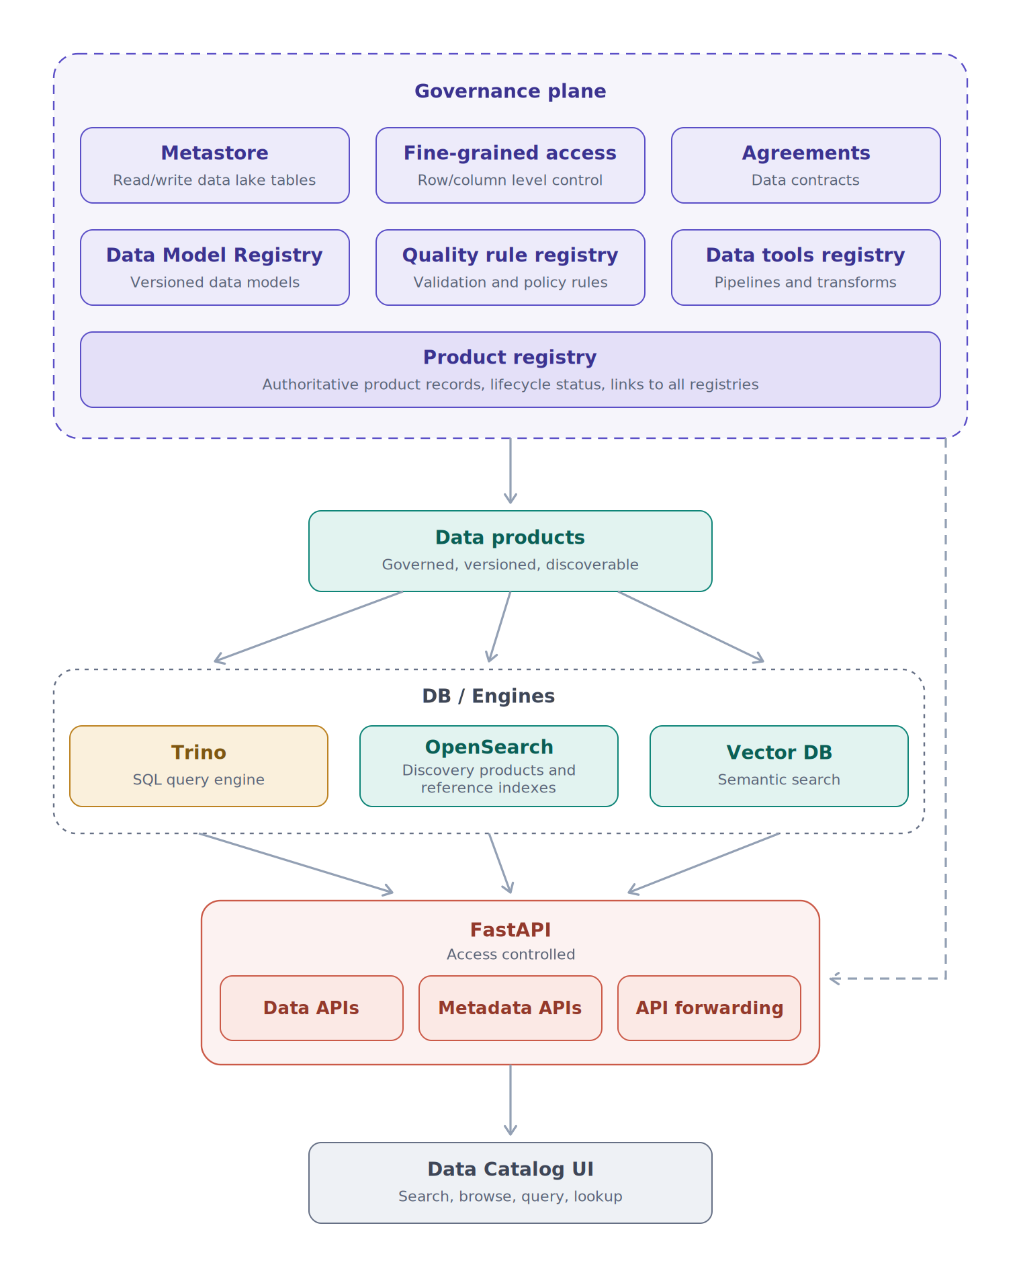
SECTION 3
System Architecture — Four Planes
Governance plane
System of record: product registry correlating the metastore, access control, and the model / agreement / rule / tool registries.
Indexing & Query plane
Thin engine layer — Trino for SQL, OpenSearch for discovery and reference indexes, a vector DB for semantic retrieval.
API plane (FastAPI)
The only doorway in: data APIs, metadata APIs, and forwarding into the enterprise catalog's search index.
User experience plane
Unified Experience UI — product pages, search, sandboxes, Artifact Library, actions, and chat — a client over the APIs.
Records are assembled at runtime from registry bindings — never copied downstream.

Slide 5
SECTION 3.1
Governance Plane
Product Registry
Enterprise Metastore — Apache Polaris
Automated aggregator every product record originates from; models, agreements, rules, and tools are all joined to product records.
Access-controlled front door for reading and writing lake tables: one consistent view of schemas and snapshots for Trino and remote engines. Considerations: credential vending, entitlements.
Exposed through: Artifact Library & product page
Exposed through: every engine and ETL job
Fine-Grained Access Control
Artifact Registries
A single governance-plane policy service — entitlements down to column and row level — from which every enforcement point (Trino filters, OpenSearch permissions, FastAPI authorization) derives.
Versioned models, agreements, quality rules, and tools that records bind to at runtime. Pushed via CI/CD from the owning code — manual forms drift. Semantic versioning lets consumers pin safely.
Exposed through: Request Access & role-gated features
Exposed through: Artifact Library

Slide 6
SECTION 3.2
Indexing & Query Plane
Trino
OpenSearch
SQL engine over structured products — interactive query directly against lake tables through the metastore, with no data copies. Product-scoped access resolves through Polaris grants, not Trino-local rules.
Discovery and reference indexes: product metadata for global search, extracted content for dataset full-text search, and reference datasets. Fast keyword and faceted retrieval — not big-data serving.
Exposed through: Query (Table) tab
Exposed through: Reference Data APIs, Discovery APIs, Query (Files) tab
Vector Database
Containerized Query Engines
Embeddings of extracted dataset content, powering semantic search and the grounding retrieval behind chat — meaning-based retrieval where keyword search falls short.
Governed engine images other ecosystems can deploy: metastore endpoint and policy enforcement baked in, central authentication, centrally patched, mandatory audit logging.
Exposed through: Chat with Data
Exposed through: offered to data partners

Slide 7
SECTION 3.3
API Plane (FastAPI)
The only supported doorway to the platform — three surfaces:
Data APIs
Metadata APIs
API Forwarding
Reference and discovery data drawn from OpenSearch — intentionally not for big data.
Assembled product records, bindings, validation results, and lineage.
Pushes searchable product metadata into the enterprise catalog's global search index, event-driven.
Under-one-week API methodology. A FastAPI template with authentication, product-scoped authorization, usage reporting, and OpenAPI docs baked in — a new Data API is configuration plus schema, not new infrastructure. Rate-limited and metered per consumer.
Serves: data partners · reference data users · catalog search bar · metadata publishers & consumers · Catalog API tab

Slide 8
PART 2
User Experience Plane
The catalog as users see it — every surface below is a projection of the planes above.

Slide 9
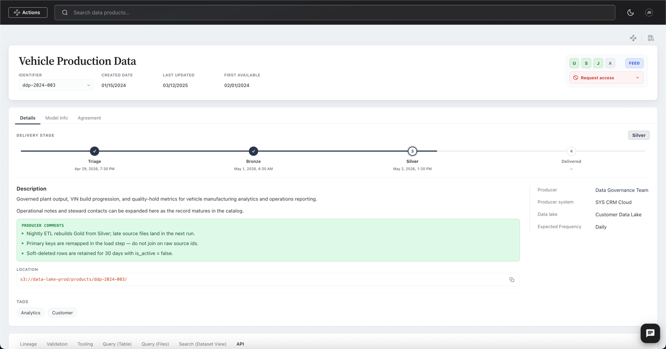
SECTION 4
Product Page
The complete record for a representative product — assembled entirely from registry bindings
Tabs span Details, Model Info, Agreement, Lineage, Validation, Tooling, Query, Search, and API
Details tab tracks the agreement-defined delivery lifecycle (currently Silver) with stage timestamps
Model Info and Agreement tabs bind at runtime to registry records — point-in-time, semantically versioned

Slide 10
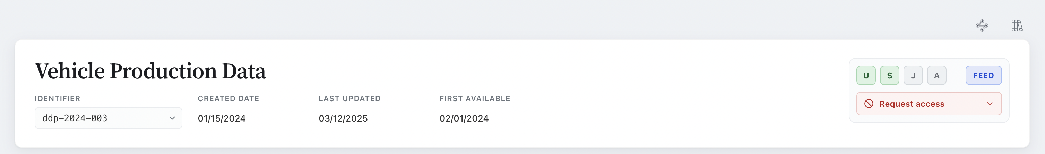
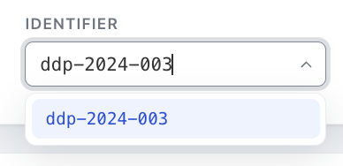
SECTION 5
Record Header & Identifier
Header: identifier, created / last-updated / first-available dates, environment chips (U/S/J/A), periodicity, and a Request Access control gating entitlement
The identifier is an editable combo box — typing filters registered product identifiers; arriving from a dataset pre-populates it
Related deliveries are sub-products, not new top-level records — the catalog stays concise
A sub-product inherits business unit, parent datasets, model, and agreement; all other metadata is independent per delivery variant

Slide 11
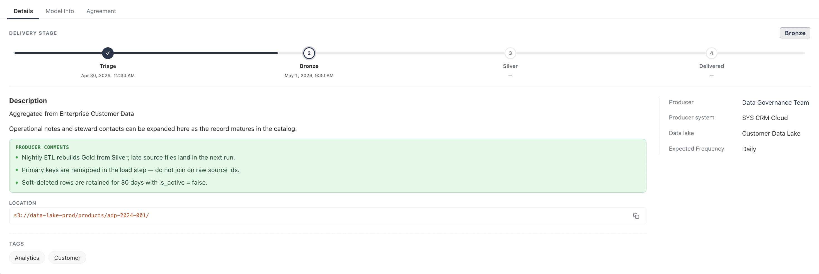
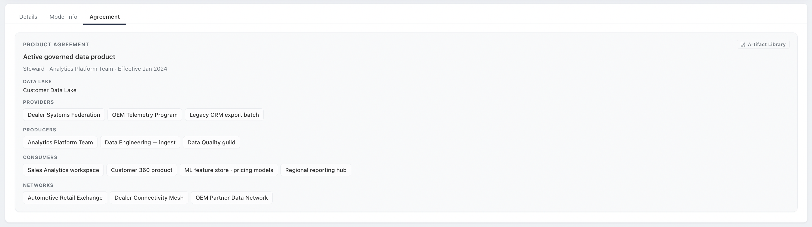
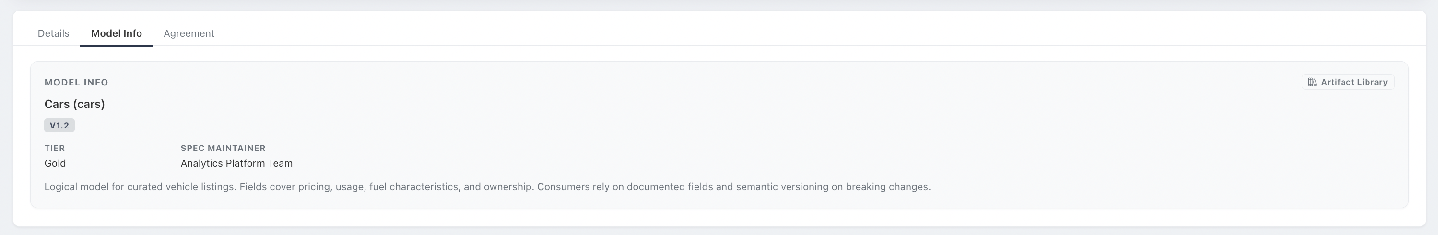
SECTION 5
Details Block
Details — the delivery-stage tracker with per-stage timestamps, the producer description, ETL producer comments, location, and tags.
Agreement — the runtime-bound product agreement: data lake, providers, producers, consumers, and networks.
Model Info — the bound logical model with tier, spec maintainer, and semantic versioning on breaking changes.

Slide 12
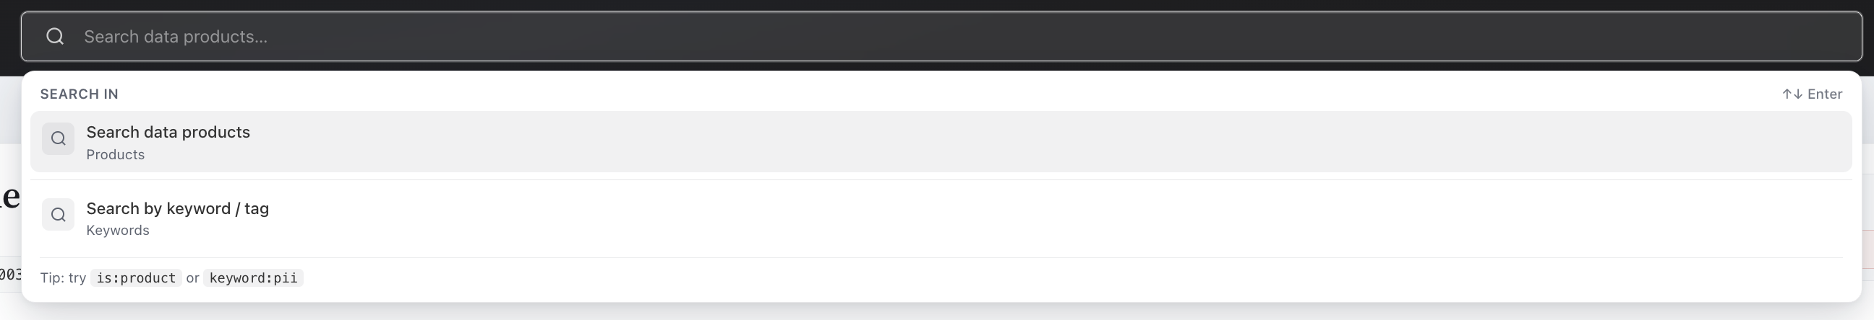
SECTION 6
Search & Discovery
Global search supports two scopes: searching data products directly, or searching by keyword / tag
Query operators like is:product and keyword:pii narrow results without leaving the search bar
Discovery is backed by the OpenSearch indexes in the engines layer

Slide 13
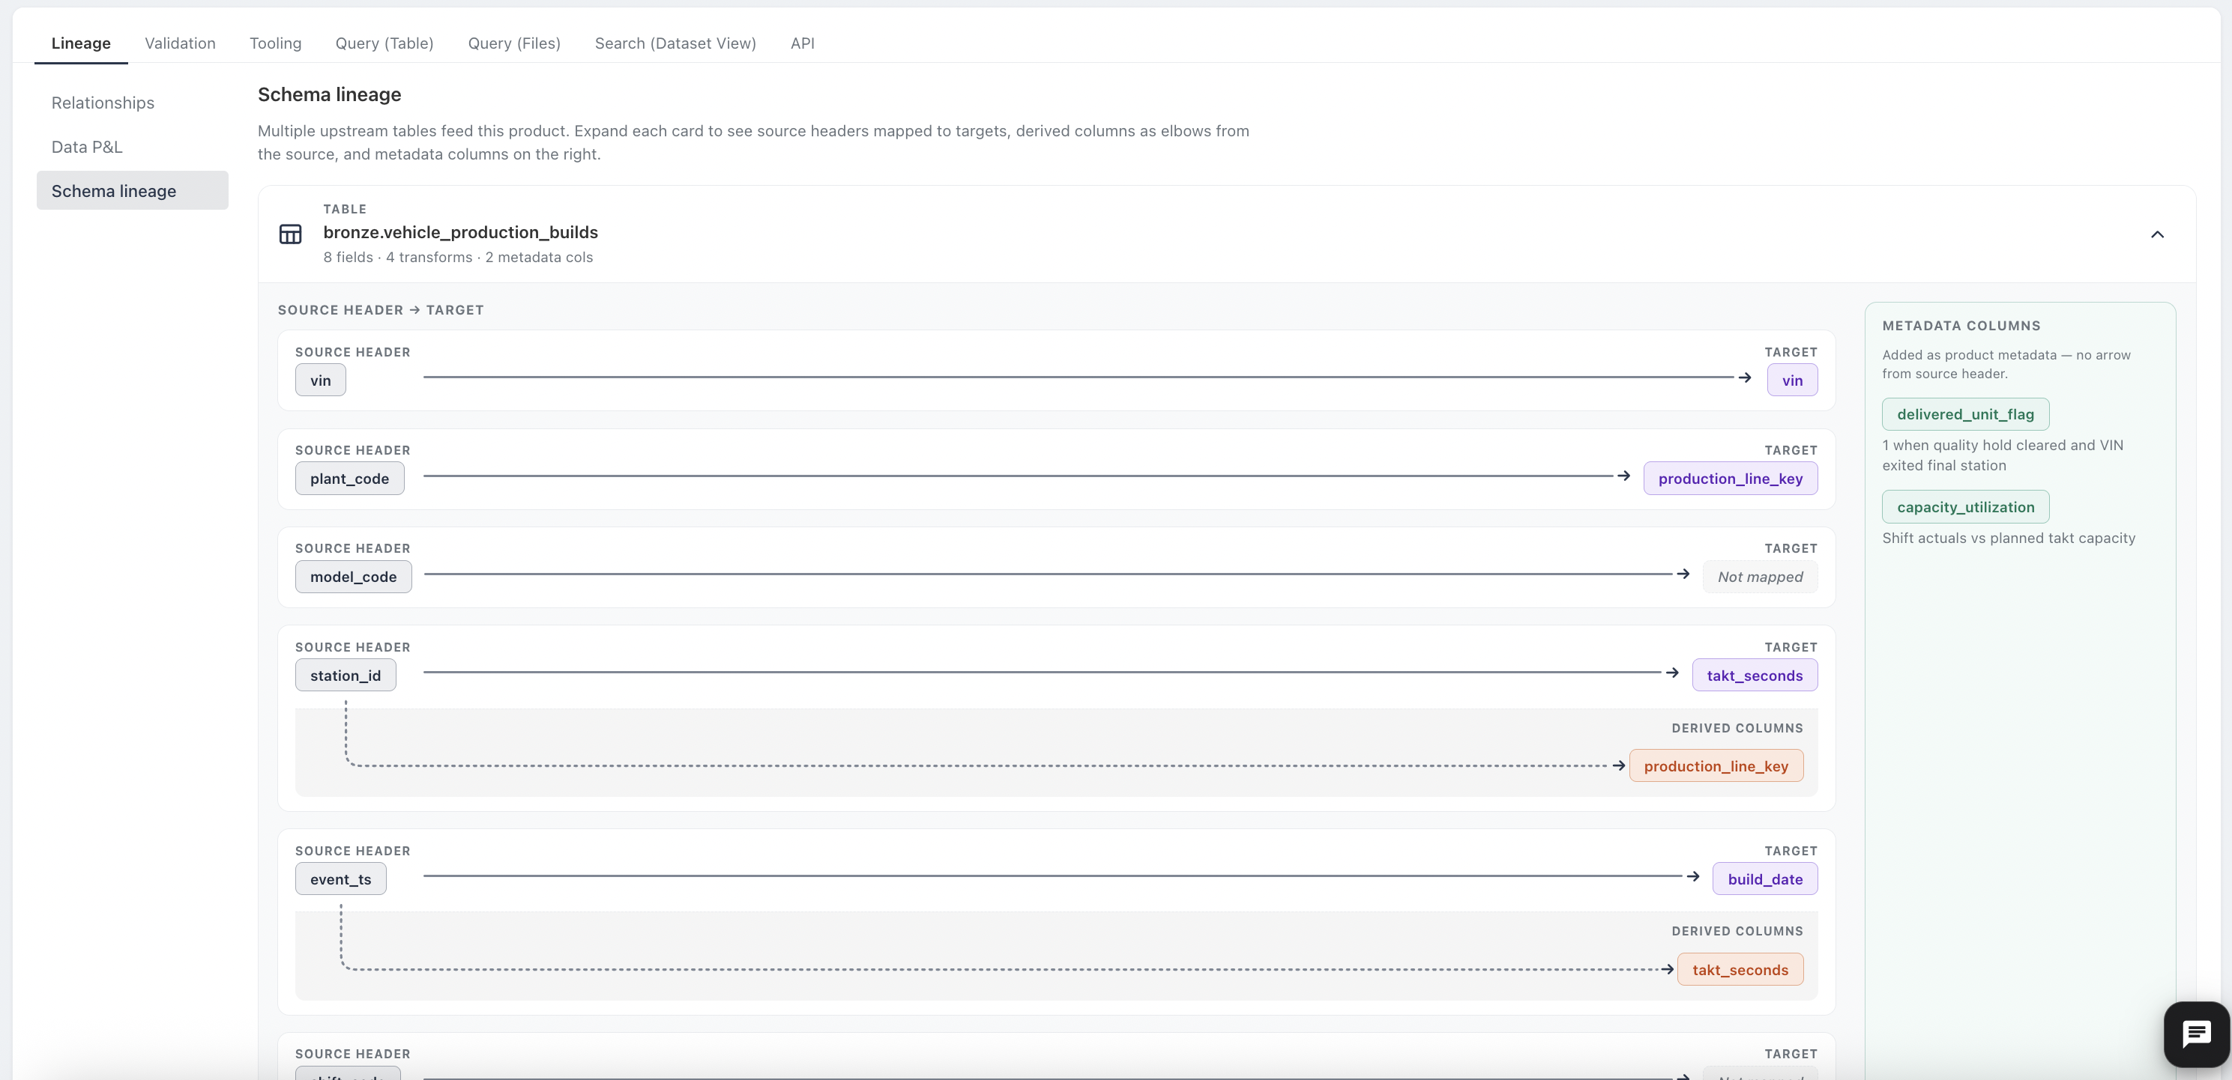
SECTION 7
Lineage
Schema lineage maps source headers to destination headers for structured tabular products
Product-level metadata columns are documented on the right, with no source arrow
Relationships and Data P&L (Provenance & Lineage) views inherit from the Catalog — out of scope for this effort

Slide 14
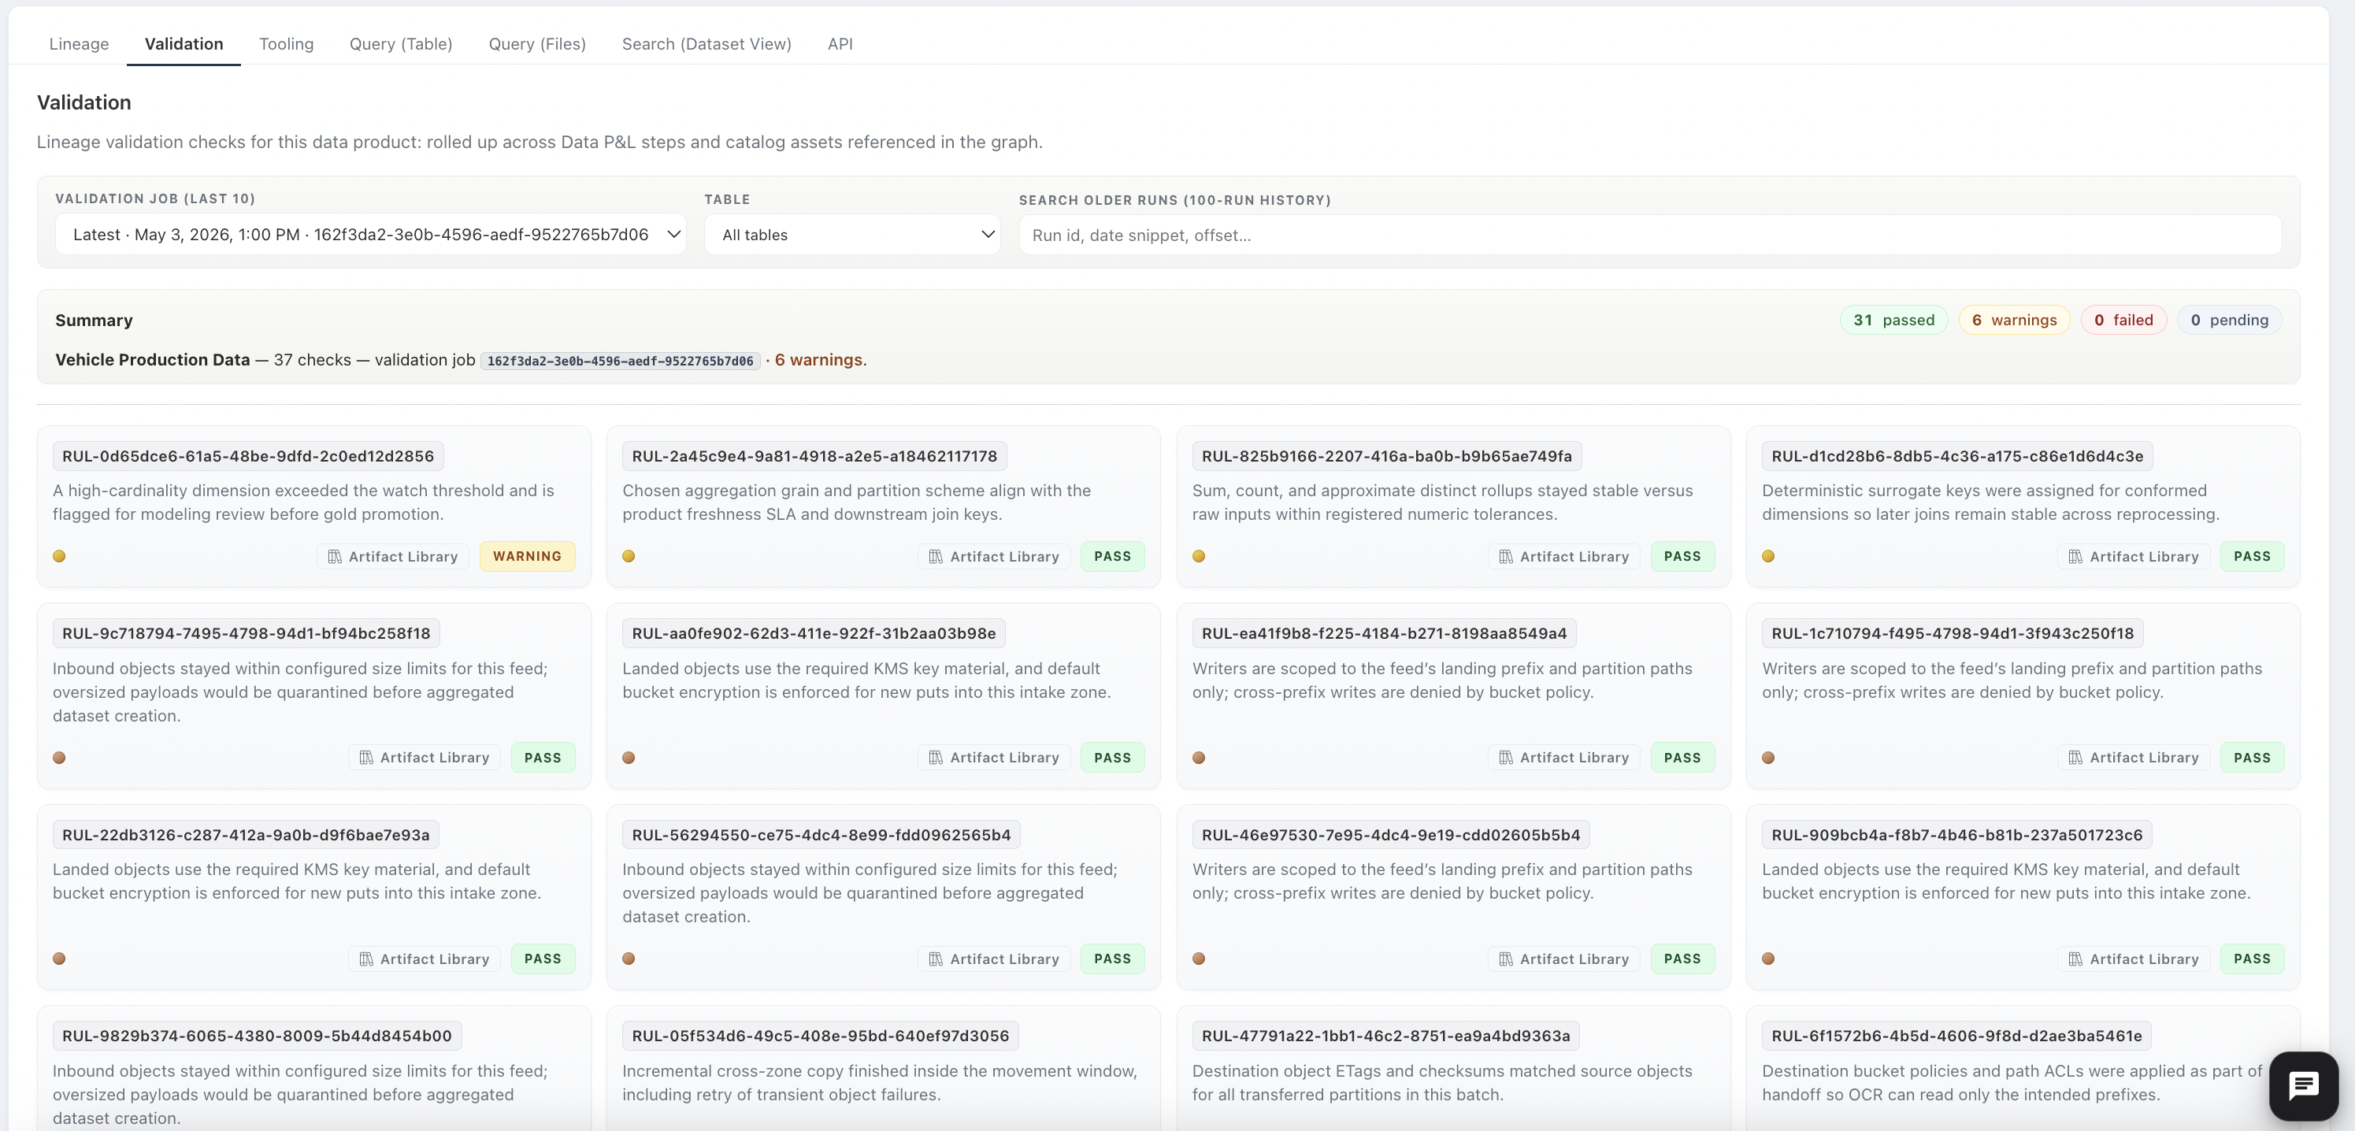
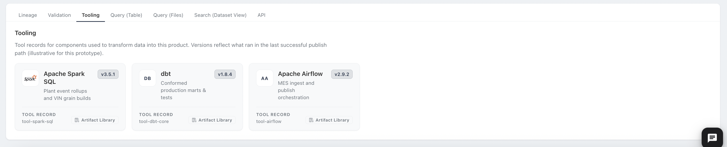
SECTIONS 8 – 9
Validation & Tooling
Validation is generated per product run — pick from the last ten jobs, filter by table, or search 100 runs by run ID
Each rule card: identifier, plain-language description, pass / fail / warning, and a link to its Artifact Library record
Tooling tab lists transform and analysis components bound to the exact versions that ran during production

Slide 15
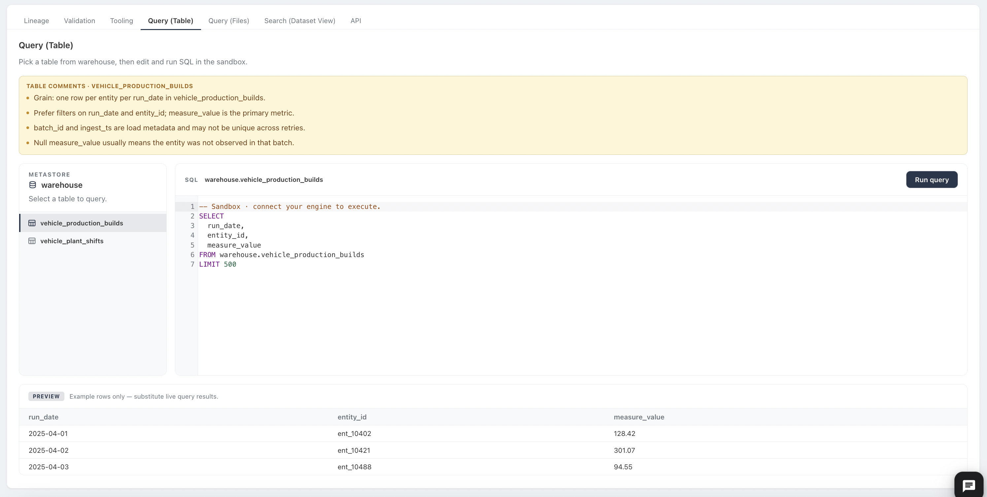
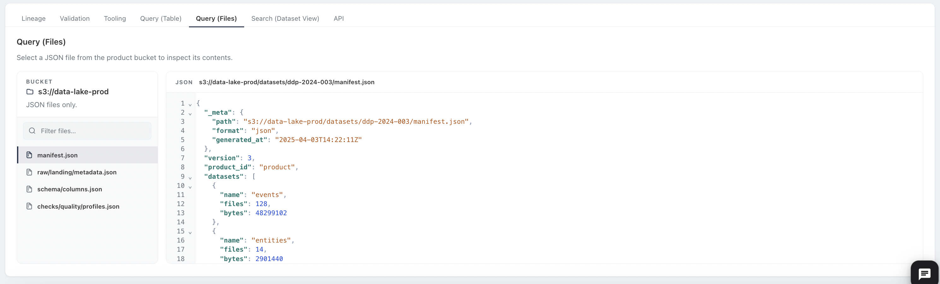
SECTION 10
Query Interfaces
Query (Table): SQL sandbox over the product-scoped metastore, powered by Trino
ETL comments surface producer decision points right beside the data
Query (Files): filterable JSON file inspector for file-delivered products
Everything gated by product entitlements — queryable by anyone with proper access

Slide 16
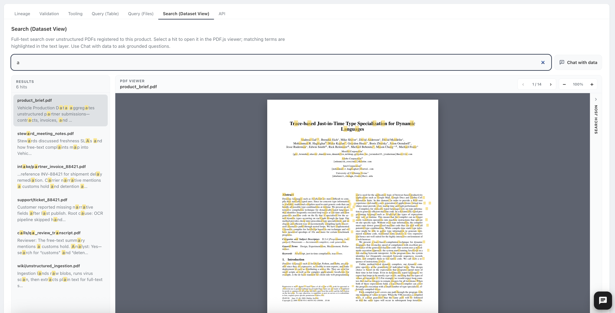
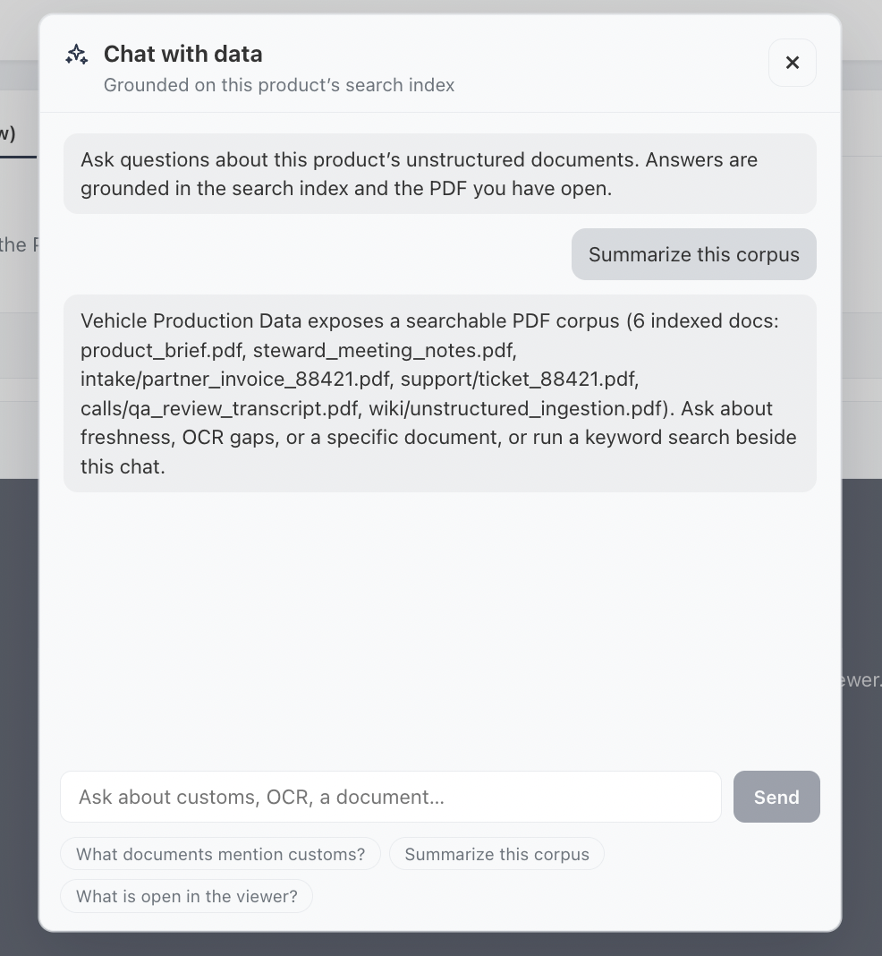
SECTION 11
Unstructured Search & Chat
Dataset-scoped full-text search over extracted content, with highlighted hits and an inline viewer
Visible from dataset records — built for discovery and reference data, not big data
Chat with Data answers grounded in the product's own index, served by OpenSearch + the vector DB behind FastAPI

Slide 17
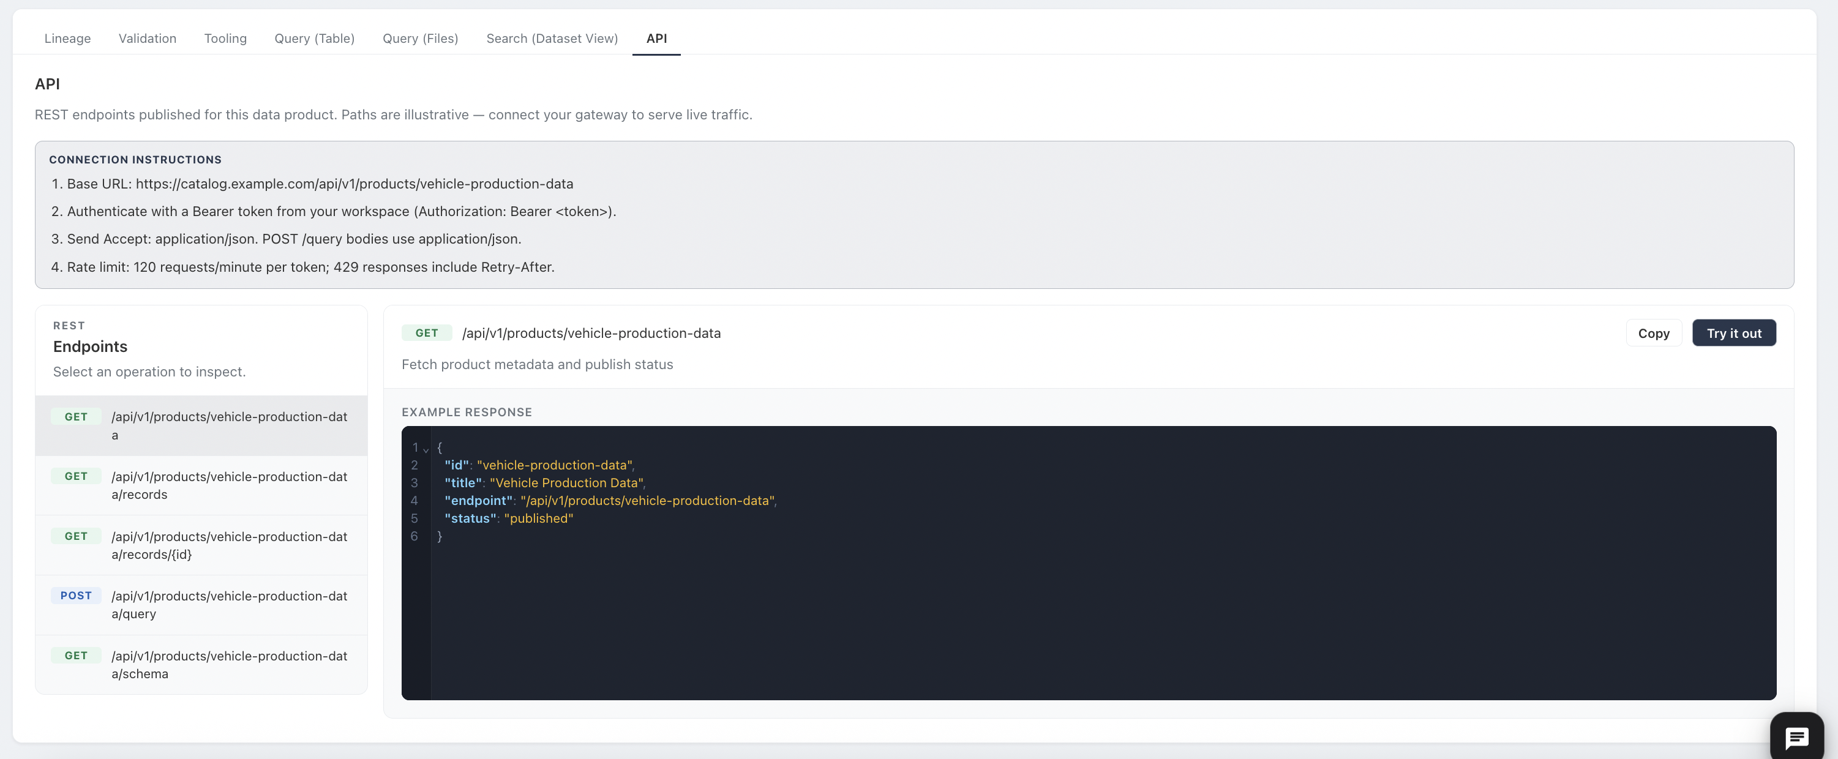
SECTION 12
Data APIs
The API tab documents the REST endpoints published for the product, with a try-it-out console
Intended for discovery data products and reference data — not for big data
Every API ships from the FastAPI template: authenticated, product-scoped, metered, and documented

Slide 18
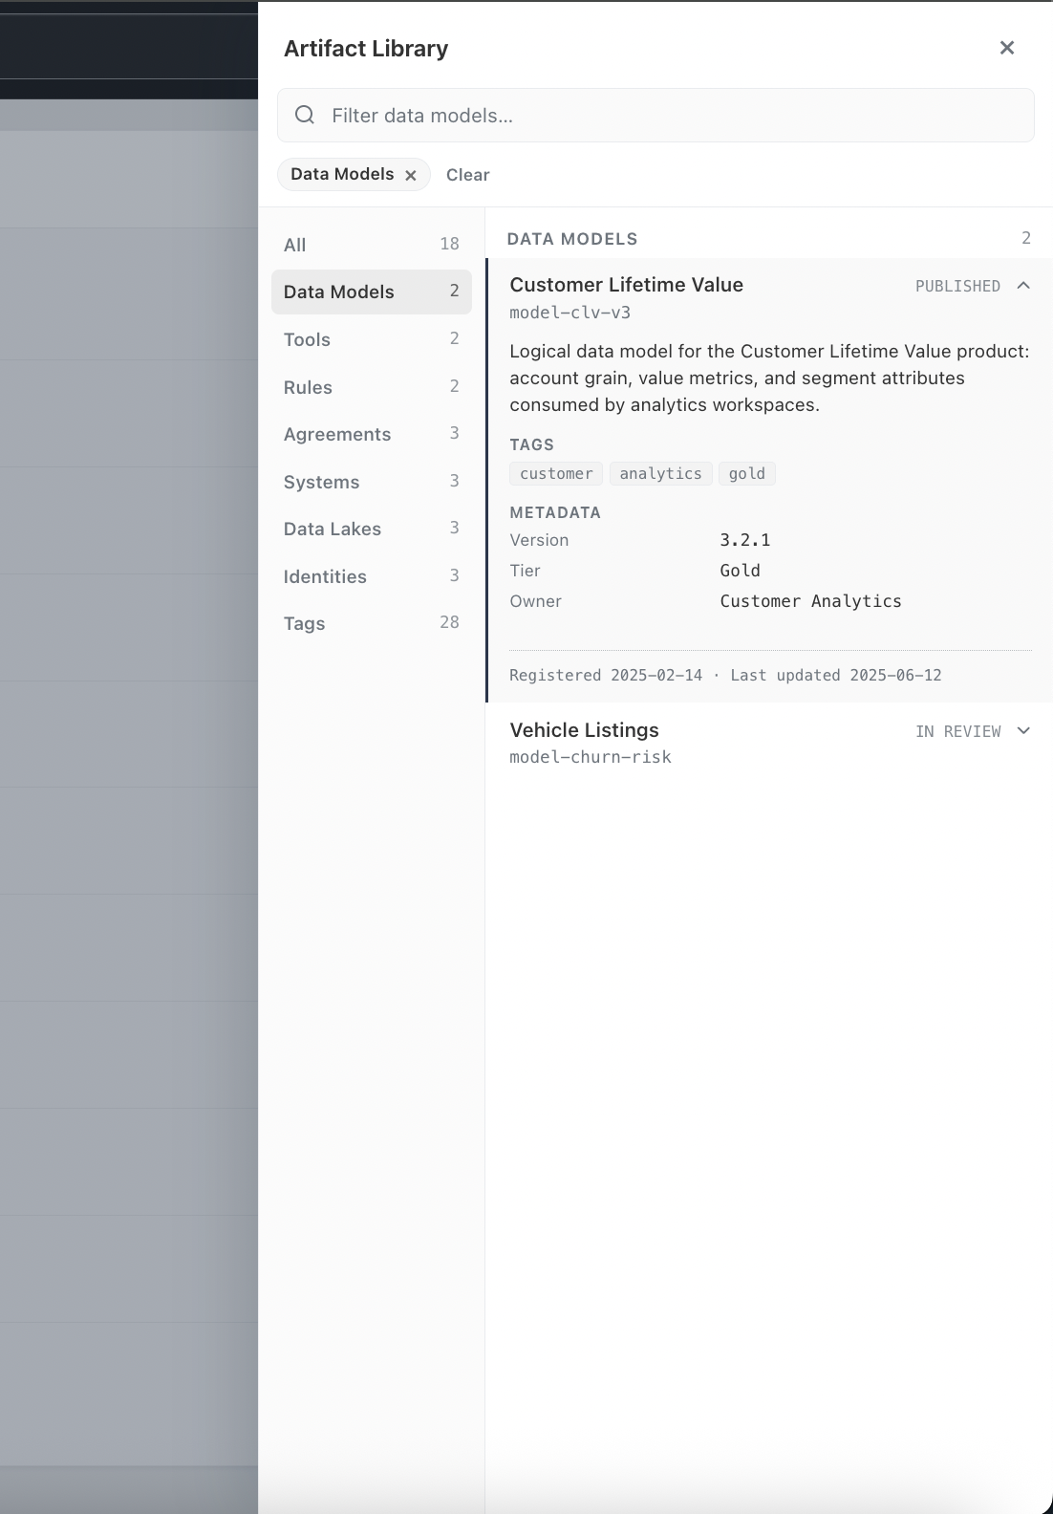
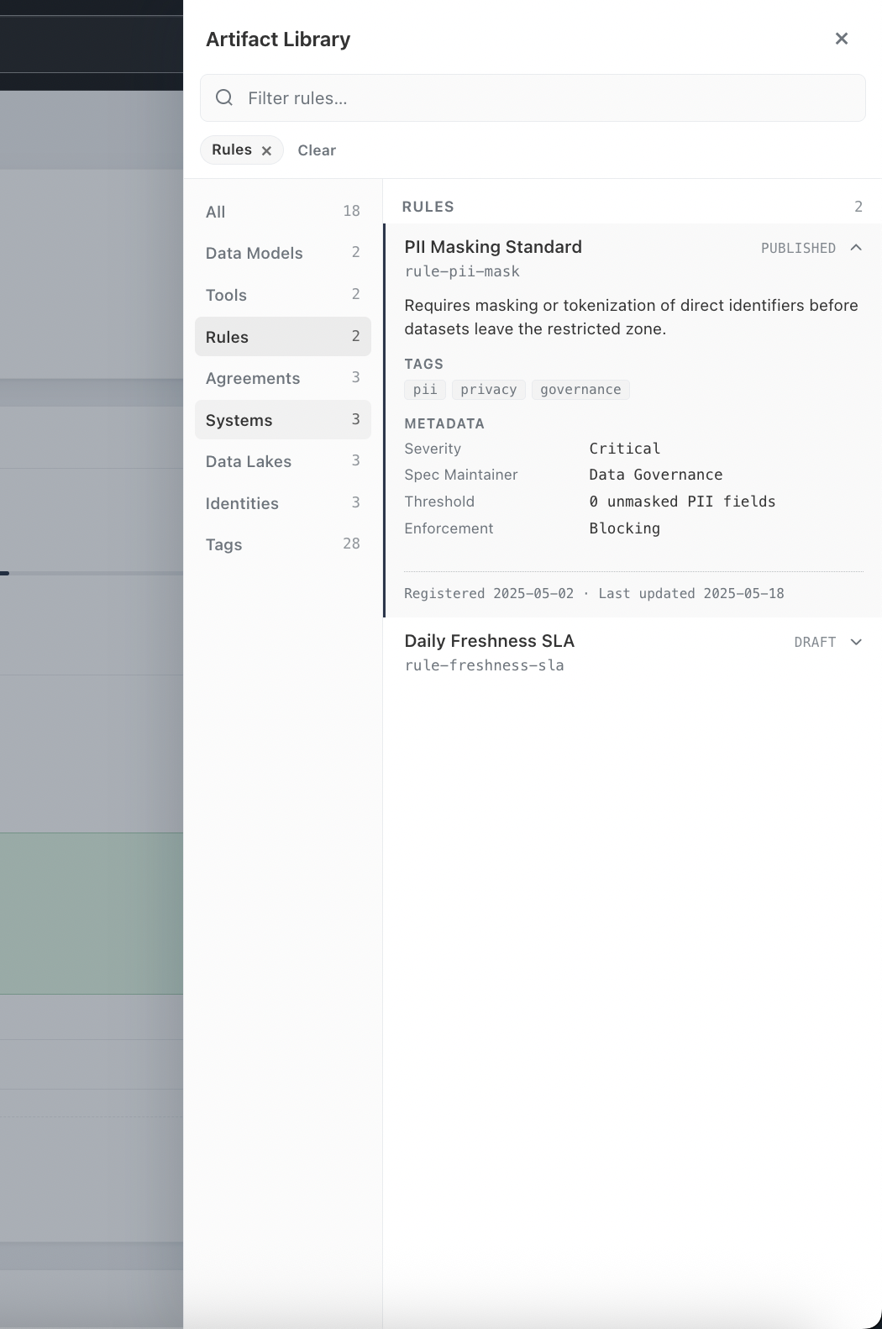
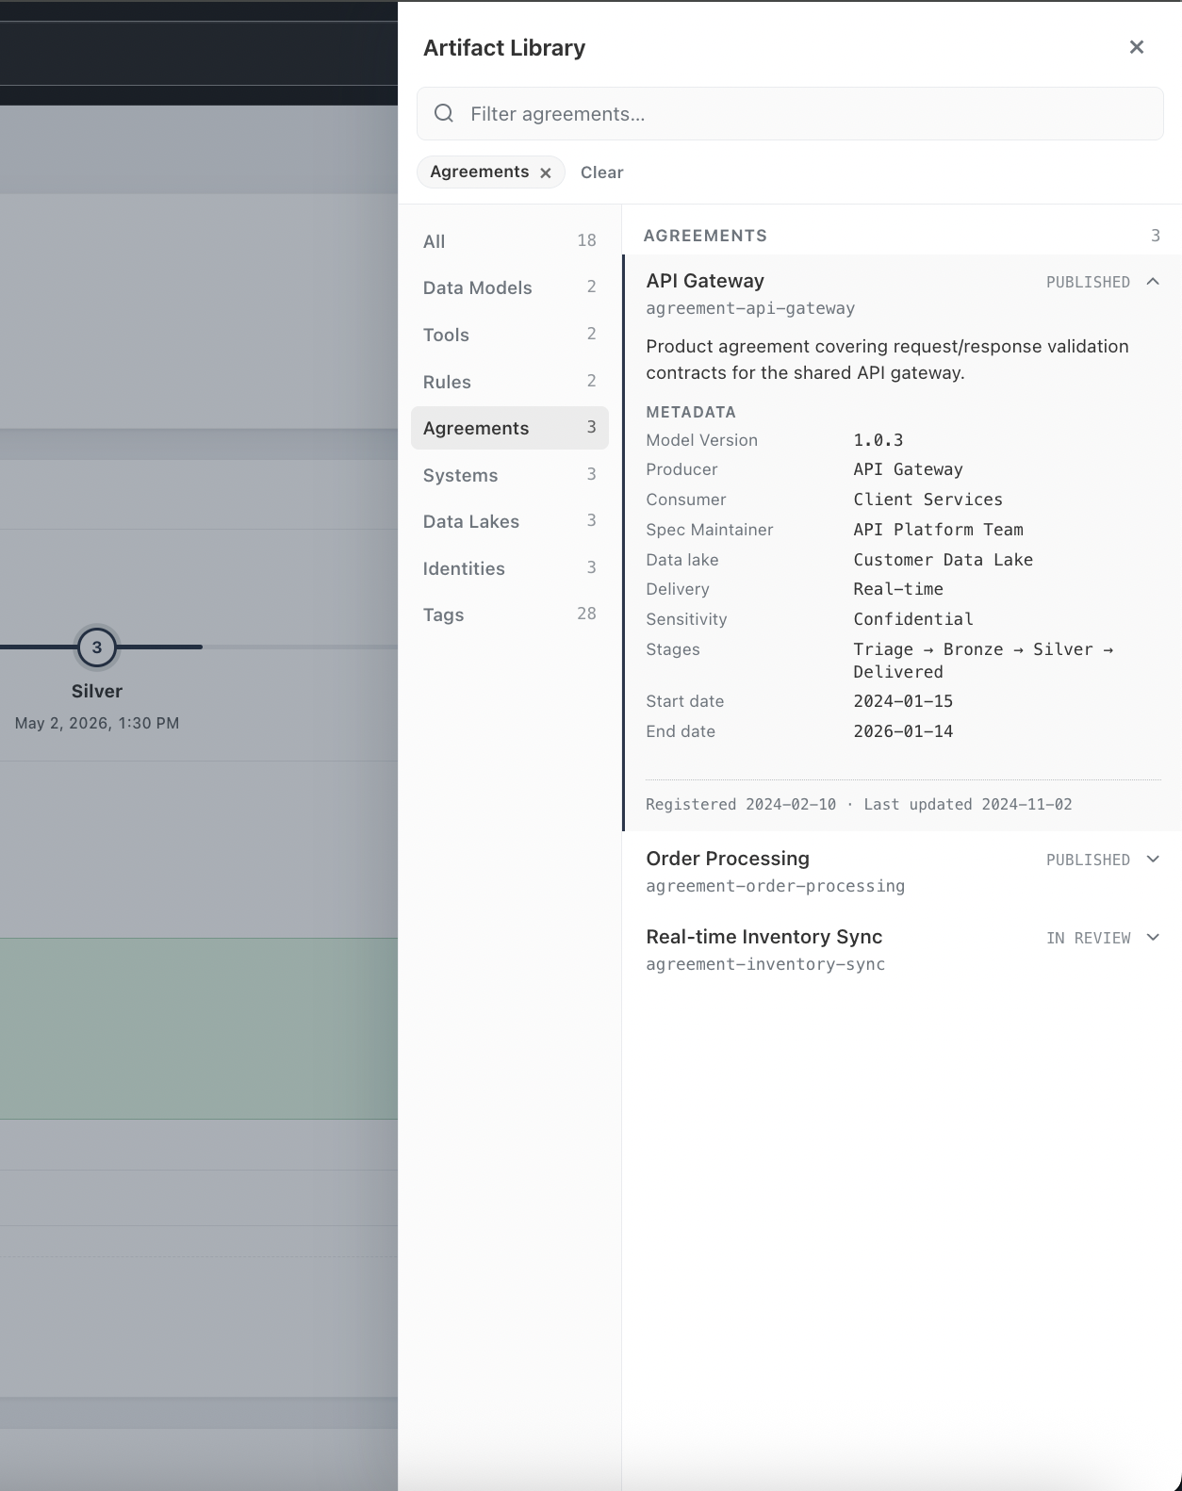
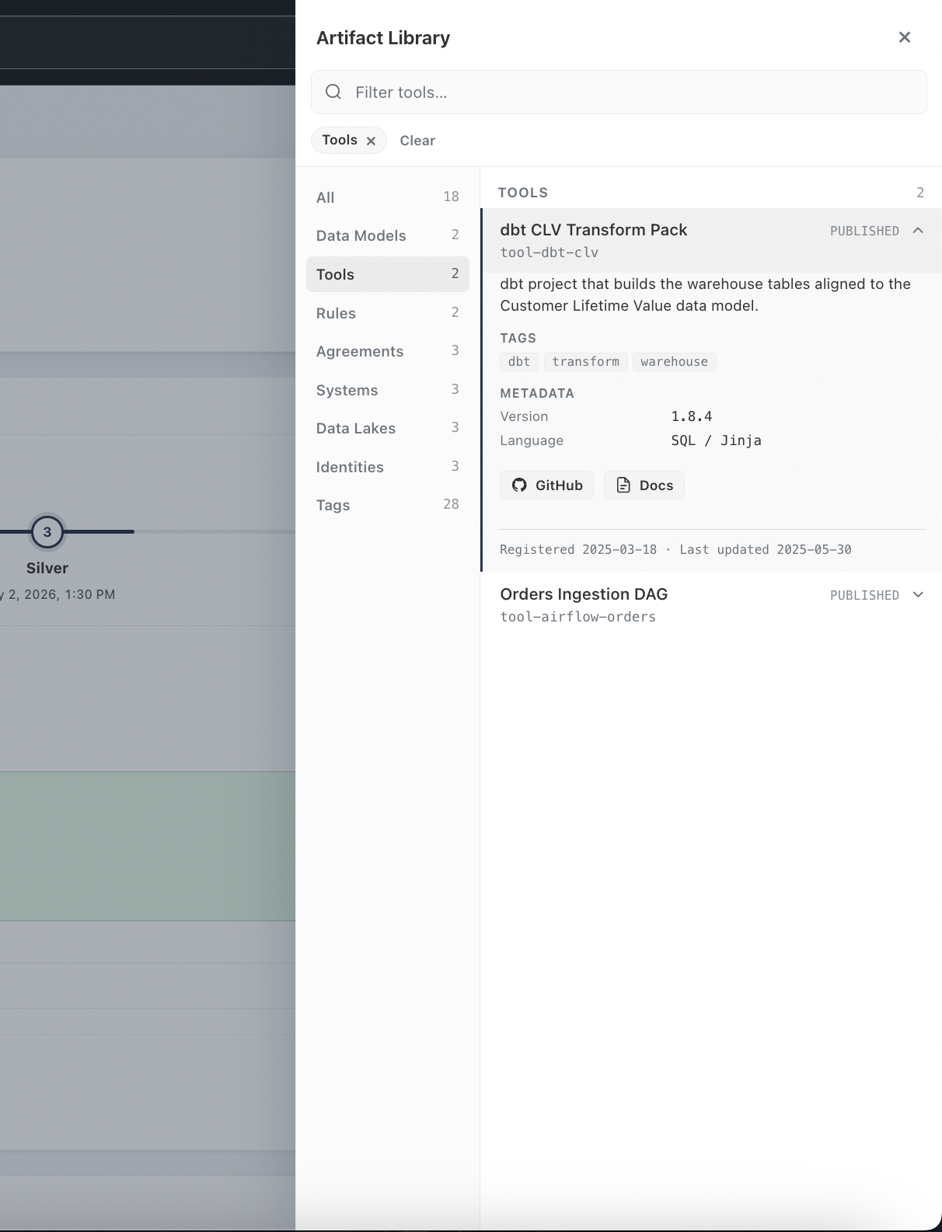
SECTION 13
Artifact Library
Data Models — specifications for modeling data. Rules — validation specs pushed from validator CI/CD. Agreements — dynamic, versioned data contracts bound into records at runtime. Tools — transform components with tags, versions, and source links, pushed from tool CI/CD.
One filterable panel across models, tools, rules, agreements, systems, lakes, identities, and tags — lifecycle status (Draft, In Review, Published) on every record.

Slide 19
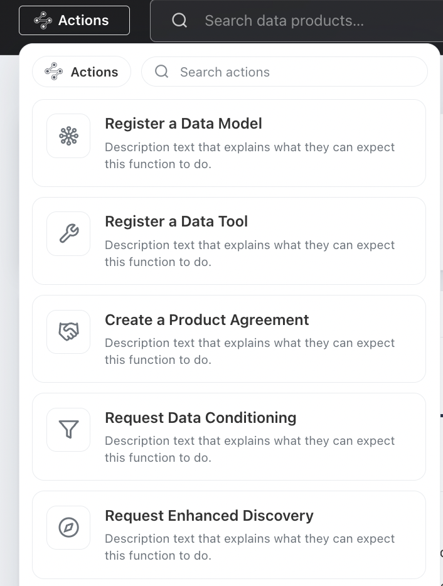
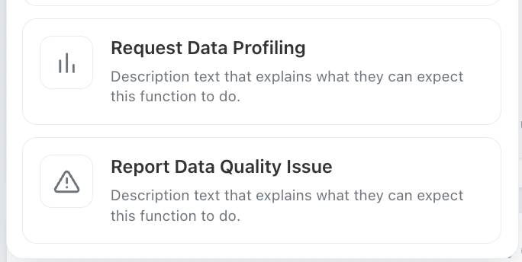
SECTION 14
Actions Menu
A global menu of searchable, self-service workflows — register a model or tool, create an agreement, request conditioning, profiling, or enhanced discovery
Actions are gated by data professional roles
Each action invokes the same governed APIs available to automation

Slide 20
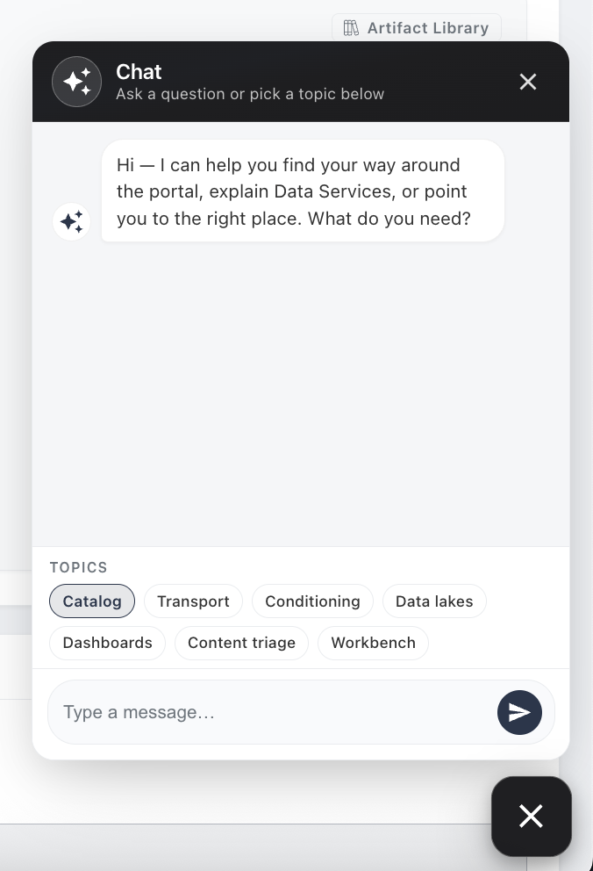
SECTION 15
Chat Assistant
A floating widget available throughout the portal, launched and dismissed from a persistent corner button
Helps users find their way around, explains Data Services, and points them to the right place
Topic shortcuts — Catalog, Transport, Conditioning, Data Lakes, Dashboards, Content Triage, Workbench — scope the conversation
Portal-wide navigation and self-service help, distinct from the product-scoped Chat with Data feature

Slide 21
From registration to transparency
Register
Run ETL
Publish
Index
Deliver
→
→
→
→
model · agreement · tooling
with bound validation
run metadata & content
catalog & search indexes
searchable · queryable · transparent
Every capability in this deck is a projection of this pipeline — no step is manual, and re-running it is always safe.
Data Product Technical Catalog · August 2026

