Slide 1
🗞️ NAIROBI NEXUS
39
Production-Grade AI Newsletter System
Workflow Nodes
5
Week 10 Final Capstone Project
News Sources
Anthony Waliaula-Lead Automation Engineer
Anne Nyambura -Documentation & Slides
n8n Automation • AI Workflow Engineering • June 2026 Github: https://github.com/awaliaula/moringan8nweek10
2×
Fault Layers
40pts
Final Capstone

Slide 2
OVERVIEW
What We'll Cover Today
01
Original Week 8 Design
05
Model Selection & Fallbacks
Architecture, assumptions & what it built
Primary vs fallback strategy
02
Identified Weaknesses
06
Operational Logging
Where the prototype could fail or mislead
Governance, auditability & Google Sheets
03
Structured AI Output
07
Why It's More Robust
JSON enforcement across all agents
Production-grade vs prototype comparison
04
Fault Tolerance Upgrades
Graceful degradation at every layer

Slide 3
WEEK 8 FOUNDATION
Original Design — The Functional Prototype
What we built in Week 8:
⏰
📡
🤖
Schedule Trigger
5 Parallel HTTP Branches
Field Reporter Agents
Fires every Friday 2:00 PM
Africa/Nairobi timezone
TechCabal, Business Daily, The Star,
Standard Media, Kenyan Wall Street
Each branch: own AI agent → extracts
top headline as structured JSON
🔀
✍️
📊
Merging Intelligence
Chief Editor — Kamau
Log & Deliver
Append mode merge of all 5 branch
outputs into one combined list
GPT-4o-mini synthesises witty newsletter
in Kenyan slang under 200 words
Google Sheets logging + styled Gmail
to marketing team for approval
✅ True distributed parallel architecture • Each HTTP paired with its own AI agent • Fault tolerant HTTP nodes • Fallback editor model

Slide 4
ARCHITECTURE
Workflow Architecture
⏰ Schedule Trigger
📡 HTTP
TechCabal
📡 HTTP
Business
Daily
📡 HTTP
The Star
📡 HTTP
Standard
Media
📡 HTTP
Kenyan
Wall St.
🤖 AI Agent
TechCabal
🤖 AI Agent
Business
Daily
🤖 AI Agent
The Star
🤖 AI Agent
Standard
Media
🤖 AI Agent
Kenyan
Wall St.
🔀 Merging Intelligence (Append Mode)
✍️ Chief Editor — Kamau
(GPT-4o-mini + Structured Output)
📊 Google
Sheets Log
📧 Gmail →
Marketing
[ Add screenshot: n8n canvas showing full parallel workflow ]

Slide 5
PROBLEM STATEMENT
What Worked — And Where It Could Break
✅ WHAT WORKED
⚠️ WEAKNESSES IDENTIFIED
True distributed parallel architecture (5 branches)
Each HTTP paired with its own AI Field Reporter
continueRegularOutput on all HTTP nodes
Chief Editor error branch → Backup Agent fallback
Gmail + Google Sheets delivery pipeline
Witty Kenyan slang newsletter output
Chief Output Parser schema mismatch — article schema on newsletter output
Free-text newsletter could break downstream nodes silently
No structured validation = AI could output anything
Google Sheets mapping used wrong field key ($json.output.newsletter)
Rate limiting caused simultaneous agent calls to fail
No governance: couldn't audit which model ran or how many sources succeeded

Slide 6
UPGRADE 1
Structured AI Output & JSON Reliability
Every agent now outputs strict, validated JSON — the system never guesses what the AI meant.
CHIEF EDITOR SCHEMA (Kamau)
FIELD REPORTER SCHEMA (×5 Agents)
{
"type": "object",
"properties": {
"newsletter_title": {
"type": "string"
},
"newsletter_body": {
"type": "string",
"description": "Full Markdown newsletter"
},
"sources_used": {
"type": "array",
"items": { "type": "string" }
},
"word_count": {
"type": "integer"
}
},
"required": [
"newsletter_title",
"newsletter_body",
"sources_used"
]
}
{
"type": "object",
"properties": {
"source": {
"type": "string",
"description": "Publication name"
},
"headline": {
"type": "string",
"description": "Top tech/business headline"
},
"status": {
"type": "string",
"description": "'success' or 'offline'"
}
},
"required": ["source","headline","status"]
}
Why this matters: Downstream nodes (Google Sheets, Gmail) can reliably reference $json.output.newsletter_body instead of guessing field names. Malformed AI responses are caught at the parser, not silently passed on.

Slide 7
UPGRADE 2
Fault Tolerance & Resilient Design
A production system degrades gracefully — it does not collapse.
🌐 Layer 1 — HTTP Safety
🔁 Layer 2 — Model Fallback
🛡️ Layer 3 — Field Reporter Fallbacks
onError: continueRegularOutput on ALL 5 HTTP nodes
Offline source → Field Reporter receives fallback text
Agent marks status: 'offline' in JSON output
Merge node collects ALL branches regardless
Chief Editor filters silently by status === 'success'
Chief Editor: onError: continueErrorOutput
Primary fails (timeout/quota) → Error Branch fires
Backup Editor AI Agent activates automatically
Uses GPT-4-turbo (OpenRouter) as fallback model
Both Chief and Backup: executeOnce: true
Each Field Reporter has its own fallback LLM
Business Daily, The Star, Standard, KWS all have OpenRouter fallback models
If primary OpenAI call fails, OpenRouter takes over per branch
Failure isolated — one reporter failing doesn't cascade
Each branch is fully independent from trigger to merge

Slide 8
UPGRADE 3
Model Selection, Constraints & Fallbacks
Agent
Primary Model
Fallback Model
executeOnce
Role
Field Reporters (×5)
GPT-4o-mini
(OpenAI)
OpenRouter
(per branch)
No
JSON extractor
Chief Editor
GPT-4o-mini
(OpenAI)
GPT-4-turbo
(OpenRouter)
Yes
Newsletter writer
Backup Editor
GPT-4-turbo
(OpenRouter)
—
Yes
Emergency fallback
Output Constraints Enforced on Chief Editor:
📏 Under 200 Words
🗣️ Kenyan Slang ×3
📋 Markdown Format
✅ Success Sources Only
Hard limit in prompt rules — word_count field captured in JSON output
Minimum 3 slang terms: Bazeng, Manze, Hii ni kubwa, Wueh!, Msee, Poa sana
newsletter_body field enforces Markdown structure via output parser schema
Chief filters status === 'success' — offline sources silently excluded

Slide 9
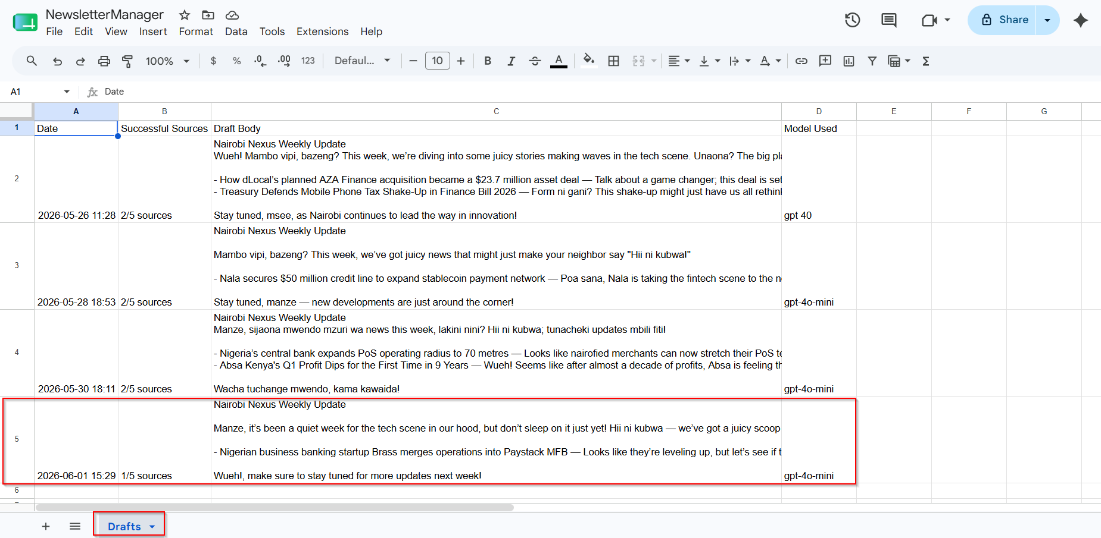
UPGRADE 4
Operational Logging & Governance Signals
If someone asks “What happened last Friday?” — the system can answer.
📊 NewsletterManager → Drafts Tab
Date
Successful Sources
Draft Body
Model Used
Governance Signals
$now.setZone('Africa/
Nairobi')
$json.output.
sources_used.join(',')
$json.output.
newsletter_body
Primary / Fallback
model name
🕐 Execution timestamp (Nairobi TZ)
✅ Sources succeeded (e.g. 1/5)
📝 Full newsletter body stored
🤖 Which model generated output
📌 Status: primary or fallback path
The workflow is fully auditable after every execution. Leadership can see exactly what ran, what succeeded, and what model wrote the newsletter.

Slide 10
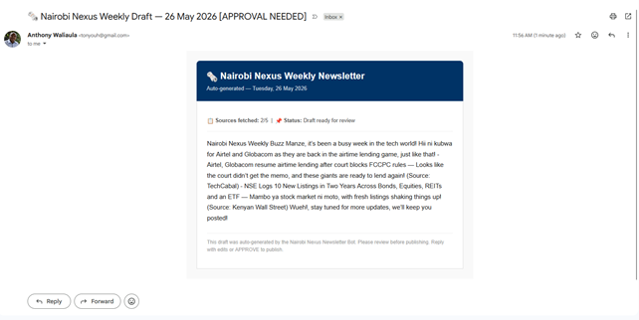
LIVE OUTPUT
Chief Editor — Live Output Sample
Structured JSON Output (Chief Editor):
📧 Gmail Delivery Preview
{
"newsletter_title":
"Nairobi Nexus — Fibre Turf:
Safaricom's $6 Play",
"newsletter_body":
"Quick hits from the streets
of Nairobi.\n\nSafaricom just
rolled out a KES 800 Fibre
Lite + Wi-Fi Bamba pilot...
Manze, this is Bazeng —
undercutting estate ISPs!
Poa sana for households,
Wueh! for competition.
Unaona?",
"sources_used": ["TechCabal"],
"word_count": 111
}
Sheets row logged: 2026-06-06 14:00 | TechCabal (1/5) | [newsletter body] | gpt-4o-mini

Slide 11
COMPARISON
Prototype vs Production — What Changed
Dimension
Week 8 Prototype
Week 10 Production
AI Output
Free-form Markdown text
Strict JSON via Structured Output Parser
Chief Parser Schema
Wrong schema (article fields)
on newsletter output
Correct schema: newsletter_title,
newsletter_body, sources_used, word_count
Downstream Safety
Sheets mapping guessed field
names — returned 'undefined'
Reliable $json.output.newsletter_body
reference — always resolves
Model Fallback
Chief Editor only
All 5 Field Reporters + Chief Editor
have independent fallback models
Logging Depth
Date + draft body only
Date, sources count, newsletter title,
body, model used — fully auditable
Rate Limiting
5 agents firing simultaneously
caused API throttling
executeOnce + proper branch isolation
reduces concurrent calls

Slide 12
ROBUSTNESS
Why This System Is More Robust
🔒
Predictable AI Outputs
🌐
Multi-Layer Fault Tolerance
JSON schema enforcement means any malformed response is caught at the parser — never silently passed downstream to break Gmail or Sheets.
HTTP safety + per-branch model fallbacks + Chief Editor fallback = 3 independent protection layers. A single failure cannot stop the workflow.
🤖
Deliberate Model Strategy
📋
Full Operational Visibility
Primary models chosen for quality (GPT-4o-mini). Fallbacks chosen for reliability (GPT-4-turbo via OpenRouter). The system decides — it doesn't hope.
Every run logs source count, model used, newsletter title, body and timestamp. Leadership can audit any Friday's run in under 30 seconds.

Slide 13
ASSESSMENT
Rubric Alignment — Week 10 (40 Points)
Structured AI Output
& JSON Reliability
10 pts
Fault Tolerance
& Resilient Design
10 pts
All 5 Field Reporters: Structured Output Parser (source, headline, status schema)
Chief Editor: Structured Output Parser (newsletter_title, newsletter_body, sources_used, word_count)
Malformed responses caught at parser — downstream nodes never receive bad data
continueRegularOutput on all 5 HTTP nodes
Chief Editor onError: continueErrorOutput → Backup Editor
Per-branch OpenRouter fallback models on all Field Reporters
executeOnce: true on Chief + Backup prevents duplicate newsletters
Model Selection,
Constraints & Fallbacks
10 pts
Operational Logging
& Governance Signals
10 pts
Primary: GPT-4o-mini (quality), Fallback: GPT-4-turbo (reliability)
Output constraints: under 200 words, ≥3 Kenyan slang terms, Markdown format
Chief Editor filters status==='success' — offline sources excluded
Error-triggered routing is deliberate and tested
Google Sheets Drafts tab: Date, Successful Sources, Draft Body, Model Used
sources_used array from structured output mapped to Sheets
Execution timestamp in Africa/Nairobi timezone
System fully auditable after each Friday run

Slide 14
TEAM
Team Roles & Contributions
Anthony Waliaula
⚙️ Workflow
Anne Nyambura
📝 Docs & Slides
n8n workflow configuration & architecture
All 5 HTTP + AI Agent branch setup
Structured Output Parser schema design
Model fallback routing (OpenAI + OpenRouter)
Chief Editor prompt engineering
Google Sheets & Gmail node configuration
Workflow JSON export & testing
Project documentation & README
Week 8 submission document
Presentation slide deck (this deck)
GitHub README and repo structure
Non-technical narrative and write-ups
Workflow architecture diagrams
QA review & submission coordination
Submission deadline: Sunday 7th June 2026 • Week 10 Final Capstone

Slide 15
🗞️ NAIROBI NEXUS
Anyone can automate a happy path.
This system was designed for failure, uncertainty, and scale.
Anthony Waliaula • Anne Nyambura
Week 10 Final Capstone • n8n AI Workflow Engineering
Thank you — Q&A
39
5
3
100%
2×
Nodes
Sources
Fault Layers
Structured Output
Model Fallbacks

