Slide 1
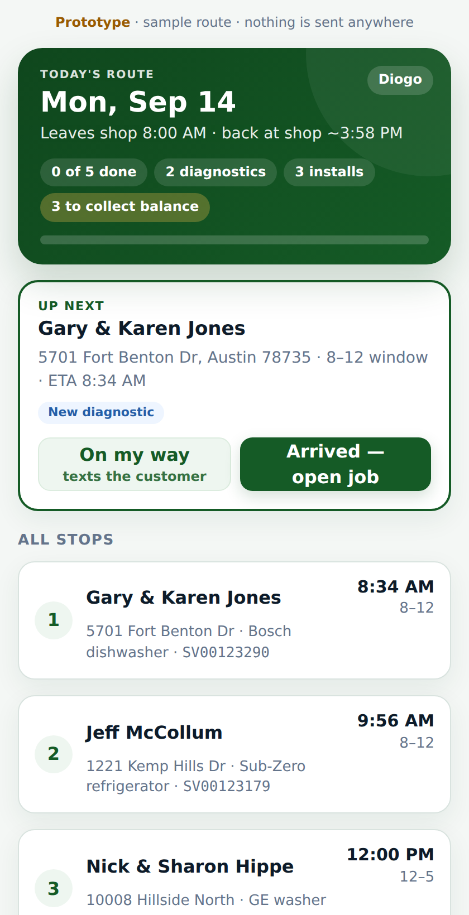
Wilson AC & Appliance · Service
Where our service calls go —
and where the time goes
A look at the process from the customer's first text to the last card charge, using our own 2026 numbers — and a proposal to move it into the dashboard one piece at a time.
Service team meeting · September 2026
Notes:
Frame: this is about our own data and our own process, not software. Ten minutes of slides, then two short live demos. Nothing is decided today except two small pilot asks at the end.

Slide 2
Our own numbers, January 1 – September 10
Source: ePASS OE-23 (SV invoices), ExportInvoice (open tickets), DispatchTrack export — pulled 9/10
15 days
33%
657
median from ticket created to finished
of billed calls end at the $169.95 diagnostic with no repair sold
open service tickets right now
p90 is 46 days
ranges 23%–56% by tech
95% carry a date in the past
Every one of these is a phone call. "Where's my part?" · "When are you coming?" · "Did you get my request?" — the customer can't answer any of them without calling us, and a third of our diag visits end without a sale.
16
2–2.5
west-side jobs with parts in hand, waiting to be scheduled
completed COD jobs per tech per day (3.5–4.5 stops with warranty)
about two full trip days
2,303 invoices · $781k
Full breakdown by tech and zone: docs/06_Data_Findings_Sep2026.md
Notes:
Let the numbers sit. These are theirs, from their reports. The 15-day median is the customer experience; the 33% is where the field quote lives; the 657/95% is the Saturday dump day and stale dates; the 16 west jobs is the argument for grouping trips. Don't explain the fixes yet.

Slide 3
What stays exactly the same
Before anything else — the parts of how we work that this does not touch
✓
Same status codes
✓
The tech who diagnoses owns the call
SO1 through SO9, SO4PRE, WAR — the codes you know, in ePASS and on the dashboard.
Installs, revisits and callbacks stay with the diagnosing tech. The system enforces it.
✓
Demitrius owns the board
✓
Noell owns quotes and billing
Two-truck view, drag and drop, pins. The board proposes; he decides. Nothing moves without him.
She reviews what the system builds and handles the exceptions — she stops re-typing PDFs.
✓
John runs his own route
✓
ePASS stays until NetSuite
West trips are built by the office and sequenced by John. The optimizer never touches his stops.
The dashboard becomes the source of truth; ePASS is kept in step by a sync queue, not by techs.
Decisions log: docs/01_Service_Journey_Blueprint.md §13
Notes:
This slide answers the fear before it's voiced: nobody is being replaced or overruled. Say the John and Demitrius lines out loud and look at them when you say it.

Slide 4
What changes — mostly work that goes away
One line per person. Red is what stops; green is what starts.
STOPS
STARTS
Techs
the next-morning write-up in ePASS · re-typing parts and labor · touching ePASS at all
notes, photos, parts and labor on the phone at the job · quote in the field, customer signs · "On my way" texts itself
Demitrius
building every route from scratch · the Saturday dump day · chasing SO5s to marry with SO1s
a board that proposes routes and trip days · customers pick their own windows · he supervises and overrides
Parts
running the SO2 and SO3 reports · price-checking quotes that already went stale
a verify queue that fills itself the moment a tech submits · PO builder · ETA that drives the customer's tracker
Noell
the quote PDF drop · manual SO3 flips · running the card by hand
quotes built from the tech's lines and sent automatically · an exceptions queue · auto-charge at completion
Michael
"TICKET MADE. MSD" · typing tech notes into ePASS
a paste-ready packet per ticket that confirms itself on the next import
Customers
calling to ask where their part is · calling to schedule · waiting for a call back
pick a time on the form · a tracker like a pizza order · a text at every step
The tech row is the live demo in a minute. Everything in the STOPS column is a report someone remembers to run today.
Notes:
Read the STOPS column first for each row. People hear "you lose the morning write-up" very differently from "you get a new app." Then the demo shows the tech row for real.

Slide 5
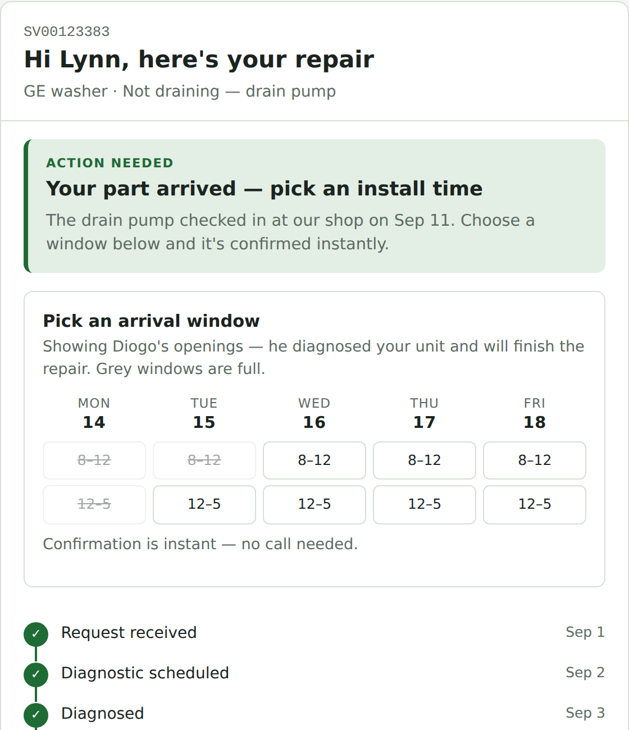
What the customer sees
"Is my repair ready yet?" — the page that replaces the phone call
Form submitted
We've got your request for your dishwasher. Your reference is SV00123421. Track it here: {link}
Parts ordered
Parts for your dishwasher are ordered and expected Sep 18. We'll text the moment they check in so you can pick your install time.
Part arrived
Your part is in! Pick an install time with Diogo: {link}
Repair complete
Your dishwasher is repaired. Your receipt: {link}. Thanks for choosing Wilson.
Nine stages, dates on each, and the one thing the customer can do right now. Customers in the Hill Country and Austin pick their own windows; far-out areas are told we group visits and get a date by text; out-of-area gets a call.
Notes:
The tracker and the texts are Phase 1 and require nothing from the techs or parts. That is deliberate: the first thing that ships takes calls away from Client Care without changing anyone's workflow. All wording is editable — Noell has the copy deck.

Slide 6
How it ships, and what I'm asking for today
Each phase is useful on its own. Phase 1 changes nothing about how any of us work.
0
Foundation
Import from ePASS every 15 min · one job record · sync queue replaces "TICKET MADE"
Michael keys from a packet; nobody else notices
THE ASK
Two techs pilot the field tool for two weeks
alongside ePASS, not instead of it. We compare their notes timing and quote rate to the others.
One hour with Demitrius
on the zone table and the trip rules — the board should encode his judgment, not replace it.
Thirty minutes with Noell and Michael
on the parts and sync queues, before the developer builds them.
1
Customer visibility
Tracker + automatic texts, driven by ePASS status
Calls drop. No workflow change for anyone
2
Field tool & quotes
Tech phone tool · field quotes with signature · parts verify queue
Techs stop writing up the next morning
3
Parts pipeline
PO builder · receiving → SO5 · ETA everywhere
Parts stops running reports
4–6
Scheduling
Customers pick windows · board proposes routes and trips · auto-charge
Demitrius supervises instead of builds
Blueprint, prototypes and the developer spec are in C:\Dev\service_call_journey — anyone can open them.
Notes:
Do not ask for approval of the whole plan. Ask for the three small things on the right and stop talking. The people who say yes become co-authors; that is how the loudest skeptic gets converted.

