Slide 1
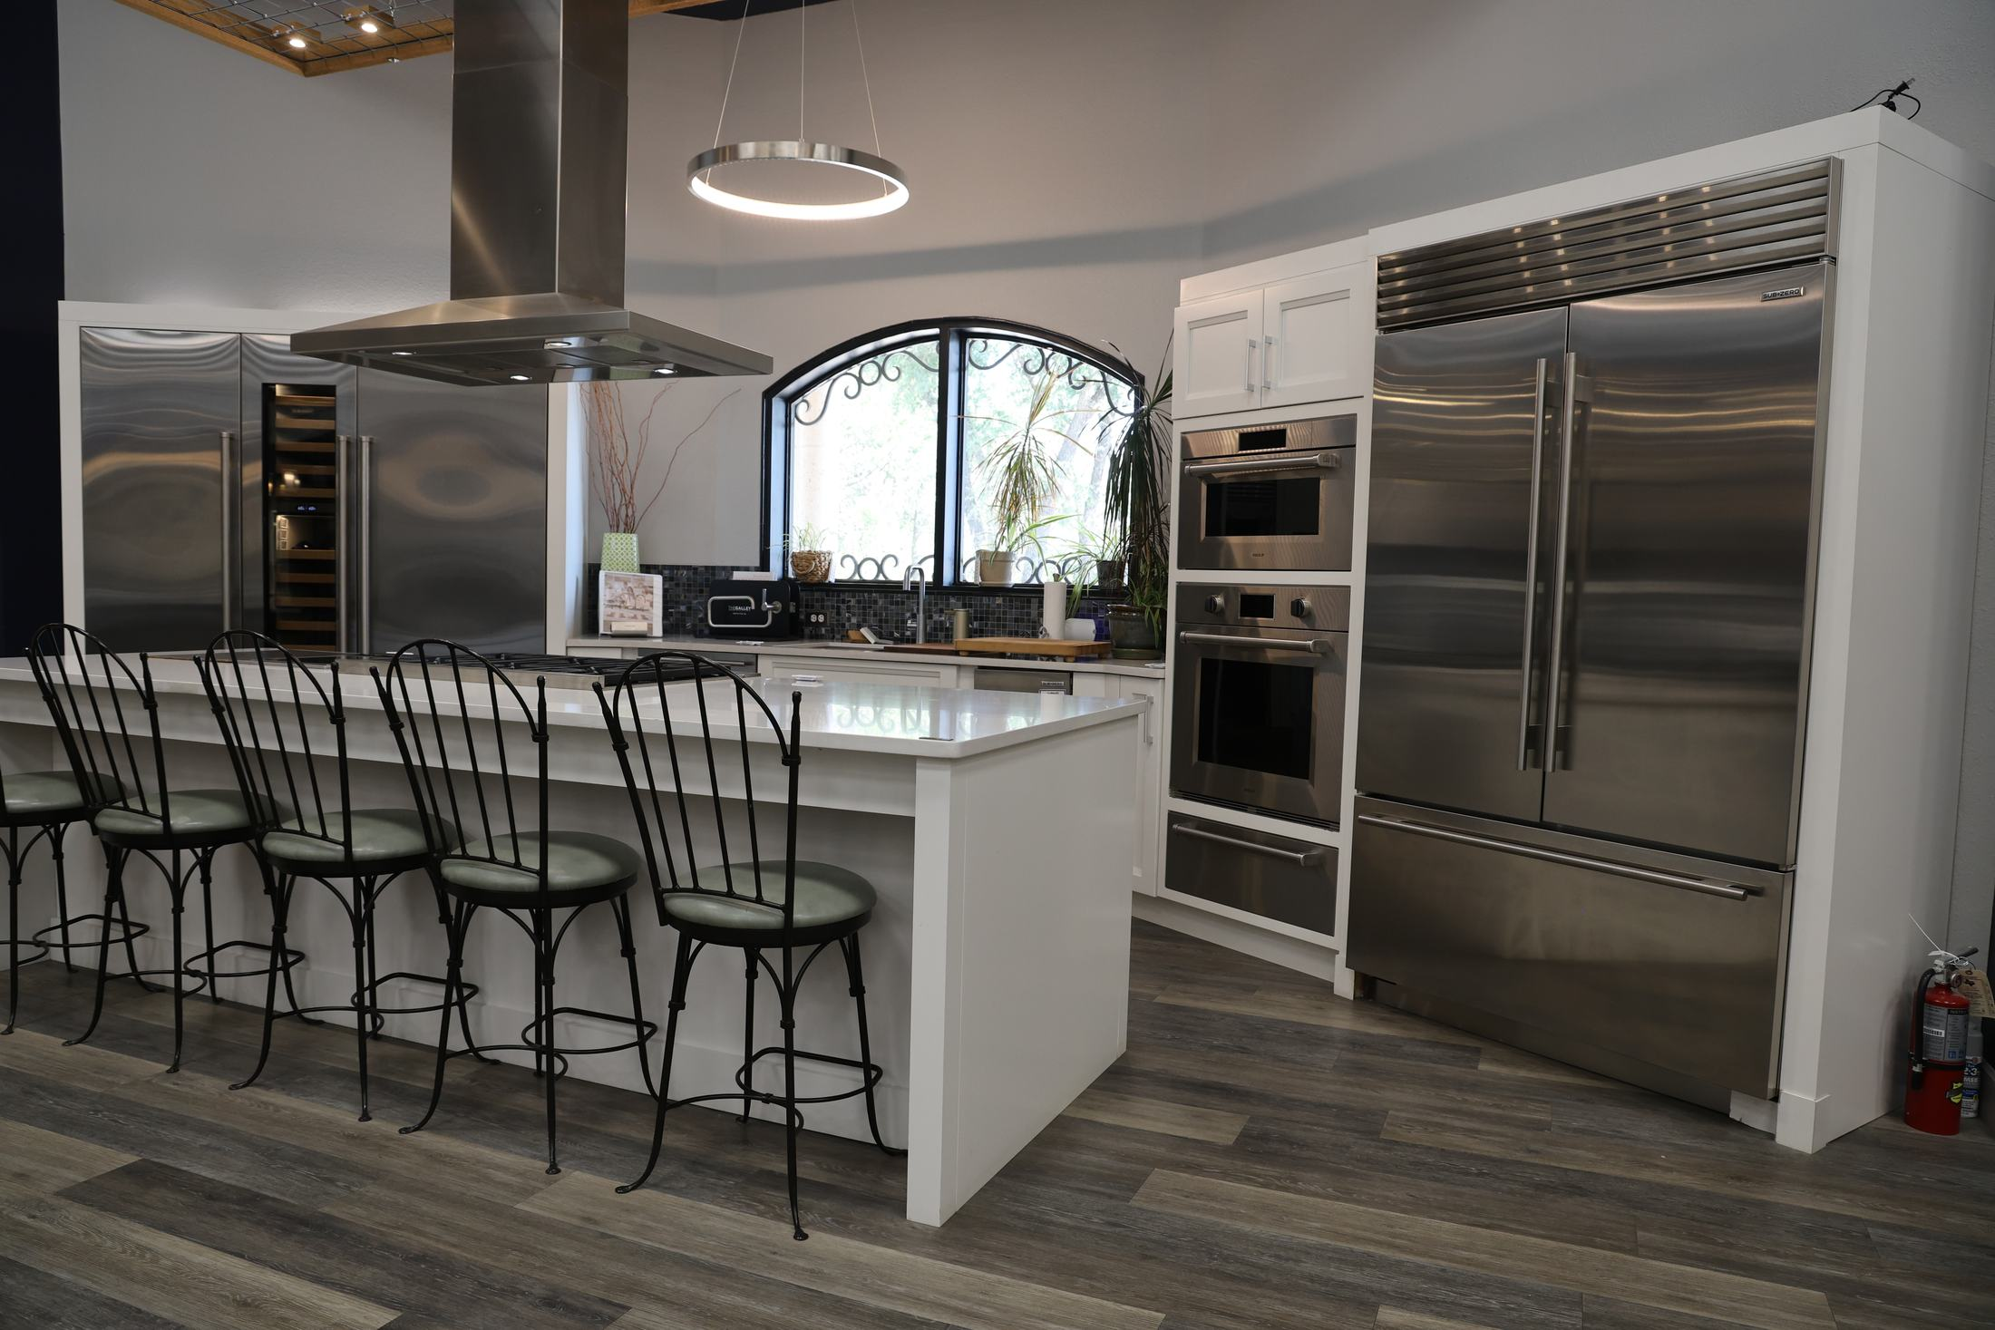
WILSON AC & APPLIANCE · LEADERSHIP BRIEFING
Agility:
Two Weeks of
New Tools
Everything we shipped August 13–27, what it does,
and what it means for your team.
August 27, 2026 · Department Managers
Notes:
Welcome — this walks through every tool and enhancement released in Agility over the last two weeks, grouped by the team it serves. Photo: our own SZWC living kitchen display, now live on the Sub-Zero landing page.

Slide 2







THE LAST TWO WEEKS
A lot shipped. Here's the shape of it.
40+
6
3
1
releases pushed
to production
department areas
touched
brand-new tools
(estimates, shop, scheduler)
principle everywhere:
nothing sends without a click
Where the work landed
Payments & receipts
Service estimates
Sub-Zero showroom
Online clearance shop
Commissions
Operations & visibility
Notes:
Rough count from the release log: 40+ production pushes since August 13. Three tools are entirely new: the service estimate tool, the online clearance shop, and the Sub-Zero consultation scheduler. Everything customer-facing follows the same rule — a person clicks, or nothing sends.

Slide 3







PAYMENTS & RECEIPTS
Getting paid — and proving it — got faster.
Text or email the pay link. One click sends it from the showroom number or the sender's email — copy/paste is now the fallback, not the default.
Podium knows about every payment. When a client pays, an internal note lands on their text thread — name, amount, order, method. Once, ever.
Reminder versions built in. A second, politely-worded nudge for links and estimates that sit unpaid — separate wording, one click.
Saved cards get reused. Card capture recognizes a returning client and offers their card on file instead of asking again.
Receipts by text. Paid orders can text the client a receipt with a live PDF link — always current, refunds stamped automatically.
Tidier descriptions. Link descriptions cap at 50 characters and clip neatly in Paid History, with the full text on hover.
Refunds in Paid History. Refunds now show alongside payments with their own receipts (PDF + email), and View Summary shows true net revenue for the day.
For your team: less chasing, cleaner records. Every send and refund is audited with who clicked it.
Notes:
Payments: pay links now text or email directly (Podium is live), with reminder variants. Receipts can be texted with a tokenized public PDF link that regenerates from Stripe, so it's always current. Refunds map into Paid History with their own receipts and net-revenue summaries. Podium gets an internal payment note on the customer's thread exactly once per payment.

Slide 4



SERVICE ESTIMATES — NEW TOOL
From scanned work order to approved repair.
1
2
3
4
5
Scan the tech's work order
Estimate builds itself — team reviews & sends
Client sees a clean page: parts, labor, tax
Approve the repair — or shop instead
“Shop instead” becomes a DIBS sales lead
Clients see their appliance, not a number. “Your Whirlpool Washer repair estimate” leads every message — the SV number is just the small reference.
Podium stays in the loop. Approval, every email touch, and every claimed lead drops a note on the client's text thread.
Text and email, standard and reminder. Four ready-made messages, all one-click, all audited. Wording is out for team review now.
Declines aren't dead ends. “I'd rather replace it” routes to the sales team as a claimable lead with the full repair context attached.
The work order rides along. Clients can open the technician's scanned work order right from their estimate page.
For service & sales: one tool from diagnosis to yes — and a warm handoff when the answer is “replace it.”
Notes:
The estimate tool went from v1 to fully in production inside these two weeks. Scan the paper work order, the parser builds the estimate, the team reviews and sends by text or email. The client page shows the appliance by name, full cost breakdown, and now the scanned work order itself. Approvals note the Podium thread; declines become claimable sales leads.

Slide 5




SUB-ZERO SHOWROOM
From brochure to booking engine.
Real photography, live now. The SZWC living kitchen display fills the page — hero, six looks, and showroom shots. No more placeholders.
Clients book a real consultation slot. Hourly times, Mon–Fri 10–5 and Saturday 10–3, three weeks out. Two consultations per slot; full times vanish.
They tell us how to reach them. Phone and email are separate now, with a Text me / Call me / Email me choice on every request.
Instant confirmation text. Prefer text or call? A brief, polite confirmation goes out from the showroom number the moment they submit.
DIBS decides who takes it. Every request flags the sales team with the time up front. First DIBS wins, the appointment is stamped to them, and a note lands on the client's Podium thread naming the owner.
For the showroom: warm, scheduled walk-ins instead of anonymous form fills — with clear ownership of every lead.
Notes:
The Sub-Zero landing page now runs on our own photography and books real appointments. Slots respect showroom hours, hold two consultations each, and everything routes through the same DIBS flow the team already knows from service leads. Scheduler deploys with today's push.

Slide 6


ONLINE CLEARANCE SHOP — NEW TOOL
Clearance units now sell themselves online.
Inventory syncs itself. The store PC uploads a nightly snapshot, so the online catalog tracks what's actually on the floor.
shop.wilsonappliance.com
Local buyers only. A ZIP check up front keeps orders inside our delivery footprint before anyone falls in love with a unit.
Fourteen releases in two weeks — v1 to v1.45. Catalog, menus, pricing import from RetailDeck, scheduling, and checkout hardening.
Card-on-file checkout. Buyers register, save a card securely through Stripe, and units lock the moment an order lands — no double-selling.
Orders file straight to the sales team with the buyer's saved card ready for the final charge.
Pickup or delivery, scheduled. Buyers pick their day at checkout, so orders arrive with fulfillment already planned.
For sales: clearance units move without floor time — the team just confirms and fulfills.
Notes:
The clearance shop went live mid-month and iterated fast: nightly inventory snapshots from the store PC, ZIP-gated to our delivery area, Stripe-secured card capture at checkout, unit locking to prevent double-selling, and buyer-selected pickup/delivery days.

Slide 7


COMMISSIONS
Transparent statements, closed-loop disputes.
Post statements to your reps. A per-rep Post button publishes the month's frozen statement to their own My Commissions page — re-post or retract anytime.
Unpaid detection. Statements catch orders that haven't actually collected yet.
Reps see exactly what you see. Totals, every line, every exclusion with its reason — no more screenshots or hallway math.
Cleaner imports. Crystal and OE-23 parsing fixed and hardened; the old import path works again.
Exceptions with a deadline. Reps flag a specific line with a note; requests route to E60/E80 leadership and close with a written response. Window: 45 days after month end.
Bonus module. Bonus tracking joined the commission suite alongside the monthly statements.
Omit a line, on the record. Returns and stray artifacts can be omitted from pay with a required note — visible to the rep, never silent.
For managers: post monthly, and disputes arrive as structured requests instead of hallway conversations.
Notes:
Commission statements are now snapshots — what you post is exactly what the rep reviews, immune to later recomputes. Exception requests are line-specific, windowed to 45 days after month end, and resolve with a written response. Action needed: assign the E60 and E80 job codes so exception flags route correctly, and grant reps the My Commissions page.

Slide 8




THE COMMUNICATION BACKBONE
Podium and email now work like one system.
Texting from Agility is live
The thread is the record
The Podium connection is in production. Pay links, estimates, receipts, reminders, delivery heads-ups — all text from the showroom number, all one-click.
Payments, receipts, estimate approvals, emails sent, DIBS claims — each drops an internal note on the customer's Podium thread. Anyone who opens it sees the whole story.
Replies come back to the sender
Emails sound like us now
Every email a person clicks to send carries their address as reply-to. Clients reply to Will, not to no-reply.
The builder-credit result email was rewritten in our own voice, with the terms PDF attached — and like everything else, it sends on a click, never automatically.
Standing rule: no customer hears from us unless a person clicked, or a manager explicitly turned the toggle on.
Notes:
This is the connective tissue under everything else. Podium OAuth went live, which unlocked every text button in the app, and the customer's text thread doubles as the customer file — internal notes record payments, receipts, approvals, email touches, and lead ownership. Reply-to stamping means client replies reach the actual sender.

Slide 9






OPERATIONS & VISIBILITY
Fewer mysteries, earlier warnings.
Delivery routing v0.1. Runs and stops in Agility, tied to Samsara — as the truck rolls, the next customer gets their heads-up text.
Service request audit trail. Every save, submit, claim, and auto-archive is stamped with who and when. “What touched this June call?” now has an answer.
Service order health flags. Aging and at-risk service orders surface on the dashboard instead of hiding in the queue.
Day-at-a-glance revenue. The Stripe summary shows collected, refunds, and per-department net for the day.
Aging inventory reporting. OE-23 open sales orders and aging snapshots, imported and reportable.
Directory & job codes overhauled. Departments and job titles carry codes (E/NE, numeric order) — dropdown chaos replaced with grouped, sorted lists.
In the pilot lane — Maintenance Plans (Test Modules). Cayden's maintenance-plan portal is mounted in Agility as a pilot: plan setup, asset tracking, and an invoice scanner that reads our real Wilson invoices field-for-field. Managers can preview it under Test Modules before we commit it to Postgres.
Notes:
Operations picked up early-warning tooling: delivery runs synced to Samsara with automatic next-stop heads-up texts, health flags for aging service orders, and OE-23 aging inventory reporting. The audit trail answers 'what changed this record' definitively. The Maintenance Plans pilot is Cayden's project, mounted under Test Modules — worth a look from service leadership.

Slide 10

WHAT WE NEED FROM THIS ROOM
Five things managers should do this week.
1
Grant the new pages User Admin → give reps My Commissions; give pilot reviewers the Test Modules pages.
2
Assign E60 / E80 job codes Commission exception flags route to those codes — they need owners before the first request lands.
3
Review the estimate wording The four client messages (text/email, standard/reminder) are out for team review — send edits back this week.
4
Fill in the Sub-Zero page blanks The promotion strip and showroom hours are still placeholders on an otherwise-live page.
5
Tell your teams about DIBS Sub-Zero consultations, service leads, and web orders all claim the same way — first DIBS owns it, and the claim is on the record.
Notes:
Concrete asks: page grants in User Admin, E60/E80 assignments before the first commission exception, estimate wording feedback, the two remaining Sub-Zero placeholders, and making sure teams know the DIBS pattern is universal now.

Slide 11
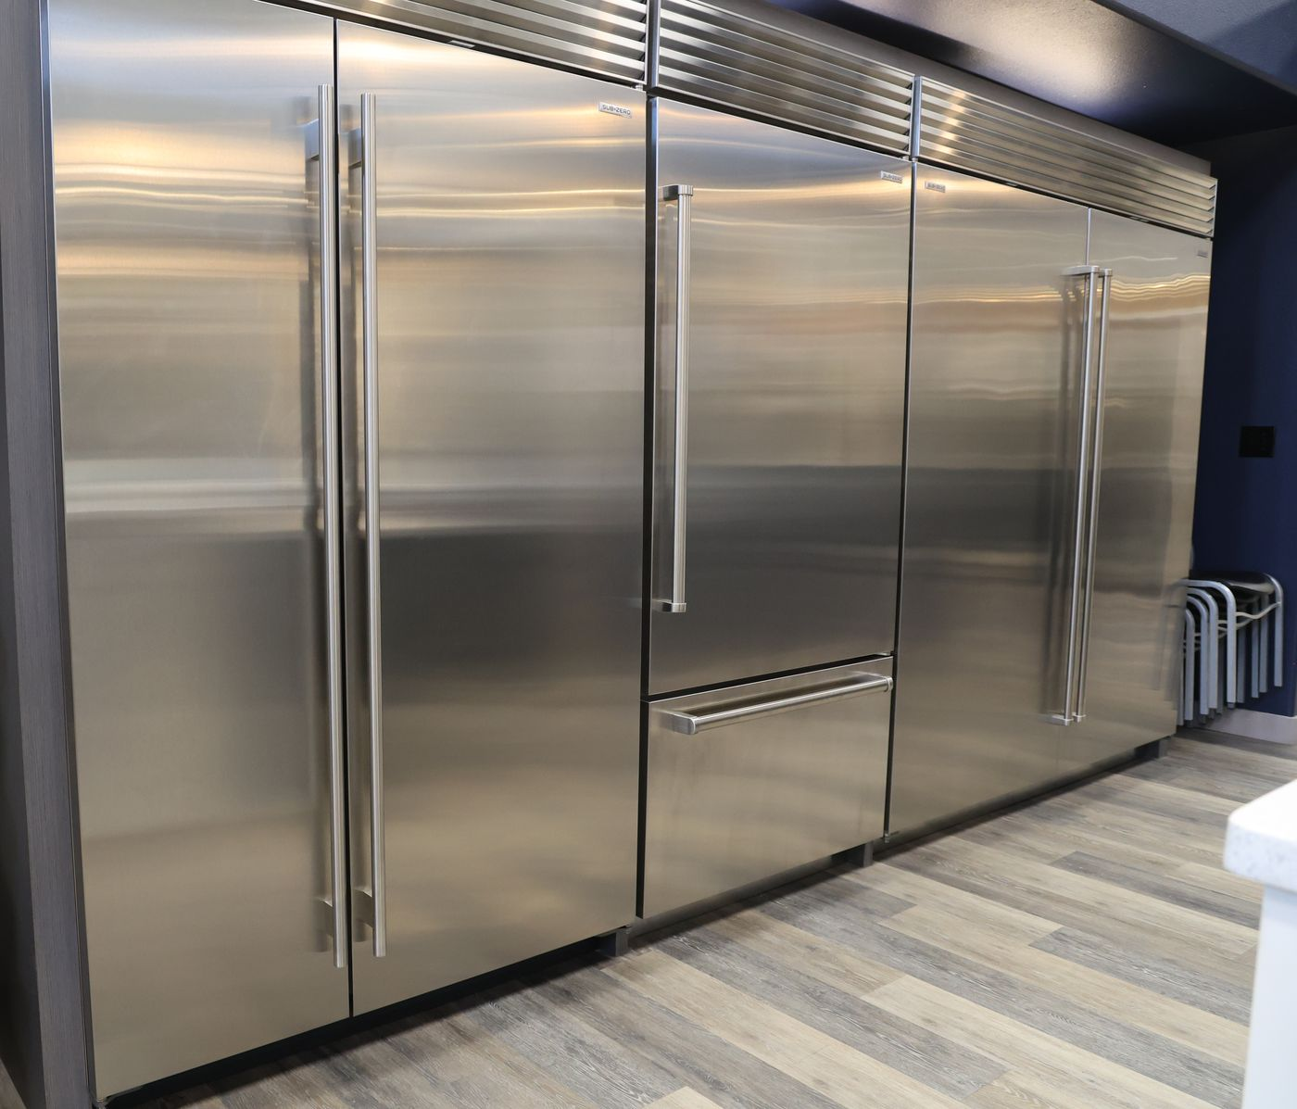
One system, one pattern.
Explicit clicks. Full audit trail. The customer's thread as the customer file.
Everything from the last two weeks follows those three rules.
Questions — or requests for the next two weeks?
Notes:
Close on the pattern: every tool follows the same three rules, which is why the pieces compose — the scheduler reuses DIBS, receipts reuse the thread notes, estimates reuse the same send-and-audit path. Invite feature requests.

