Slide 1
The Life-Changing Magic of Tidying Up (Your Data in R)
Alice Walsh

Slide 2
Introduction to part 1
As the saying goes, data scientists spend 80% of their time cleaning data… and the other 20% complaining about data cleaning.
In this workshop, participants will learn how to use R packages to ingest, clean, and reshape data.

Slide 3
What we are doing
We will introduce useful R packages and learned wisdom on how to approach data wrangling in general
We will take on a series of challenges
We will discuss the various solutions that were arrived at by different participants
We will discuss how to ask coding questions effectively

Slide 4
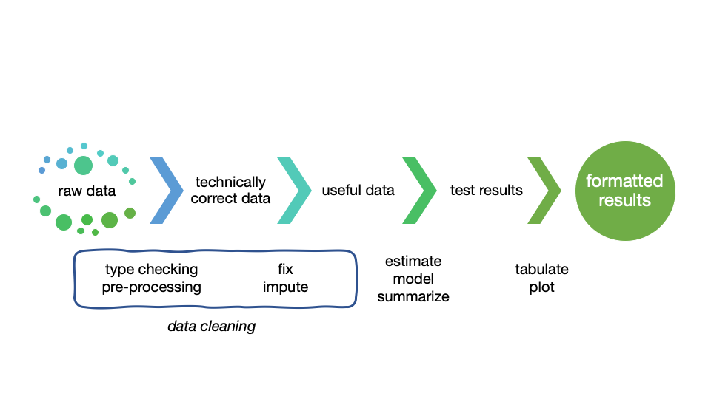
The data value chain
Adapted from “An introduction to data cleaning in R” by Edwin de Jonge and Mark van der Loo

Slide 5
Useful packages
tidyverse: readr, dplyr, tidyr, stringr, purrr
janitor
skimr
DataExplorer (requires later R version)

Slide 6
Getting the @#$@! Data into R
What if the raw data cannot even get into R?

Slide 7
What is tidy data?
https://r4ds.had.co.nz/tidy-data.html
There are three interrelated rules which make a dataset tidy:
Each variable must have its own column.
Each observation must have its own row.
Each value must have its own cell.
Usually datasets are organized to make data entry easy, but not to make data analysis easy.

Slide 8
Example non-tidy data
https://r4ds.had.co.nz/tidy-data.html
table2 #> # A tibble: 12 x 4 #> country year type count #> <chr> <int> <chr> <int> #> 1 Afghanistan 1999 cases 745 #> 2 Afghanistan 1999 population 19987071 #> 3 Afghanistan 2000 cases 2666 #> 4 Afghanistan 2000 population 20595360 #> 5 Brazil 1999 cases 37737 #> 6 Brazil 1999 population 172006362 #> # … with 6 more rows

Slide 9
Example tidy data
https://r4ds.had.co.nz/tidy-data.html
table1 #> # A tibble: 6 x 4 #> country year cases population #> <chr> <int> <int> <int> #> 1 Afghanistan 1999 745 19987071 #> 2 Afghanistan 2000 2666 20595360 #> 3 Brazil 1999 37737 172006362 #> 4 Brazil 2000 80488 174504898 #> 5 China 1999 212258 1272915272 #> 6 China 2000 213766 1280428583

Slide 10
Let’s take on some challenges
Ingest rectangular data - readr vs. base R vs. data.table
Inspect the data - dplyr, skimr, DataExplorer
Fix some dirty fields - dplyr, tidyr, janitor
Ingest other data - JSON
Pivoting - RIP to tidyr::gather(), tidyr::spread()
Pivoting - new tidyr pivot_ functions

Slide 11
Go to RStudioCloud
LINK HERE
Go to exercises/challenge.Rmd
We will work on three Philadelphia datasets: locations of farmers markets, locations of Wawas, and real estate prices

Slide 12
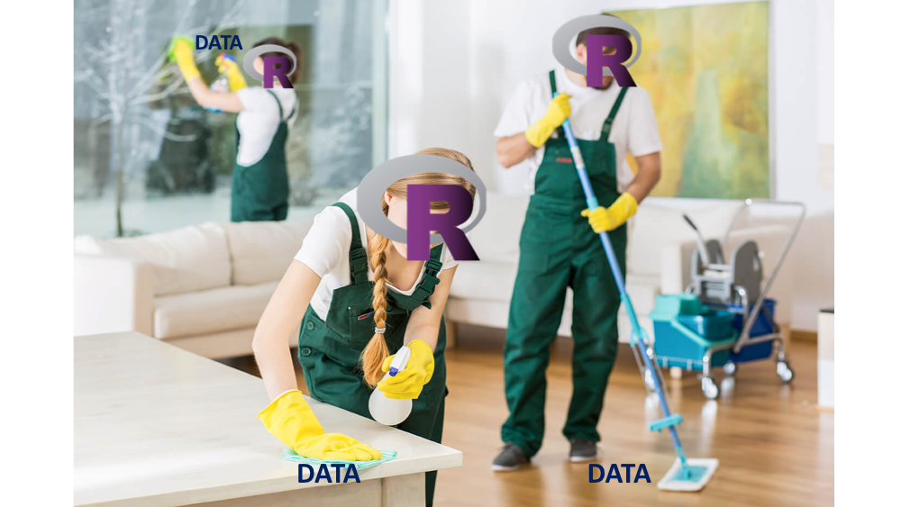
Time to share

Slide 13
How to ask better questions
a reprex is a reproducible example.
https://github.com/tidyverse/reprex

Slide 14
Recommended reading
https://learniningwithsckinta.netlify.com/post/2019-10-22_data_wrangling/
https://www.tidyverse.org
https://github.com/rstudio/cheatsheets
https://cran.r-project.org/doc/contrib/de_Jonge+van_der_Loo-Introduction_to_data_cleaning_with_R.pdf
https://resources.rstudio.com/rstudio-conf-2020/lightning-talk-maya-gans

