Slide 1
The Life-Changing Magic of Tidying Up (Your Data in R)
Alice Walsh

Slide 2
Introduction to part 1
As the saying goes, data scientists spend 80% of their time cleaning data… and the other 20% complaining about data cleaning.
In this workshop, participants will learn how to use R packages to ingest, clean, and reshape data.

Slide 3
What we are doing
We will introduce useful R packages and learned wisdom on how to approach data wrangling in general
We will take on a series of challenges
We will discuss the various solutions that were arrived at by different participants
We will discuss how to ask coding questions effectively

Slide 4
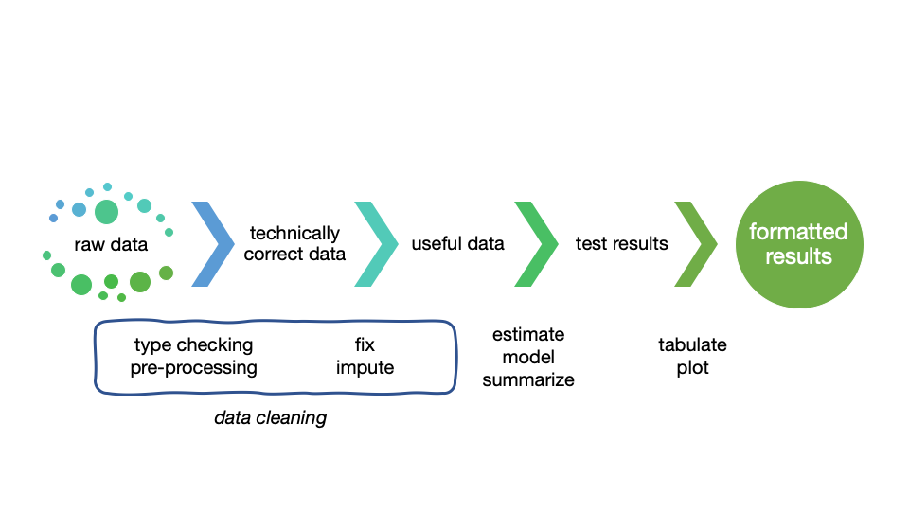
The data value chain

Slide 5
Adapted from “An introduction to data cleaning in R” by Edwin de Jonge and Mark van der Loo

Slide 6
Useful packages
tidyverse: readr, dplyr, tidyr, stringr, purrr
janitor
skimr
DataExplorer (requires later R version)

Slide 7
Getting the @#$@! Data into R
What if the raw data cannot even get into R?

Slide 8
What is tidy data?
https://r4ds.had.co.nz/tidy-data.html
There are three interrelated rules which make a dataset tidy:
Each variable must have its own column.
Each observation must have its own row.
Each value must have its own cell.
Usually datasets are organized to make data entry easy, but not to make data analysis easy.

Slide 9
Let’s take on some challenges
Instructions and background on the data
Ingest rectangular data - readr vs. base R vs. data.table
Inspect the data - dplyr, skimr, DataExplorer
Fix some dirty fields - dplyr, tidyr, janitor
Ingest other data - JSON
Pivoting - RIP to tidyr::gather(), tidyr::spread()
Pivoting - new tidyr pivot_ functions

Slide 10
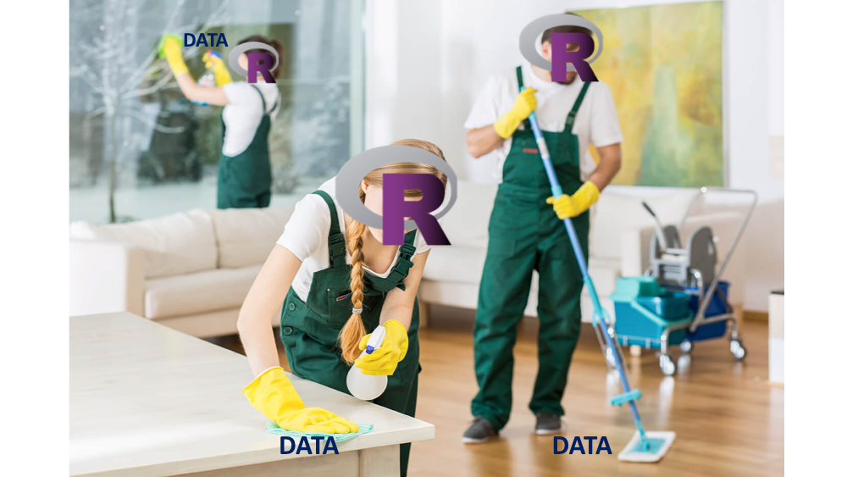
Time to share

Slide 11
How to ask better questions
a reprex is a reproducible example.
https://github.com/tidyverse/reprex

Slide 12
Recommended reading
https://learniningwithsckinta.netlify.com/post/2019-10-22_data_wrangling/
https://www.tidyverse.org
https://github.com/rstudio/cheatsheets
https://cran.r-project.org/doc/contrib/de_Jonge+van_der_Loo-Introduction_to_data_cleaning_with_R.pdf

