Slide 1
Online Driving Quiz-Game
By: Alex Walters, Joey Strickler, Alvin Kim, & Jamal Lodge

Slide 2
Roles
Alex: Database matters - queries
Jamal: Managing hosting, domain, interface implementation
Joey: Quiz design
Alvin: Webpage Design & Requirements
Shared: Quiz Question Writing

Slide 3
Requirements
Must be online and hosted by a server for anyone to access
User can create account or continue anonymously
Must present questions about driving exam in form of a test for user to take
Payment system embedded for users to pay subscriptions or sponsors to donate
Must allow parental usage over minor accounts - being able to link them together
Have the option for users to link social media to their accounts
MVA/DOT ability to review records of users
Store data records of each individual user and allowing them to view these records

Slide 4
Website Design
High level architecture: Website and quiz core, connecting to DB and off-site components
Monetization, Social Media, DMV/MTA access port
Planned Website Structure: Front page with login and registration, quiz page, and user account page
User account page has account management, record view, and parent/child configuration functions

Slide 5
Quiz Design
Multiple choice questions
Standard design for real tests
Easy to implement
Questions randomly selected from pool
Wide range of questions while keeping size down
Necessary for useful testing
Implementation using QuizHD wordpress plugin
Considered using mix of question types
Doesn't appear workable at the moment.

Slide 6
Use Cases And Sequence Diagrams
Write-up very important for figuring out how more complex cases worked
Example: Writing out how to give a parent access to the kid's records
Seems simple on first glance
Actually two use cases depending on who initiates
Certain use case plans became redundant when we found libraries
Example - the details of the quiz use case are largely decided by the library
Sequence diagrams have similar role. Also good for showing where we use the same function more than once
Important lesson for the future - determine platform, find libraries, then do more detailed design planning.

Slide 7
Testing
Unit test design is standard - test each chunk of functionality individually
Some tests blur the line with integration - testing multiple question retrieval requires calling smaller chunks.
Will need to be revised, was designed before picking libraries
Integration tests cover each function as seen by the user.
Test by use case, basically
Simple way to catch everything and ensure nothing slips through
System test plan is basically a complete user session.
Regression testing focus on core functions
Login, quiz and records
Without these working - none of the rest matters

Slide 8
Code Review Plans
Fairly standard review planned out
Proper structure, internal documentation, avoid coupling
Focus on making sure that we can understand each others code
Only one person here knows js, and it looks wordpress need to add php which none of us knows now
So it's very important to make clear what's happening
Not a good position to figure out code on the fly

Slide 9
Content Management And Libraries
We're building on top of the Wordpress system.
It came well recommended, covers features we need like login, and has the libraries we need.
For the quiz itself we're using the HDQuiz wordpress library.
Covers all the features we need from the quiz itself

Slide 10

Domain
We will be using the domain of www.practicedrivingsolutions.com
We chose our domain from Name.com
This was chosen from the github student developer pack (Discount)

Slide 11
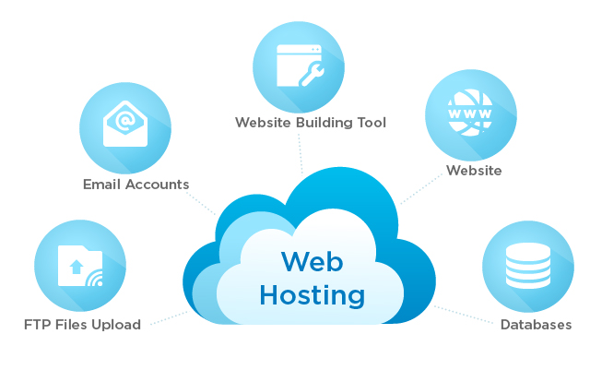

Hosting
HostGator for our hosting
We had first considered BlueHost because it was recommended by wordpress
Chose HostGator for value (Discount) and reliability.
Extremely easy to use and efficient c-panel

