Slide 1



FINAL PROJECT
Data Analyst
Customer Segmentation Analysis for Hotel Customers
PRESENTED BY:
Agus Setiawan
Understanding Customer Profiles • Identifying High-Value Segments • Reducing Churn Risk

Slide 2

Problem statement
01
The company does not yet have a clear customer segmentation based on data..
Project Background
02
Marketing & loyalty programs are still generic and not targeted..
The hotel industry is becoming increasingly competitive.
Acquiring new customers is more expensive than retaining existing ones.
The company needs to retain high-value customers and reduce churn.
Currently, all customers are treated the same — no personalized strategies yet.
.
03
High-value customers are churn-prone due to lack of personalized attention..
04
Management needs insights to identify customer groups and prioritize retention efforts..

Slide 3


04/10
Objectives and Goals
Clarify the project's main overall objectives and goals.
Goal # 2
Goal # 4
Analyze customer segments generated through clustering.
Recommend data-driven retention and marketing strategies.
Goal # 1
Goal # 3
Understand customer demographics and behaviors.
Identify high-value but at-risk customers.

Slide 4
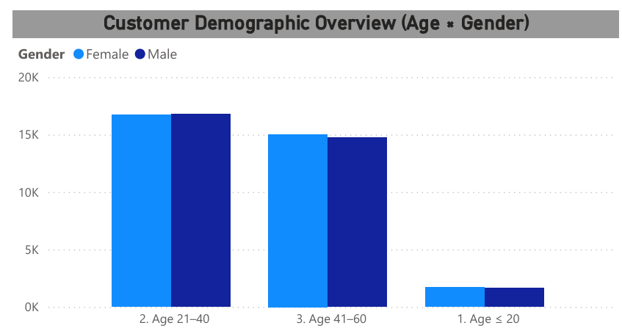

05/10
Business Implications:
Main target audience: adults and family-oriented customers.
Marketing campaigns can be crafted without gender bias.
Insight :
Majority of customers fall within the 21–40 and 41–60 age groups.
Customers below age 20 represent a very small portion.
Gender distribution is balanced, indicating a neutral market.

Slide 5
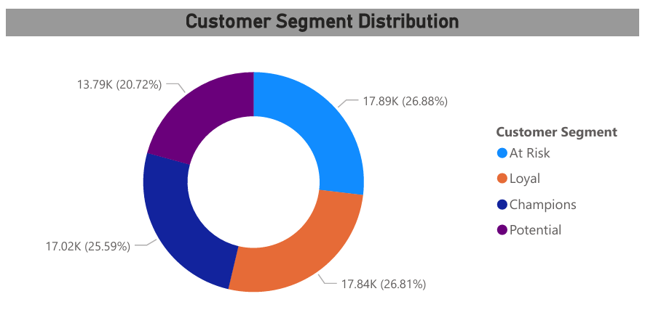
Insight :
Segment proportions are relatively balanced across the four clusters.
At Risk is the largest segment (~26–27%).
Champions is the smallest (~20%), indicating room for expansion.
Business Implications:
Balanced distribution = stable segmentation model.
A large portion of customers are at risk → requires intervention.

Slide 6
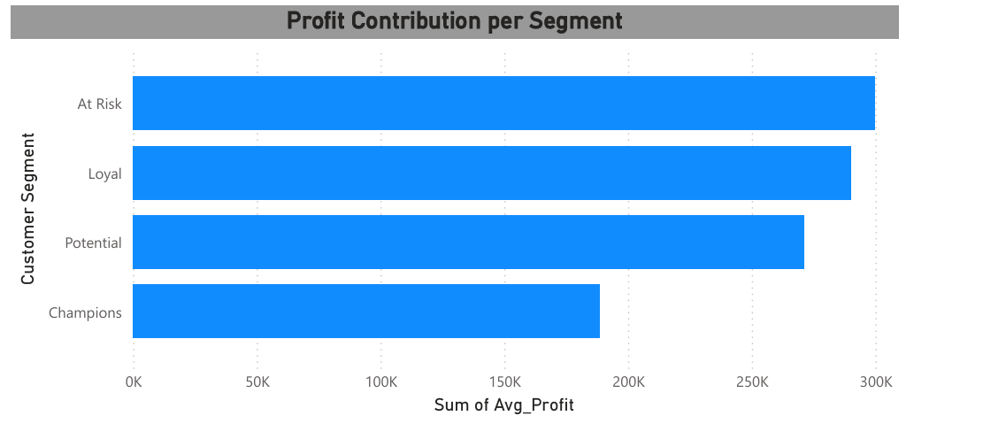
Business Implications:
Losing At Risk customers could cause major revenue impact.
Loyal & Potential customers can be nurtured into Champions.
Champions require enhanced engagement to increase revenue contribution.
Insight :
At Risk group contributes the highest profit, despite showing declining engagement.
Loyal customers provide stable revenue.
Potential customers offer considerable opportunities for growth.
Champions have the lowest profit contribution.

Slide 7
Strategic Recommendations
At Risk (Highest Priority):
Loyal Customers:
Strengthen loyalty program
Exclusive benefits (early check-in, late check-out)
Maintain frequent engagement
Personalized win-back offers
Limited-time discounts
Feedback survey to capture dissatisfaction
Incentives to rebook (free upgrade / cashback)
Potential Customers:
Champions:
Targeted promotions & bundled offers
Encourage repeat bookings
Introduce loyalty benefits
Enhance VIP experience
Provide referral rewards
Convert them into brand advocates

Slide 8
10/10
Thank you
CONTACT US
E-mail
agussetia190897@gmail.com
Phone
085704 768010

