Slide 1
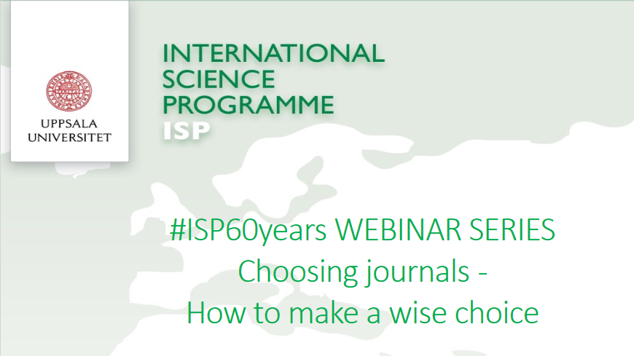

Slide 2
Choosing journals - how to make a wise choice
#ISP60years Webinar 2021-05-25
Anders Wändahl aw@kth.se

Slide 3
About me
Librarian
KTH 1994-2002, Karolinska Institutet 2002-2018, KTH 2018-
Have been working with access to scientific information and publishing in LIC/LMIC (mainly Africa) since 2004
Interested in how to publish in a good way, in order to boost your career and enhance your scientific visibility.
Not a publishing researcher myself

Slide 4
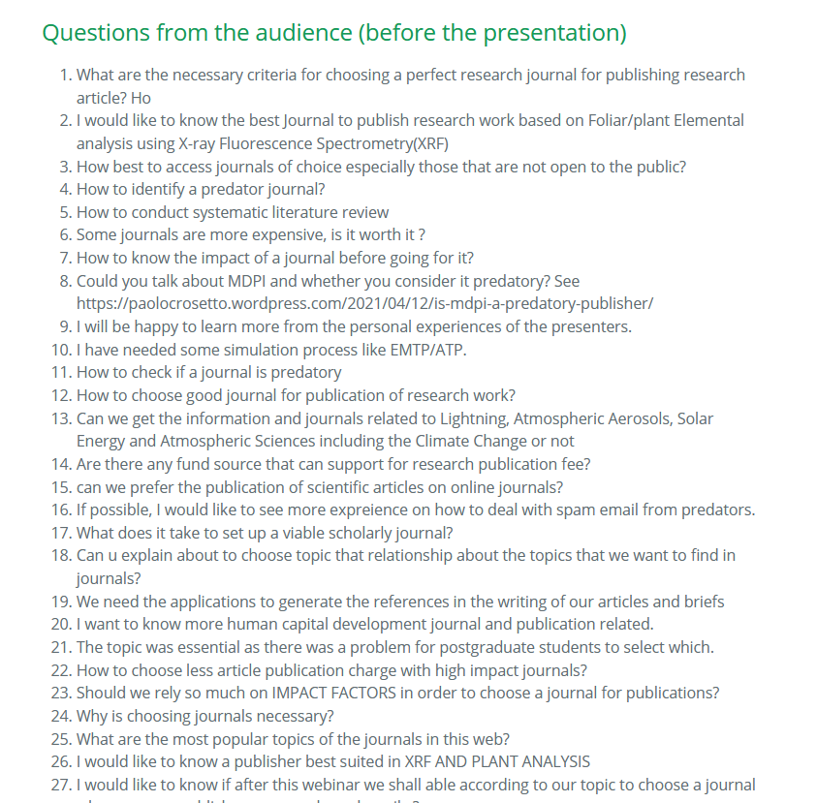

Slide 5
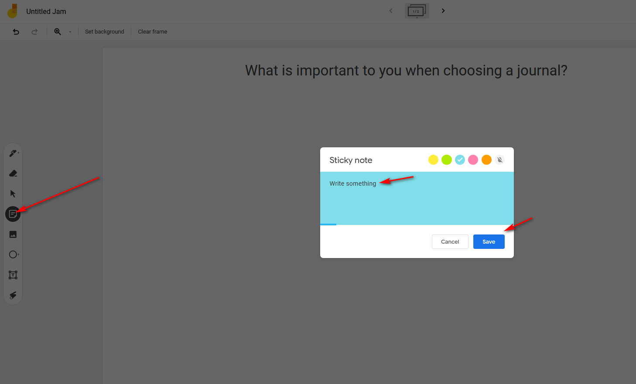

Slide 6
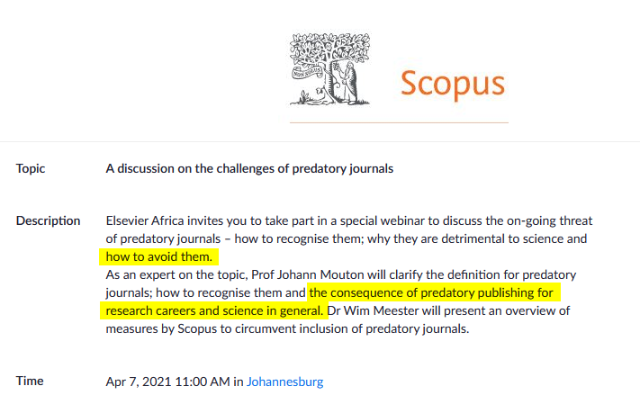

Slide 7
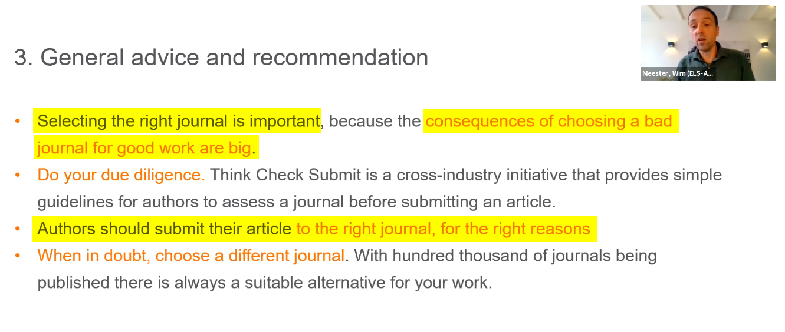

Slide 8

Positive approach

Slide 9

Disclaimer: the strenght and weaknesses of the actual paper is not covered here…
Image: https://www.sltinfo.com/strengths-and-weaknesses-of-research-styles/

Slide 10
The factors
Topic/field, document type and study design
Coverage in major bibliographic databases
Impact factors and other metrics on the journal level = journal ranking
Open Access options
Journal and research funders’ demands in relation to Open Access and research data
Peer-review process
Turn-around-time and acceptance rate of the journal

Slide 11
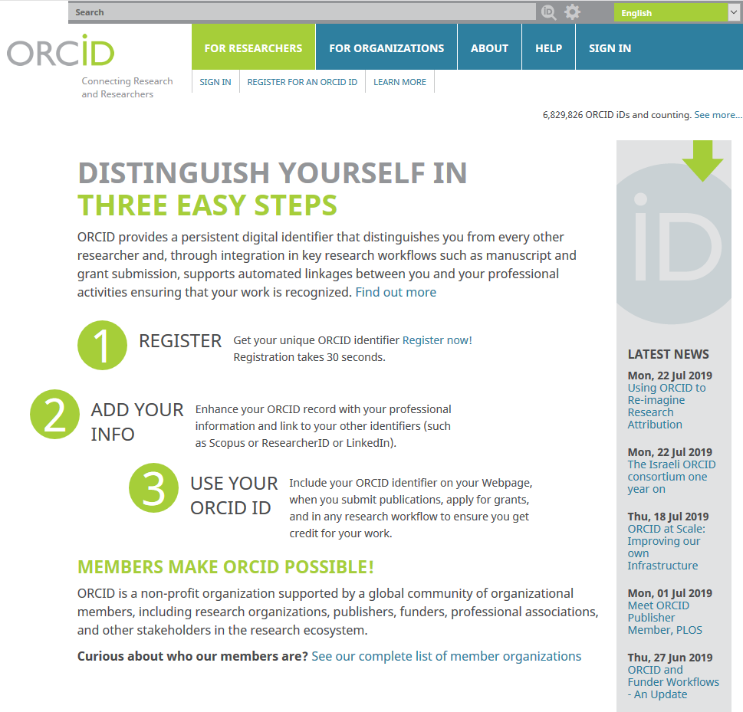
https://orcid.org

Slide 12
Exercise (5 min)
Get an ORCiD
Edit your ORCiD page (e.g. add education)
Try to add some publications

Slide 13
Thank you!

