Slide 1
Andrew Wang
Electrical Engineering Intern

Slide 2
background
Electrical Engineering Major
University of Illinois at Urbana-Champaign
Graduation Date: May 2020

Slide 3
Projects

Slide 4
Hardware:
Project Tadpole

Slide 5
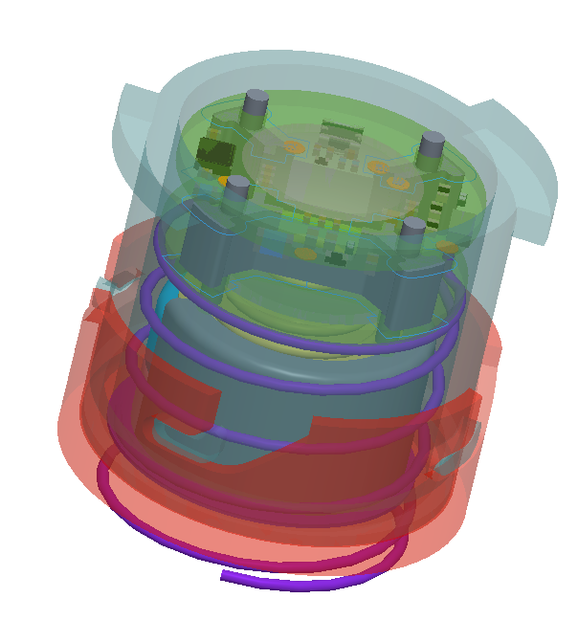
Project tadpole
Objective: Design the smallest-possible shifter unit
Smallest-possible PCBA layout area
Compact
Multifunctional

Slide 6
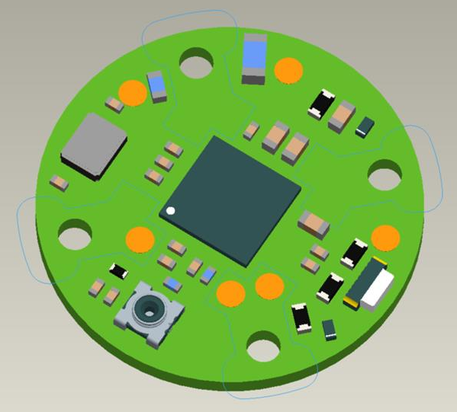
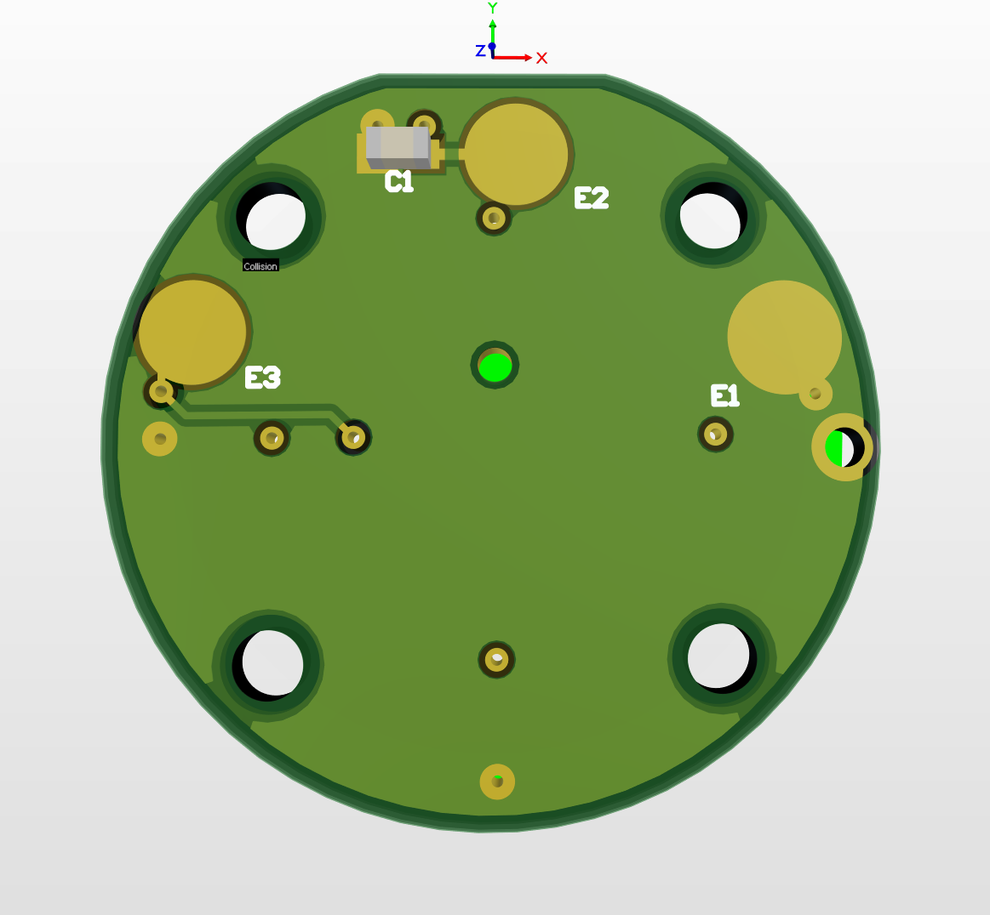
Project Tadpole PCBA Layout
Smallest possible PCBA layout area
13.5mm diameter
6 layer board
High-density interconnects (HDI) stackups
nRF52840 CSP microprocessor
3.5x3.5 mm² area
Compared to 7x7 mm² area for the QFN version
No Mod button
Antenna is external & separate from main PCB
Coaxial RF connector used in PCB
Main PCBA
Battery PCBA

Slide 7
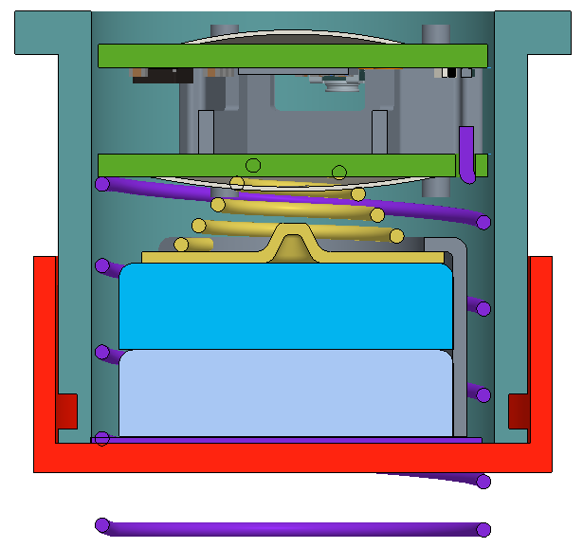
Project Tadpole 3D Model
1st dome switch
Main PCBA
Plastic PCBA supports
Battery PCBA
16mm
2nd dome switch
Conical spring
2 LR30 batteries in series
Battery contact spring
18mm

Slide 8
Project tadpole Functionality
F
F
f
1st dome actuates
2nd dome actuates
Both domes actuate

Slide 9
Software:
Automated Linking of PPQM Sample Tracking Issue Info
(Project ALPSTII)

Slide 10


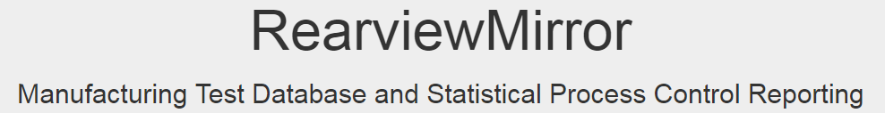
ALPSTII
Objective: Automatically populate Post-Production Quality Monitoring (PPQM) Sample Tracking JIRA issues with their corresponding…
Serial Number
CQF Web Link
RVM Web Search Link
Manufacturing date
Saves 10 minutes of time manually gathering information per issue
10 min saved per issue x ~300 issues = A lot of time saved!!!
Notes:
This Epic captures issues to create a serial number centric PPQM issue (Sample Tracking) where issues are automatically populated with links to RVM/GTT test DB??? and information from RVM.
Initial implementation will result in the following workflow:
engineer creates PPQM issue with issue type Sample Tracking
engineer populates serial number on creation
Jira webhook will be notified on new issue creation and populate:
RVM search link
CQF link
GTT Database (TBD) ?????
manufacturing date (from RVM EOL date)
Having all of the information related to a given sample available in a single location (Jira) will allow us to make better reports and decisions using existing data. For example:
finding date ranges for all samples that have suffered water ingress

Slide 11
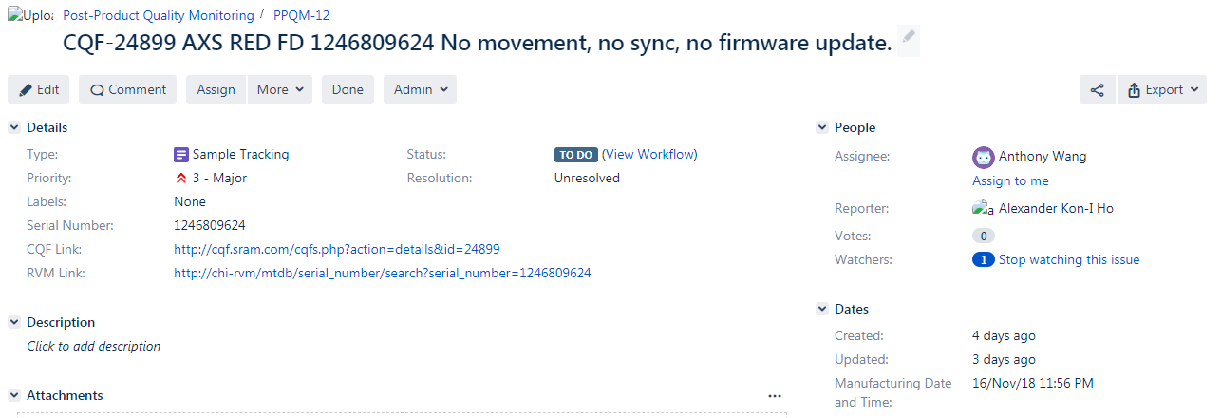
Example

Slide 12
ALPSTII Block diagram
JIRA Server
7) Populate serial number, CQF link, RVM search link, and manufacturing date fields of all PPQM Sample Tracking issues
1) Query serial number in summary
2) Retrieve serial number
Local Host
6) Retrieve RVM search link & manufacture date
5) Query RVM search link & manufacture date
3) Query CQF link
4) Retrieve CQF link
CQF Server
RVM Server
Notes:
Query Jira instance using API to return all PPQM Sample Tracking issues that contain serial number in summary
Populate a single PPQM issue Serial Number field with Serial Number in Summary
Extract Serial Number from a single Jira issue
Update Serial Number field of all PPQM Issues with Issue Type "Sample Tracking“
Create a link to a CQF for a given serial number
Create a link to RVM search for a given serial number
Populate CQF and RVM fields for PPQM Sample Tracking Issues
Retrieve Manufacturing Date and Populate Issues using RVM API
Populate PPQM Sample Tracking issue fields on creation

Slide 13
Webhook block diagram
Automation procedure
HTTP server and URL for POST request are created
JIRA issue is created or updated
Issue data is sent via a POST request
JIRA Server
Webhook Host
ALPSTII process is run automatically on the issue
ALPSTII Process

Slide 14
What I’ve learned

Slide 15
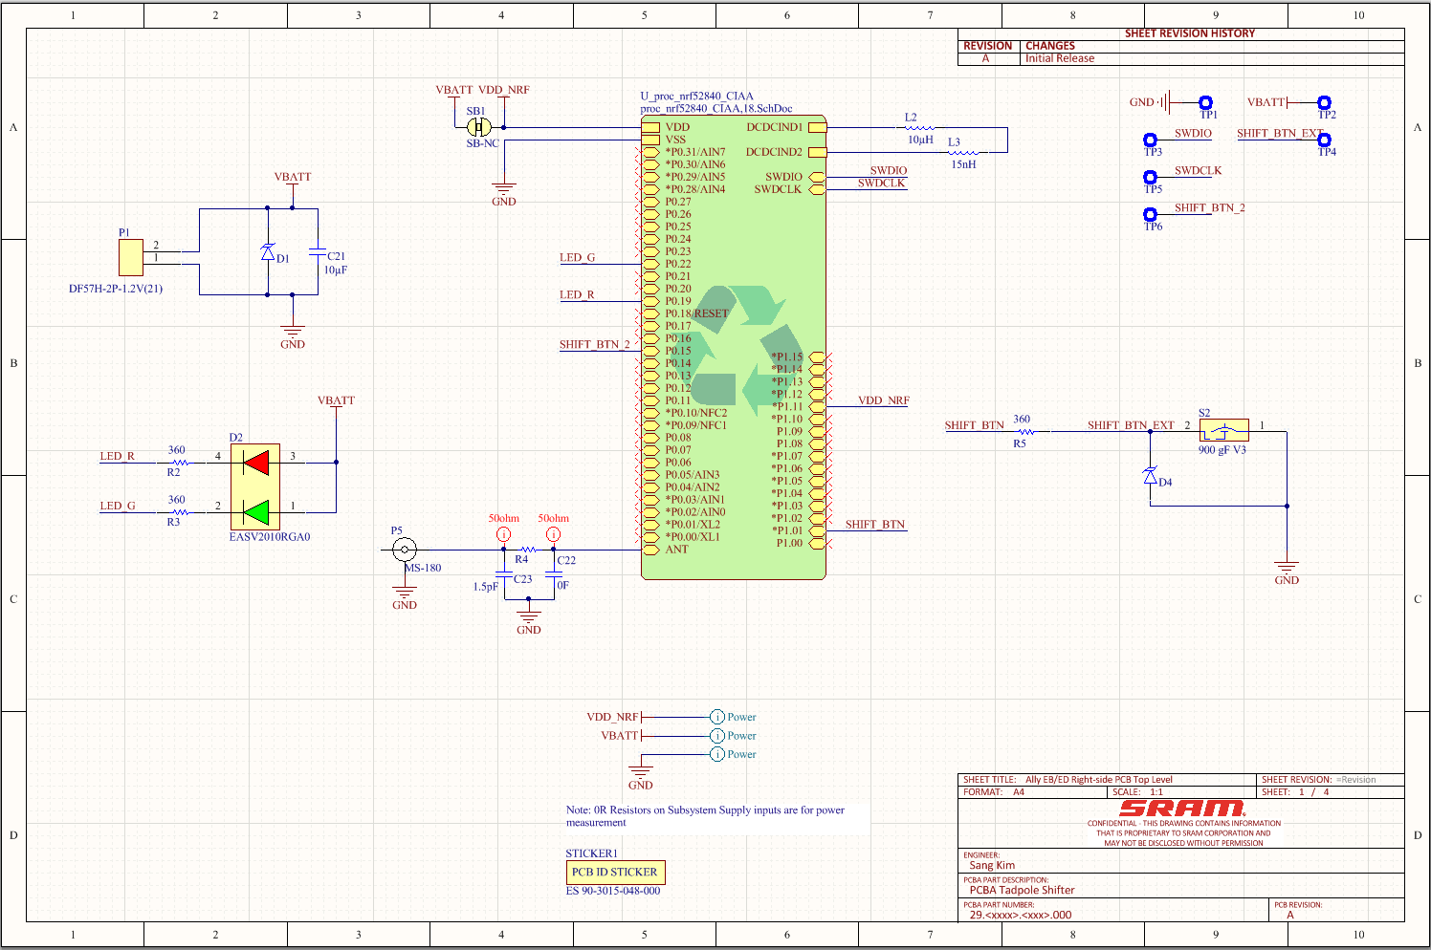
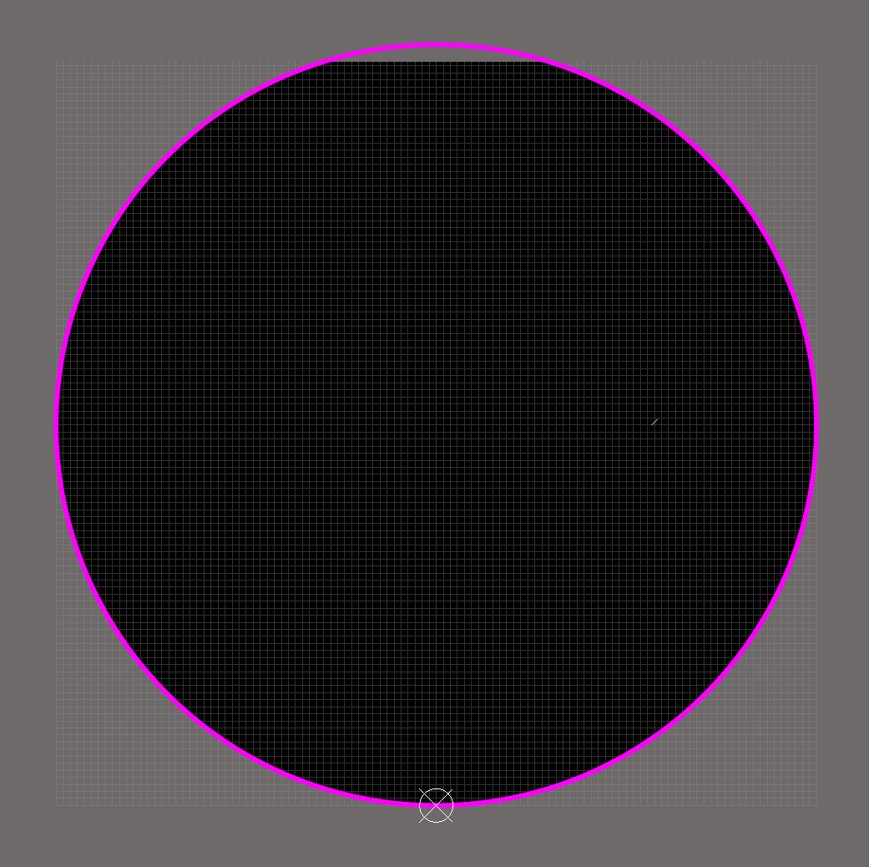
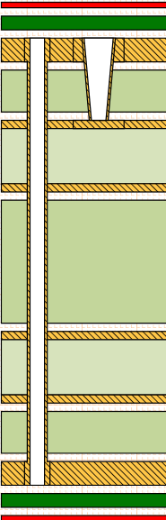
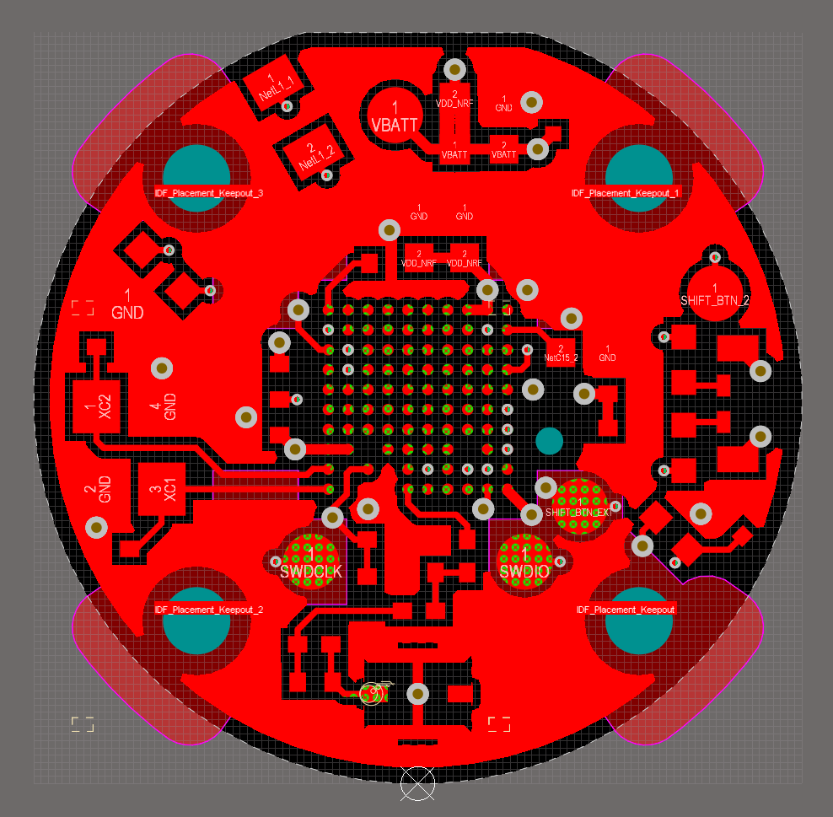
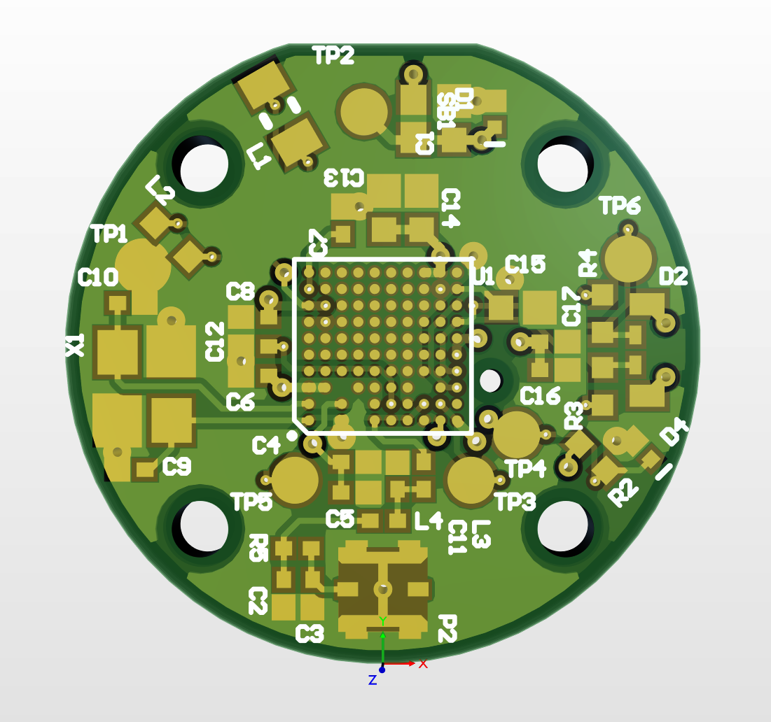
What I’ve learned
PCB design process in Altium for complex consumer electronics in industrial environment
Proper schematic capture
Board outline definition
Ideal layer stack design
Component selection & footprinting
Routing of analog, digital, & RF subsystems
Design optimization for manufacturability

Slide 16
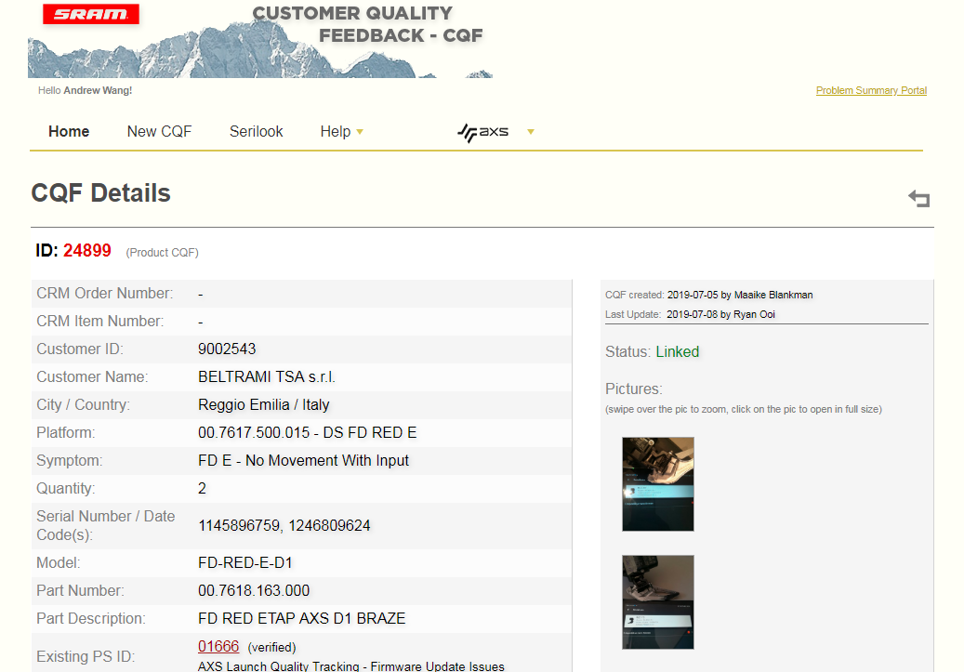
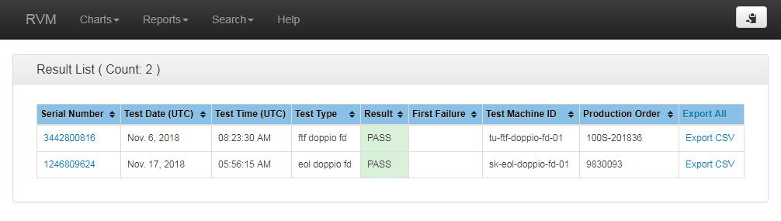
What I’ve learned
Python JIRA Software development
JIRA API development
RVM API development
CQF server web scraping
Automate the process of populating JIRA issues with queried data using JIRA Webhook
Working on QA server for testing purposes

