Slide 1
Project 2: You’re Fired
John McCain, Alan Wang, Audrey Evans, Hari Ramanan

Slide 2

Platform
C++
Terminal based clock and user interface
Now:
C++
Tried QT, QT hates us :-(
Psuedo Shell terminal

Slide 3
Work Allocation
John
Threading
Timer task
Github master
GUI
ClockShell
Alan
User interface
GUI
Stopwatch/timer
Audrey
Calendar
Documentation
UML diagrams
Presentation
Hari
Timer task
Stopwatch/timer
General extra help

Slide 4
Challenges
Platform- c++ and terminal
Threading/Timer Task
Trying to figure out a GUI and learning that QT would not work
Creating a Shell program for the user interface

Slide 5
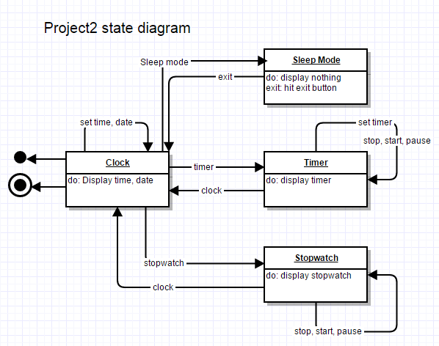
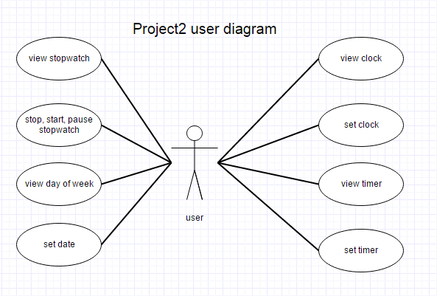
UML Diagrams

Slide 6
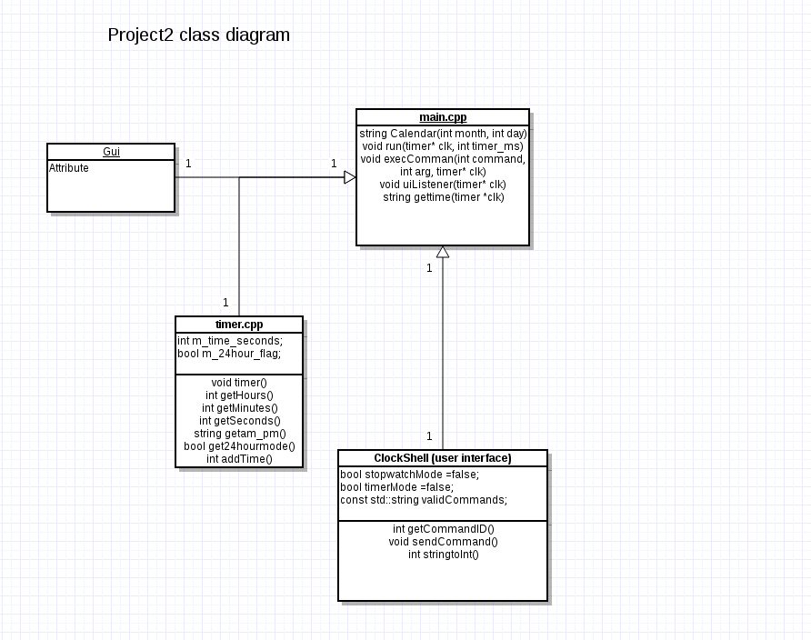
UML Diagrams

Slide 7
Retrospective
C++ is not an ideal language for simple non-resource intensive applications

