Slide 1
Consumer App – Information Architecture
Splash Screen
Card Selector
Home Screen
Limit, balance, recent transactions, alerts
Transaction Alert
Transaction details, actions
Expense Alert
Details, defined limits, summary of transactions
Rate Experience
Customized feedback form, rate, prior ratings
Manage - Transactions
List transactions, search
Offers
Offers and offer settings, discount discovery
Secure
Security Settings, Overview, List of defined rules
Post Rating Offer
Customized offer based on rating and purchase history
Analytics
Transactions by category, time
Transaction Details
Details, call/block merchant, review, tag transactions
Offer Details
Offer details, scannable barcode/QR Code
Rule Details
Rules for a category, timeframe or expense type
Tagged Transactions
Summary of transactions by tag, share, email report
Merchant Review
Customized review, past reviews

Slide 2
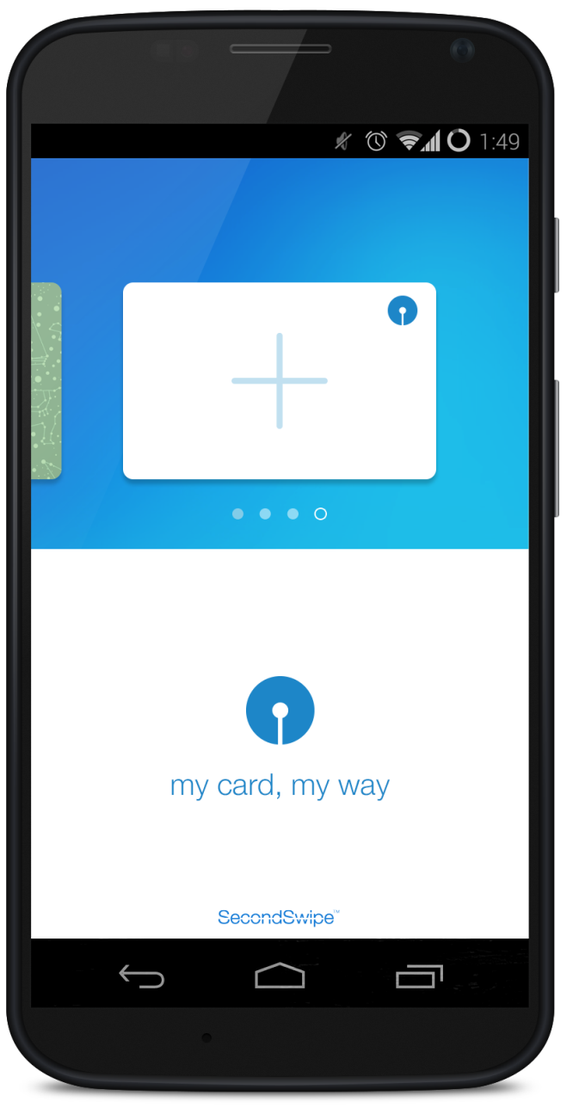
Consumer App – Splash Screen: No Card Registered
User clicks icon to register a new card

Slide 3
Consumer App – Splash Screen: No Card Registered
Phone Number
Card Number (last 4)
Activation Code
Register My Card
Account validated against master account list

Slide 4
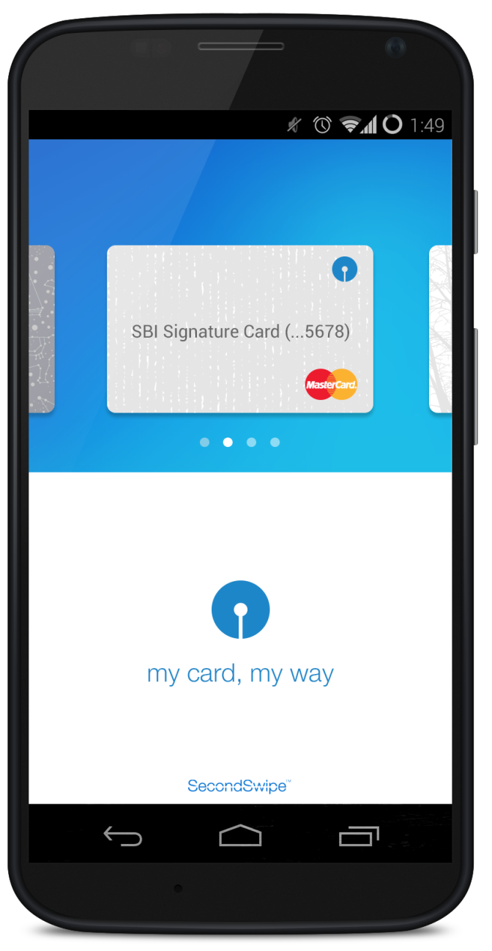
Consumer App – Splash Screen
User can scroll thru multiple accounts; to add additional account, user can scroll to empty card with “add” icon
Product name retrieved from account details
Card type logo is dynamic and retrieved from account details

Slide 5
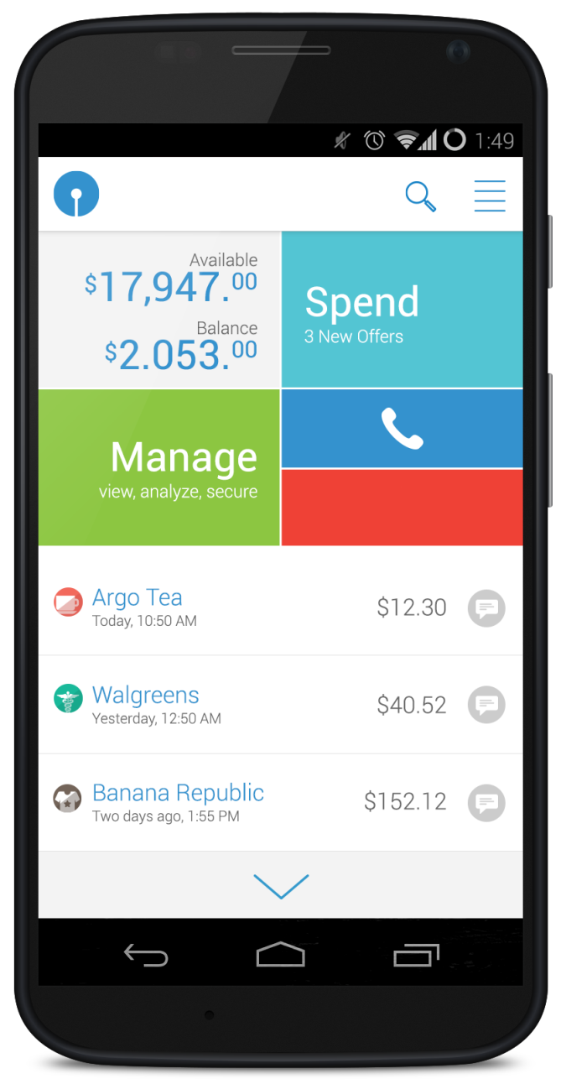

Consumer App – Home Screen
Navigates to transaction list page with search open
Available credit and balance pulled from bank service
Shows count of current offers
Configured to call SBI customer service
Goes to transaction list page
Toggles between locked and unlocked state
Category Icons based on transaction MCC code
Humanized time display(today, 2 hours ago, etc.)
New transactions and offers should be pushed to app and should refresh all data on page

Slide 6
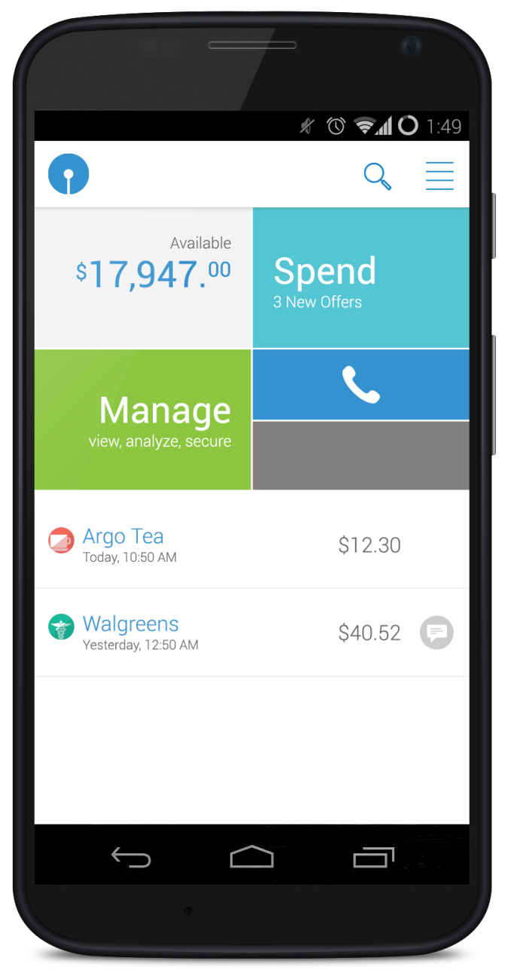

Consumer App – Home Screen – Alternative Scenarios
For debit cards, only available balance will be shown
This is default unlocked state
The “REVIEW” icon is only shown if applicable
The additional scroll bar is not displayed if there is not enough data

Slide 7
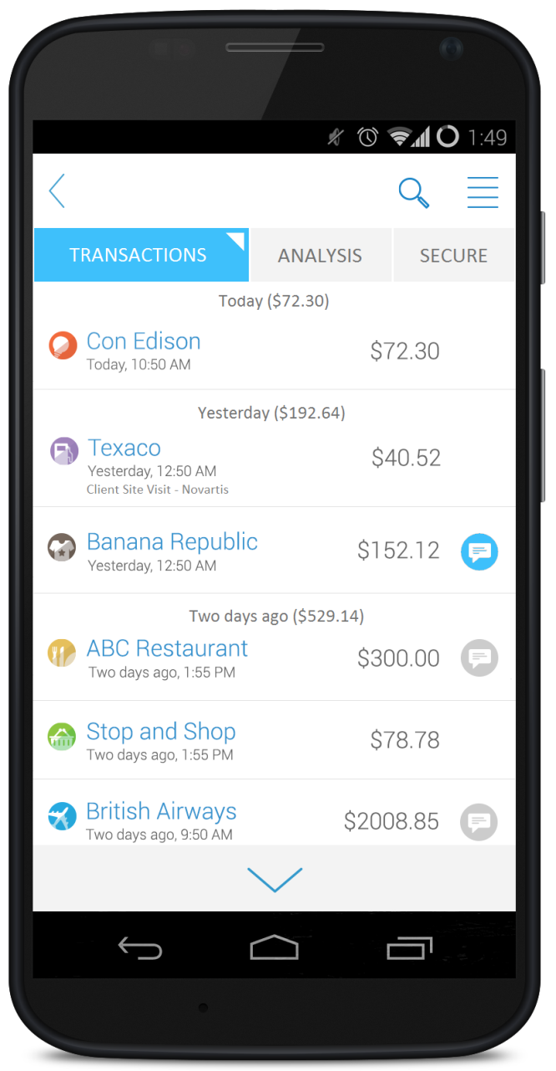
Consumer App – Transaction List
Navigation back to home screen
Sub-menu indicator
Transactions grouped by date with total for the date (Today, Yesterday, Two Days Ago, Last Week, Last Month, Older)
If transaction has been tagged, the tag is displayed in the list
Item already reviewed
Indicates transactions where review is requested by merchant

Slide 8
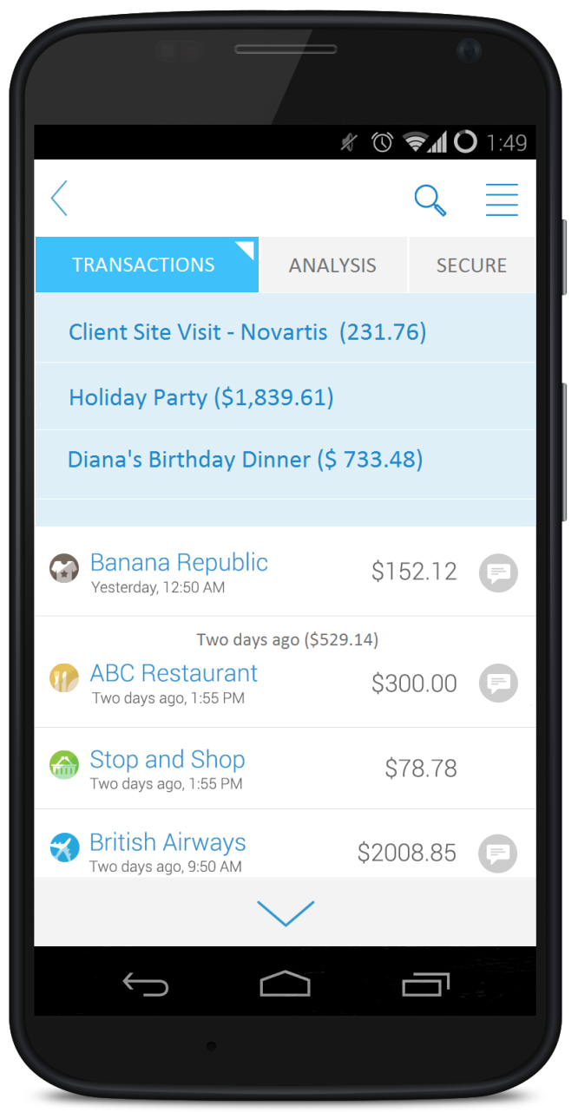
Consumer App – Transaction List – Quick Filter
Ability to quickly filter
Transactions by the tag; all used tags are shown.

Slide 9
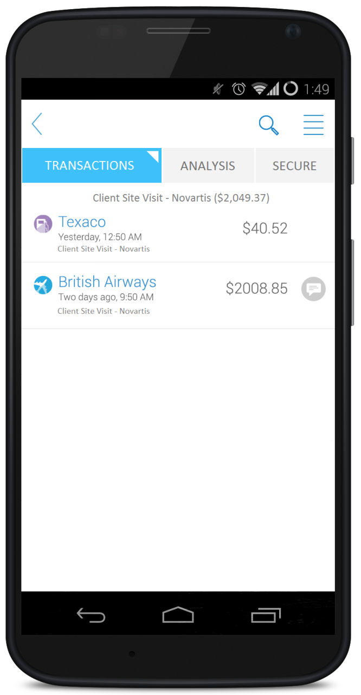
Consumer App – Transaction List – Quick Filter Results
Selected tag is shown as header with total

