Slide 1
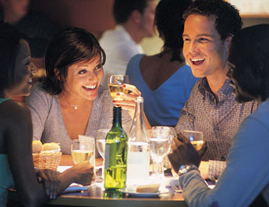
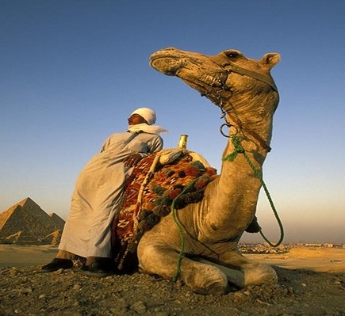

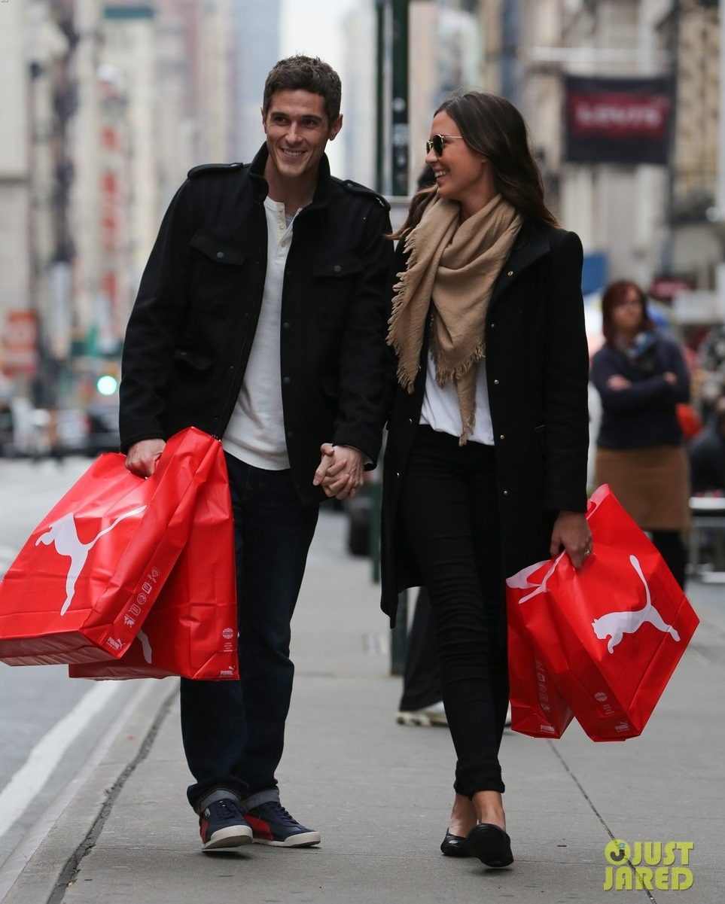
Dheeraj Singh (….3020)
i.Dine
i.Travel
i.Live
i.Shop
Fredericos
New York, NY
Flight to Turkey
Expedia.co.in
FreshMarket
Gurgaon
Puma Store
Mumbai
my card, my way

Slide 2
Dheeraj Singh (….3020)
i.Dine
i.Travel
i.Live
i.Shop
My bill is…
Fredericos
New York, NY
Flight to Turkey
Expedia.co.in
Cancel
Pay
FreshMarket
Gurgaon
Puma Store
Mumbai
Fredericos
New York, NY
my card, my way

Slide 3
Dheeraj Singh (….3020)
i.Dine
i.Travel
i.Live
i.Shop
Thank You!
Close
Fredericos
New York, NY
Flight to Turkey
Expedia.co.in
FreshMarket
Gurgaon
Puma Store
Mumbai
Fredericos
New York, NY
my card, my way

Slide 4
Dheeraj Singh (….3020)
i.Dine
i.Travel
i.Live
i.Shop
Your transaction was declined!
Fredericos
New York, NY
Flight to Turkey
Expedia.co.in
Cancel
Retry
FreshMarket
Gurgaon
Puma Store
Mumbai
Fredericos
New York, NY
my card, my way

