Slide 1
Lambda
awantikdas@gmail.com

Slide 2
Agenda
What lambda expressions are
Why we need lambda expressions
The syntax for defining lambda expressions
Target typing for lambda expressions
Commonly used built-in functional interfaces
Method and Constructor references
Lexical scoping of lambda expressions

Slide 3
What ?
A lambda expression is not a method, although its declaration looks similar to a method. As the name suggests,
a lambda expression is an expression that represents an instance of a functional interface.
// Takes an int parameter and returns the parameter value incremented by 1
(int x) -> x + 1
// Takes two int parameters and returns their sum
(int x, int y) -> x + y
// Takes two int parameters and returns the maximum of the two
(int x, int y) -> { int max = x > y ? x : y;
return max;
}
// Takes no parameters and returns void
() -> { }

Slide 4
// Takes no parameters and returns a string "OK"
() -> "OK"
// Takes a String parameter and prints it on the standard output
(String msg) -> { System.out.println(msg); }
// Takes a parameter and prints it on the standard output
msg -> System.out.println(msg)
// Takes a String parameter and returns its length
(String str) -> str.length()

Slide 5
Why ?
// Using an anonymous class
StringToIntMapper mapper = new StringToIntMapper() {
@Override
public int map(String str) {
return str.length();
}
};
// Using a lambda expression
StringToIntMapper mapper = (String str) -> str.length();

Slide 6
Syntax for Lambda Expressions
(<LambdaParametersList>) -> { <LambdaBody> }
• A lambda expression does not have a name.
• A lambda expression does not have a return type. It is inferred by the compiler from the
context of its use and from its body.
• A lambda expression does not have a throws clause. It is inferred from the context of its use
and its body.
• A lambda expression cannot declare type parameters. That is, a lambda expression cannot be generic.

Slide 7
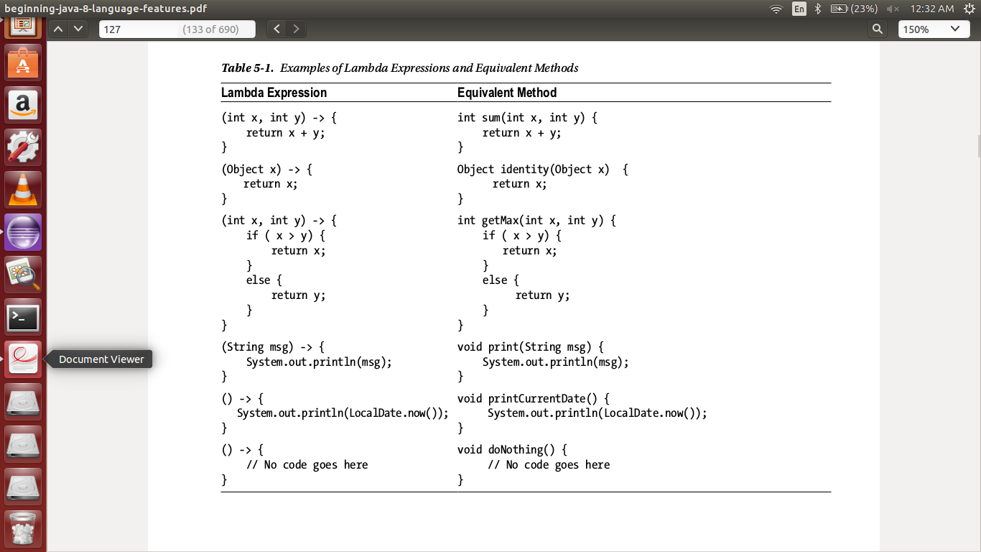
Expression

Slide 8
Omitting Parameter Types
// Types of parameters are declared
(int x, int y) -> { return x + y; }
// Types of parameters are omitted
(x, y) -> { return x + y; }
// A compile-time error
(int x, y) -> { return x + y; }

Slide 9
Declaring No Parameters
// Takes no parameters
() -> { System.out.println("Hello"); }
It is not allowed to omit the parentheses when the lambda expression takes no parameter. The following
declaration will not compile:
-> { System.out.println("Hello"); }

Slide 10
Declaring a Single Parameter
// Declares the parameter type
(String msg) -> { System.out.println(msg); }
// Omits the parameter type
(msg) -> { System.out.println(msg); }
// Omits the parameter type and parentheses
msg -> { System.out.println(msg); }
The parentheses can be omitted only if the single parameter also omits its type. The following lambda expression
will not compile:
// Omits parentheses, but not the parameter type, which is not allowed.
String msg -> { System.out.println(msg); }

Slide 11
Declaring Body of Lambda Expressions
// Uses a block statement. Takes two int parameters and returns their sum.
(int x, int y) -> { return x + y; }
// Uses an expression. Takes a two int parameters and returns their sum.
(int x, int y) -> x + y
// Uses a block statement
(String msg) -> { System.out.println(msg); }
// Uses an expression
(String msg) -> System.out.println(msg)

Slide 12
Target Typing
A poly expression is an expression that has different types in different contexts. The compiler determines the type of the expression. The contexts that allow the use of poly expressions are known as poly contexts. All lambda expressions in Java are poly expressions.
Adder adder = (double x, double y) -> x + y;
The compiler now verifies the compatibility of the returned value from the lambda expression and the return type of the add() method. The return type of the add() method is double. The lambda expression returns x + y, which
would be of a double as the compiler already knows that the types of x and y are double. The lambda expression does not throw any checked exceptions. Therefore, the compiler does not have to verify anything for that. At this point, the compiler infers that the type of the lambda expression is the type Adder.

Slide 13
Lambda expressions can be used only in the following contexts:
Assignment Context: A lambda expression may appear to the right-hand side of the assignment operator in an assignment statement. For example,
ReferenceType variable1 = LambdaExpression;
Method Invocation Context: A lambda expression may appear as an argument to a method or constructor call. For example,
util.testJoiner(LambdaExpression);
Return Context: A lambda expression may appear in a return statement inside a method, as its
target type is the declared return type of the method. For example,
return LambdaExpression;
Cast Context: A lambda expression may be used if it is preceded by a cast. The type specified in
the cast is its target type. For example,
(Joiner) LambdaExpression;

Slide 14
Functional Interface
A functional interface is simply an interface that has exactly one abstract method. The following types of methods in
an interface do not count for defining a functional interface:
• Default methods
• Static methods
• Public methods inherited from the Object class
@FunctionalInterface
public interface Comparator<T> {
// An abstract method declared in the interface
int compare(T o1, T o2);
// Re-declaration of the equals() method in the Object class
boolean equals(Object obj);
/* Many static and default methods that are not shown here. */
}

Slide 15
Using the @FunctionalInterface Annotation – More of assurance from the compiler

Slide 16
