Slide 1
E-learning system
LMS & SCORM

Slide 2
E-learning system definition
e-learning is a computer based educational tool or system that enables you to learn anywhere and at any time. Today e-learning is mostly delivered though the internet, although in the past it was delivered using a blend of computer-based methods like CD-ROM.

Slide 3
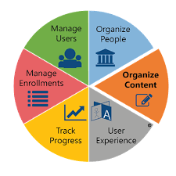
LMS definition
LMS stands for Learning Management System and it's a global term for a computer system specifically developed for managing online courses, distributing course materials and allowing collaboration between students and teachers. A LMS will allow you to manage every aspect of a course, from the registration of students to the storing of test results, as well as allowing you to accept assignments digitally and keep in touch with your students. In essence, the LMS is the backbone of most e-learning activities.

Slide 4
LMS communication tools
The functionality of LMS(Learning Management System) is categorized by three modes of functionality :
Tools for one-way communication
Tools for two-way communication
Tools for organizing content and structure

Slide 5
One-way communication
Document
PDF
One way communication tools such as :
Documents
Content files(media):
Audio
Video
Text
PDF
PPT
ONE –WAY
Communication
Tools
Audio
Video
Text
PPT

Slide 6
Two-way communication
Allow students interact with each other or with the instructor . Such as:
Discussion forums
Chat system
Online tests/quizzes
Assignments
TWO-WAY
Communication
Tools
Discussion
Forums
Chat
Quizzes
&
Assign.

Slide 7
LMS tools for organization
LMS allows the logical grouping of users and resources for a given course
For example:
The site can be organized to set of :
[1] Activities : assignment, chat, quiz, lesson, survey…… etc
[2] Resources: books, files, folders….. etc

Slide 8
What is SCORM?
SCORM is a set of technical standards for e-learning software products. SCORM tells programmers how to write their code so that it can “play well” with other e-learning software. It is the de facto industry standard for e-learning interoperability. Specifically, SCORM governs how online learning content and Learning Management Systems (LMSs) communicate with each other.

Slide 9
SCORM standard
The SCORM standard makes sure that all e-learning content and LMSs can work with each other, just like the DVD standard makes sure that all DVDs will play in all DVD players. If an LMS is SCORM conformant, it can play any content that is SCORM conformant, and any SCORM conformant content can play in any SCORM conformant LMS.

Slide 10
What does SCORM stand for?
SCORM stands for “Sharable Content Object Reference Model”.
So , What this mean ?

Slide 11
What does SCORM stand for?
Each one of the items(video, Audio, Text, Quiz…etc) is called a ‘Learning Object’
These learning objects can be combined to get a ‘Larger Learning Object’
These learning objects are called Sharable Content Object(SCO) which form the first 3 words of SCORM
“Sharable Content Object” indicates that SCORM is all about creating units of online training material that can be shared across systems. SCORM defines how to create “sharable content objects” or “SCOs” that can be reused in different systems and contexts
“Reference Model” a way of packaging different learning objects together so they can be re-used over and over again in different ‘LMS’ systems. It tells developers how to properly use them together.

Slide 12
Sharable Content Object(SCO)
Learning Object
SCO(Sharable Content Object)
Learning Object
Text
QUIZ
Video
Audio

Slide 13
E-Learning course
‘’By combining many Sharable Content Objects(SCOs) by our design what we have is an e-Learning course’’
SCO
SCO
SCO
SCO
SCO
SCO
SCO
SCO

Slide 14
Publishing Courses
CD
Web/Intranet
REGULAR
Web pages
Learning
Management
System

Slide 15
Synchronous e-learning vs. asynchronous e-learning
Synchronous e-learning
Asynchronous e-learning
Online Chat
Web
Conference
Real-time
involvement
Discussion
Forum
Email
No-Real-time
involvement

Slide 16
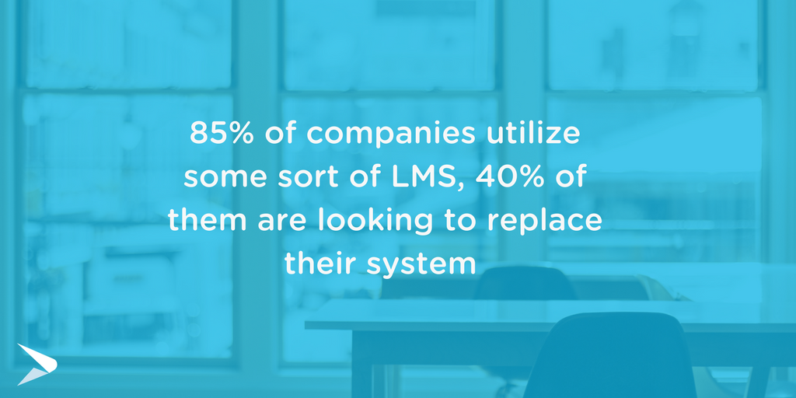
What to Look for in a Modern LMS
Intuitive User Experience
Social Learning
Content Authoring
Learning Tracks and Automation
Assessments and Quizzes
Reporting and Analytics
Integrations
Multi-device Learning

