Slide 1
▷◁
σ π ×
−
∪
Π
ρ

Slide 2
Sort_{T1.Carid,T2.Carid}
σ_{T1.Carid<T2 .Carid} (T₁×C₂)
Π_{Carid,Trip}(ρ_{T1}(Trip))
Sort_{Distance}
Π_{Carid,Distance}(ρ_{C1}(T₂))
ρT2(Carid,minvalue(T1.Trip, T2.Trip) as Distance)(Trip)

Slide 3
π_{T1.carid, T2.carid, minValue}
Limit k
Order By_{minValue}
𝒢_{minValue(T1.Trip <-> T2.Trip)}
_{Distance(trip, trip)}
_{T1.trip T2.trip}
×
σ_{T1.carid < T2.carid}
Trip
Trip

Slide 4
𝒢_{knn(T1.mpid ,T2.mpid, k)}
ρ(Distance(T1.Trajectory, T2.Trajectory) as Distance)
_{getsegmenttable(mpid)}
segment
_{sfunc(t1.mpid, t2.mpid, k)}
Trip1
Trip2

Slide 5
π_{Trip.carid, Distance}
_{Limit k}
_{Order ByMinDistance}
MinDistance(trajectory(trip), ‘POINT (10, 10)’)
Trip.trip ‘POINT (10, 10)’
Trip

Slide 6
π_{T1.carid, T2.carid, minValue}
_{Limit k}
_{Order ByminValue}
𝒢_{minValue(T1.Trip <-> T2.Trip)}
_{Distance(trip, trip)}
_{T1.trip T2.trip}
×
σ_{T1.carid < T2.carid}
Trip
Trip

Slide 7
π_{M}
𝒢_{knn(T1.mpid ,T2.mpid, k)}
_{ffunc(M)}
_{N.add((mpid, distance ))}
_{create an array N}
_{sfunc(t1.mpid, t2.mpid, k)}
Trip
Trip

Slide 8
𝒢_{knn(Trip.mpid ,Poi.geo, k)}
σ _{(kPQ)}
σ_{Mtrip (kPQ.add(mpid, d))}
Accumulate(Trip.mpid, POI.geo,k)
M_{trip}
Trip
POI

Slide 9
𝒢knn(Trip.mpid , ‘POINT (10 ,10)’,, k)
σ _{(kPQ)}
σ_{Mtrip (kPQ.add(mpid, d))}
Accumulate(Trip.mpid, ‘POINT (10 ,10)’,k)
M_{trip}
Trip

Slide 10
𝒢_{knn(Trip.mpid ,Trip.mpid, k)}
σ _{(kPQ)}
σ_{Mtrip (kPQ.add(mpid, d))}
Accumulate(Trip.mpid, Trip.mpid, k)
M_{trip}
M_{trip}
Trip
Trip

Slide 11
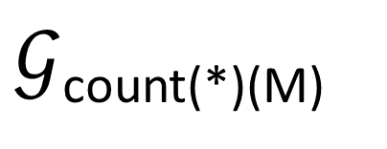
𝒢_{knn(Trip.mpid ,poi.geo, k)}
$𝒢$_{count(*)(M)}
_{< k}
σ_{expand(mbr, d*2) (M)}
ρ_{M (π*(σmbr overlap t (mpid))}
Accumulate(Trip.mpid, POI.geo, k)
M_{trip}
Trip
POI

Slide 12
𝒢knn(Trip.mpid , ‘POINT (10 ,10)’, k)
$𝒢$_{count(*)(M)}
_{< k}
σ_{expand(mbr, d*2) (M)}
ρ_{M (π*(σmbr overlap t (mpid))}
Accumulate(Trip.mpid, ‘POINT (10 ,10)’, k)
M_{trip}
Trip

Slide 13
𝒢_{knn(Trip.mpid ,Trip.mpid, k)}
$𝒢$_{count(*)(M)}
_{< k}
σ_{expand(mbr, d*2) (M)}
ρ_{M (π*(σmbr overlap t (mpid))}
Accumulate(Trip.mpid, Trip.mpid, k)
M_{trip}
M_{trip}
Trip
Trip

Slide 14

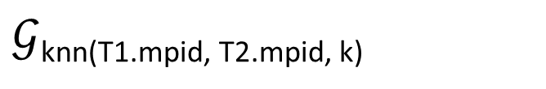


π_{M}
$𝒢$_{knn(T1.mpid, T2.mpid, k)}
ffunc(M)
$𝒢$_{count(*)}(M)
σ_{radius = α * 2} (M)
< k
ρ_{M}π*(σ_{radius = α} (mpoint_oid))
mpoint_oid
sfunc(s1.trajectory, s2.trajectory, k)
Trip
Trip

Slide 15
π_{M}
$𝒢$_{knn(T1.mpid, T2.mpid, k)}
ffunc(M)
$𝒢$_{count(*)}(M)
σ_{radius = α * 2} (M)
< k
ρ_{M}π*(σ_{radius = α} (mpoint_oid))
mpoint_oid
sfunc(s1.trajectory, s2.trajectory, k)
Trip
Trip

Slide 16
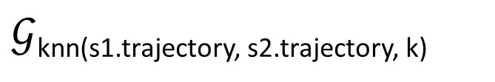
$𝒢$knn(s1.trajectory, s2.trajectory, k)
FFUNC(Arr)
mpoint_oid
SFUNC(s1.trajectory, s2.trajectory, k)
Trip
Trip
σ_{segtableoid = trip.oid}
σ_{segtableoid = trip.oid}
Trip
Trip

Slide 17
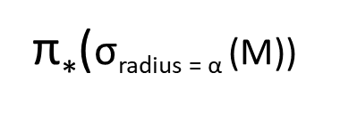
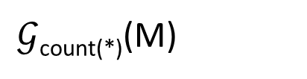
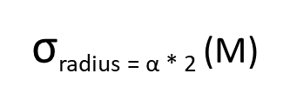
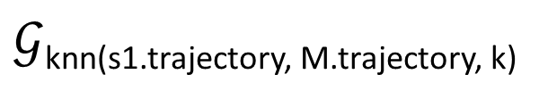
FFUNC(M)
$𝒢$_{count(*)}(M)
σ_{radius = α * 2} (M)
< k
SFUNC(s1.trajectory, M.trajectory, k)
$𝒢$knn(s1.trajectory, M.trajectory, k)
ρ_{S1}(segtable)
π*(σ_{radius = α} (M))
σ_{segtableoid = Trip.trip}
ρ_{M} (segtable)
Trip
Trip

Slide 19
k₃
k₁
geo
k₂

Slide 20
k₃
k₁
geo
p
k₂
minxy
mbr

Slide 21
k₃
k₁
geo
p
k₂
minxy
mbr

Slide 22
k₃
k₁
geo
p
d
k₂
minxy
mbr

Slide 23
k₃
k₁
geo
p
k₂
minxy
mbr

Slide 24
k₃
k₁
geo
p
d
k₂
minxy
mbr

Slide 25
k₃
k₁
geo
p
k₂
minxy
mbr

