Slide 1
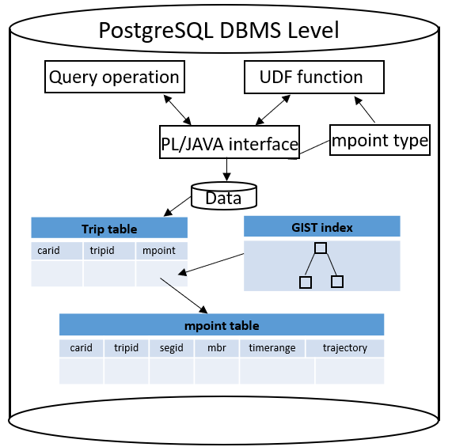
Subsequent work
Install MADlib
Choose the suitable dataset

Slide 2
carid | tripid | mpid
1 | 1 | (1,170573)
2 | 2 | (2,170573)
.. | .. | ..
connected
mpid | segid | mbr | timerange | trajectory
1 | 1 | Box() | [start,end] | trajectory1
1 | 2 | Box() | [start,end] | trajectory2
2 | 1 | Box() | [start,end] | trajectory3
.. | .. | .. | .. | ..
SELECT
m_knn(mpid, ’POINT (10 10)’, 5)
FROM Trip
Calculate the min distance of point and trajectory
(mpid,dis)
Comparing from the
last element and
replace if smaller
If array not full
else
add and sort array
M_KNN_SFUNC(array, mpid, ’POINT (10 10)’, 5)
(mpid,dis) | (mpid,dis) | (mpid,dis) | (mpid,dis) | (mpid,dis)
K = 5
M_KNN_FFUNC(array)
Return result

Slide 3
carid | tripid | mpid
1 | 1 | (1,170573)
2 | 2 | (2,170573)
.. | .. | ..
mpid | segid | mbr | timerange | trajectory
1 | 1 | Box() | [start,end] | trajectory1
2 | 1 | Box() | [start,end] | trajectory2
3 | 1 | Box() | [start,end] | trajectory3
.. | .. | .. | .. | ..
connected
Predefined α , and check sfunc is first run
Yes
No
SELECT
m_knn(t1.mpid, t2.mpid, 5)
FROM Trip t1,Trip t2
Query includes “WHERE”
Yes
No
algorithm
new a materialized view using α radius
mpid | distance
50 | 0.368
346 | 0.541
… | …
M_KNN_SFUNC(array, mpid, ’POINT (10 10)’,5)
else α *2
If count(materialized) ≥ 5
M_KNN_FFUNC(array)
Return result

Slide 4
carid | tripid | mpid
1 | 1 | (1,170573)
2 | 2 | (2,170573)
.. | .. | ..
mpid | segid | mbr | timerange | trajectory
1 | 1 | Box() | [start,end] | trajectory1
2 | 1 | Box() | [start,end] | trajectory2
3 | 1 | Box() | [start,end] | trajectory3
.. | .. | .. | .. | ..
connected
Predefined
Check query includes “WHERE”
SELECT
M_KNN(t1.mpid, t2.mpid, 5)
FROM Trip t1,Trip t2
YES
YES
M_KNN_SFUNC(array, mpid, ’POINT (10 10)’,5)
M_KNN_FFUNC(array)

Slide 5
carid | tripid | mpid
1 | 1 | (1,170573)
2 | 2 | (2,170573)
.. | .. | ..
mpid | segid | mbr | timerange | trajectory
1 | 1 | Box() | [start,end] | trajectory1
2 | 1 | Box() | [start,end] | trajectory2
3 | 1 | Box() | [start,end] | trajectory3
.. | .. | .. | .. | ..
connected
M_KNN_SFUNC(array, mpid, ’POINT (10 10)’,3)
SELECT
M_KNN(mpid, ’POINT (10 10)’,3)
FROM Trip
M_KNN_FFUNC(array)

Slide 6
carid | tripid
1 | 1
2 | 2
.. | ..
carid | tripid | mpid
1 | 1 | (1,170573)
2 | 2 | (2,170573)
.. | .. | ..
SELECT addmgeometrycolumn
('public', ‘Trip', 'mpid', 4326, 'mpoint', 2, 50)
Trip table
Connect
mpid | segid | mbr | timerange | trajectory
1 | 1 | Box() | [start,end] | trajectory1
1 | 2 | Box() | [start,end] | trajectory2
2 | 1 | Box() | [start,end] | trajectory3
.. | .. | .. | .. | ..
Moving Object Table

