Slide 1
Technicolor Trends
Visualizing data for the top 1000 highest grossing movies based on movie poster colors

Slide 2
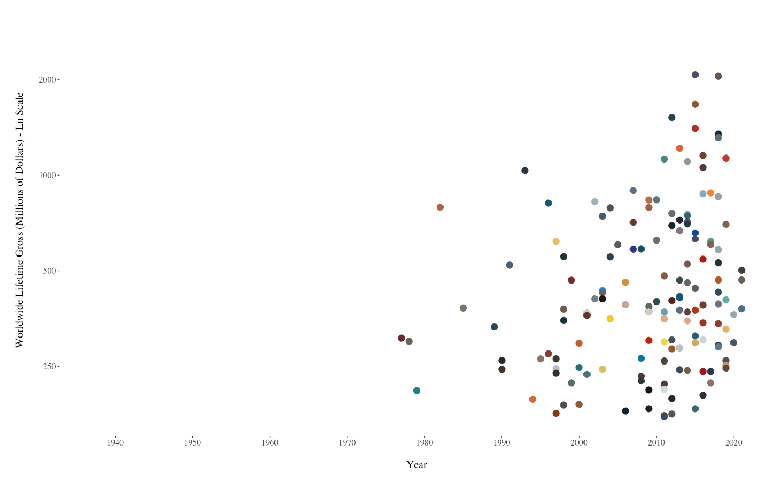
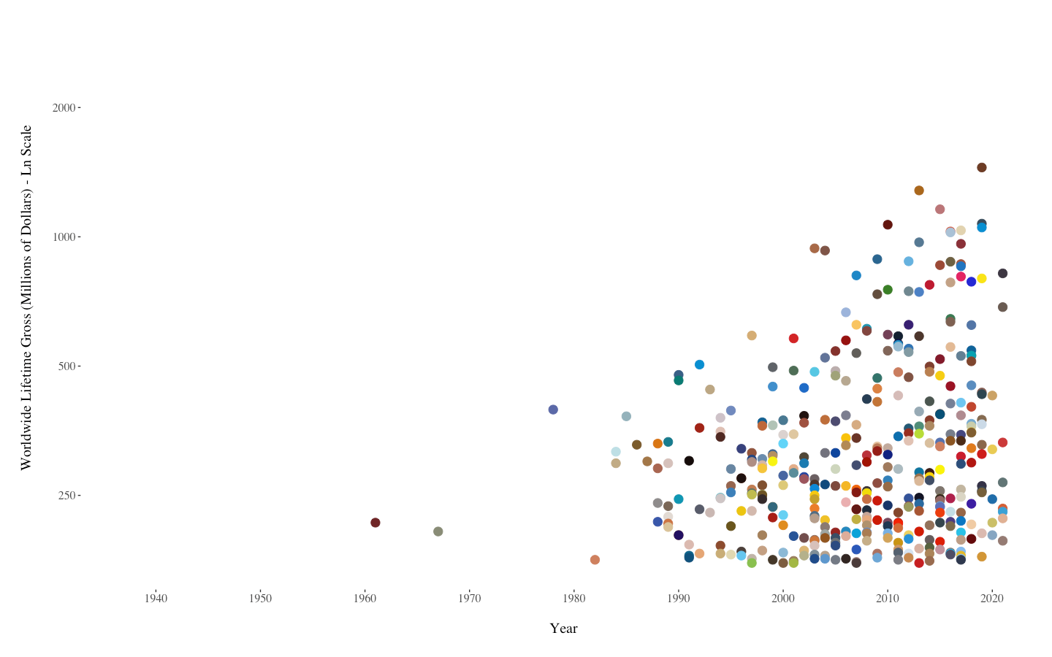
Which graph shows comedy movies, and which graph shows sci-fi movies?
Notes:
All graphs in this presentation (excluding the very last one, which has its own legend about the colors used) have points that are colored based on the brightest dominant color on the movie poster, as found on IMDb. The method for finding the “brightest dominant color” is included in the Devpost and the Python file.

Slide 3
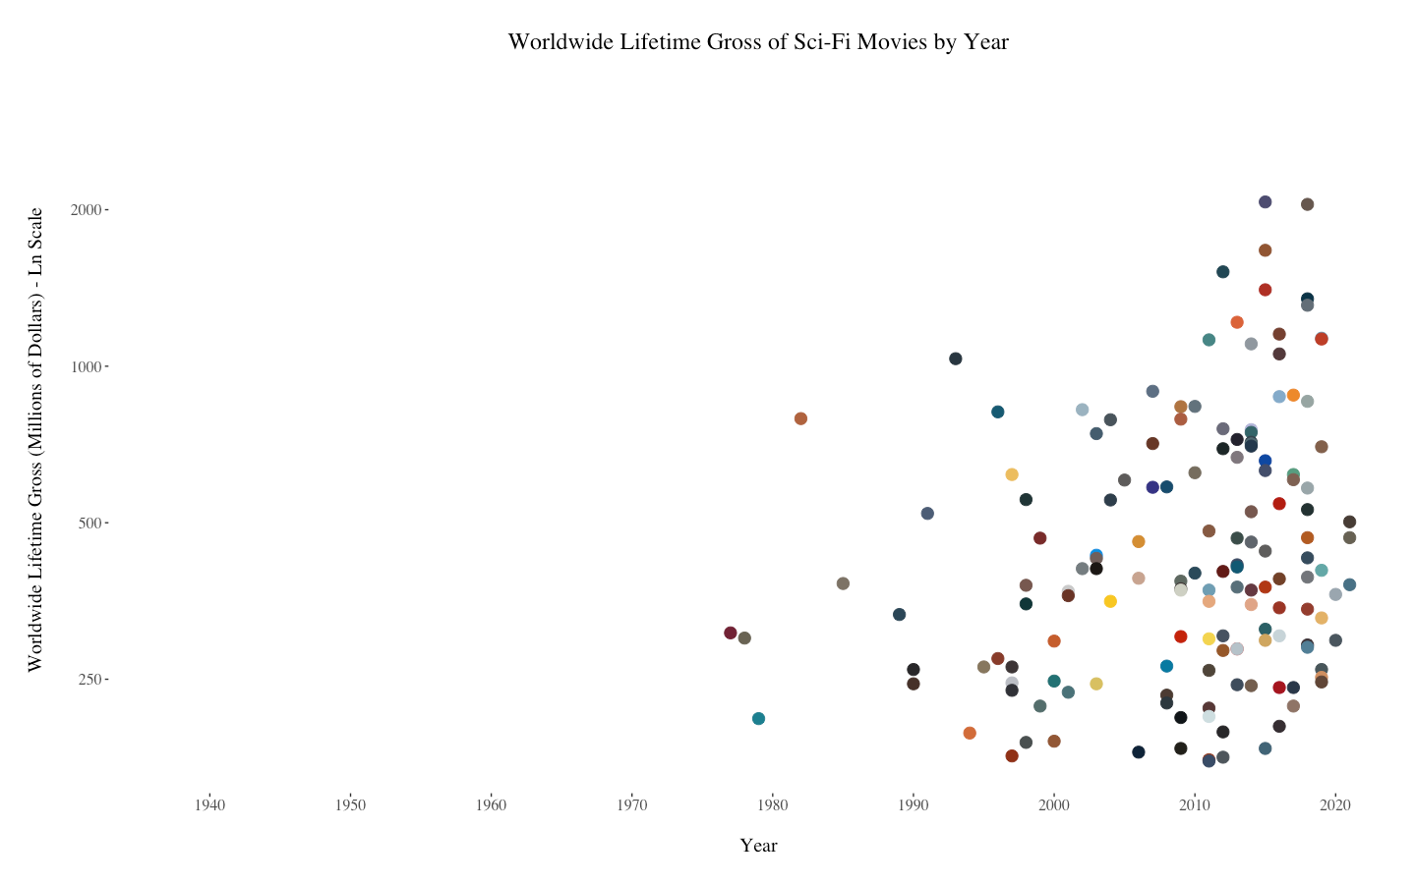
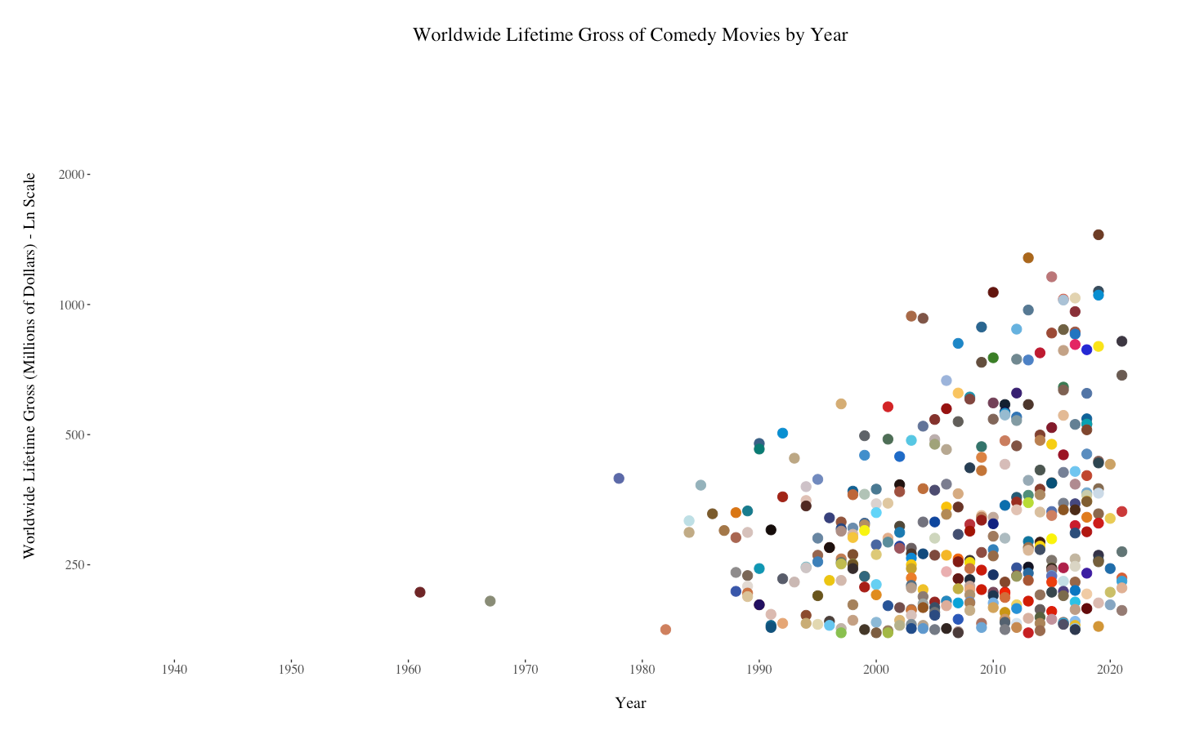
Notes:
This comparison is pretty obvious, isn’t it? The comedy movies have a much brighter color scheme, while the sci-fi movies generally include more greys and muted colors.

Slide 4
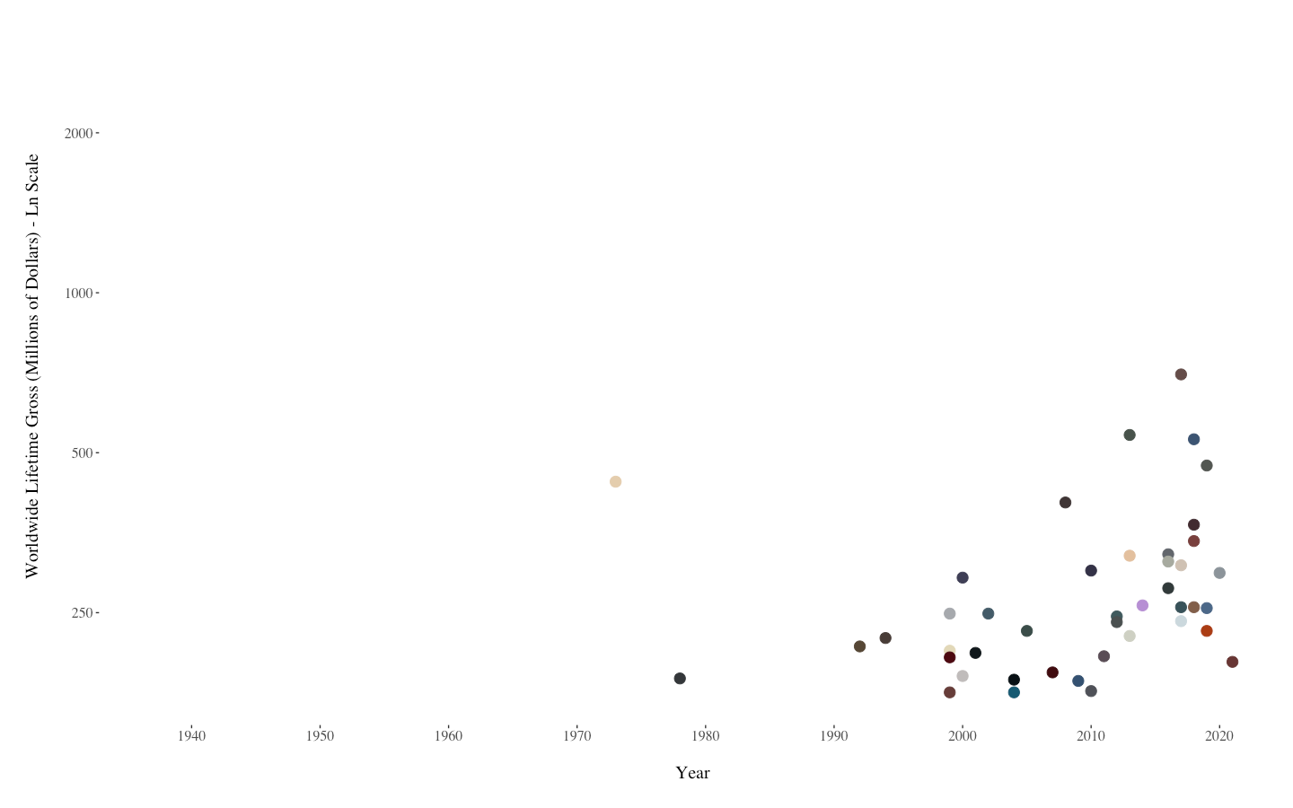
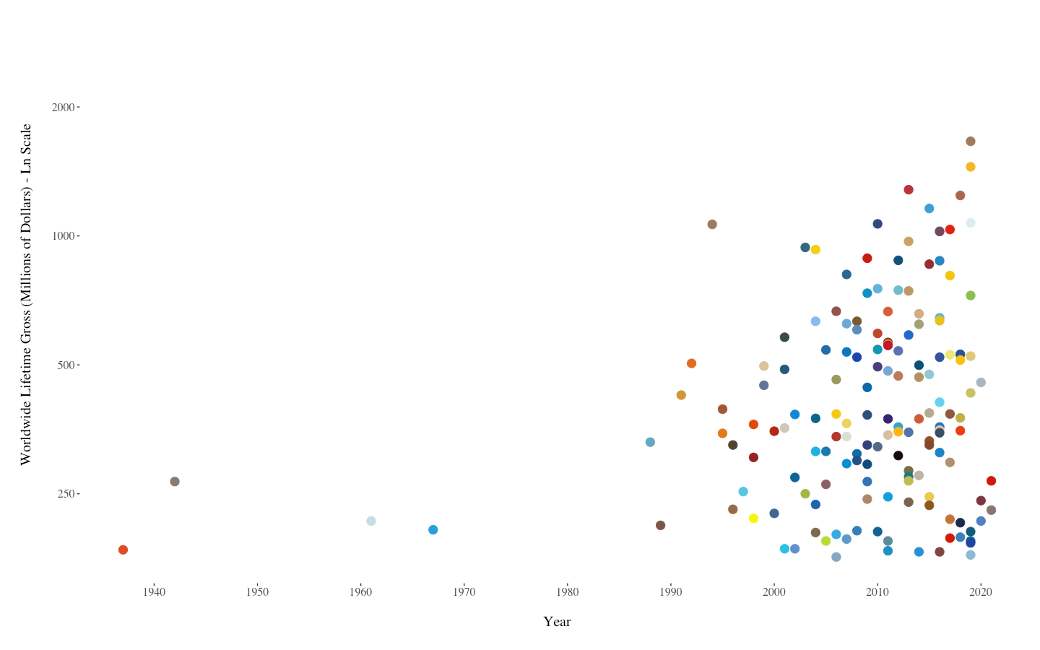
Which graph shows animated movies, and which graph shows horror movies?

Slide 5
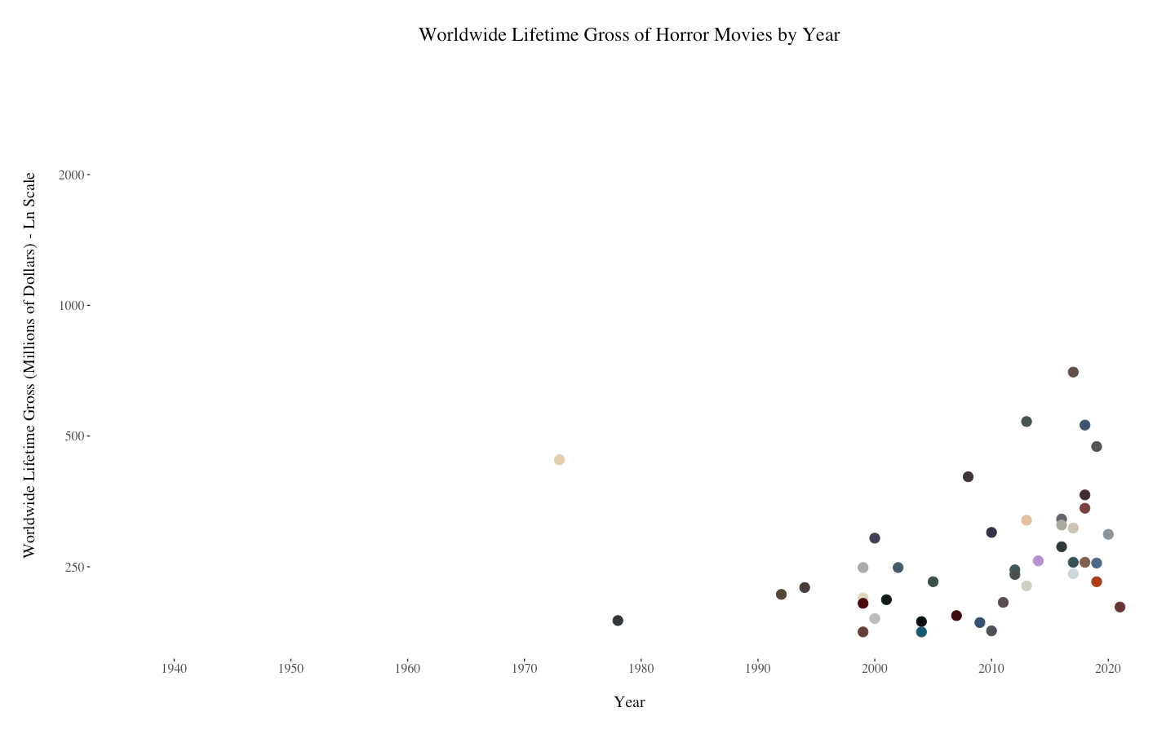
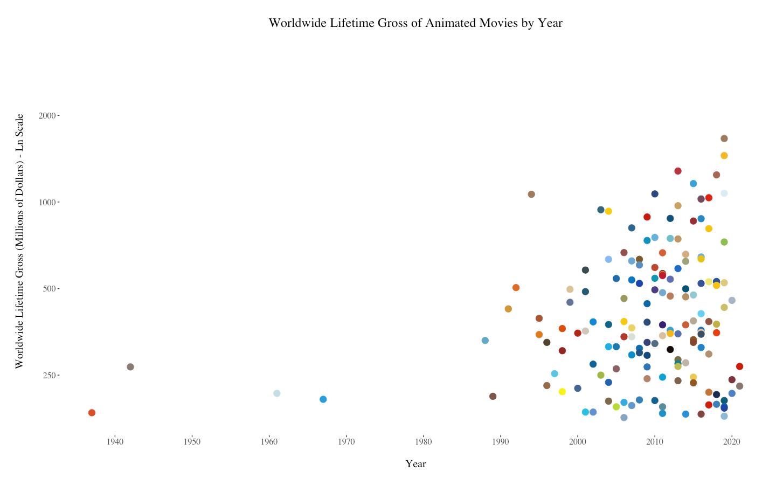
Notes:
Again, pretty obvious: most horror movies have grey as the dominant color on the movie poster, while animated movies make use of plenty of bright blues, yellows, and reds.

Slide 6
Complete Graph

Slide 7
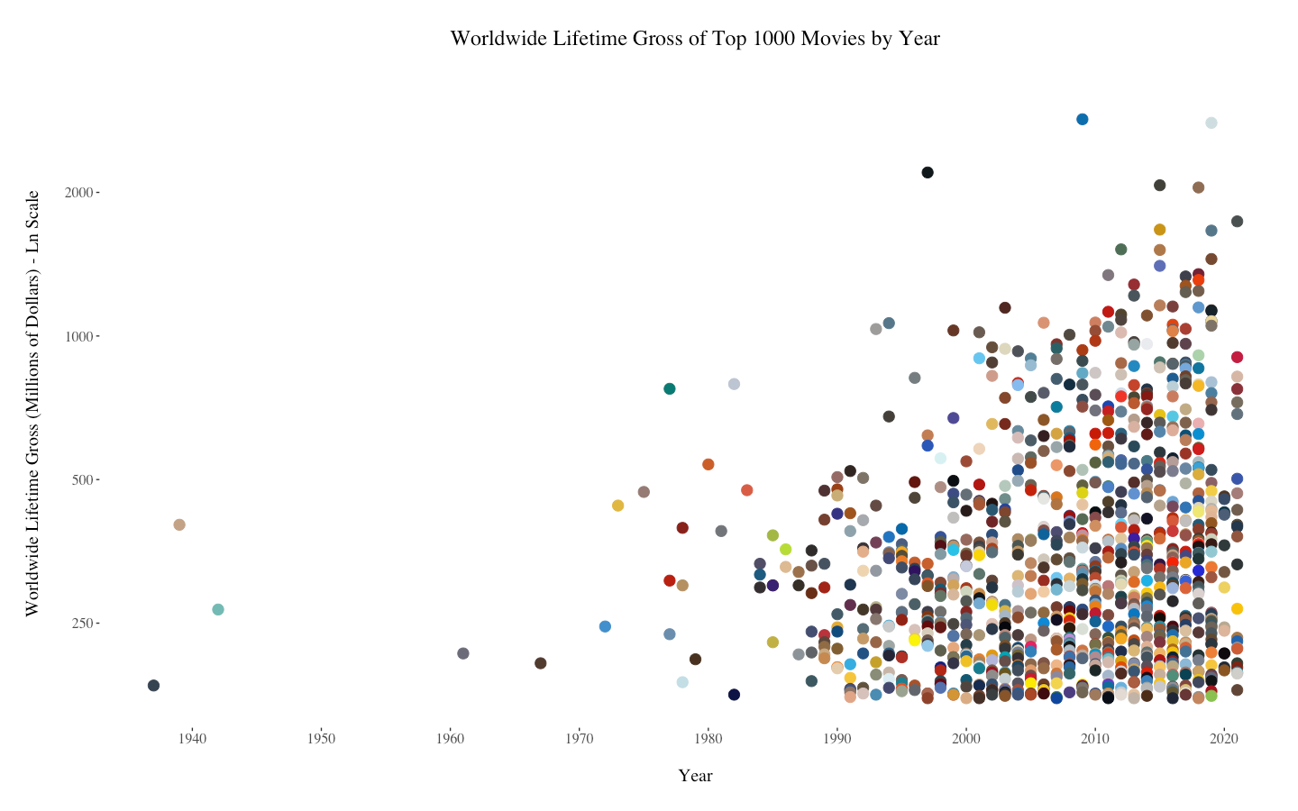
Notes:
This graph plots the top 1000 highest grossing movies as listed on IMDb.

Slide 8
Genre-Specific Graphs
Notes:
Genres defined by IMDb; movies can belong to up to three genres.

Slide 9
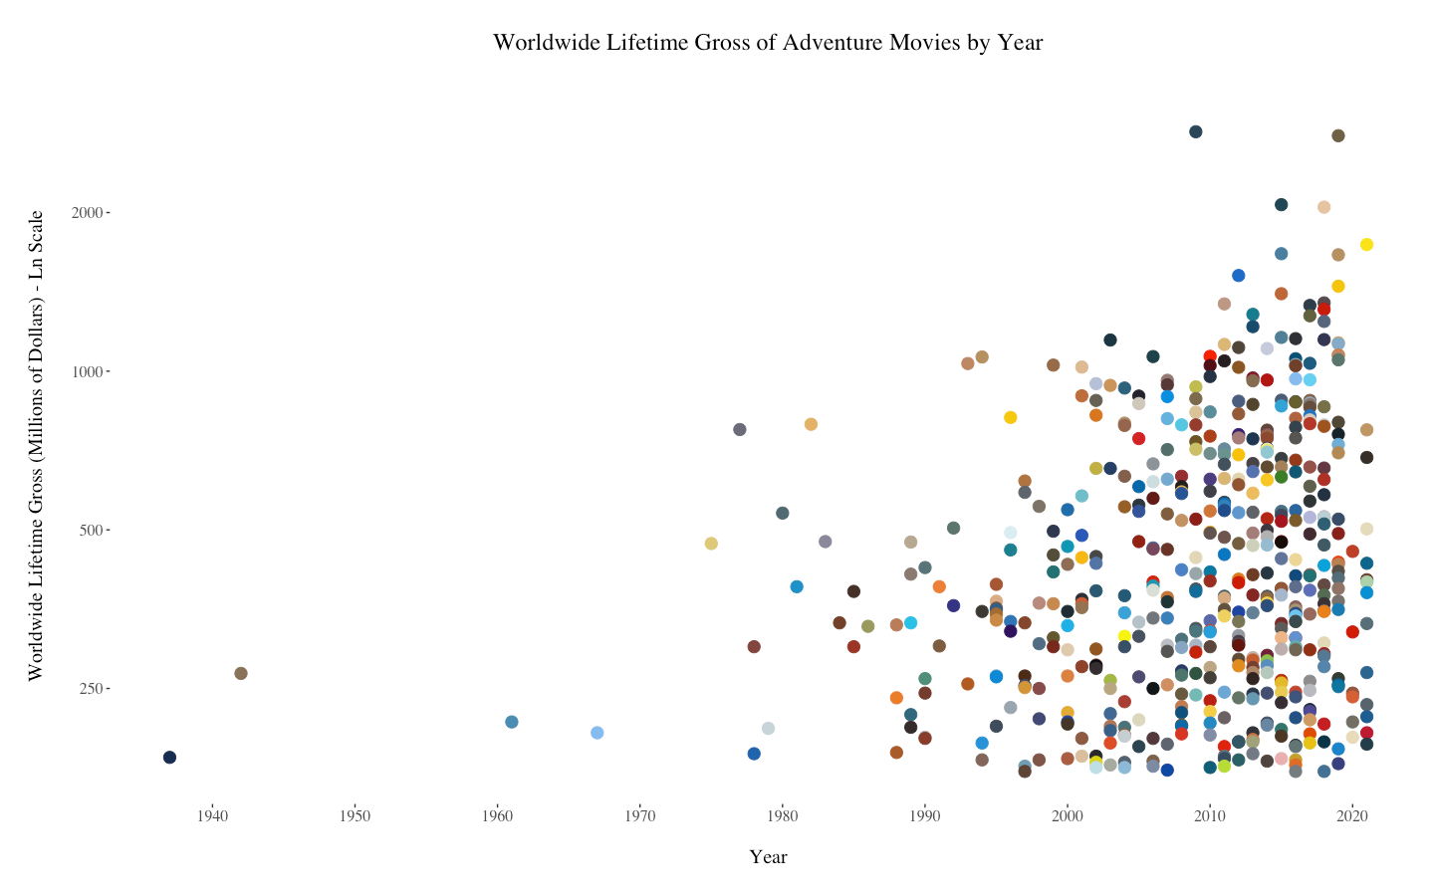
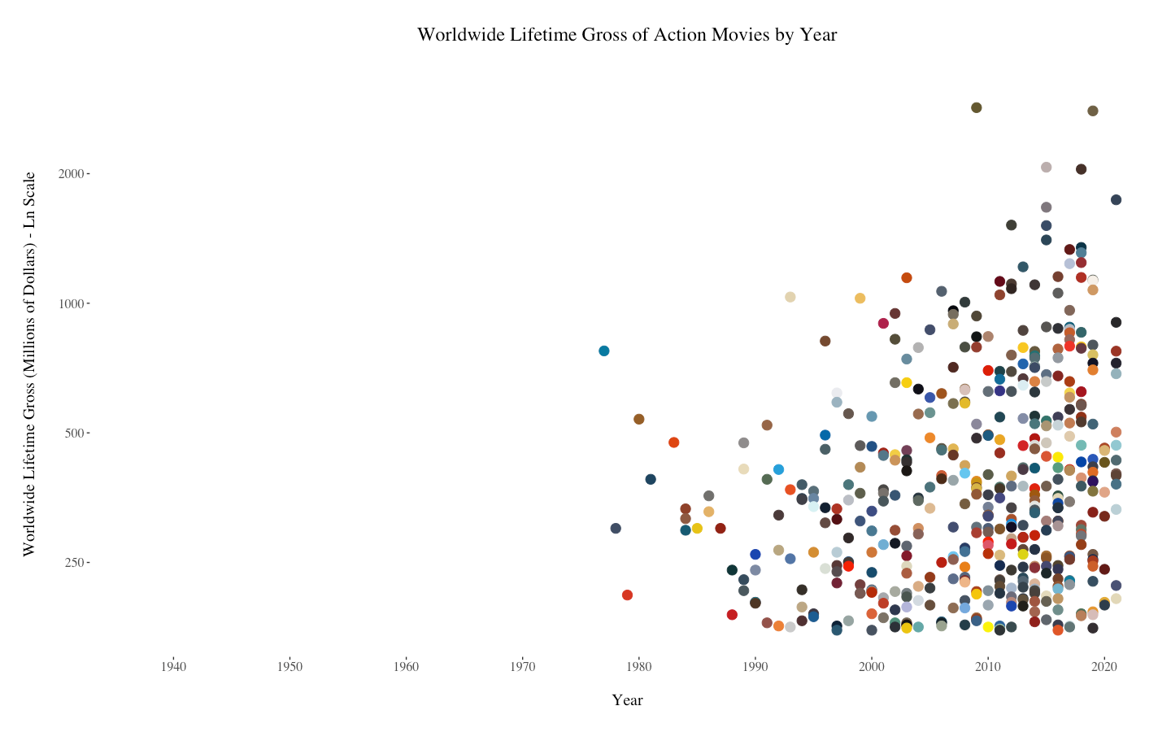

Slide 10
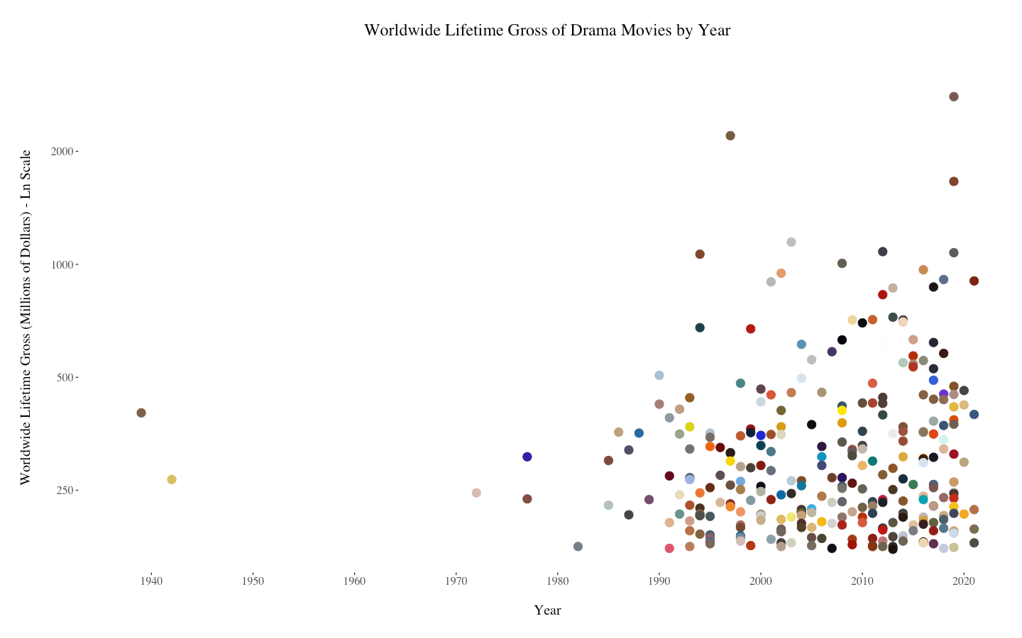
Notes:
There isn’t a huge contrast in these color schemes, but drama movie posters have slightly more muted colors than those for comedy movies.

Slide 11
Notes:
There is quite a contrast in the color schemes of the graphs on this slide: animated movie posters tend to be bright and colorful, which sci-fi movies have more grey and earthy tones.

Slide 12
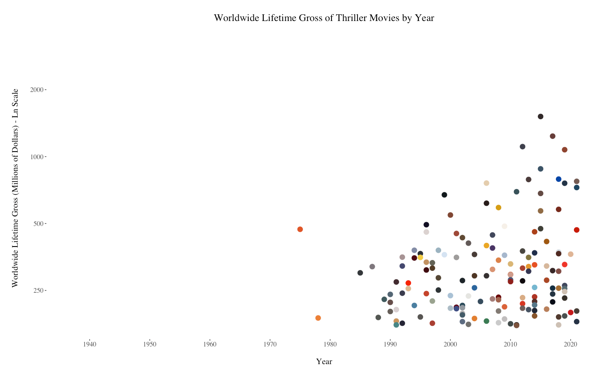
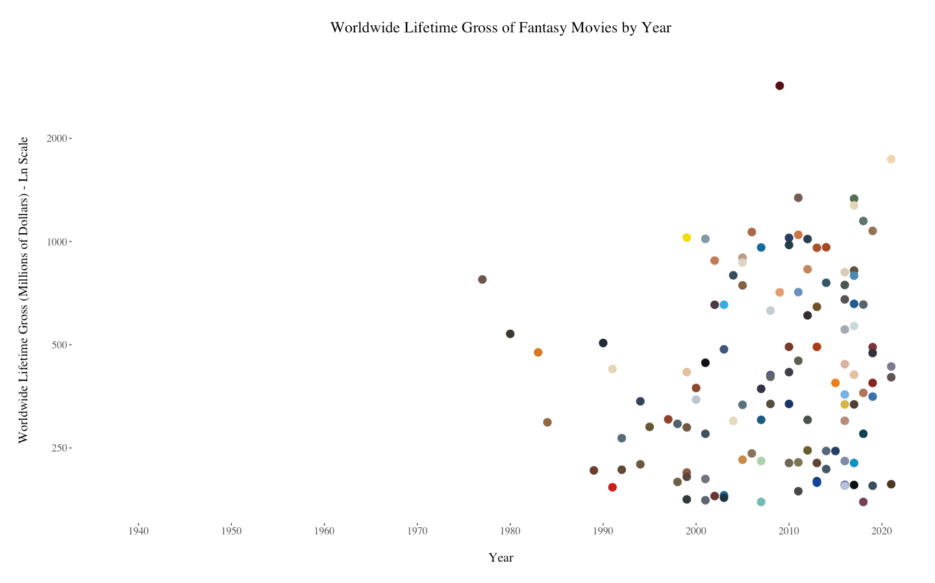

Slide 13
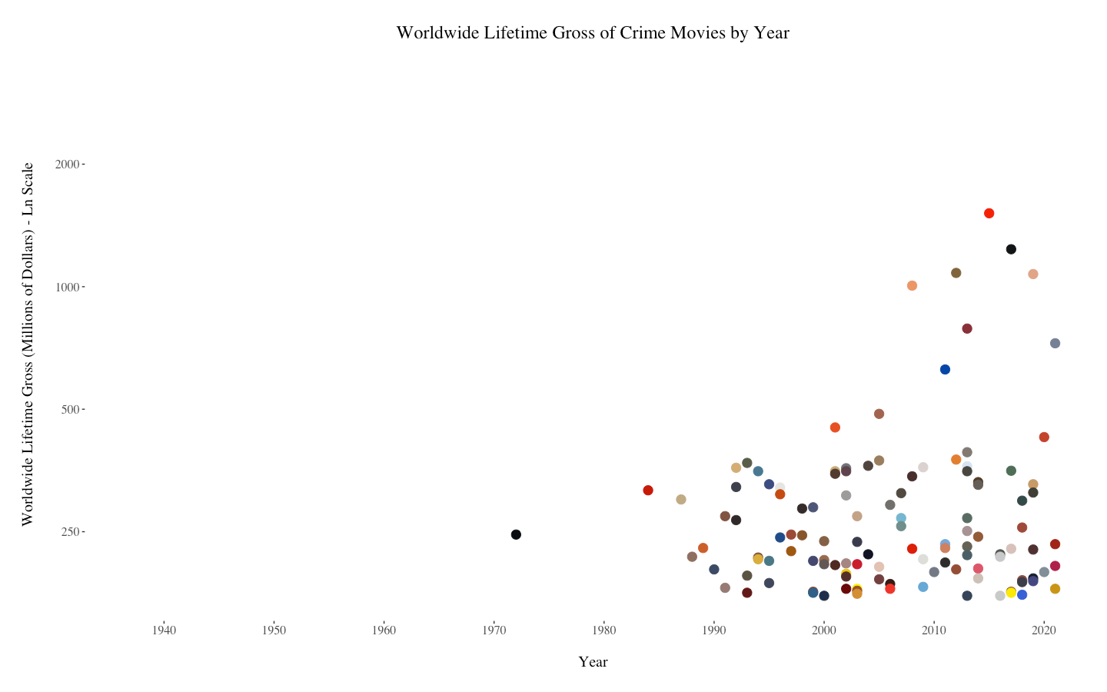
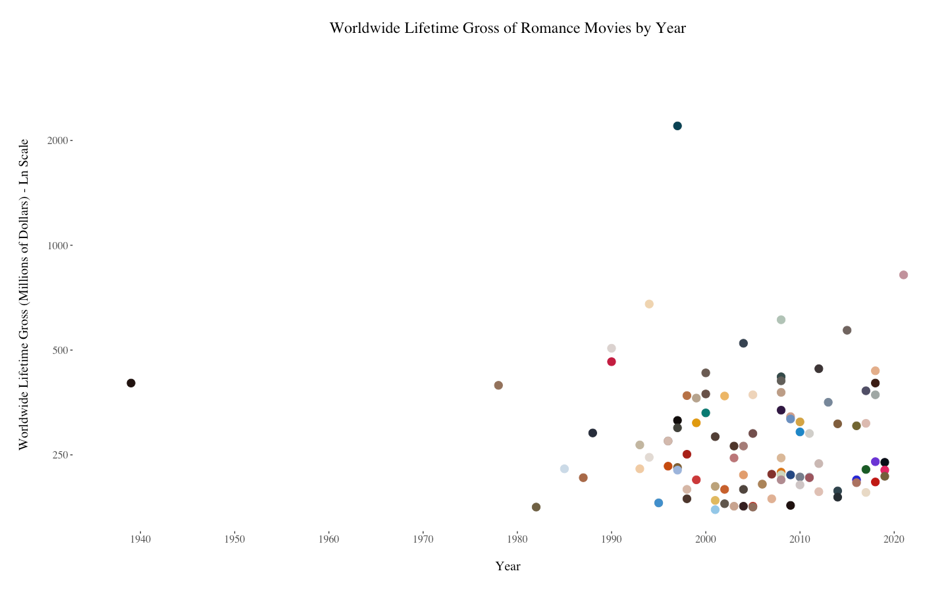

Slide 14
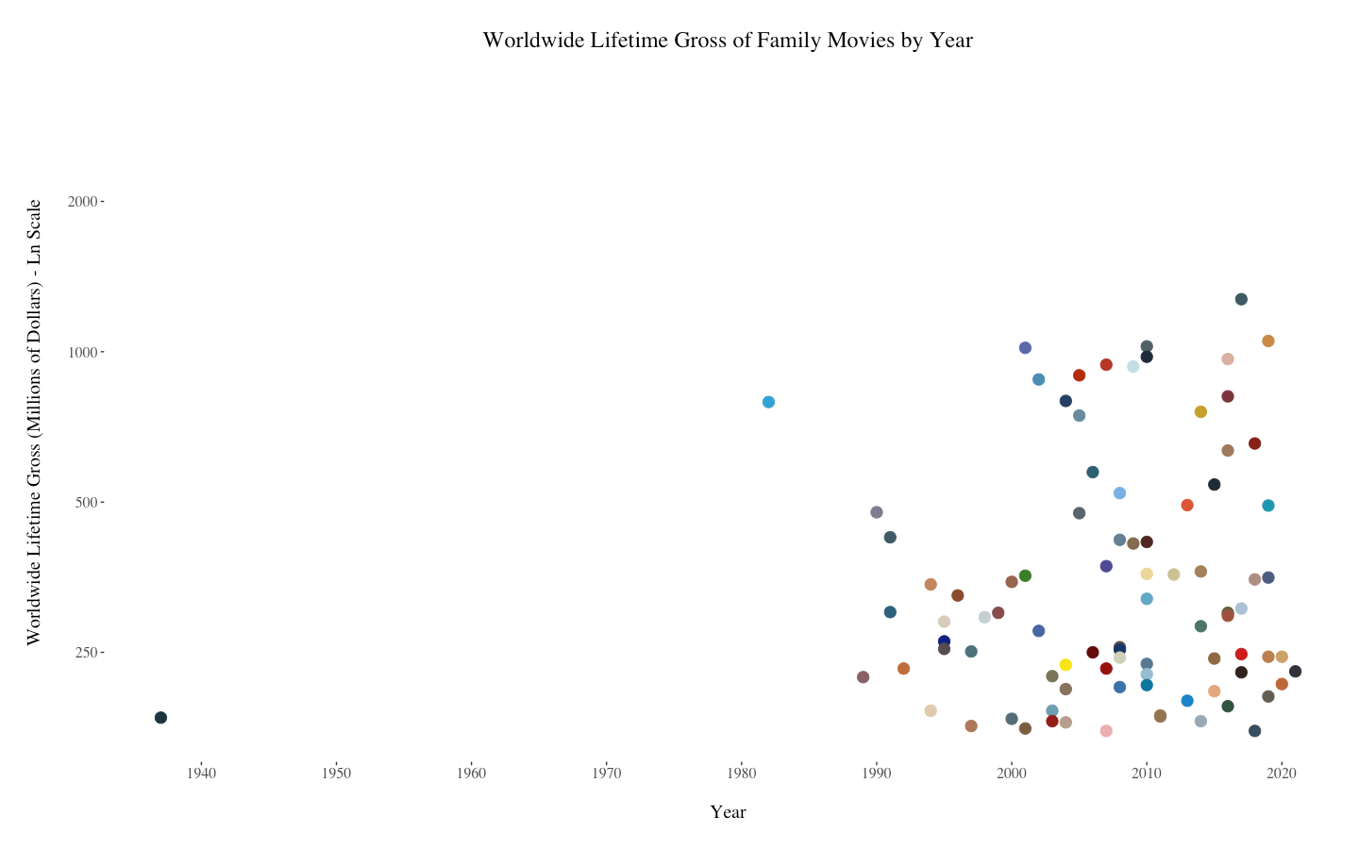
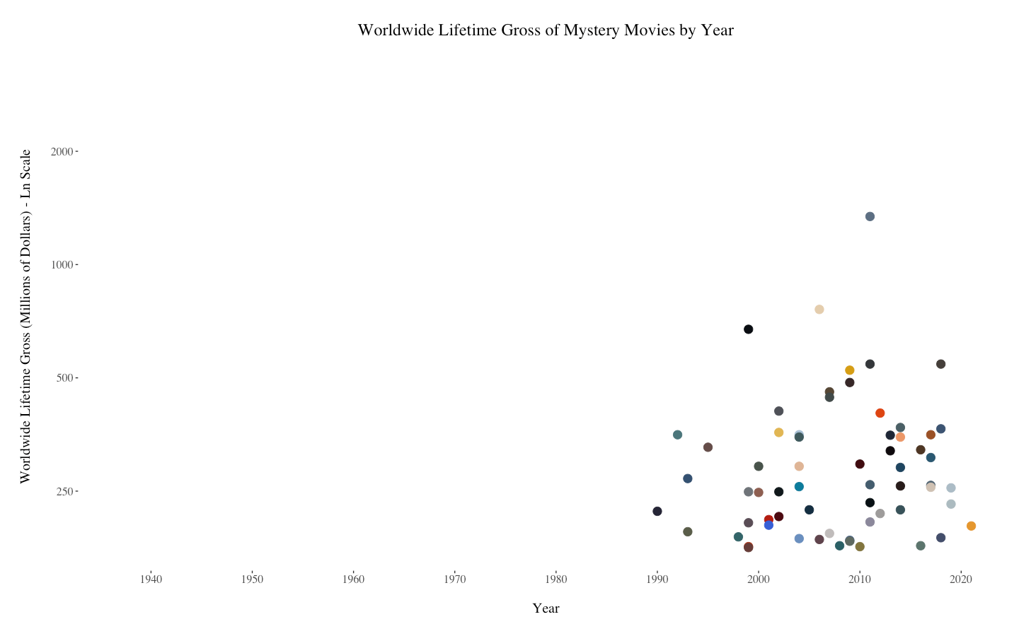
Notes:
Mystery movie posters have a slightly more muted color scheme than family movie posters.

Slide 15
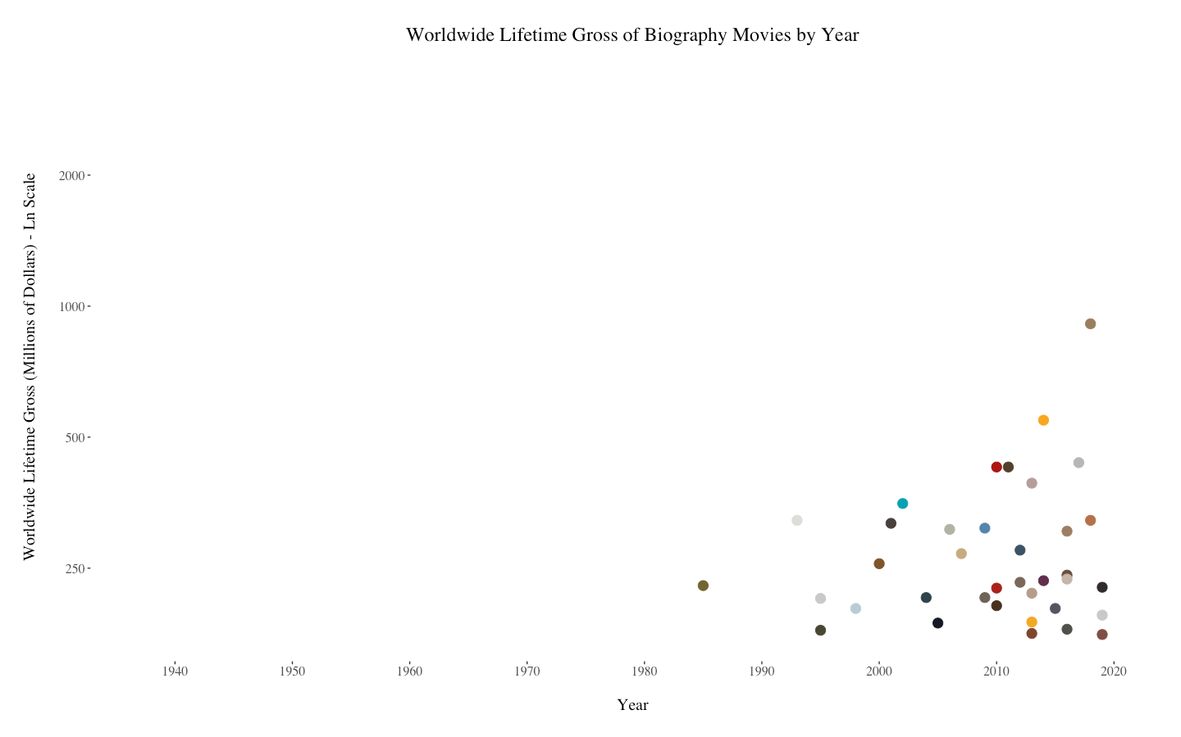
Notes:
Horror movie posters have a lot of darker blacks and greys, while biography movie posters are overall lighter with some blues and yellows.

Slide 16
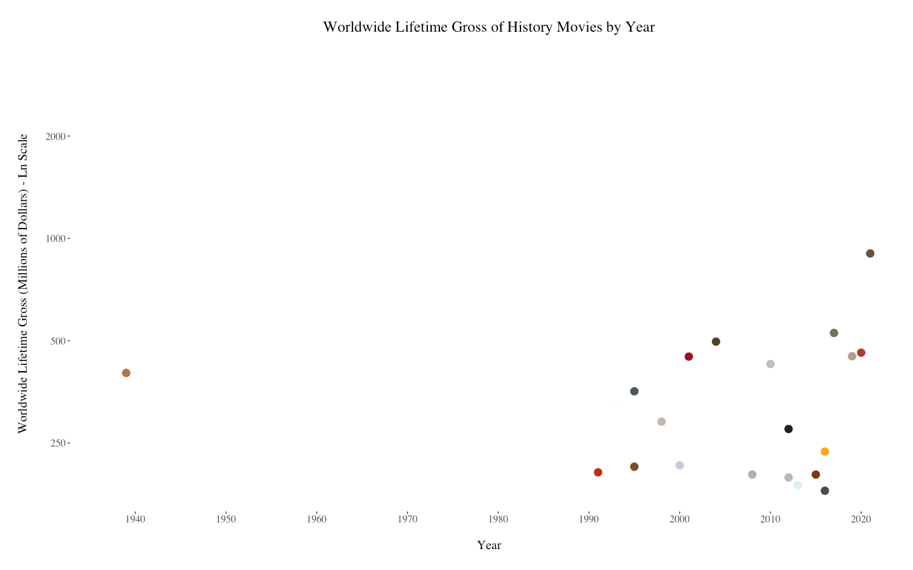
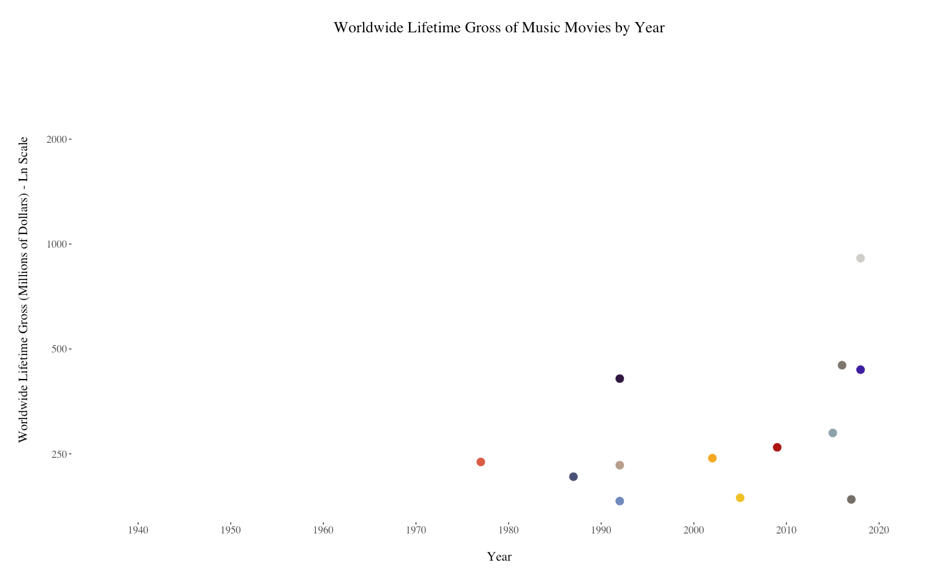
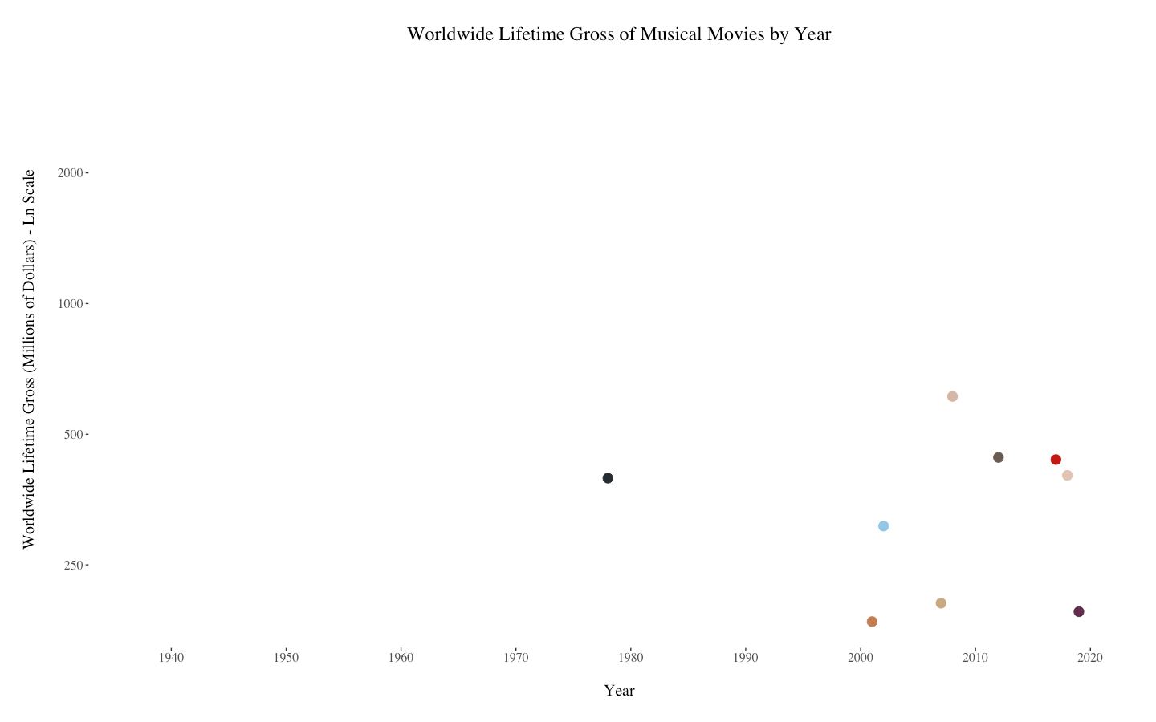

Slide 17
Other Graphs

Slide 18
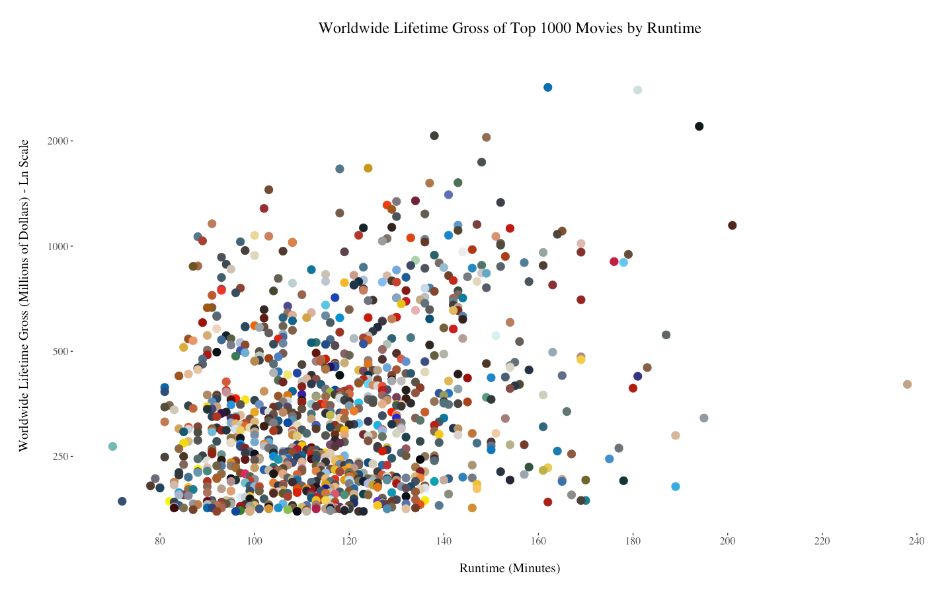
Notes:
There is a very loose positive correlation between runtime and gross earnings; the obvious outlier at nearly 240 minutes is Gone with the Wind (1939).

Slide 19
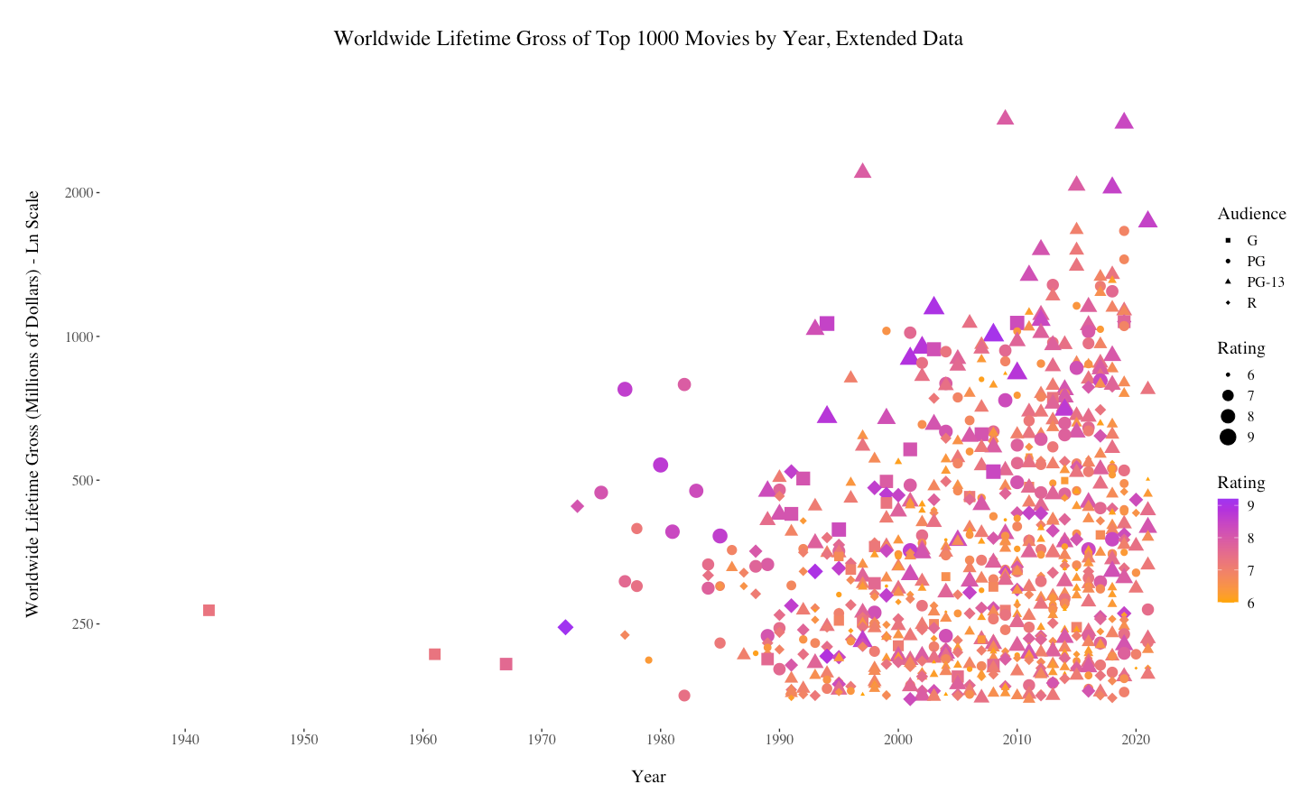
Notes:
This graph does not show all 1000 movies; it includes only movies with a rating of at least 6 and G, PG, PG-13, or R audience content ratings (there were a few movies with TV audience content ratings as well as older movies with pass/fail audience content ratings). This left about 800 movies, which I felt was still sufficient to graph. Rating accounts for both size and color of points, since one or the other on its own doesn’t provide enough contrast.

Slide 20
Thank You!
Check my Devpost for:
Details about this hack
Larger images of all the graphs in this presentation
A link to GitHub, which includes
Both files of code
The csv file
This presentation, which has more details/analysis in the presentation notes

