Slide 1


GROUND UP SERIES
TM
Apache Nifi
Awase Khirni Syed
RESEARCHER | ENTREPRENEUR | TECHNOLOGY COACH
Elain Technologies Inc Canada aks@elain-tech.com
Syed Awase earned his PhD from University of Zurich in GIS, supported by EU V Framework Scholarship from SPIRIT Project (www.geo-spirit.org). He currently provides consulting services through his startup www.territorialprescience.com and www.sycliq.com . He empowers the ecosystem by sharing his technical skills worldwide, since 2008. www.Elain-Tech.com. Apache Nifi is trademark of Apache all rights belong to Apache.

Slide 2
Slide Version Updates
Last Updated | Version | Release Date | Updated by | Code Plays Done @
2023 Nov 30 |  |  | Awase Khirni Syed
© Awase Syed 2023 – Apache Nifi

Slide 3

Overview
© Awase Syed 2023 – Apache Nifi

Slide 4
A dataflow system based on the concepts of flow-based programming. The purpose of Nifi is to automate data transfer across systems. Any data content can be propagated from any source to any destination.
Strong and scalable directed graphs of data routing, transformation, and system mediation logic are supported by Apache Nifi.
Use a data flow management system to tackle complex data capture, ingest, transformation, and routing problems at the global enterprise level.
created to meet the challenges posed by the enterprise data flow
SECTION-I
© Awase Syed 2023 – Apache Nifi

Slide 5
Current Challenges of Enterprise Data Flow
Visual Command and Control
Data Lineage(Provenance)
Data Prioritization
(agile processes)
To ensure data veracity/trust
Ingestion is a sequential process
Data Buffering/Back-Pressure
Control Latency vs Throughput
Scale out clustering
Seamless transfer
adaptability
Scalability
Secure Control Plane/Data Plane
Extensibility
Secure transfer
Expandability
© Awase Syed 2023 – Apache Nifi

Slide 6
Nifi Users?
© Awase Syed 2023 – Apache Nifi

Slide 7
Features
Browser-based user interface for seamless experience for design, control, feedback and monitoring
Data provenance/lineage tracking
Extensive configuration support
  Loss-tolerant and guaranteed delivery
  Low latency and high throughput
  Dynamic prioritization
  Runtime modification of flow configuration
  Back pressure control
Extensible design
  Component architecture for custom processors and services
  Rapid development and iterative testing
Secure Communication
  HTTPS with configurable authentication strategies
  Multi-tenant authorization and policy management
  Standard protocols for encrypted communication including TLS and SSH
Drag and drop interface
Focus on configuration of processors
Scalable across a cluster of machines
Guaranteed Delivery/ No Data Loss
© Awase Syed 2023 – Apache Nifi

Slide 8
Use cases
Ideal Use cases
Not Ideal Use cases
Reliable and secure transfer of data between systems
Delivery of data from source to analytic platforms
Enrichment and preparation of data:
  Conversion between formats
  Extraction/Parsing
  Routing decisions
Distributed Computation
Complex Event Processing
Joins, rolling windows, aggregates operations ( Not as good as Apache Spark)
© Awase Syed 2023 – Apache Nifi

Slide 9
Building Blocks
Flowfile
Processor
Connector
It is essentially data
It comprises of two critical elements
  Content: the data itself
  Attributes: key value pairs associated with the data (creation data, etc…)
Gets persisted to disk after creation
Applies a set of transformations and rules to flow files, to generate new flow files.
Any processor can process any flow file
Processors are passing flow file references to each other to advance the data processing
Executed in parallel using threads.
It is basically a queue of all the flow files that are yet to be processes by the Processor2
Defines the rules about how Flowfiles are prioritized (which one first, which one not at all)
Can define backpressure to avoid overflow in the system
© Awase Syed 2023 – Apache Nifi

Slide 10
Typical Workflow
Using the building blocks of Apache Nifi
Processor
FlowFile
Input
(source)
Processor
Processor
Processor
Target
Data
FlowFile
FlowFile
FlowFile
FlowFile
Processor
FlowFile
© Awase Syed 2023 – Apache Nifi

Slide 11
Nifi vs python vs Spark
Challenges | Nifi | Python | spark
Visual command and control
Data lineage |  | Stairlight
Data prioritization
Data buffering/back-pressure
Control latency vs throughput
Scale out clustering
Secure control plane/ data plane
extensibility
© Awase Syed 2023 – Apache Nifi

Slide 12
Setting up Nifi
https://archive.apache.org/dist/nifi/1.16.3/nifi-toolkit-1.16.3-bin.zip
© Awase Syed 2023 – Apache Nifi

Slide 13
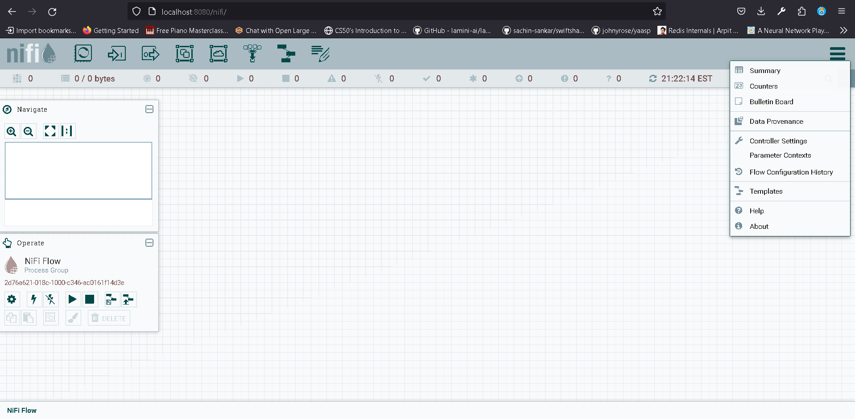
Running apache nifi
Navigate to nifi-1.12.1/bin folder
Execute run-nifi.bat file on windows platform.
Now lets open the following URL in the browser
http://localhost:8080/nifi/
© Awase Syed 2023 – Apache Nifi

Slide 14
Key Components of Nifi Dashboard
Template
Processor
Input Port
Process Group
Funnel
Output Port
Remote Process Group
Label
© Awase Syed 2023 – Apache Nifi

Slide 15
Processer Categorization
Category | Description
Data Transformation | Replace text, jolt transform JSON
Routing and Mediation | RouteOnAttribute, RouteOnContent,ControlRate
Database access | ExecuteSQL,ConvertJSONToSQL, PutSQL
Attribute extraction | EvaluateJsonPath,ExtractText,UpdateAAttribute
System interaction | Execute Process
Data ingestion | GetFile,GetFTP,GetHttp,GetHDFS, ListenUDP,GetKafka
Sending data | PutFile, PutFTP,PutKafka,PutEmail
Splitting and aggregation | SplitText,SplitJson,SplitXML,Merge
http | GetHttp,ListenHttp,PostHttp
AWS | FetchS3Object,PutS3Object,PutSNS,GetSQS
© Awase Syed 2023 – Apache Nifi

Slide 16
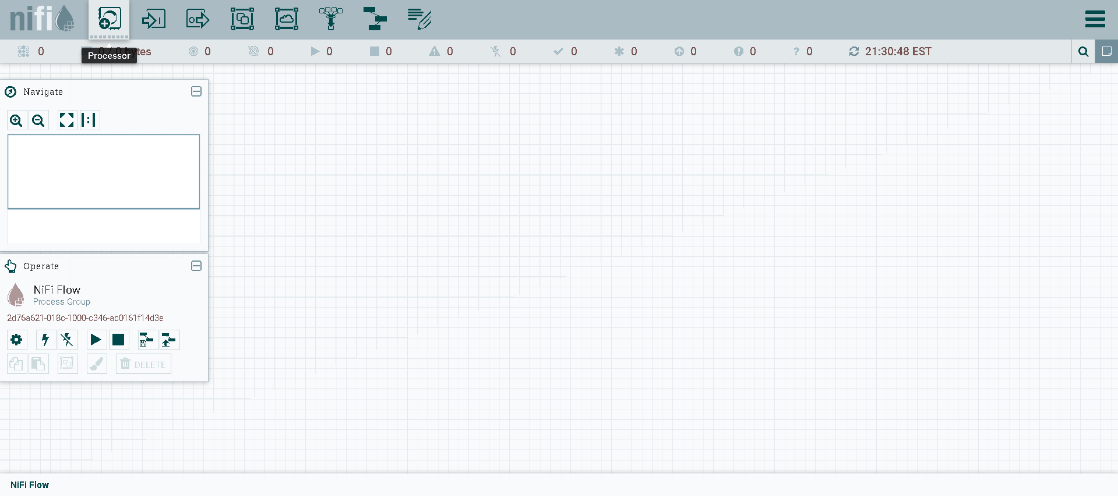
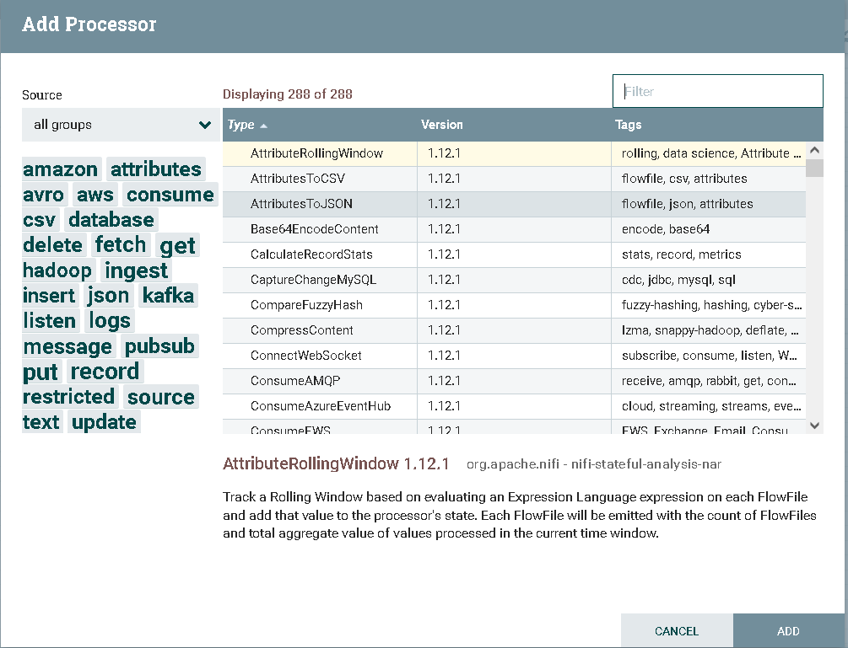
Processor Component
© Awase Syed 2023 – Apache Nifi

Slide 17
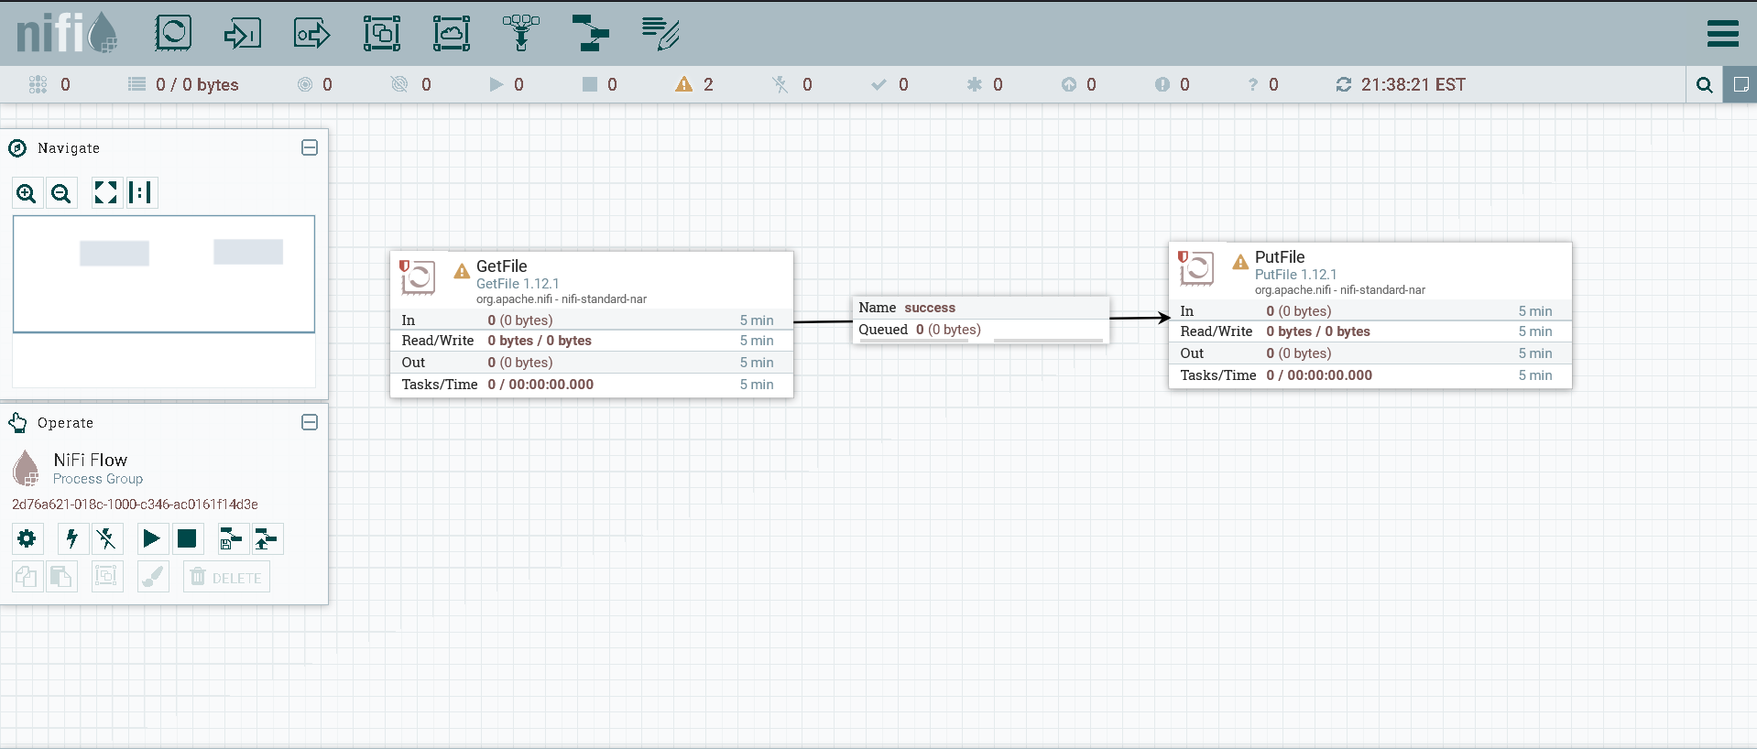
Simple Workflow
Connector
Processor
Processor
© Awase Syed 2023 – Apache Nifi

Slide 18
© Awase Syed 2023 – Apache Nifi

