Slide 1

RecyclerView
by Aleksander Wasilik

Slide 2
Topics:
Short definition
Components
LayoutManager types
Item click event
Drag and drop in recycler
Custom swipe behavior
CODE SAMPLE AVAILABLE HERE

Slide 3
1. Short definition:
RecyclerView is advanced listview suitable for large data sets. It has built in mechanism for memory-efficient handling multiple list items. When user scrolls items outside of visible area Recycler sets is state to Scrap, next the scrap view is fully detached and marked as Dirty, adapter makes data binding and the view is attached to the new postion.

Slide 4
1. Short definition:
Dirty
Scrap
Adapter OnBindViewHolder

Slide 5
2. Components:
Adapter – provides binding from app specific data to list views.
LayoutManager – responsible for measuring and positioning views inside recyclerView. It also contains policy for when to recycle no longer visible views.
ViewHolder – single list item with data outlets for easy binding.
ItemDecoration – allows to draw custom effects for recycler items.
ItemTouchHelper – adds swipe and drag’n’drop support for items in recycler
ItemTouchHelper.Callback – contract between ItemTouchHelper and app defining custom callbacks on item movement

Slide 6
3. LayoutManager types:
LinearLayoutManager
GridLayoutManager
StaggeredGridLayoutManager

Slide 7
4. Item click event
Adding „Click” event in adapter is dangerous cause we do it by: view.Click += myEvent;
If the view is bound multiple times it is dangerous cause the event is fired multiple times. We should make some mechanism to prevent subscribing multiple times.
SAMPLE IN CODE
Notes:
Change MainLauncher to second activity

Slide 8
5. Drag and drop in recycler
Android provides with a class called ItemTouchHelper. Attaching one to RecyclerView allows almost out of the box in simple drag’n’drop and swipe to dismiss elements.
SAMPLE IN CODE

Slide 9
6. Custom swipe behavior
CODE

Slide 10
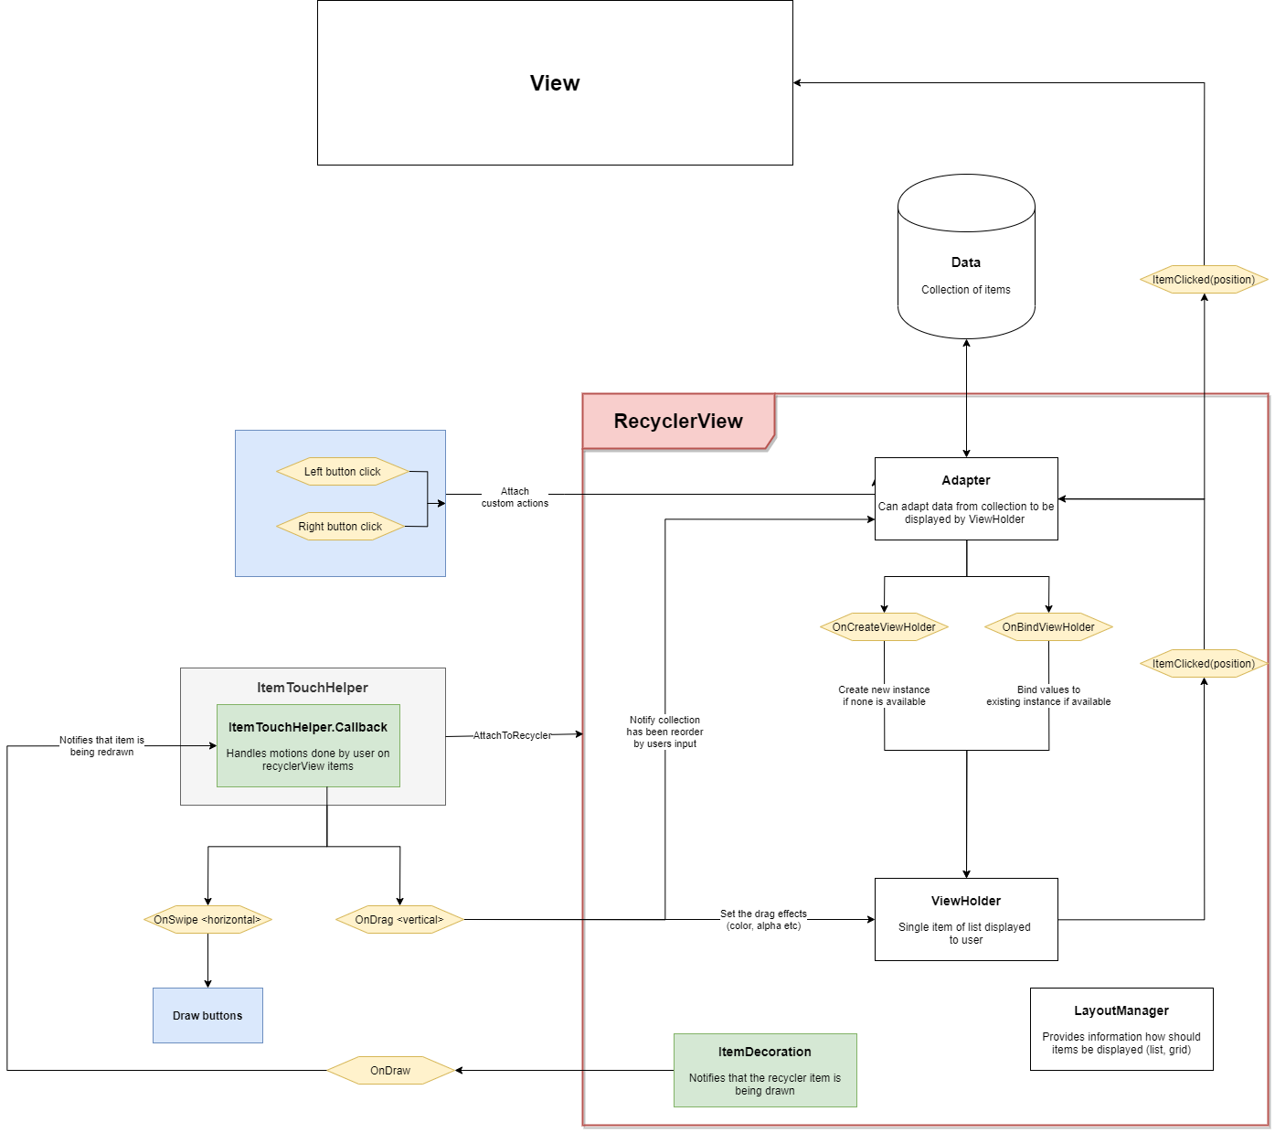
Scheme

Slide 11

CODE

