Slide 1
Modeling ion transport in nanochannels
10.585 Course Project
Gaurav Awasthi
First-year PhD student, MIT ChemE
Dec 5, 2024

Slide 2
Outline
Ion-exchange and osmotic power generation
Flow through nanopores: introduction
System and datasets
Analysis 1: Electric potential-driven flow
Analysis 2: Salinity gradient-driven flow
Conclusions

Slide 3
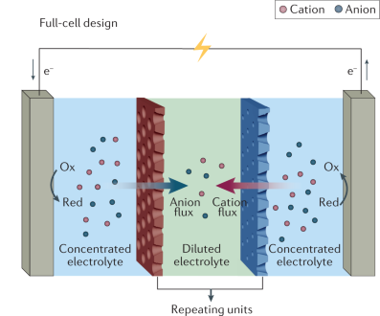
Ion-exchange membranes and osmotic power generation
Ion-exchange membranes
Thin, selective membranes that allow specific ions (e.g., H⁺ or Na⁺) to pass through while blocking others. Widely used in desalination, fuel cells, and energy generation.
Applications
Water purification and desalination
Gas separation (e.g., CO₂ capture)
Drug delivery and biosensors
Power generation
Ion gradients create electrical energy by driving ion flow through membranes
Mixing of solutions of different concentrations leads to the release of Gibbs’ free energy
“Blue” energy
Zhang, Z., Wen, L. & Jiang, L. Nanofluidics for osmotic energy conversion. Nat Rev Mater 6, 622–639 (2021). https://doi.org/10.1038/s41578-021-00300-4

Slide 4
Flow through nanopores: key differences from bulk flow
Difference | Consequence | Potential Application
Size and Confinement Effects | Increased surface-to-volume ratio; dominant surface interactions | Enhanced filtration and separation technologies (e.g., water desalination, ion-selective membranes)
Increased Surface Forces (electrostatic, van der Waals, molecular friction) | Higher slip length, violation of no-slip condition, increased flow rates, greater ion selectivity | Biosensing, molecular sieves, drug delivery
Hydrodynamic vs diffusive and electrokinetic transport | Diffusive transport dominates at nanoscale | Electrophoresis, electrosmotic pumps

Slide 5
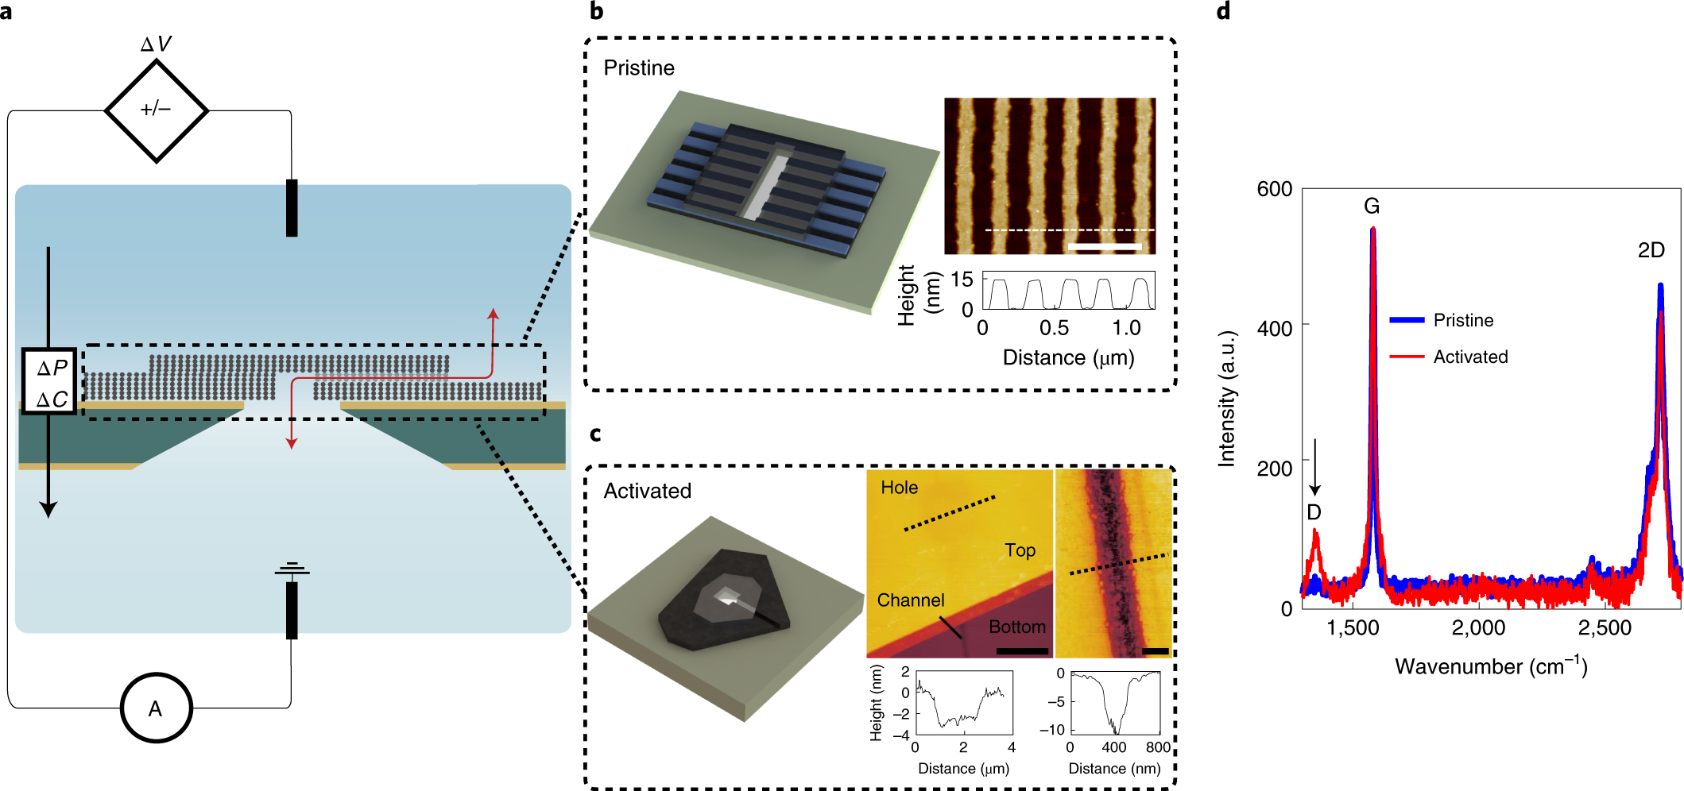
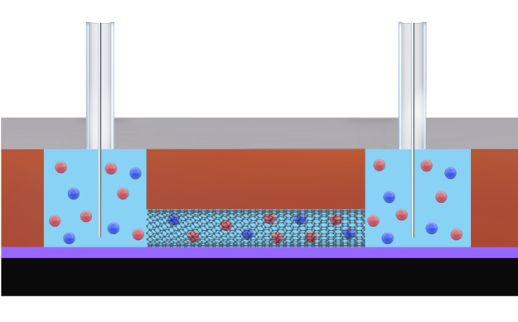
The System
4 systems compared across 2 driving-force conditions
Electric-potential driven flow
Single-walled cylindrical CNT
Pristine graphene rectangular nanochannel
Activated carbon rectangular nanochannel
Salinity-gradient driven flow
Pristine graphene rectangular nanochannel
Activated carbon rectangular nanochannel
Sinusoidally-shaped activated carbon nanochannel
Cui, G., Xu, Z., Li, H. et al. Enhanced osmotic transport in individual double-walled carbon nanotube. Nat Commun 14, 2295 (2023). https://doi.org/10.1038/s41467-023-37970-3
Emmerich, T., Vasu, K.S., Niguès, A. et al. Enhanced nanofluidic transport in activated carbon nanoconduits. Nat. Mater. 21, 696–702 (2022). https://doi.org/10.1038/s41563-022-01229-x
Notes:
Reasons why these conditions are important: electric potential driven flow important for separation, salinity-driven important for power generation
Activated channels have greater surface charges due to functional groups, also more pores

Slide 6
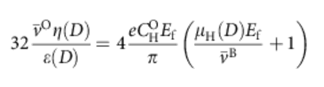
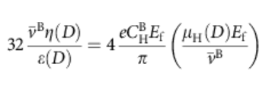

Analysis 1: Electric potential-driven flow in nanoconduits of varying geometries
Open pore: The flow of ions is driven by the application of the electric field and the convective transport of the solvent (water)
Closed pore: current reduces to purely convective transport at a reduced velocity
Equations for velocity in open and closed pores
Mobility of protons as a function of pore diameter
Choi, W., Ulissi, Z., Shimizu, S. et al. Diameter-dependent ion transport through the interior of isolated single-walled carbon nanotubes. Nat Commun 4, 2397 (2013). https://doi.org/10.1038/ncomms3397

Slide 7
Explanation of Parameters
Parameter | Physical Relevance
e | Electronic charge
E | Electric field, V/L
 | Mobility of ion
C | Number of ions per unit length
 | Velocity
 | Flow enhancement factor

Slide 8
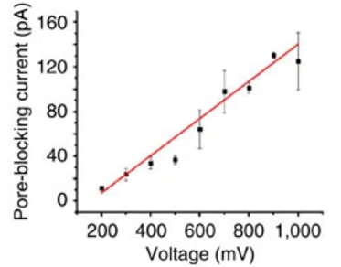
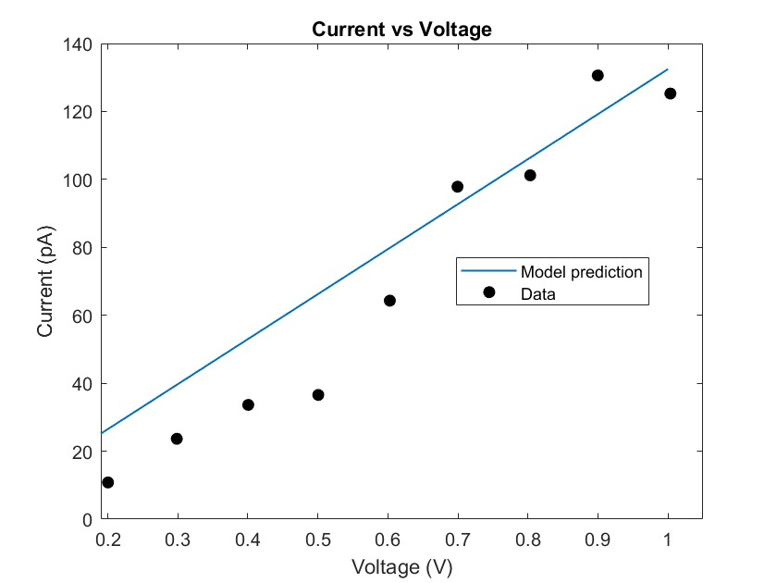
Electric potential-driven flow: Replication of results
System Characteristics
Cylindrical single-walled carbon nanotube
Average diameter = 2 nm
Average length ~ 1 mm
Parameters Estimated
Key Parameters | Significance | Value
 | Flow enhancement factor | 500
 | Surface charge on nanotube | 1 C/m2
Data from: Choi, W., Ulissi, Z., Shimizu, S. et al. Diameter-dependent ion transport through the interior of isolated single-walled carbon nanotubes. Nat Commun 4, 2397 (2013). https://doi.org/10.1038/ncomms3397

Slide 9
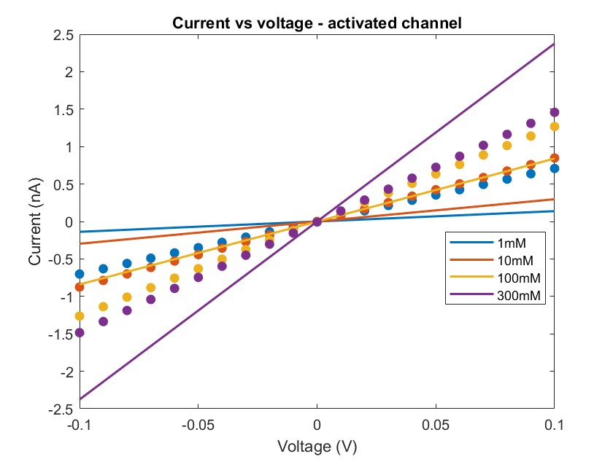
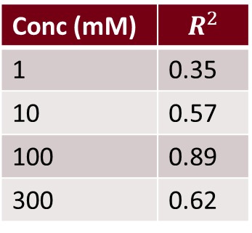
Electric potential-driven flow: Application of model to dataset
Line: model; circle marker: data
System Characteristics
Rectangular cross-section, activated carbon
Width = 100 nm
Height = 3 nm
Average length ~ 10 microns
Conc (mM) | $$R^{2}$$
1 | 0.35
10 | 0.57
100 | 0.89
300 | 0.62
Results
Model underestimates at lower concentration and overestimates at higher concentrations
Possible reasons for discrepancy
“Hydraulic diameter” approximation may not be appropriate
Different length of channel (factor of 100)
Relative importance of entrance effects
Different voltage regimes
Data from: Emmerich, T., Vasu, K.S., Niguès, A. et al. Enhanced nanofluidic transport in activated carbon nanoconduits. Nat. Mater. 21, 696–702 (2022). https://doi.org/10.1038/s41563-022-01229-x

Slide 10
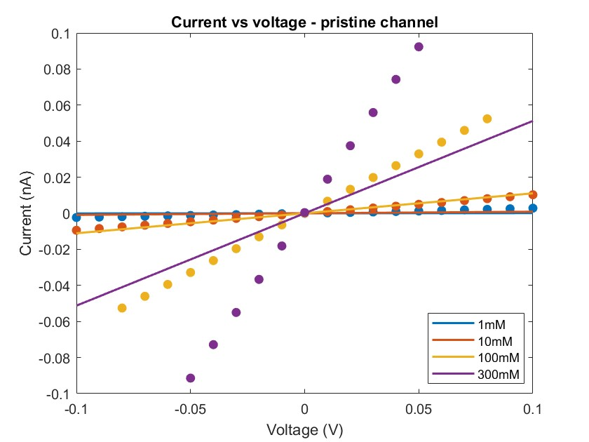
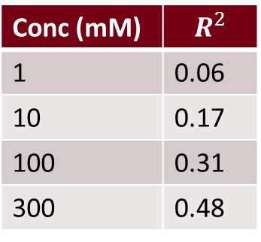
Electric potential-driven flow: Application of model to dataset
Line: model; circle marker: data
System Characteristics
Rectangular cross-section, pristine graphene
Width = 120 nm
Height = 3 nm
Average length ~ 9.6 microns
Results
Model is more accurate at higher concentration of charge carriers, maybe the higher concentrations of electrolyte overcome the lower surface conductivity of pristine channels
Conc (mM) | $$R^{2}$$
1 | 0.06
10 | 0.17
100 | 0.31
300 | 0.48
Possible reasons for discrepancy
“Hydraulic diameter” approximation may not be appropriate
Different length of channel (factor of 100)
Relative importance of entrance effects
Different voltage regimes
Surface charge driven conductivity
Data from: Emmerich, T., Vasu, K.S., Niguès, A. et al. Enhanced nanofluidic transport in activated carbon nanoconduits. Nat. Mater. 21, 696–702 (2022). https://doi.org/10.1038/s41563-022-01229-x

Slide 11
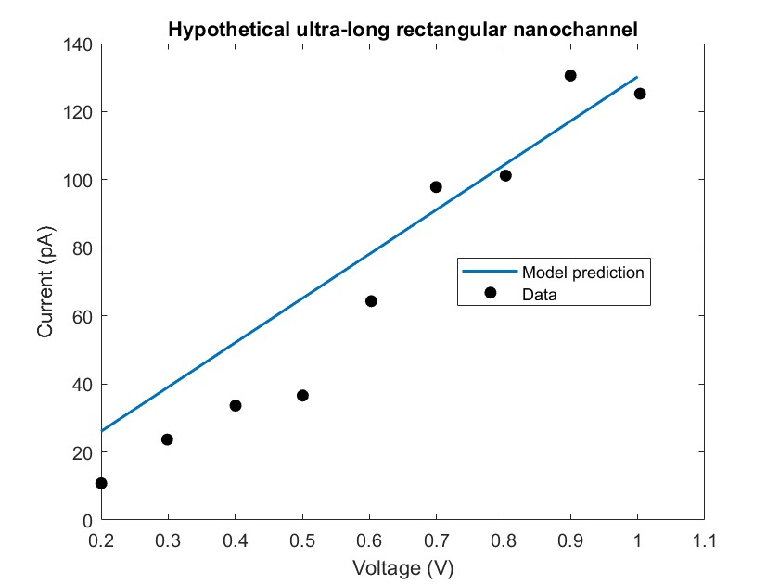
Electric potential-driven flow: accounting for length and voltage effects
Hypothetical system
Rectangular cross-section, activated carbon
Width = 100 nm
Height = 1 nm
Average length ~ 1 mm
Voltage range 200-1000 mV, same as Choi et al.
Results
Good fit similar to replication data
Indicates that the hydraulic diameter approximation is appropriate
Further implies that the Choi model is not appropriate for shorter length nanochannels
Data from: Choi, W., Ulissi, Z., Shimizu, S. et al. Diameter-dependent ion transport through the interior of isolated single-walled carbon nanotubes. Nat Commun 4, 2397 (2013). https://doi.org/10.1038/ncomms3397

Slide 12
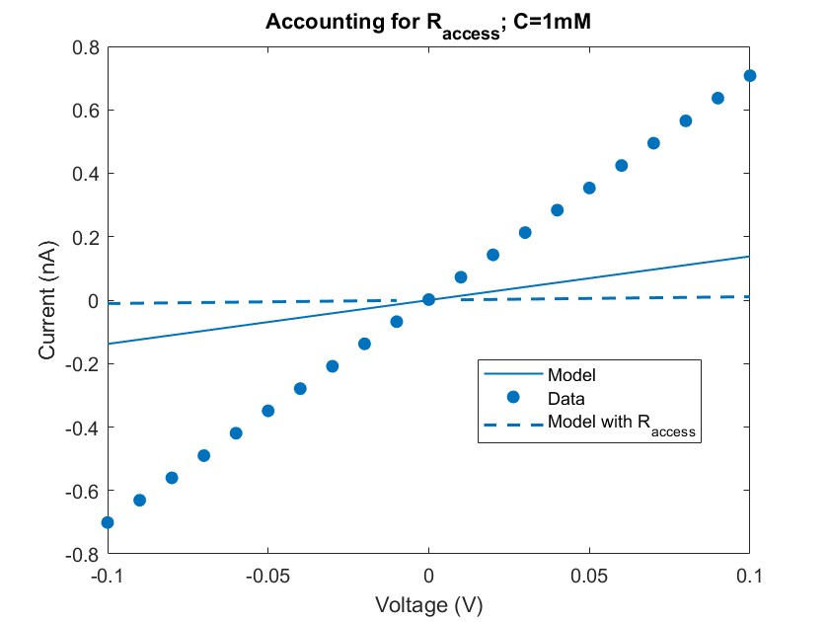
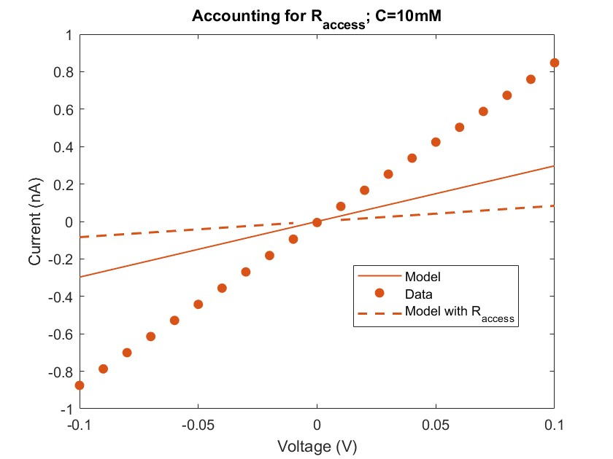
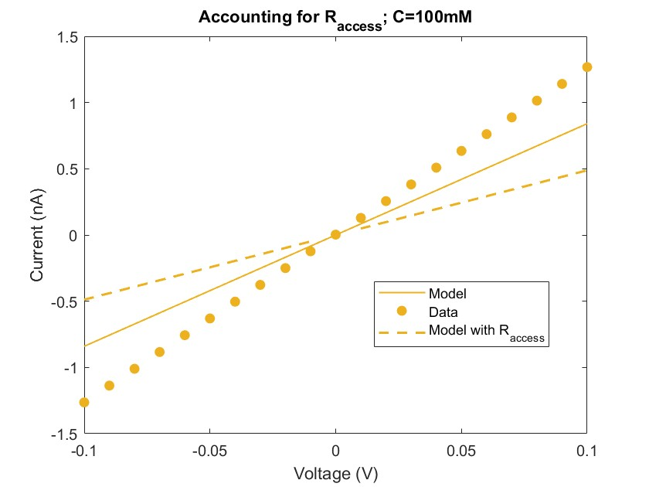
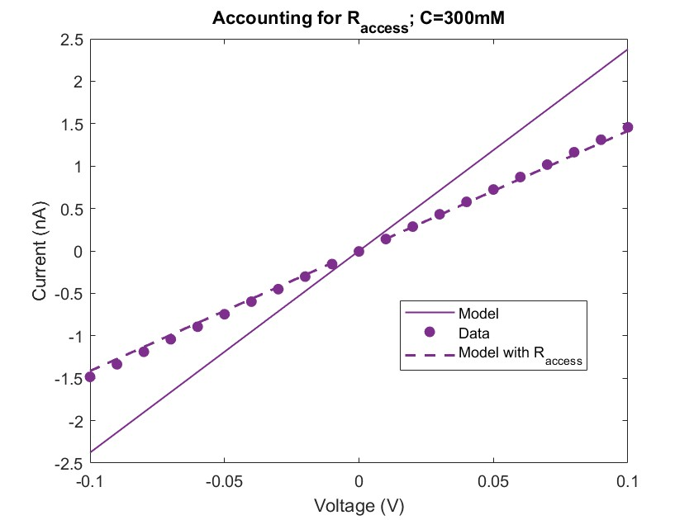
Electric potential-driven flow: accounting for entrance effects
System Characteristics
Rectangular cross-section, activated carbon
Width = 100 nm
Height = 3 nm
Average length ~ 10 microns
Attempt to correct for entrance effects:
Results
Significant access resistance at lower concentrations
Accounting for access resistance leads to better predictions for higher concentrations
Sahu, S., & Zwolak, M. (2018). Maxwell-Hall access resistance in graphene nanopores. Physical Chemistry Chemical Physics, 20(7), 4646–4656. https://doi.org/10.1039/C7CP07924A
Data from: Emmerich, T., Vasu, K.S., Niguès, A. et al. Enhanced nanofluidic transport in activated carbon nanoconduits. Nat. Mater. 21, 696–702 (2022). https://doi.org/10.1038/s41563-022-01229-x
Notes:
Resistivity of electrolyte – seawater is 0.2 ohm-metres and has around 0.5 M NaCl, linearly rescaled from that

Slide 13
Conclusions and Next Steps
“Hydraulic diameter” is suitable for simplifying the analysis of non-cylinder cross-sections
Choi et al. model applies better to ultra-long nanotubes; does not fit well at shorter lengths
Model is more accurate at higher concentration of charge carriers
Accounting for access resistance is a promising step to understand transport through shorter nanochannels
Results can be used to optimize nanochannel design
Shape-specific access resistance formulations have been developed and can be used for a more accurate analysis
Notes:
in the case of high concentration difference, although the ion flux is increased, the thickness of the double electric layer is reduced, and the ion selectivity is reduced, which leads to the decrease in the membrane potential
Longer nanochannels have better selectivity

Slide 14
Analysis 2: Salinity gradient-driven flow in nanoconduits of varying geometries
Osmotic current through nanochannel
Osmotic conductivity
Osmotic conductance for circular cross-sections
Maximum power generated
Cui, G., Xu, Z., Li, H. et al. Enhanced osmotic transport in individual double-walled carbon nanotube. Nat Commun 14, 2295 (2023). https://doi.org/10.1038/s41467-023-37970-3

Slide 15
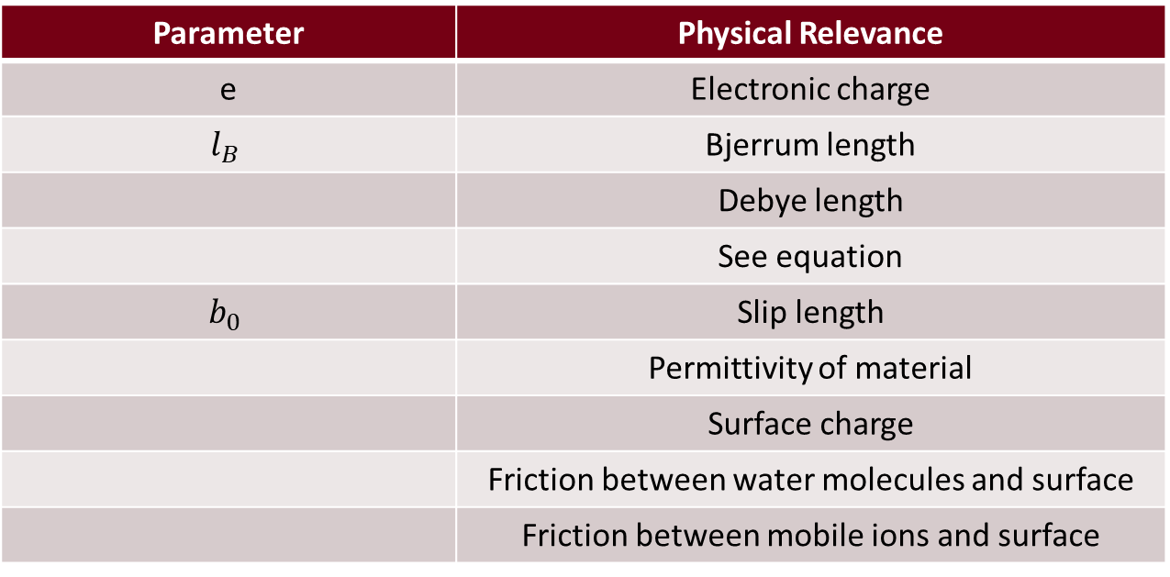
Explanation of Parameters
Parameter | Physical Relevance
e | Electronic charge
$$l_{B}$$ | Bjerrum length
 | Debye length
 | See equation
$$b_{0}$$ | Slip length
 | Permittivity of material
 | Surface charge
 | Friction between water molecules and surface
 | Friction between mobile ions and surface

Slide 16
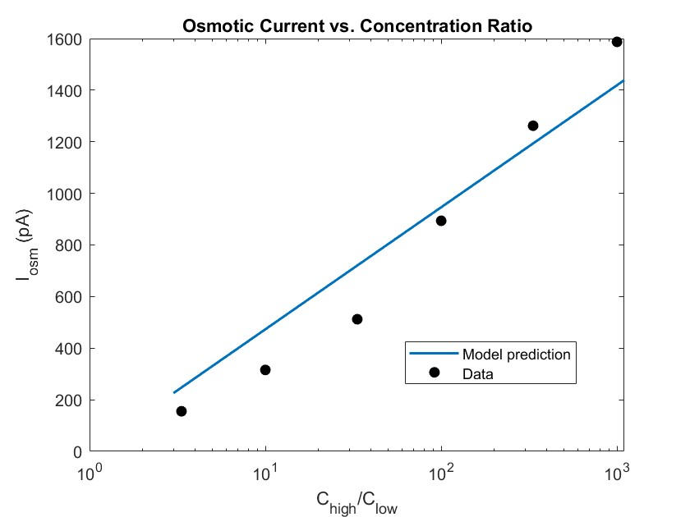
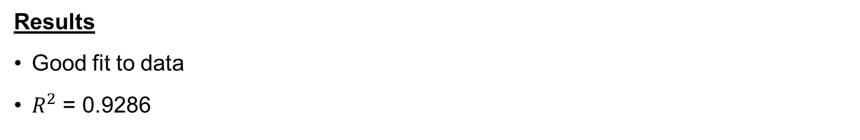
Salinity gradient-driven flow: Replication of results
System Characteristics
Rectangular cross-section, activated carbon
Width = 100 nm
Height = 3 nm
Average length ~ 10 microns
Results
Good fit to data
$R^{2}$ = 0.9286
Data from: Emmerich, T., Vasu, K.S., Niguès, A. et al. Enhanced nanofluidic transport in activated carbon nanoconduits. Nat. Mater. 21, 696–702 (2022). https://doi.org/10.1038/s41563-022-01229-x

Slide 17
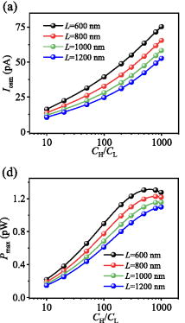
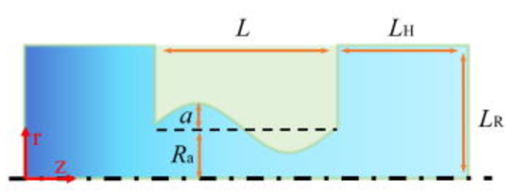
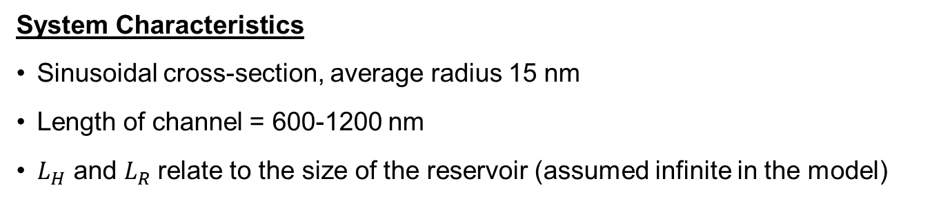
Salinity gradient-driven flow: the dataset
The study
Motivation: irregular nanochannels are naturally formed during fabrication
Finite-element methods to solve the Navier-Stokes, Nernst-Planck and Poisson equations in a sinusoidally varying channel
System Characteristics
Sinusoidal cross-section, average radius 15 nm
Length of channel = 600-1200 nm
$L_{H}$ and $L_{R}$relate to the size of the reservoir (assumed infinite in the model)
Data from: Changzheng Li, Zhenquan Li, Zhe Zhang, Nan Qiao, Mengzhen Liao; Salinity gradient power generation in sinusoidal nanochannels. Physics of Fluids 1 February 2024; 36 (2): 022007. https://doi.org/10.1063/5.0186962

Slide 18
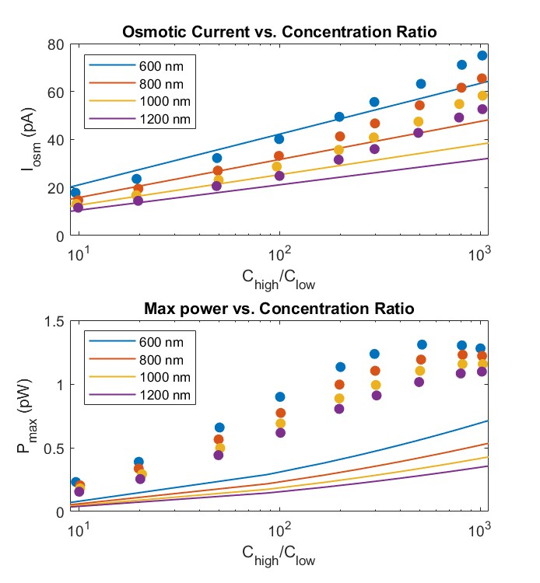
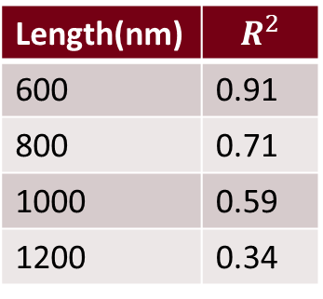
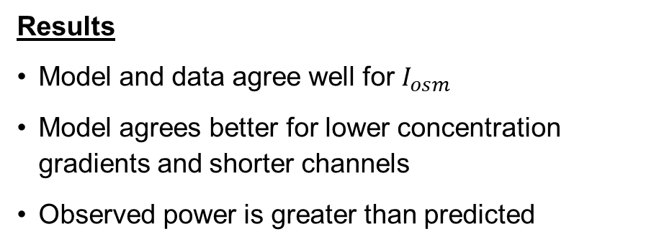
Salinity gradient-driven flow: Application of model to dataset
Line: model; circle marker: data
System Characteristics
Sinusoidal cross-section, average radius 15 nm
Length of channel = 600-1200 nm
Length(nm) | $$R^{2}$$
600 | 0.91
800 | 0.71
1000 | 0.59
1200 | 0.34
Results
Model and data agree well for $I_{osm}$
Model agrees better for lower concentration gradients and shorter channels
Observed power is greater than predicted
Possible reasons for discrepancy
Larger surface area leads to more charge carriers
Non-linear effect on conductance G
Data from: Changzheng Li, Zhenquan Li, Zhe Zhang, Nan Qiao, Mengzhen Liao; Salinity gradient power generation in sinusoidal nanochannels. Physics of Fluids 1 February 2024; 36 (2): 022007. https://doi.org/10.1063/5.0186962

Slide 19
Conclusions and Next Steps
Channel shape strongly affects osmotic current and power generation
Sinusoidally-varying channel is shown to have 2-3x greater power generation capacity than cylindrical channels of similar dimensions
Model described by Cui et al. and Emmerich et al. applies better for lower concentration gradients and shorter channels
Increasing channel length decreases the power generated
Results can be used to optimize nanochannel design
A fixed surface charge density can be replaced by one varying with pH, solution concentration, temperature etc.
Notes:
in the case of high concentration difference, although the ion flux is increased, the thickness of the double electric layer is reduced, and the ion selectivity is reduced, which leads to the decrease in the membrane potential
Longer nanochannels have better selectivity

Slide 20
Thank you! Questions?

