Slide 1
CSE 5524 Project Presentation
License Plate Character Recognition
Vritangi Kansal; Sarthak Awasthi
The project aims to detect the vehicle license plate, segment the characters on that plate, and identify each using a KNN algorithm. All these steps involve some traditional computer vision techniques. The main function takes an image as input and displays the corresponding characters on the car plate as the output.

Slide 2


Framework
For segmenting characters:
Pre-processing the possible plates by gray-scaling, Gaussian blurring, and thresholding.
Find connected components having character-like features for every possible plate by setting dimensional constraints for possible characters.
Segment each character by finding its bounding box.
For classification and character recognition:
Each character acts as an input into the KNN classifier (K=1) to find the nearest character and classify it accordingly.
Perform the same loop for all characters.

Slide 3
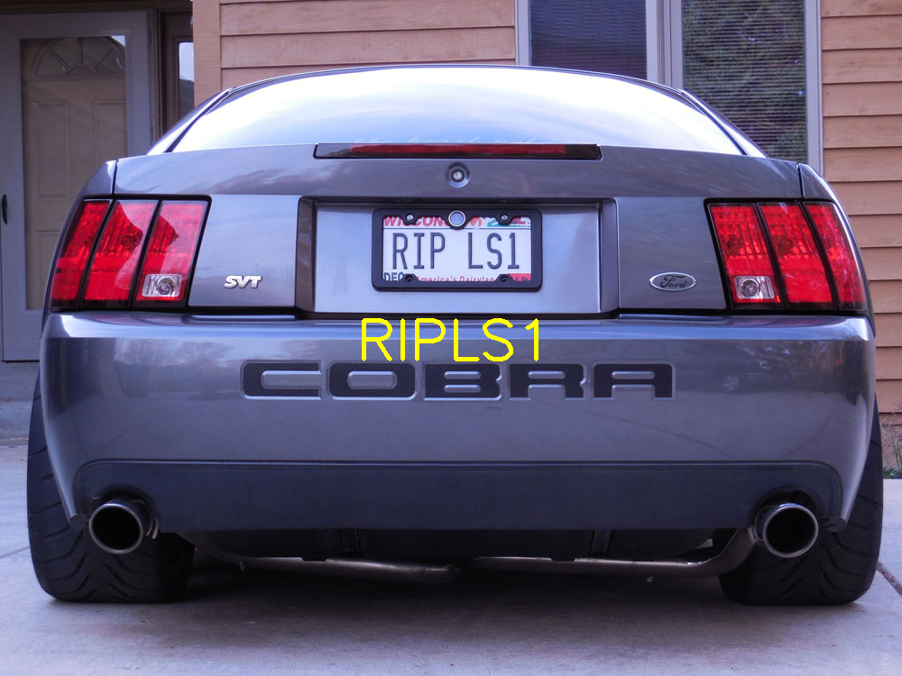
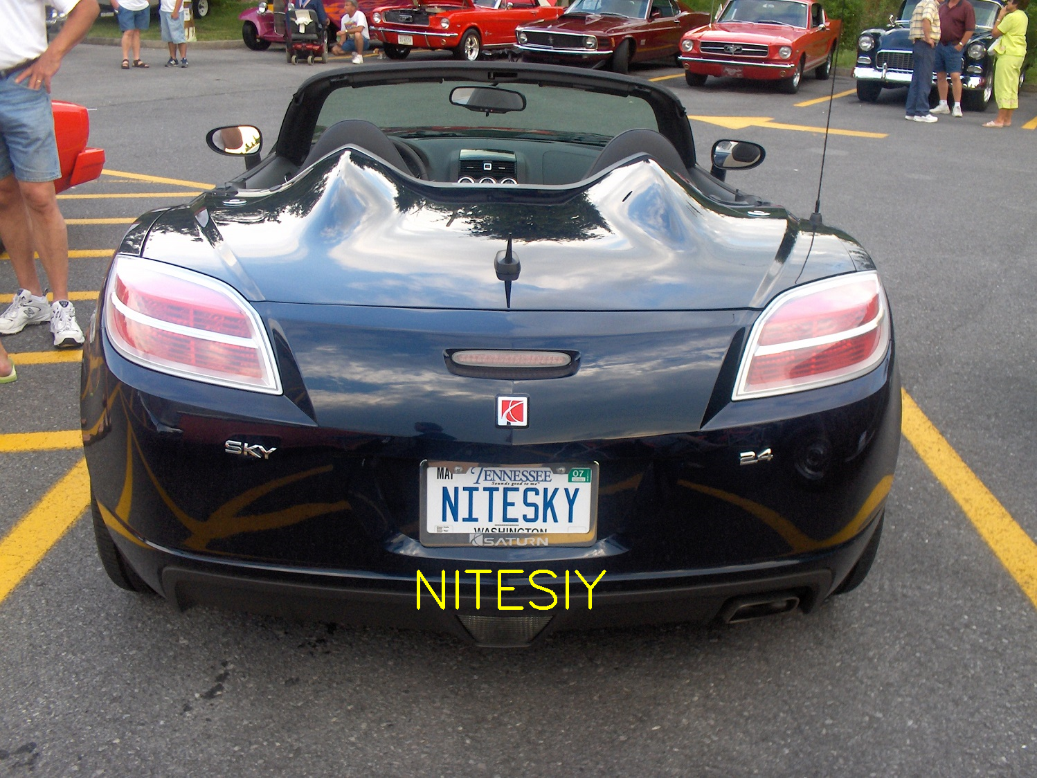
Results
Results:
The model successfully identifies the correct license plate characters.
Problems encountered:
The plate detection might fail for images taken in the dark.
Some characters might not be recognized correctly.
Lessons learned
Image quality needs to be sufficiently high to detect characters.
Applying preprocessing techniques solves a lot of issues regarding
noise and background.
Keeping similar parameters does not work in all examples.
What else could be done (if you had more time)?
Extracting frames from a video to perform the same algorithms.
Look for better techniques to solve the problems mentioned above.

