Slide 1
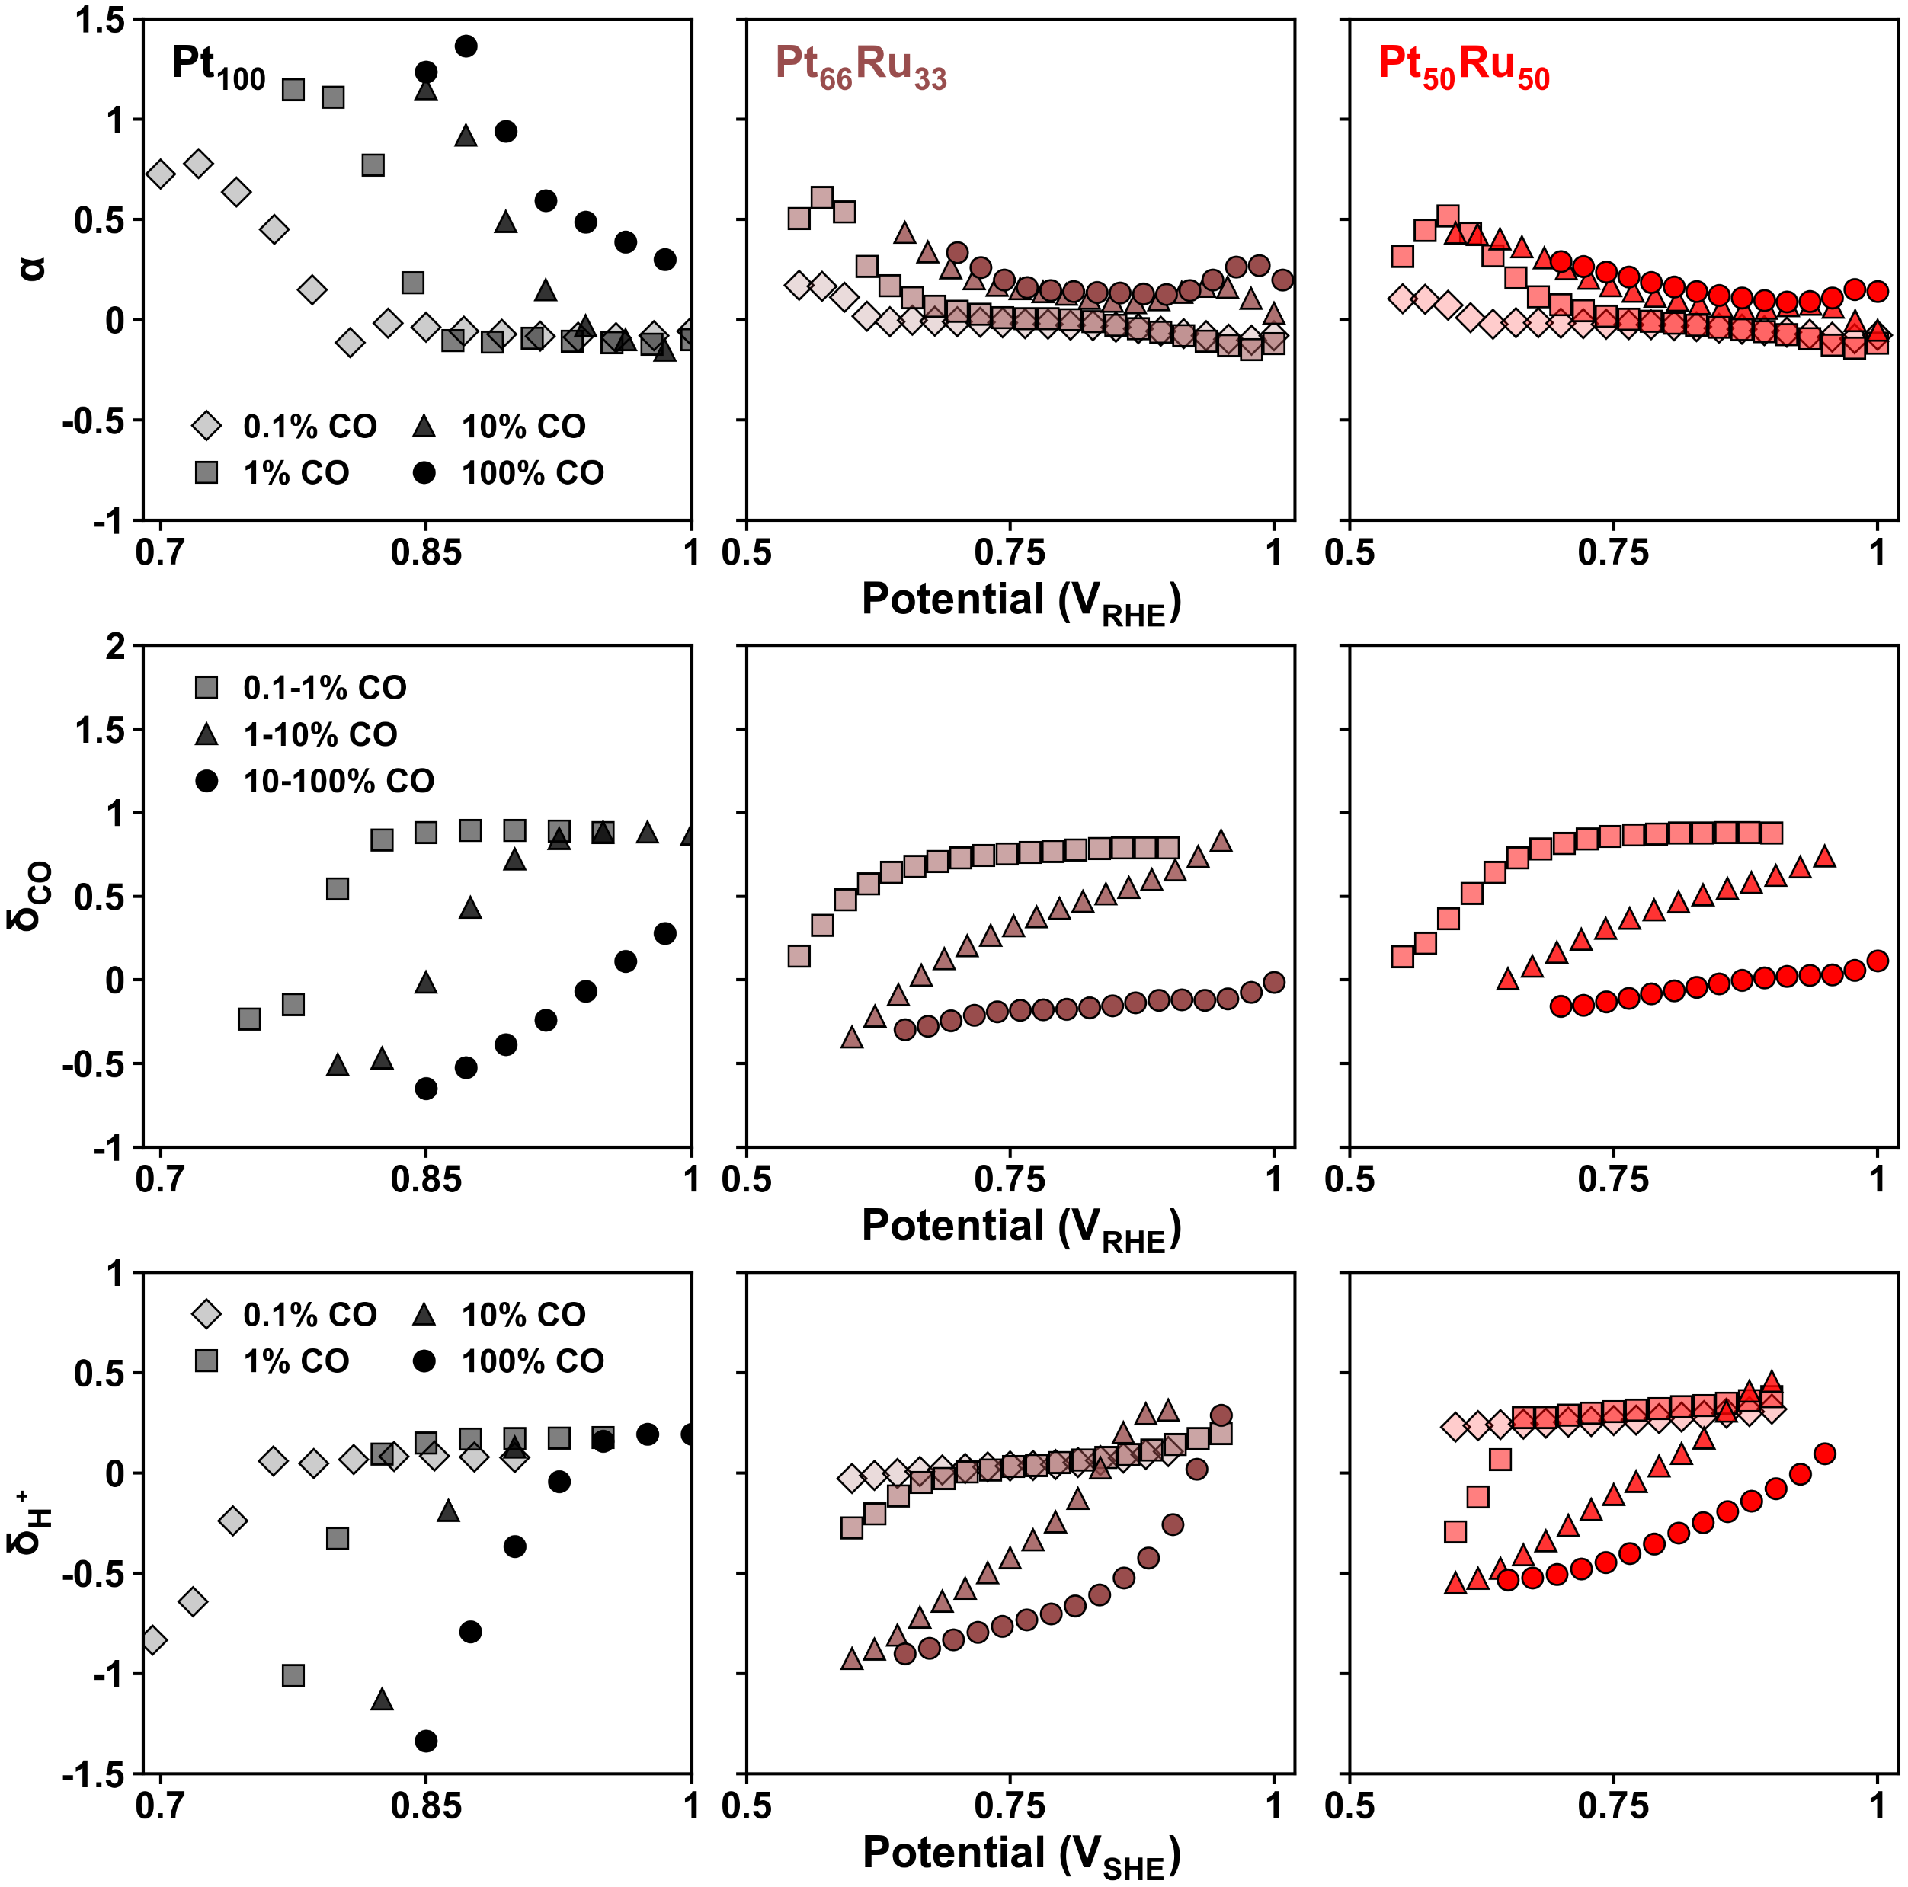

0.1 M HClO4
$δ_{H^{+}}$ is the same for all acid concs

Slide 2
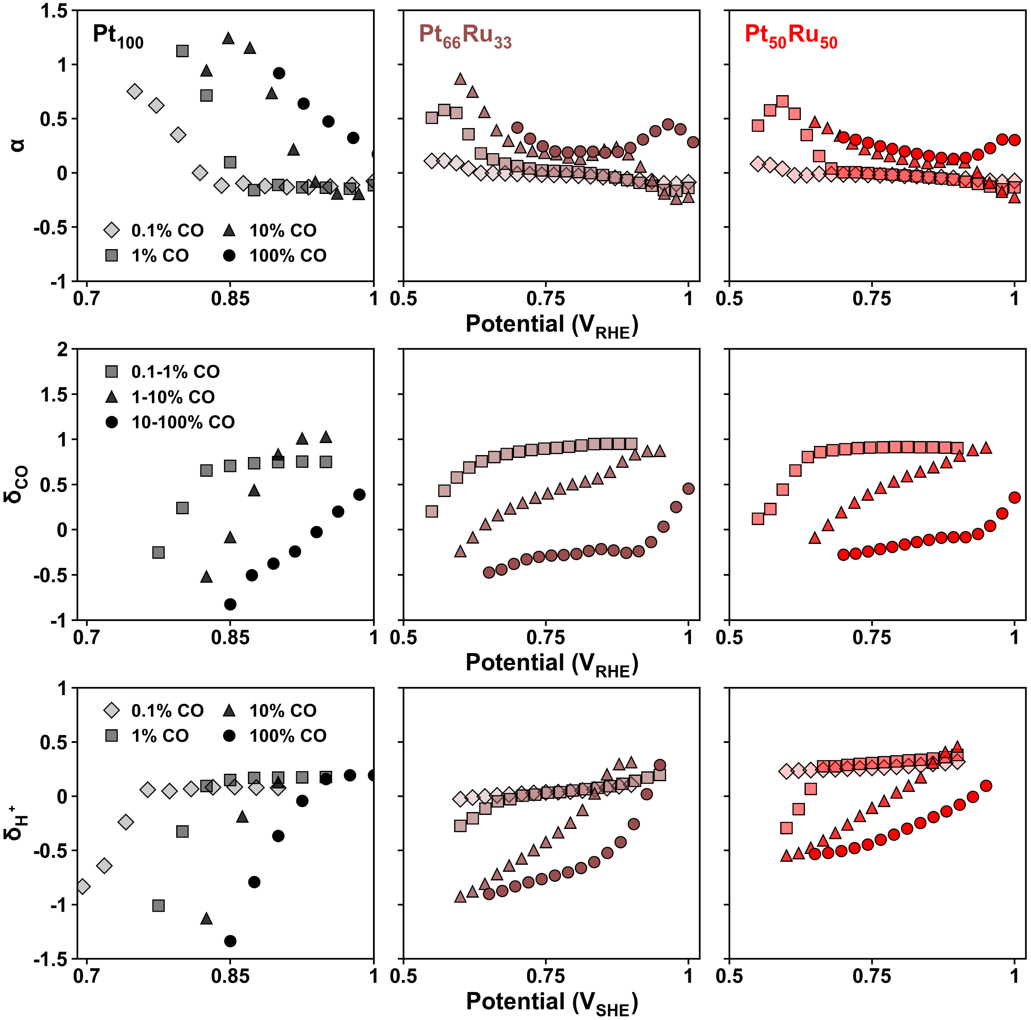
0.25 M HClO4

Slide 3
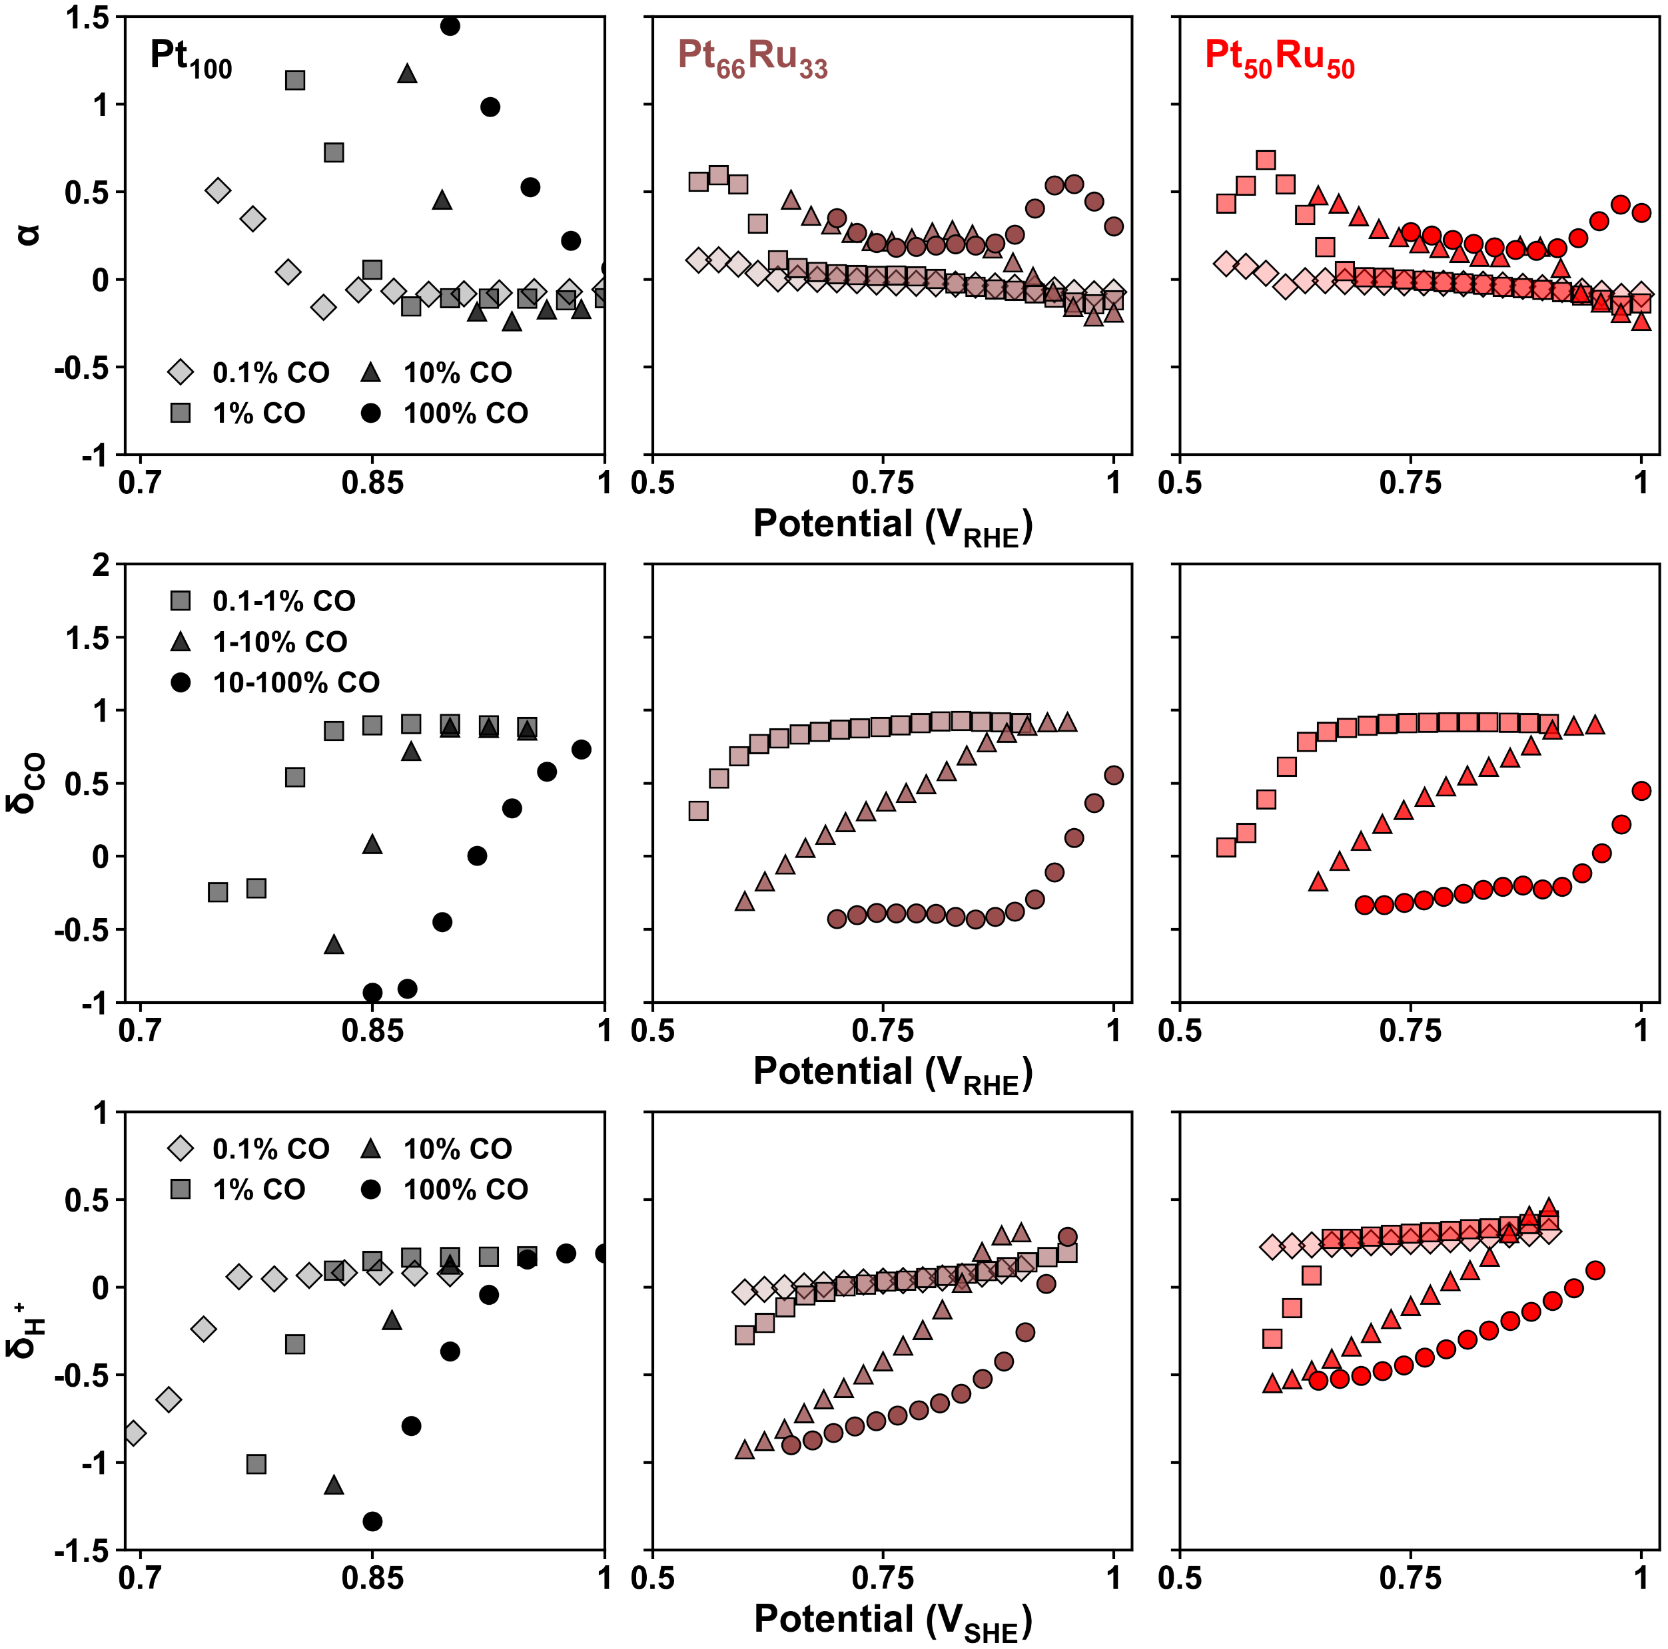
0.5 M HClO4

Slide 4
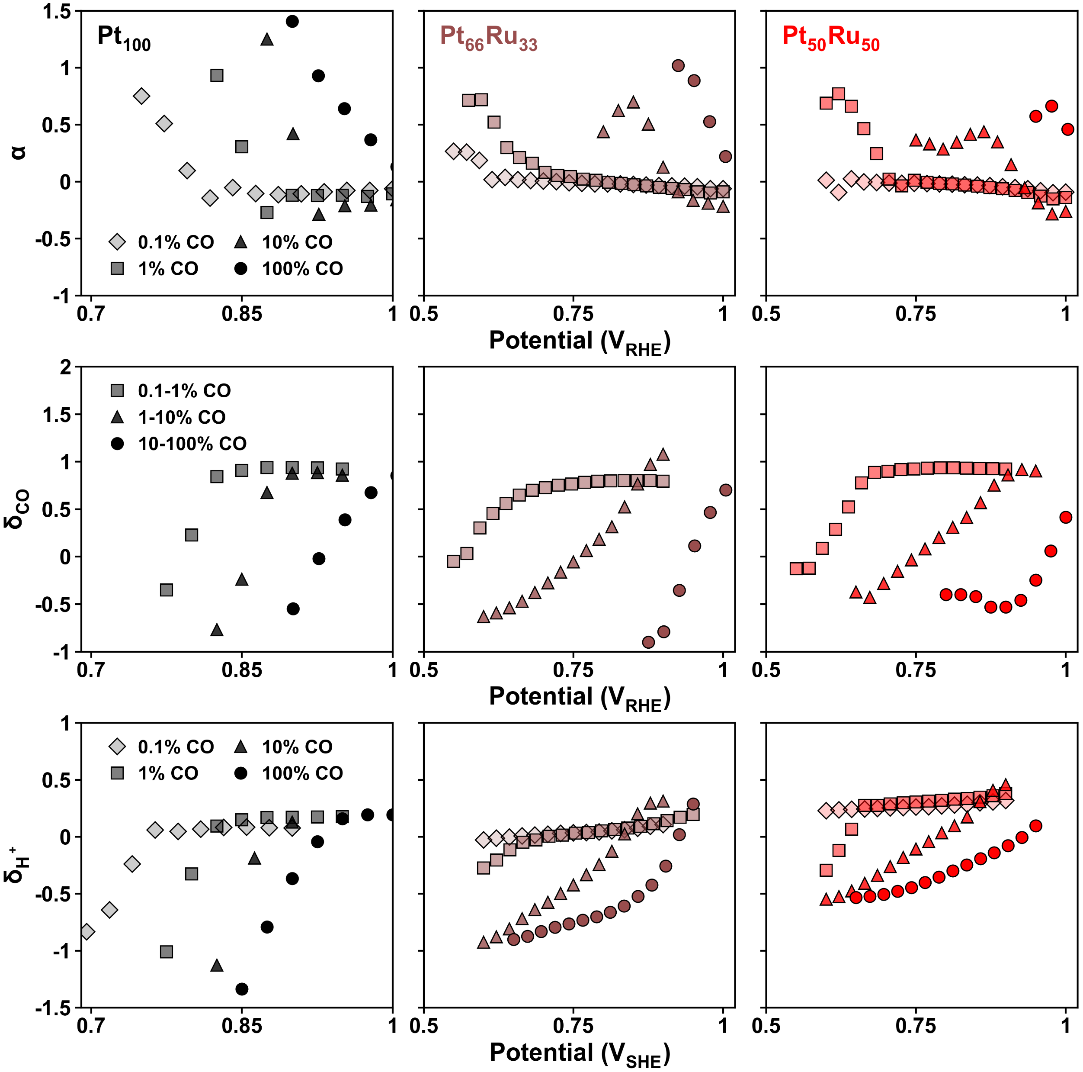
1 M HClO4

